Slide 1
Optimism
A Philosophy for Life
How do we make optimism a part of our daily lives and live the creed?
Lue Drummond
2023-2024 Governor
Atlantic Central District
17 October 2023

Slide 2
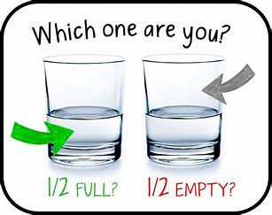
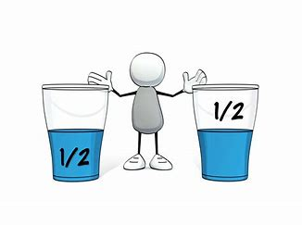
The idea is that if you say the glass is half empty, you see the world in a negative, or pessimistic way.
If you say the glass is half full, you have a more optimistic viewpoint. The exact origin of the expression is unclear.
However, digital records seem to show the idea originated in the first half of the 1900s.
writingexplained.org/idiom-dictionary/glass-half-empty

Slide 3
Optimism (noun)
hopefulness and confidence about the future or the successful outcome of something.
synonyms:
hopefulness · hope · confidence · buoyancy · cheer · good cheer · cheerfulness · sanguineness · positiveness · positive attitude
Is Optimism
a Choice?
Yes, No, Maybe
https://www.bing.com/search?FORM=HI2CDF&PC=HI2C&q=definition+of+optimism
https://www.merriam-webster.com/dictionary/optimism

Slide 4
Philosophy (noun)
pursuit of wisdom
a search for a general understanding of values and reality by chiefly speculative rather than observational means
Philosophy of Optimism
In philosophy and theology, Leibniz* is most noted for his optimism, i.e. his conclusion that our world is, in a qualified sense, the best possible world that God could have created, a view sometimes lampooned by other thinkers, such as Voltaire.
Is Optimism
a Choice?
Yes, No, Maybe
*Gottfried Wilhelm (von) Leibniz was a German polymath active as a mathematician, philosopher, scientist, and diplomat. He is a prominent figure in both the history of philosophy and the history of mathematics.
https://www.bing.com/search?FORM=HI2CDF&PC=HI2C&q=definition+of+optimism
https://www.merriam-webster.com/dictionary/optimism

Slide 5
How do we make
Optimism
a part of our daily lives?

Slide 6
Directions for The Optimism-Pessimism Quiz
Read the following statements and indicate your answer by checking “True” or “False.”
You need a regular routine in your life, or you feel insecure.
______ True ______ False
2. You think your past was better than your future will be.
______ True ______ False
3. On a quiet night when everyone’s asleep, you find your mind wandering to the possibilities of a burglar breaking into your house, a huge storm coming, or some other disaster. ______ True ______ False
4. When buying presents, you feel the pressure to get the exact right gift. ______ True ______ False
5. If you’re the new person in a group, it takes time for the others to warm up to you. ______ True ______ False
https://www.drzimmerman.com/tuesdaytip/are-you-more-prone-to-negativity-or-a-positive-attitude

Slide 7
Directions for The Optimism-Pessimism Quiz
Read the following statements and indicate your answer by checking “True” or “False.”
6. To keep your place in the workplace hierarchy, you sometimes have to step on a few people. ______ True ______ False
7. A workplace without problems would be a dull place to work.
______ True ______ False
8. You’ve just had an unappealing appetizer in an expensive restaurant. You now expect the main course to be rather mediocre as well.
______ True ______ False
9. You are driven by money. ______ True ______ False
10. You don’t believe you have what it takes to overcome any obstacle that gets in your way. ______ True ______ False
https://www.drzimmerman.com/tuesdaytip/are-you-more-prone-to-negativity-or-a-positive-attitude

Slide 8
Directions for The Optimism-Pessimism Quiz
Read the following statements and indicate your answer by checking “True” or “False.”
SCORING:
Give yourself one point for each “True” answer and three points for each “False” answer. Add up the total score to discover where you stand on the scale of Optimism versus Pessimism.
***If you scored 10 to 20, you fall on the pessimistic side of the scale.
As human beings we need pessimism to a certain extent, because it can occasionally keep us out of danger.
But extreme pessimism will not serve you well.
In fact the lower your score, the more you tend to see things in a negative light.
You spend too much time and energy thinking about upsetting memories from your past, your failures in the present, or disappointments you may experience in the future. You may think that life has nothing to offer and feel too much anxiety, worry, shame, depression, or sadness.
***If you scored 21 to 30, you fall on the optimistic side of the scale.
https://www.drzimmerman.com/tuesdaytip/are-you-more-prone-to-negativity-or-a-positive-attitude

Slide 9
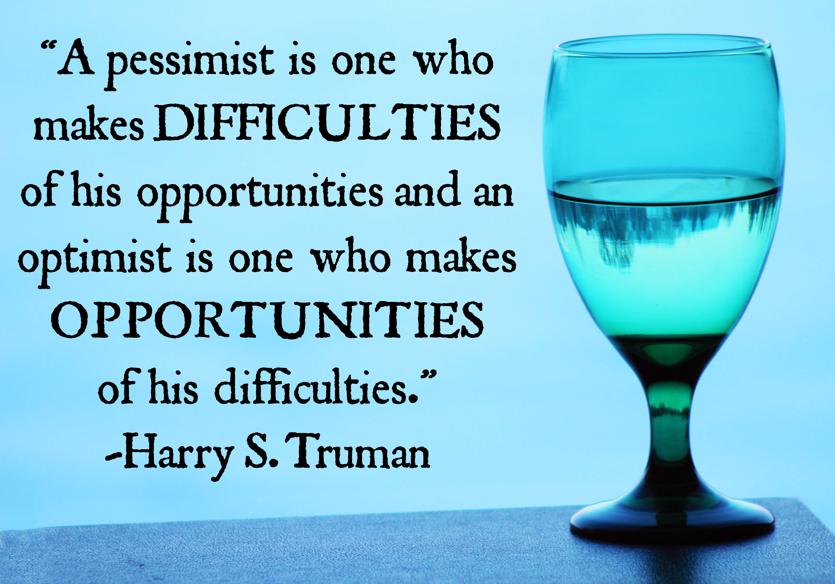

Slide 10
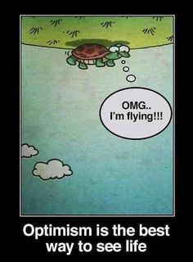
Optimism
A Philosophy for Life
As a philosophy of life, optimism is a choice one makes in response to uncontrollable circumstances.
Optimism is a fundamental attitude.
Optimism is not an opinion about reality; it’s a starting point for dealing with reality.
https://www.utne.com/mind-and-body/philosophy-of-life-ze0z1412zsau#:~:text=As%20a%20philosophy%20of%20life%2C%20optimism%20is%20a,it%E2%80%99s%20a%20starting%20point%20for%20dealing%20with%20reality.

Slide 11
This is how to become
an OPTIMISTIC person:
1. Avoid catastrophic thinking. Avoid the use of words like awful, disgusting, horrible, dreadful, revolting, repulsive, etc.
2. Give yourself credit for your own success.
3. Be persistent and "act as if" you are an optimist. Some would say, "fake it till you make it."
4. Reframe disappointment. When you fail think about the lessons you learned.

Slide 12
How do we make
Optimism
a part of our daily lives?

Slide 13
Optimist International Clubs have been "Bringing Out the Best in Kids" since 1919 and meeting the needs of young people in communities worldwide. Members of Optimist Club are continuing the FIVE PURPOSES of Optimist International within the communities we serve:
To develop optimism as a philosophy of life utilizing the tenets of the Optimist Creed.
To promote an active interest in good government and civic affairs.
To inspire respect for the law.
To promote patriotism and work for international accord and friendship among all people.
To aid and encourage the development of youth in the belief that the giving of one’s self in service to others will advance the well-being of humankind, community life, and the world.

Slide 14
How do we live the Optimist Creed?

Slide 15
The Optimist Creed, Promise Yourself…
To be so strong, that nothing can disturb your peace of mind.
To talk health, happiness and prosperity to every person you meet.
To make all your friends feel that there is something in them.
To look at the sunny side of everything and make your optimism come true.
To think only of the best, to work only for the best, and expect only the best.

Slide 16
The Optimist Creed,
Promise Yourself…
To be just as enthusiastic about the success of others as you are about your own.
To forget the mistakes of the past and press on to the greater achievements of the future.
To wear a cheerful countenance at all times and give every living creature you meet a smile.
To give so much time to the improvement of yourself that you have no time to criticize others.
To be too large for worry, too noble for anger, too strong for fear, and too happy to permit the presence of trouble.

Slide 17
What is the mission of your Rotary Club that is similar to the mission of the Optimist organization?
Our mission
We provide service to others, promote integrity, and advance world understanding, goodwill, and peace through our fellowship of business, professional, and community leaders.

Slide 18
Optimist International Clubs have been "Bringing Out the Best in Kids" since 1919 and meeting the needs of young people in communities worldwide. Members of Optimist Club are continuing the FIVE PURPOSES of Optimist International within the communities we serve:
To develop optimism as a philosophy of life utilizing the tenets of the Optimist Creed.
To promote an active interest in good government and civic affairs.
To inspire respect for the law.
To promote patriotism and work for international accord and friendship among all people.
To aid and encourage the development of youth in the belief that the giving of one’s self in service to others will advance the well-being of humankind, community life, and the world.
https://www.drzimmerman.com/tuesdaytip/are-you-more-prone-to-negativity-or-a-positive-attitude

Slide 19
Optimist - Good government and civic affairs

Slide 20
What does your Rotary Club do for good government and civic affairs?
What we do
Rotary members believe that we have a shared responsibility to take action on our world’s most persistent issues. Our 46,000+ clubs work together to:
Promote peace
Fight disease
Provide clean water, sanitation, and hygiene
Save mothers and children
Support education
Grow local economies
Protect the environment

Slide 21
Optimist International Clubs have been "Bringing Out the Best in Kids" since 1919 and meeting the needs of young people in communities worldwide. Members of Optimist Club are continuing the FIVE PURPOSES of Optimist International within the communities we serve:
To develop optimism as a philosophy of life utilizing the tenets of the Optimist Creed.
To promote an active interest in good government and civic affairs.
To inspire respect for the law.
To promote patriotism and work for international accord and friendship among all people.
To aid and encourage the development of youth in the belief that the giving of one’s self in service to others will advance the well-being of humankind, community life, and the world.

Slide 22
Optimist – To inspire respect for the law

Slide 23
What does your Rotary Club do to show respect for law?
What we do
Rotary members believe that we have a shared responsibility to take action on our world’s most persistent issues. Our 46,000+ clubs work together to:
Promote peace
Fight disease
Provide clean water, sanitation, and hygiene
Save mothers and children
Support education
Grow local economies
Protect the environment

Slide 24
Optimist International Clubs have been "Bringing Out the Best in Kids" since 1919 and meeting the needs of young people in communities worldwide. Members of Optimist Club are continuing the FIVE PURPOSES of Optimist International within the communities we serve:
To develop optimism as a philosophy of life utilizing the tenets of the Optimist Creed.
To promote an active interest in good government and civic affairs.
To inspire respect for the law.
To promote patriotism and work for international accord and friendship among all people.
To aid and encourage the development of youth in the belief that the giving of one’s self in service to others will advance the well-being of humankind, community life, and the world.

Slide 25
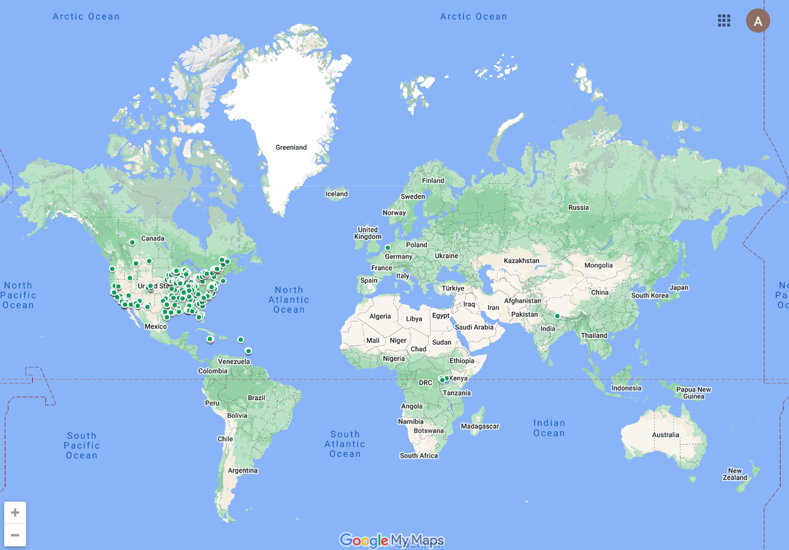
Optimist - promote patriotism and work for international accord and friendship among all people

Slide 26
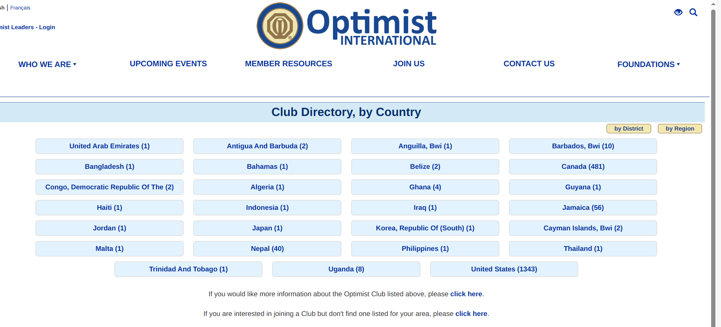
Optimist - promote patriotism and work for international accord and friendship among all people

Slide 27
What does your Rotary Club similar international projects?
Rotary is dedicated to causes that build international relationships, improve lives, and create a better world to support our peace efforts and end polio forever.

Slide 28
Optimist International Clubs have been "Bringing Out the Best in Kids" since 1919 and meeting the needs of young people in communities worldwide. Members of Optimist Club are continuing the FIVE PURPOSES of Optimist International within the communities we serve:
To develop optimism as a philosophy of life utilizing the tenets of the Optimist Creed.
To promote an active interest in good government and civic affairs.
To inspire respect for the law.
To promote patriotism and work for international accord and friendship among all people.
To aid and encourage the development of youth in the belief that the giving of one’s self in service to others will advance the well-being of humankind, community life, and the world.

Slide 29
Optimist - development of youth in the belief that the giving of one’s self in service to others will advance the well-being of humankind, community life, and the world.

Slide 30
What does your Rotary Club have similar programs for Youth?
Rotary believes in developing the next generation of leaders. Our programs help younger leaders build leadership skills, expand education and learn the value of service.

Slide 31
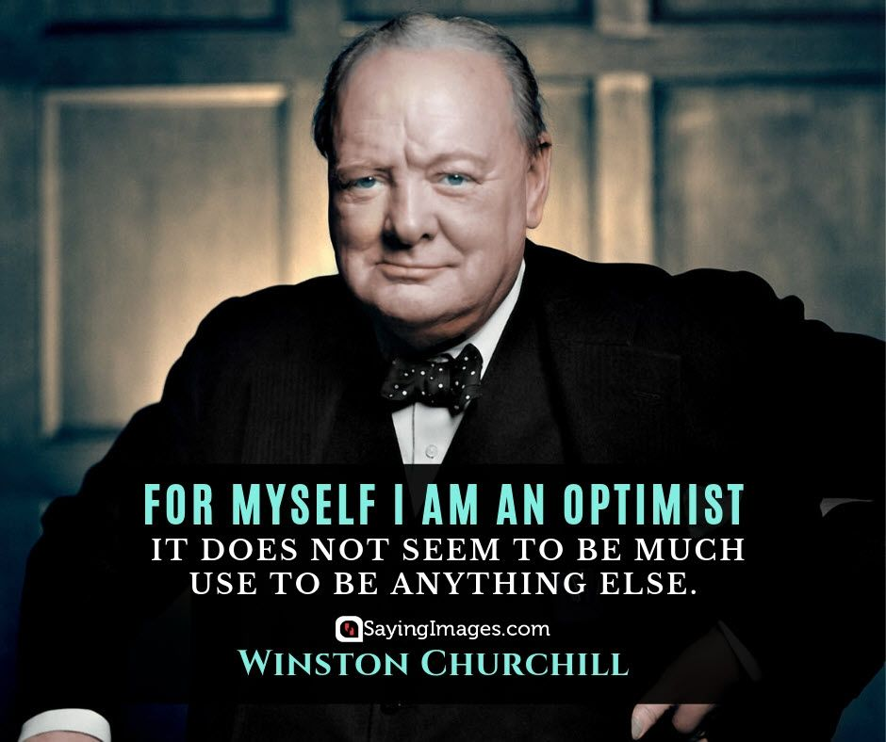

Slide 32
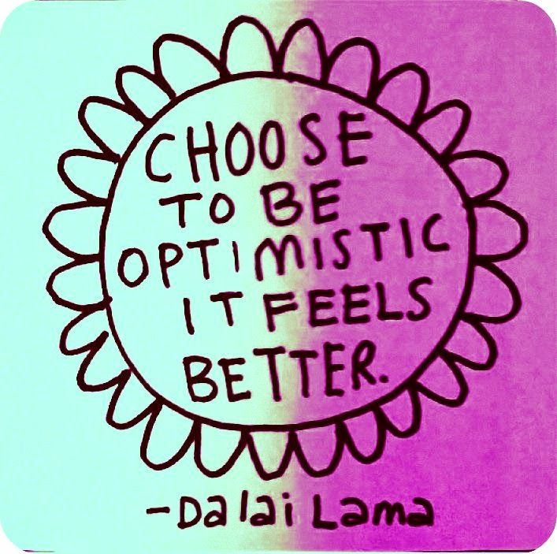
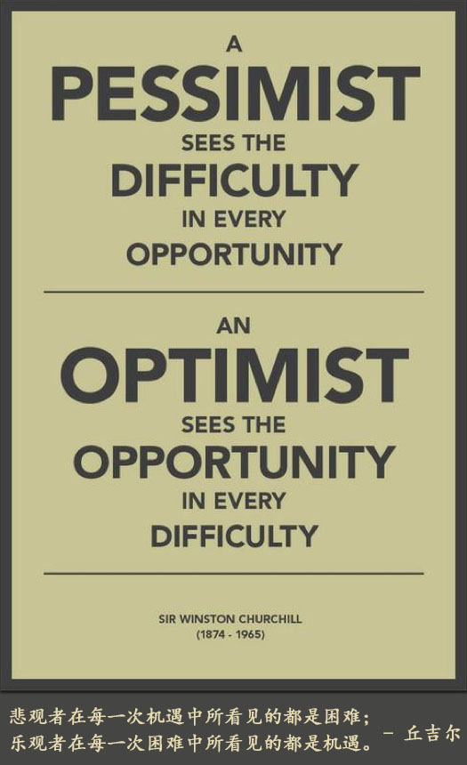

Slide 33
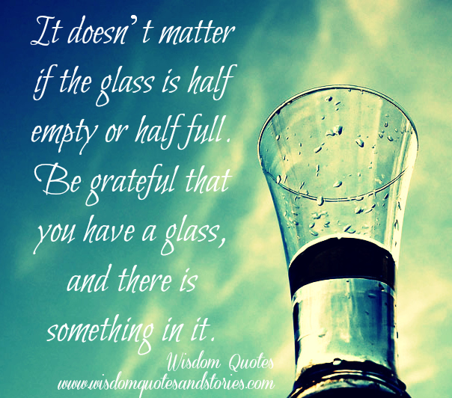
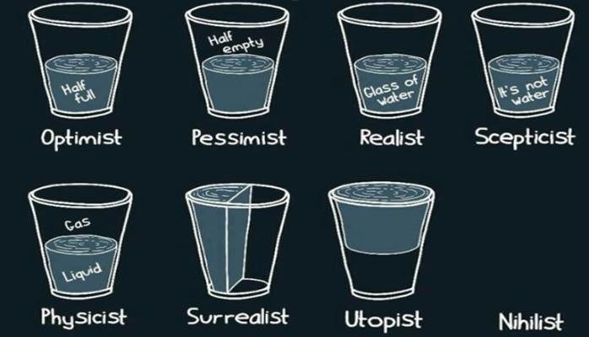

Slide 34
What are ways that your Rotary Club and
Optimist Clubs partner together?
When you partner with Rotary, our 1.4 million members amplify your impact, elevate your brand, advance important causes, improve communities, and gain access to global connections.

Slide 35
Partnership-Celebrate Community, a joint initiative of Optimist International and three other major volunteer service organizations, continued this year with a focus on local community service. Events were scheduled for the week of September 10-17, 2023.

Slide 36
What are ways that your Rotary Club and
Area Optimist Clubs can partner together?
Club | Date | Time | Activity | Location
Dream Builders | 11/11/2023 | 4pm to 6pm | Thaddeus Smith Recognition of Veterans at Applebee’s | Applebee's 323 Old York Rd, Jenkintown, PA 19046
East Montco | 11/16/2023 |  | Attitude of Gratitude | Send in gratitude cards to EastMontcoOptimistClub@hotmail.com
DBOC EMOC OCLM | 12/5/2023 | 10am-2pm | Toys for Tots Hatboro/Horsham/Abington Volunteer For Toys for Tots | Hatboro/Horsham/Abington Marine Corps Toys For Tots, 1348 Easton Rd Abington Pa 19001, Angela Dixon/Jennie Lee Coordinators
Dream Builders East Montco | 1/27/2024 | 11am-1pm | Valerie Lomax SOUPER Bowler & Super Hero Luncheon | Giant Food Store Community Room, 315 York Rd, Willow Grove, PA 19090 (215) 784-1960
DBOC EMOC | 3/16/2024 | 4pm-6:30pm | Feed the Homeless at Chosen 300 Ministries | Chosen 300 Ministries, 1116 Spring Garden St, Philadelphia, PA 19123, (215) 765-9807
Lower Montco | April 13/20 2024 |  | Spring Tea | Bethlehem Baptist Church, 712 Penllyn Pike, Spring House, PA 19477, (215) 643-4977
East Montco | 4/26/2024 | 10am-2pm | Penn Relays Team Jamaica Bickle | University of Pennsylvania Franklin Field 235 S 33rd St, Philadelphia, PA 19104, (215) 898-4324
Dream Builders | 5/5/2024 | 3pm-5pm | Recognition Day Program for Young People, Light refreshments served after Program | Montgomery Community College Blue Bell, PA
Dream Builders East Montco | May 7/9, 2024 | 6pm-9pm | Respect for Law Program with the First Baptist Church of Crestmont: Focus on Security Personnel in Church, Synagogue, and/or Mosque | First Baptist Church of Crestmont, 1678 Fairview Ave, Willow Grove, PA 19090, (215) 659-9528

Slide 37
Optimism
A Philosophy for Life

