Slide 1


THE ROTARY FOUNDATION
DOING GOOD IN THE WORLD
Supported and funded by Rotarians,
the Foundation exists to Serve and benefit Rotarian sourced projects
7 Areas of Focus

Slide 2
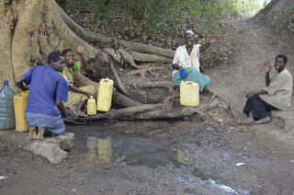
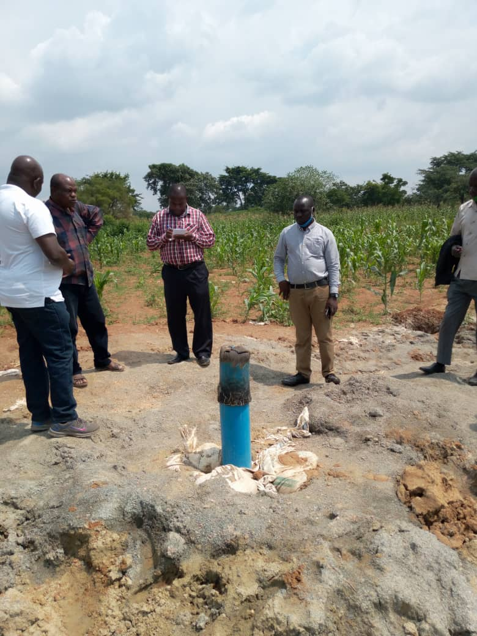
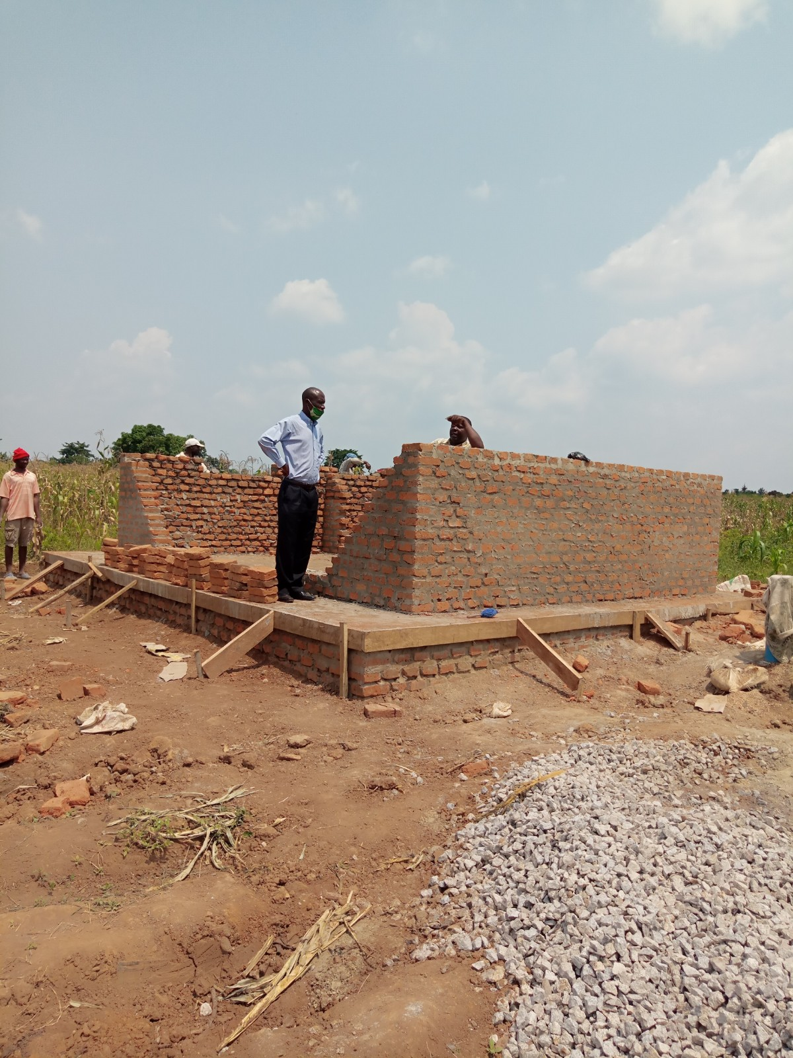
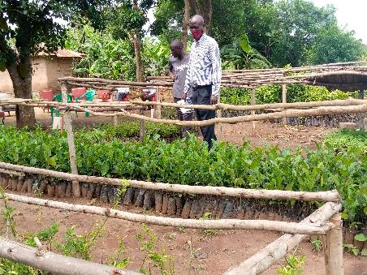
Nabiganda Solar Powered
Borehole Water System,
Sanitation Training, and
Tree Planting Project
Global Grant # GG1987270
Our Rotary Foundation At Work….

Slide 3
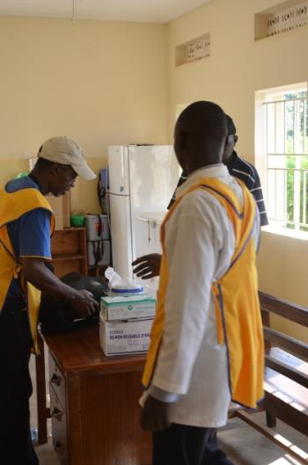
The MCH Project Vision
Focus on healthcare education
  Emergency obstetrics
  Neo-natal pediatrics
  Midwife Training in
  Community Health Centers
Exchange healthcare professionals (VTT)
Develop & Support network of healthcare professionals
Improve community health center infrastructure
Develop distance education programs to maximize impact

Slide 4
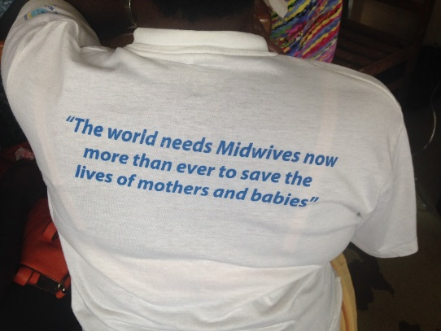
The Final Phases
A Model for Midwife Healthcare
Education in Developing Countries
Regional Training Centers for Midwife Education
Emergency Obstetrics and Newborn Emergency Care(EmONC)
  Basic Emergency Obstetric Care
  Basic Emergency Newborn Care
  Post Partem Care & Family Planning
  Post Abortive Care
Building out the Distance Education infrastructure
Content / Internet / Trainers
Engaging other Uganda Universities & Rotary Clubs

Slide 5


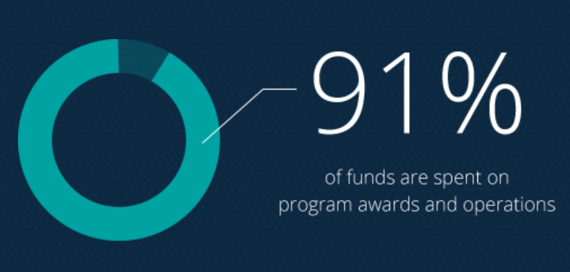
OUTSTANDING PERFORMANCE IN 2021
$440.9 million
Rotarians raised for the Foundation

Slide 6
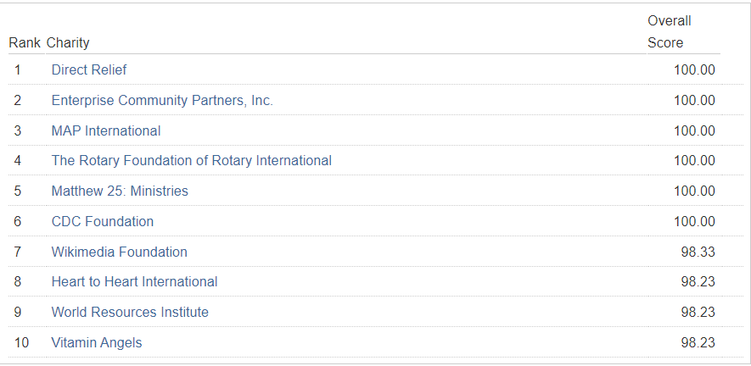
Charity Navigator’s List of 10 Best charities WORLDWIDE!
Consider making the Rotary Foundation one of your charities of choice
To “Do Good in the World”

Slide 7
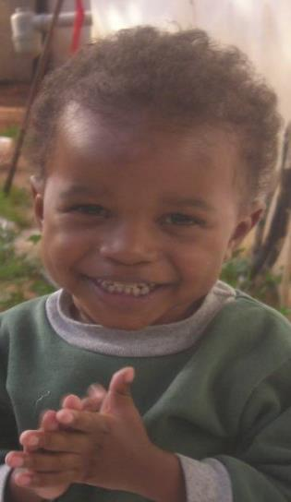

Programs
Polio Plus
Grants
Peace Centers
Disaster Recovery

Slide 8
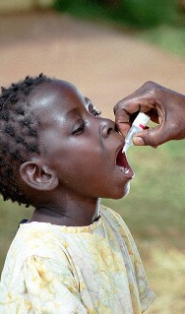
PolioPlus
~ 3 billion children received vaccine
since 1980…
Only 2 remaining endemic
countries…Afghanistan & Pakistan
Only 3 cases reported in 2022 to date
Rotarians will have invested $2.2 B
to eradicate polio…
Bill and Melinda Gates Foundation
contributing $700M and adding
$300M
In 2020-21, program awards, including
PolioPlus Partners grants, totaled$149.9 M
2:1 Match from Gates continues…
Presented By:
Kristopher J. Newbauer
Training Specialist

Slide 9

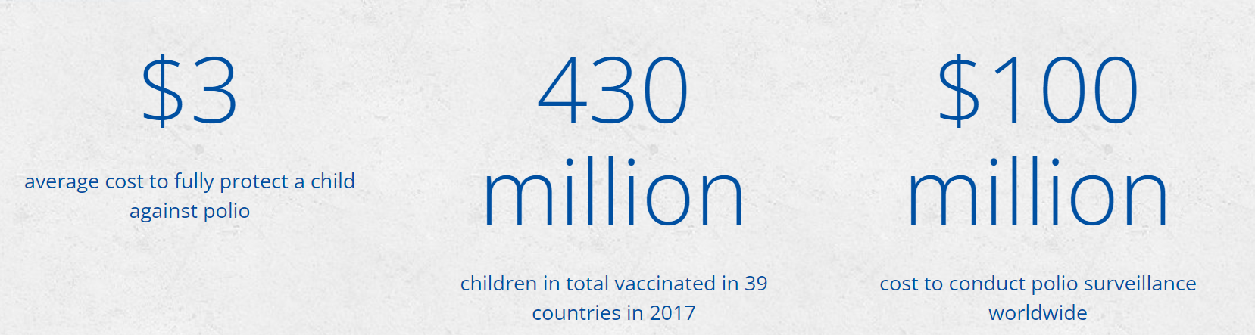
Notes:
9

Slide 10
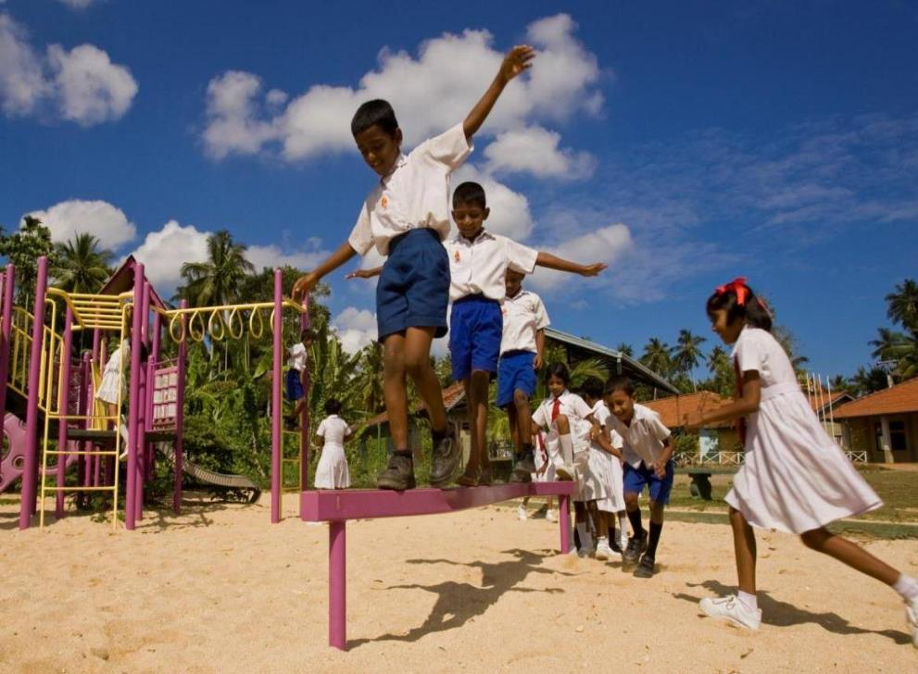

GRANTS
District
&
Global
Notes:
10

Slide 11
Rotary Foundation Grant Programs
District grants
District grants support small-scale, short-term projects related to the Foundation’s mission. In 2020-21, the Foundation approved 467 district’s with the funds to support their own local district grants, and program awards totaled $31.1 million.
Global grants Global grants fund large-scale international activities with sustainable, measurable results that support Rotary’s areas of focus. Activities include humanitarian projects, scholarships, and vocational training teams. In 2020-21, the Foundation approved 2,066 global grants, and program awards totaled $130 million.

Slide 12
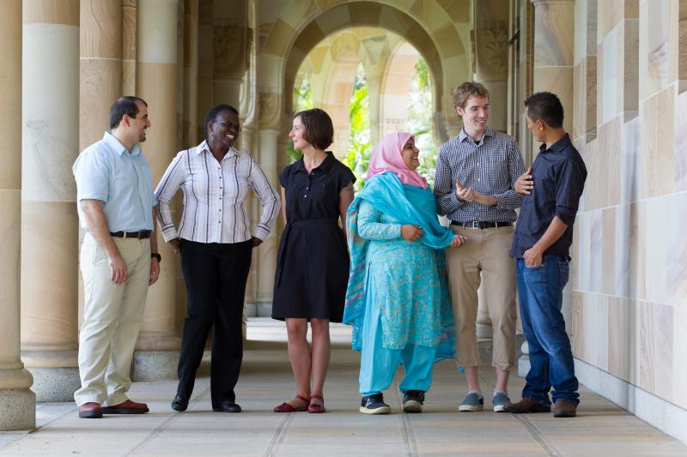


Peace Centers
7 Rotary Centers and One professional program with leading universities around the world
To advance knowledge and world understanding among potential future leaders
In the year 20/21, 117 fellows from 63 countries began their Master studies at the Rotary Peace Centers, and program awards for the fellows and centers totaled $4.4 million
Since the program began in 2002, the Rotary Peace Centers have trained more than 1,487 fellows who now work in more than 115 countries
Notes:
Chulalongkorn University, Thailand (certificate program)
Duke University and University of North Carolina at Chapel Hill, USA
International Christian University, Japan
University of Bradford, England
University of Queensland, Australia
Uppsala University, Sweden

Slide 13
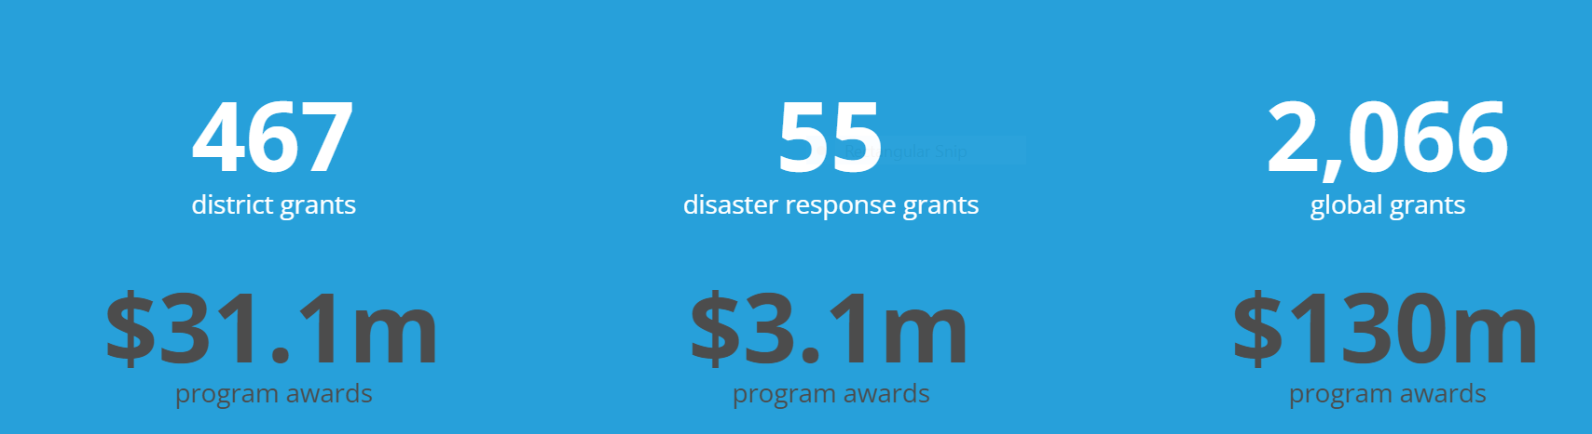
SUMMARY - GRANT SPENDING
Notes:
Ask for questions from participants. Review contact information.

Slide 14
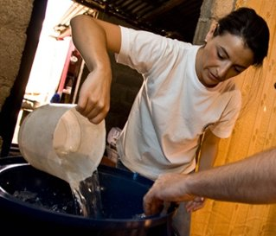


Supporting The Rotary Foundation
you choose where your donation goes
Annual Fund
For support today
Endowment
Fund
To secure tomorrow
PolioPlus Fund
To End Polio Now

Slide 15
Rotary Finances
Entity | Fund | Tax Deductible | Ways to Contribute | Supports
The Rotary Foundation | PolioPlus Fund | Yes | Rotary Direct (https://my.rotary.org/en/rotary-direct), Rotary Donate (https://www.rotary.org/en/donate), Check to BBRC designating donate to RI Fund | Polio and other health initiatives
 | Annual Fund |  |  | Grants – District and Global
 | Endowment Fund |  |  | Rotary Endowment
 | Peace Centers |  |  | Peace Centers
Rotary Club of Blue Bell | Operating Account | No | Dues, Happy Dollars, Club Gear Purchases, Meals (Venmo, Check) | Club operating expenses, District/RI Dues, Awards, Website, Taxes
Charitable Foundation of the Rotary Club of Blue Bell | Foundation Account | Yes | Venmo (Passes through Operating Account) Check OneCause (New) Amazon Smile Fundraising Events | International Projects, Service Projects, Youth Activities, Beneficiaries, Donations to RI Foundation, etc

Slide 16


Funding Our Rotary Foundation
The Rotary Foundation Programs
Contributions from:
PolioPlus
Polio
Rotarians
Rotary Clubs
Others
Peace Centers
Annual Fund
DDF
Peace Centers
World
Fund
District and Global Grants
Endowment Fund
Notes:
16

Slide 17

Donor Benefits
Plan & budget your giving
No chance for lost checks
Easy way to stay a Sustaining Foundation Member
RFUK Standing Order Form
RFUK Standing Order Form
Rotary Foundation Benefits
Faster processing & recognition
Reduce gift processing costs
Improve accuracy in records
“Annuity” that keeps on giving

Slide 18

Think About Creating YOUR Rotary Legacy
Your Rotary Legacy
Rotary’s tomorrow depends on what you do today. By remembering The Rotary Foundation in your Will, you will help to ensure that the work of the Foundation will continue beyond your lifetime.
Do
As part of any bequest, you can specify which of Rotary’s causes you would like to support through your gift to The Rotary Foundation.
If you specify Endowment Fund SHARE part of the interest will come back each year to help fund D7780’s local and International projects

Slide 19

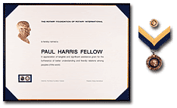
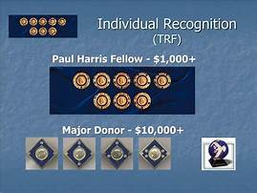
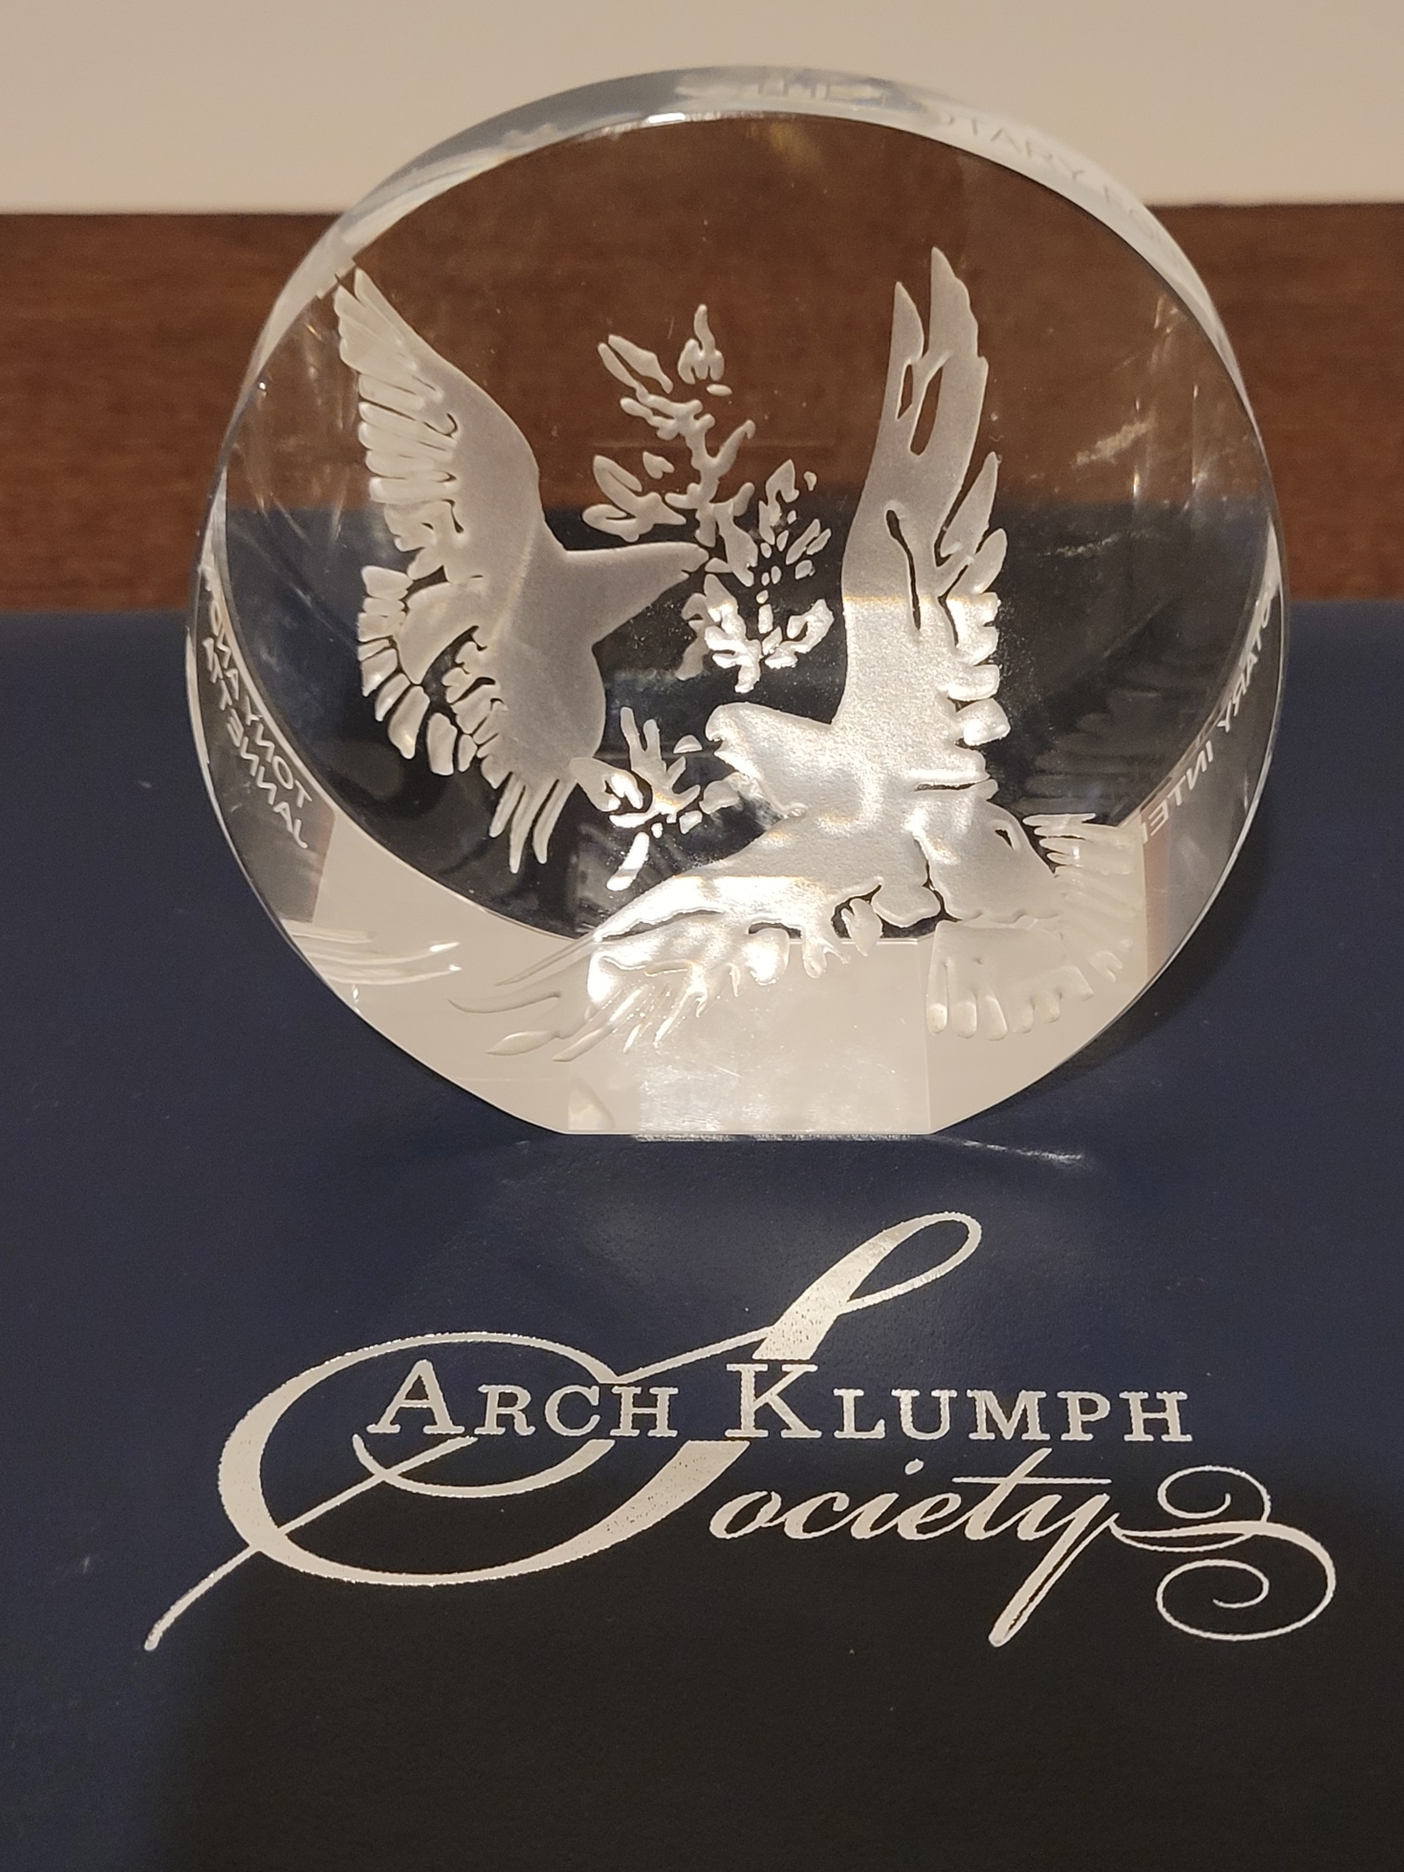
DONOR RECOGNITION
The Rotary Foundation welcomes a number of opportunities to show its appreciation to individuals and clubs for personal outright contributions supporting its humanitarian and educational programs. A PH can also be awarded to a Rotarian or Member of the public in recognition of their Exceptional Service thru contributions made by a Club or Rotarian
Paul Harris Fellow
Paul Harris Society
Polio Plus Society (D-7780)
Benefactor
Bequest Society
Major Donor
Arch Klumph Society

Slide 20
Paul Harris Fellow Recognition Explained
Paul Harris Fellow:
An individual Rotarian who contributes US$1,000*
Or
A Rotarian or Member of the Public in whose name US$1,000 is contributed* to recognized there outstanding service to Rotary or Work in the community
* to the Annual Fund or other approved programs.

Slide 21


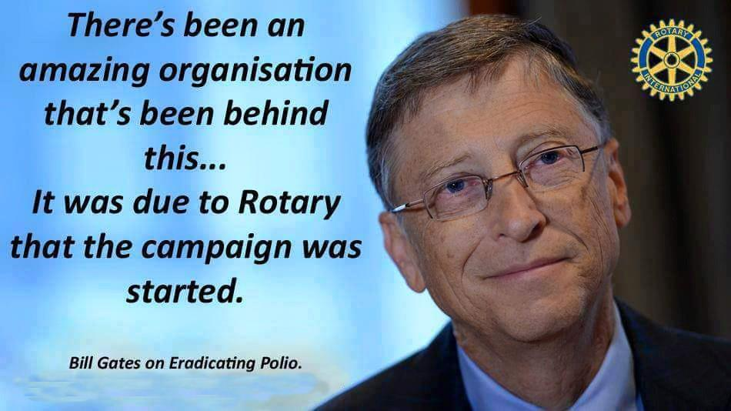
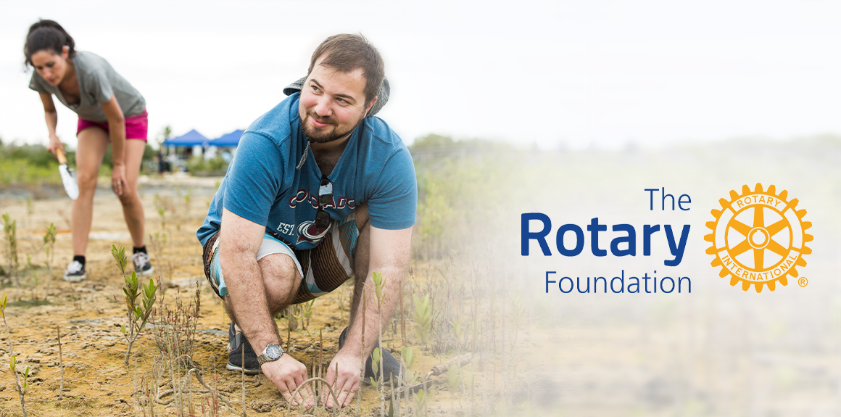



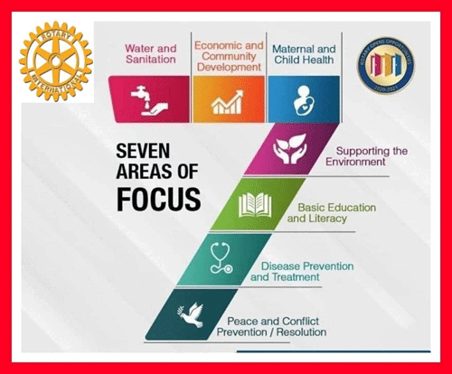
TRF our Charity doing Good in Our Own Communities and around the World

Slide 22
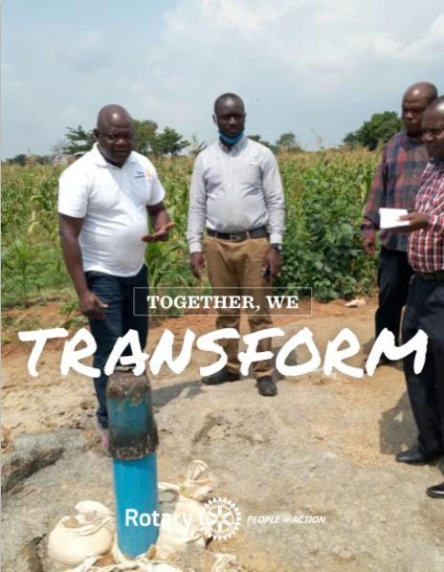

THANK YOU !
The Rotary Foundation
Connecting Rotary Clubs & Communities
“Doing Good in the World” saving and improving the lives of so many, only achieved with Your support
Contact Details, Email: dave.sargent@bluebellrotary.org Tel:650-465-8445

Slide 23
THE ROTARY FOUNDATION
DOING GOOD IN THE WORLD
Supported and funded by Rotarians,
the Foundation exists to Serve and benefit Rotarian sourced projects in our
7 Areas of Focus

Slide 24


Slide 25
Appendix

Slide 26

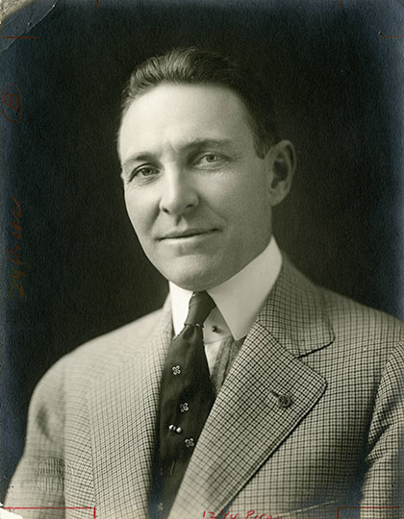
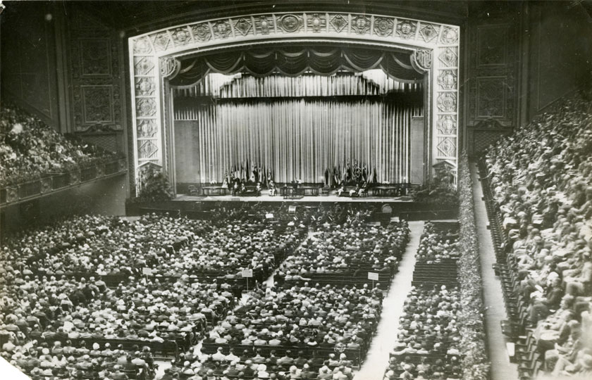
HISTORY
At the 1917 convention, outgoing RI President Arch C. Klumph proposed to set up an endowment “for the purpose of doing good in the world.” In 1928, it was renamed The Rotary Foundation, and it became a distinct entity within Rotary International.
In 1929, the Foundation made its first gift of $500 to the International Society for Crippled Children. The organization, created by Rotarian Edgar F. “Daddy” Allen, later grew into Easter Seals Society.
1978: Rotary introduced the Health, Hunger and Humanity (3-H) Grants. The first 3-H Grant funded a project to immunize 6 million Philippine children against polio.
1985: The PolioPlus program was launched to eradicate polio worldwide.

Slide 27

7 Area’s of Focus
Water, Sanitation & Hygiene
Disease Prevention &
Treatment
Maternal & Child Health
Basic Education and Literacy
Community Economic
Development
Peacebuilding and Conflict
Prevention
Protecting the Environment

Slide 28

Notes:
28

Slide 29
Rotary Clubs in District 7780 use of District Grants funded by the Rotary Foundation.
NOTE: To apply for DG’s Clubs MUST have Foundation Goals in Rotary Club Central… RC Fryeburg Area now has them ☺
Below are some great examples of the types of projects that have benefited local communities
Outdoor adventure project for disadvantaged children
Raised vegetable beds in a community garden
Riding for disabled people /Meals on Wheels
Environmental Projects … Local conservation efforts
Defibrillators in rural communities
Services for disadvantaged teenagers / Drug programs
Multi Club (4) Covid-19 PPE
Smaller or start-up International Project Grants
Examples
Of
District
Grants
Notes:
29

Slide 30
Rotary Foundation Grant Programs
Disaster Response grants
Rotary’s disaster response grants support relief and recovery efforts in areas that have been affected by natural disasters within the past six months.
In 2020-21, the Foundation approved 55 disaster response grants, and program awards totaled $3.1 million.

Slide 31

Rotary Foundation Grant Programs
Disaster Response Grants
The Rotary Foundation creates a channel for direct humanitarian support in Ukraine region:
In response to the deepening humanitarian crisis in Ukraine, The Rotary Foundation has created an official channel for Rotary members around the world to contribute funds to support the relief efforts underway by Rotary districts and has designated its Disaster Response Fund as the main avenue for contributions.
Disaster Response fund contributions for Ukrainian relief efforts… $15M

Slide 32
Disaster Response By Rotary Explained
Rotary members and The Rotary Foundation play a unique role in disaster recovery and rebuilding efforts. Working closely with our partner ShelterBox and other organizations that specialize in disaster relief, Rotary members lead projects to support every phase of a community's recovery.
Rotary supports three phases of relief:
Immediate response:
Our local clubs and partners immediately offer helping hands and supplies.
2.Short-term assistance:
Our clubs and districts help affected communities wherever we can through funds and materials to re-establish day-to-day operations.
(Funded in part by Grants awarded from donations made to the Disaster Relief Fund)
3.Long-term rebuilding:
Our clubs plan and implement projects that rebuild affected communities.
(Funded in part by Grants awarded from donations made to the Annual Fund)

Slide 33


ROTARY PEACE CENTERS MAJOR GIFTS INITIATIVE
The goal is to fully endow the program
$200 million by 2023
Focus on major gifts

Slide 34
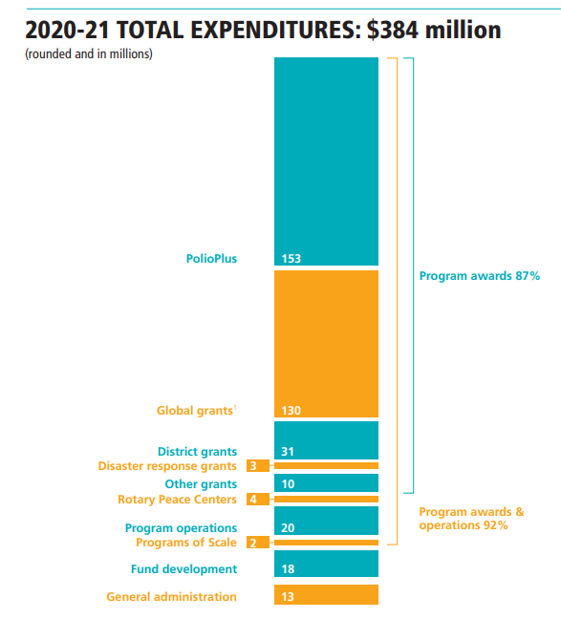
SUMMARY -
SPENDING

Slide 35
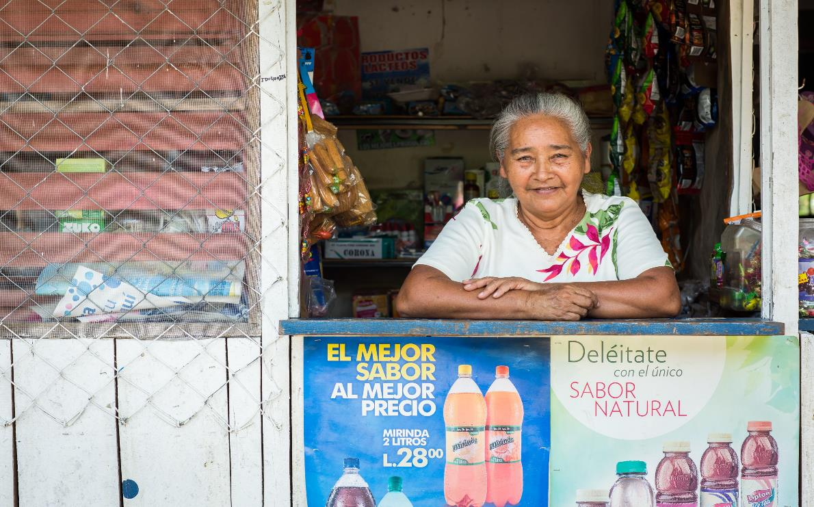
EVERY ROTARIAN EVERY YEAR – Annual Fund
$139 million given to the Annual Fund
2,066 Global Grants awarded
31% of Rotarians supported the Annual Fund
Notes:
These projects we’ve just discussed are possible because Rotarians supported the Foundation and participated in Foundation grants.
Several years ago, we started a fundraising initiative for the Annual Fund called Every Rotarian, Every Year. The goal of Every Rotarian, Every Year is to encourage support of the Annual Fund and increase Rotarian engagement with the Foundation.
How many of you have heard of Every Rotarian, Every Year?
This effort is based on the idea that if every Rotarian gave at least $25 every year to the Annual Fund, the possibilities of what the Foundation could accomplish would multiply.
In 2018-19, we accomplished a lot:
Rotarians gave a little over $126 million to the Annual Fund
The Foundation awarded more than 1,400 global grants
With nearly a third of Rotarians making a gift to the annual fund and becoming EREY eligible worldwide, we’ve achieved a lot and improved the lives of many. Can you imagine how many more lives could be changed through grant projects if we encourage even more Rotarians to contribute at least $25 to the Annual Fund every year?
**Numbers are unaudited from 2018-19 Rotary Year

Slide 36


EVERY ROTARIAN, EVERY YEAR
Rotarian’s who contributes $100 annually
  A Program to Promote 100% Member Participation
  Goal: $100/yr per Rotarian

Slide 37
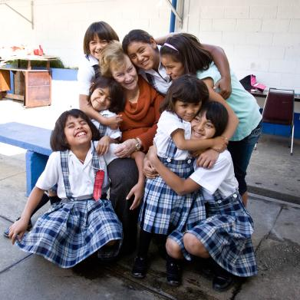
ENDOWMENT FUND
Contributions are professionally invested
Only the earnings are spent
$1.04 B in Assets and Expectancies
Goal: $2.025 B by 2025
to generate ~ $50 M annually in earnings
Notes:
The Endowment Fund offers donors a way to create their own lasting legacy through Rotary.

Slide 38
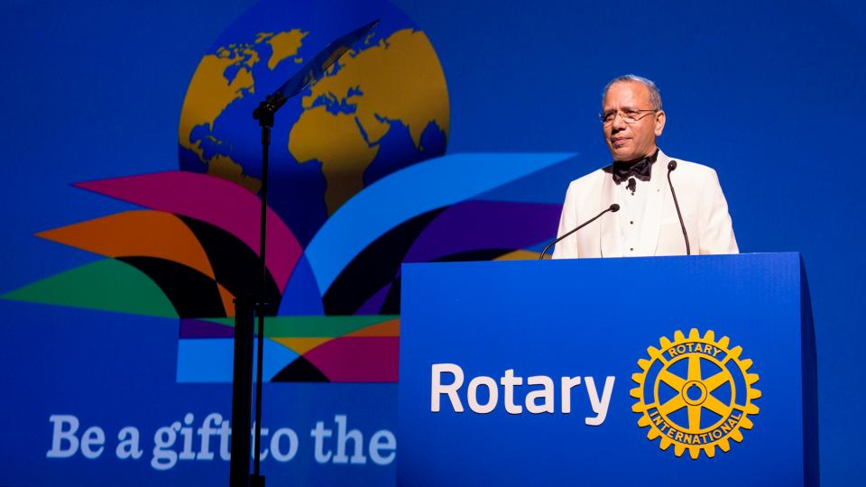
Why We ask Every Rotarian to consider making TRF one of their Charities of Choice
K.R. Ravindran
2020-21 Trustee Chair
The Rotary Foundation
Foundation Chair PRIP Ravi asks us to think about this ”Not Everybody has the resources to give a lot to our Foundation but Everybody can give something”
We are all proud to be Rotarians and by financially supporting our Foundation we are funding projects here and communities around the world, Today and into the Future
Your donations and or Legacy could encourage others in your club to do the same
You will inspire and help future Rotarians achieve their goals with your funding in the work they do within Rotary's Seven Area’s of Focus…
How Many Charites let you choose, direct and see the results of where your money goes?

Slide 39
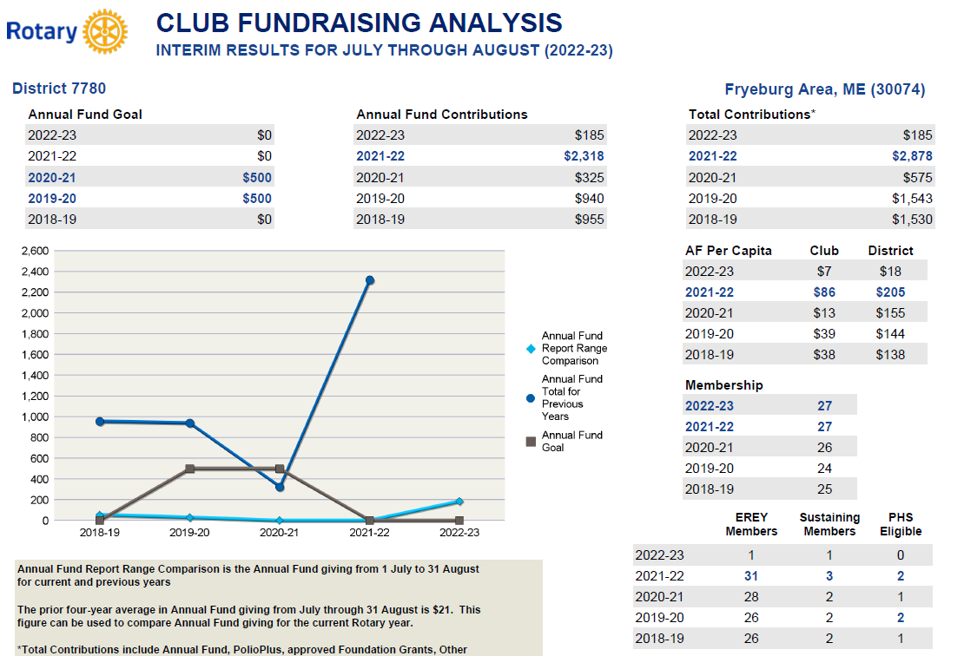

Slide 40
Paul Harris Fellow
Rotary started with the vision of one man — Paul Harris. The Chicago attorney formed the Rotary Club of Chicago on 23 February 1905, so professionals with diverse backgrounds could exchange ideas and form meaningful, lifelong friendships.
The Paul Harris Fellow recognition acknowledges individuals who contribute, or who have contributions made in their name, of $1,000 to The Rotary Foundation
When you give additional gifts of $1,000 or more to the Annual Fund, PolioPlus, or an approved Foundation grant
Rotary Direct – Automatically charges/withdrawls funds on a regular basis

Slide 41
Funding Our Rotary Foundation
Contributions
from
- Rotarians
- Rotary
Clubs
- Others
TRF Programs
- Polio
- Peace
Centers
- Grants
District
& Global
PolioPlus
Peace Centers
Annual Fund
DDF
47.5%*
~ $100 M +
Held 3 years
World
Fund
47.5%*
After 3 years
Endowment Fund
Earnings
*after deduction for operating expenses
Notes:
41

