Slide 1
September 19 CLUB meeting
Rotary Club of Blue Bell
Title Page Option

Slide 2

Today’s presentation – September 19

Slide 3


Slide 4


Slide 5

District 7430 – rotoplast team

Slide 6


Slide 7
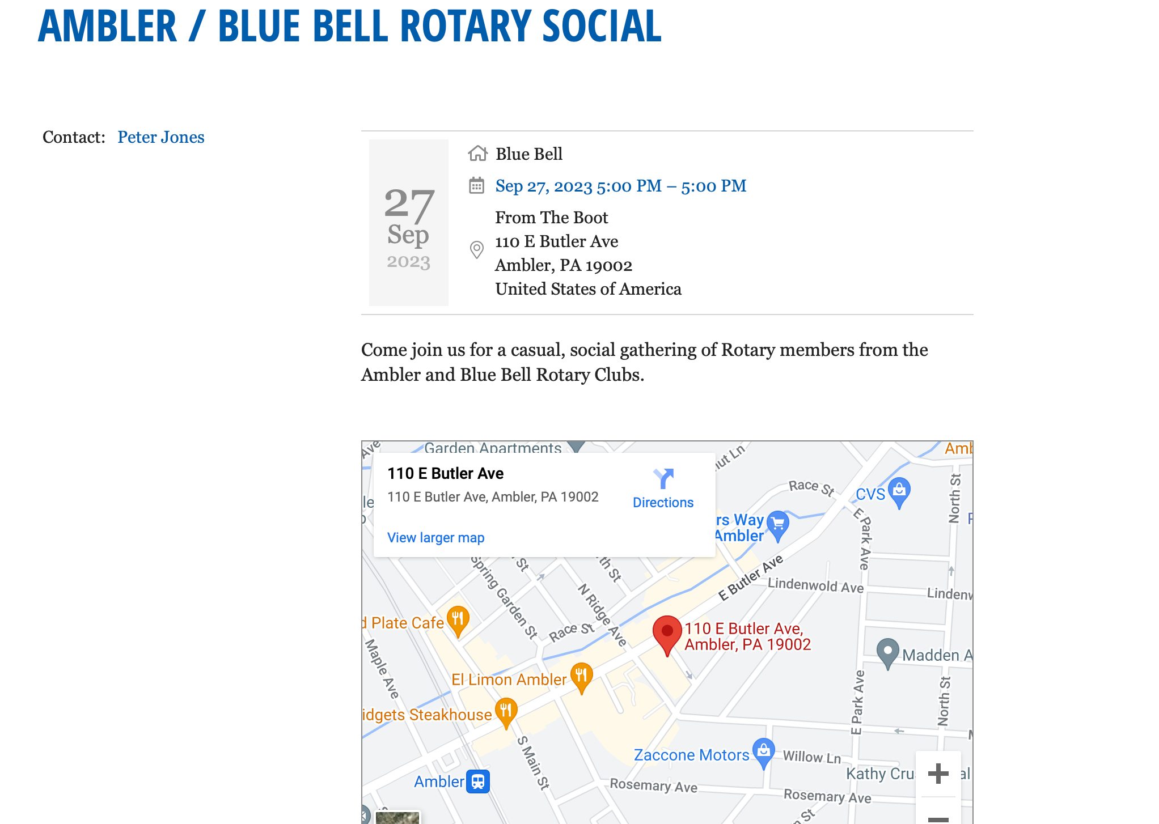
Next week: Social – September 27

Slide 8


