Slide 1
The Welcome Mat
District 7430 Diversity, Equity & Inclusion Committee

Slide 2
Which “Welcome Mat” represents how others in your community view our club? Why?
A
B

Slide 3
The Welcome Mat – April 2023
The Welcome Mat
March 2023

Slide 4
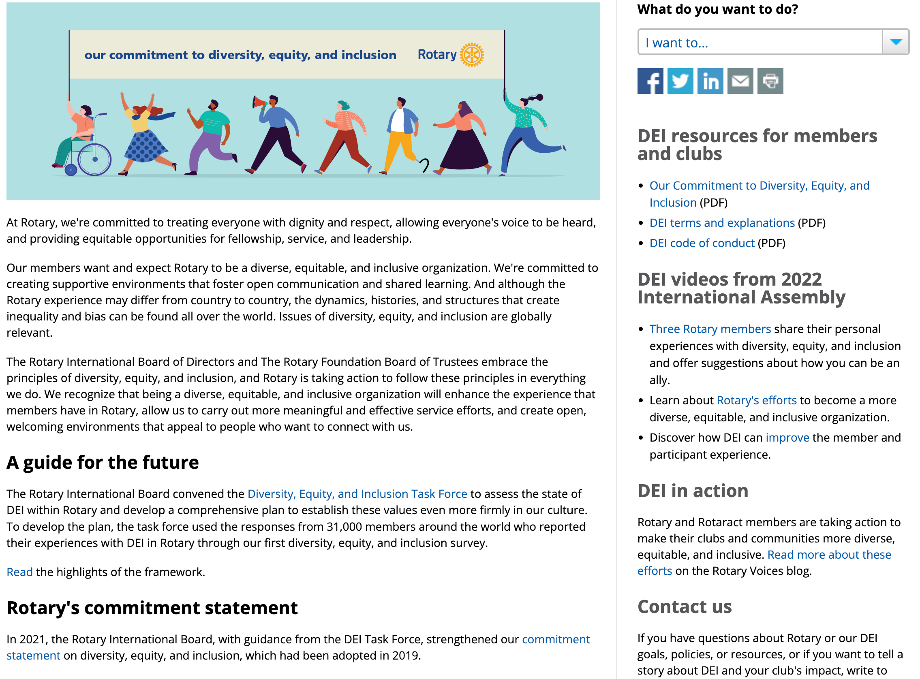
Rotary’s Commitment to Diversity, Equity and Inclusion
https://my.rotary.org/en/learning-reference/about-rotary/diversity-equity-and-inclusion

Slide 5
Rotary’s DEI
Commitment Statement
https://my.rotary.org/en/learning-reference/about-rotary/diversity-equity-and-inclusion

Slide 6
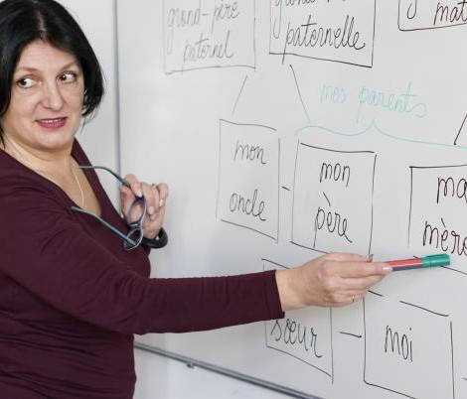
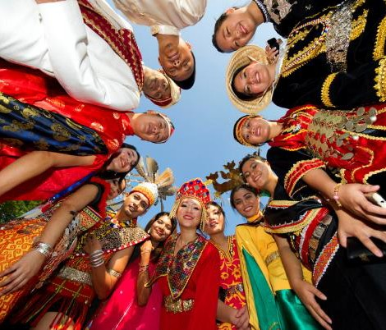
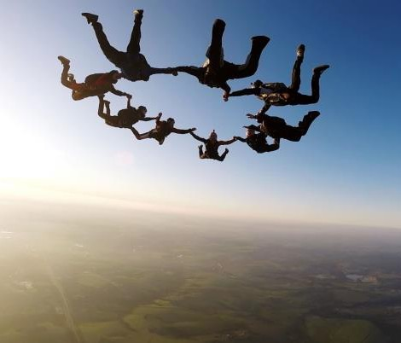
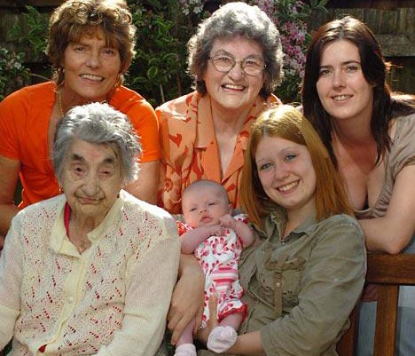
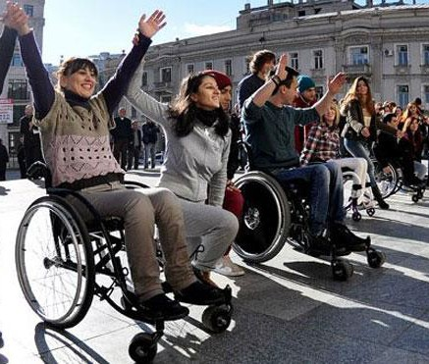
What is Diversity?
Thinking Styles
Language
Ethnicity
Religion
Perspectives
Experiences
Nationality
Job Level
Race
Gender
Age
Culture
Physical
Sexual
Skills
Abilities
Orientation

Slide 7
What is Inclusion?
Diversity is simply a representation of many different kinds of people (gender, race, ability, religion, etc.)
Diversity often focuses on the differences and is referred to as "the mix.“
Inclusion is the intentional act of welcoming diversity and creating an environment where all can thrive and succeed.
Diversity is what you have. Inclusion is what you do.
Equity ensures that everyone, no matter who they are, has an equal opportunity to succeed.

Slide 8
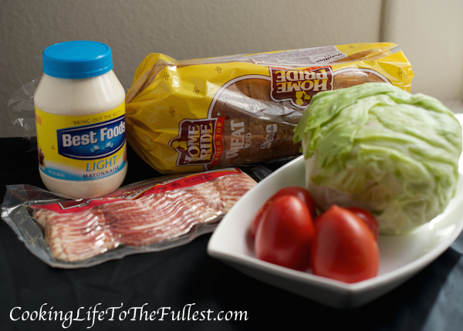
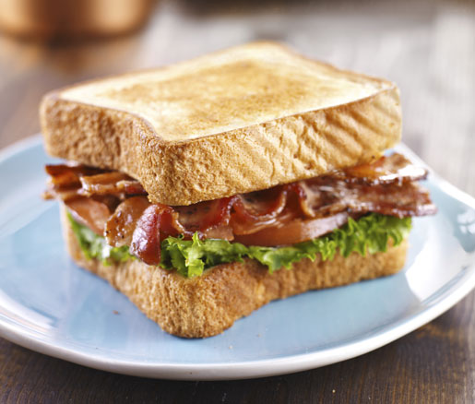
Inclusion is the act of "making the mix work."
Diversity
Inclusion
The “Mix”
Making The “Mix” Work

Slide 9
D7430 DEI Committee Statement
A top priority for D7430 is growing and diversifying our membership to reflect the communities we serve.
We're creating an organization that is more open and inclusive, fair to all, builds goodwill, and benefits our communities. We want people with differing perspectives and ideas who will help Rotary take action to create lasting change in communities in our District.
We want our members to feel a sense of belonging not because they are same as everyone else, but because they have been accepted as who they are.

Slide 10
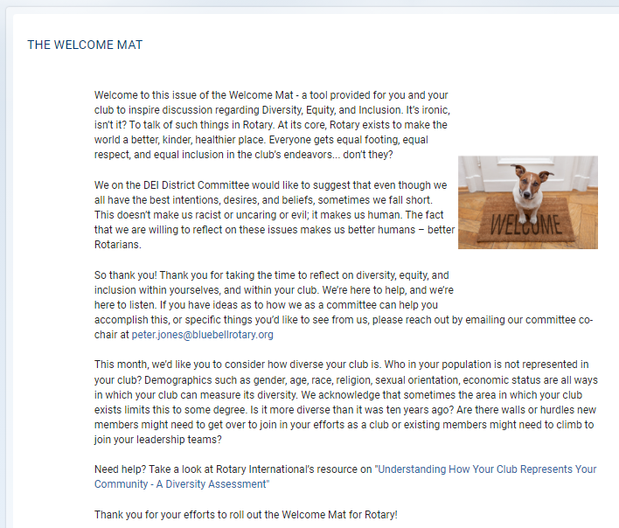
The Welcome Mat – April 2023
The Welcome Mat
April 2023

Slide 11
Discussion Questions

Slide 12
Questions
How does our club create a sense of belonging and connectedness among members?
What does our club do to welcome, onboard and orient new members?
What are club practices that may unintentionally signal a less welcoming experience for new members?
What can the DEI Committee do to help our club with issues related to DEI?

Slide 13
New Member Bingo
Notes:
Here's a copy of the New Member Bingo we started using in our welcome packet for new members of the Emmaus Rotary Club. The packet also includes a New Member Guide with essential information about our club - our club traditions, the four-way test, our areas of focus, expectations, dues, meeting info, how to get involved, how to stay connected with club news, and some Rotary history. The welcome packet and temporary name badge are presented to the new members as soon as they are voted in. Once the bingo card is complete w/ members of the club signing squares as indicated, the new member can claim a small prize from our club president and be recognized at the meeting.

Slide 14
Best Practices – Welcoming Clubs

Slide 15
Summary

Slide 16
Member | Email
Peter Jones, Co-Chair | peter.jones@bluebellrotary.org
Mary Cook, Co-Chair | Mary.cook7430@gmail.com
Steve Kendra | stevenakendra@gmail.com
Valerie Deneen | vdeneen@gmail.com
Gayle Rogers | gayjoy12@gmail.com
Mindi Vogel | mvogel@fairmountbenefits.com
Robert Hobaugh | rotarianbob@hometownu.com
Janet Kolepp | rotaryconnects@gmail.com
Rotary
District 7430
Diversity, Equity & Inclusion Committee

Slide 17
