Slide 1
Silent Auction Initiative

Slide 2
Silent Auction Themed Baskets
Club Members Needed to Own a Basket

Slide 3
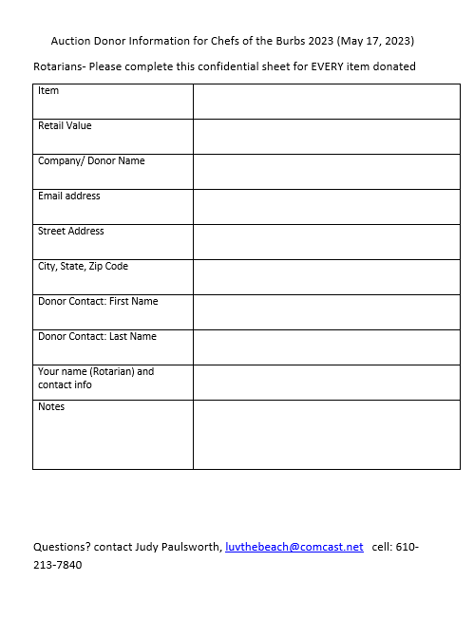
Intake Form

