Slide 1
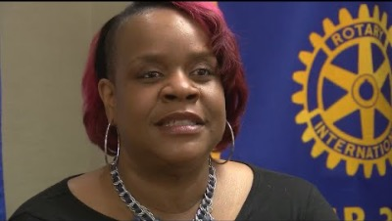
Shandra Summerville – President Champaign Rotary Club (2021 – 2022)
1

