Slide 1
Women's History Month Blue Bell Rotary Club

Slide 2
Why is Women’s History Month Important?
Many Unacknowledged Women Made History (think “Hidden Figures”).
Women Weren't Allowed To “Be An Active Part of” History for A very long time (men were the official authors of history books until the early 1900s).
It Busts Myths About What Women “Can’t Do” and focuses on what they “Can Do” and “Have Done.”
History Is Inspirational To Current and Future Generations.

Slide 3
Key Dates—US Women’s History Month
1909
First Women’s History day in NYC recognized garment workers protesting working conditions and wages
1917
First Women’s Party was established to lobby for women’s right to vote
1972
Title IX passed to prohibit discrimination against women in education. Equal Rights act passed in Senate and Congress (1973)
1978
Sonoma California school district creates a week-long celebration of women’s societal contributions.
Women’s contributions added to school curriculum
1980
Jimmy Carter declared week of March 8 as National Women’s History Week
1987
Congress declared March as National Womens History Month
In 1911, First International Women’s Day commemorated throughout Europe, initiated by women in Germany

Slide 4
Interesting Facts about Women in Rotary
1950
Enactment to delete the word ‘male’ from Rotary Constitution--India
1977
Rotary Club of Duarte, Ca admits women in violation of the RI Constitution. Lose RI membership in 1978 (reinstated in 1986)
1980
RI BOD and clubs in India, Sweden and Switzerland and USA propose to remove ‘male persons’ from the RI constitution
1983–1986
Duarte lawsuit rules in favor of RI upholding gender-based qualification for California clubs
1987
US Supreme court rules that Rotary clubs must admit women
Silvia Whitlock becomes first woman Rotary President
1987
Rotary Club of Marin Sunrise is chartered as the first club to have women members
1990
There are 20,200 female Rotarians worldwide. 1990 Rotary Club of Blue Bell is Chartered!
1993
Jody Richwagen First BBRC women president 1
2022
Jennifer Jones first female RI president

Slide 5
Women Presidents of BBRC
1990s
2000s
1993 JoEllen Richwagon
1994 Phyllis Lieberman
1997 Carole Pyne
1998 Marianne Cross
2001 Carmelita Karhoff
2003 Patti Smith
2007 Polly Beckham
2011 Dale Rubincam
2012 Lisa Miller
2014 Joanne Messerschmidt
2017 Lei Barry
2019 Leilani Katz
2020 Mindi Vogel
* 13 of 33 BBRC Presidents from 1990-2023

Slide 6
Imagine……….
Where would we be today without the initiatives and achievements of these women Presidents?
What might we be missing?

Slide 7
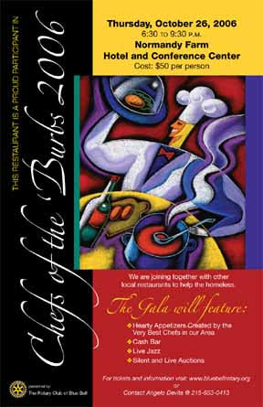
Let’s Have a Look!
Hosted the First ever Chef of the Burbs at Normandy Farms
Participated in 5K Run/Walk/Trot, Hoops Jam at Christmas, and Wellness Expo
Initiated fundraiser/awareness “Operation Sugarplum” for military families with deployed parents
Created “Open World Event” with 5 Russian professional women to introduce them to “How things work in Philadelphia”

Slide 8
Let’s Have a Look!
50% of the club attended ALL fundraisers. Nearly 100% attended at least one fundraiser. And nearly 70% attended one or more hands-on activities
More than 5,000 hours of club and community service
Established club's first strategic plan
Met with nearly every member for feedback
Celebrated a woman as Community Citizen of the Year
Increased community awareness of Four Way Speech Contest
Supported the launch of what is now Wissahickon Boys and Girls club
Established MCCC Rotaract
Created media piece internally to engage members and externally to educate about Rotary

Slide 9
Let’s Have a Look!
Passed CPR Bill in all PA schools as result of 6 years of advocacy. SARS and Center Square Fire Company presented and BBRC practiced.
Wellness Expo with MCCC
Focus on youth—”It’s All About the Kids”
Camp Neidig
Student of The Quarter
Cassidy Scholarships
4-way Test Speech Contest
Youth Exchange Services
Middle School Interact Club
MCCC Rotaract Club
Initiated annual Pancake Breakfast at Manor House to raise funds for the Second Alarmers Rescue Squad—3+ years
Attracted younger members, women, and more ethnic and racial diversity through intentional focus
Connected club with local community—brought in Township speakers and created videos
Expanded BBRC connection to District and had several members attend District changeover dinner

Slide 10
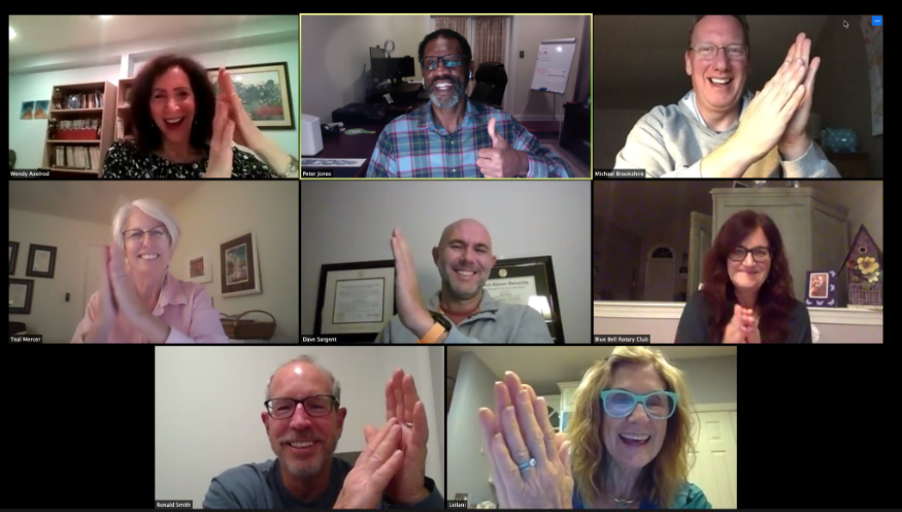
Let’s Have A Look!
Ongoing connection during a time of isolation……
First club to move to zoom meetings and kept this going through COVID
Educated the District about Zoom
Started DEI committee
1st Virtual Chefs of the Burbs- raised $ for beneficiaries while supporting restaurants hurt by covid
Virtual and outdoor happy hours
Covid steering committee introduced projects such as the Senior Buddy Program and Delta Community Services Mentorship

Slide 11
Presenting….
Polly Beckham---2007
Lisa Miller--2012
Joanne Messerschmidt--2014
Lei Barry--2017
Leilani Katz--2019
Mindi Vogel--2020
(Dale Rubincam, 2011 President cannot be with us today)

