Slide 1

Pandemic 2020: What is going on?
James V. McDonald MD, MPH
Chief Administrative Officer; Board of Medical Licensure and Discipline
Medical Director; Division of Customer Services
Medical Director; Division of Policy, Information, and Communication
Medical Director; Drug Overdose Prevention Program
Medical Director; Prescription Drug Monitoring Program
Rhode Island Department of Health

Slide 2
What are some of the most powerful public health interventions?
1. Clean water
2. Soap
3. Vaccines
4. Yet one of the most important in 2020 is….

Slide 3
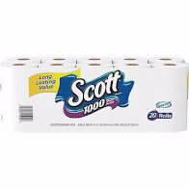
What did Walmart
know that I should have known?

Slide 4
What is a Syndemic?
Syndemic:
A set of linked health problems involving two or more afflictions, interacting synergistically, and contributing to excess burden of disease in a population
It’s ok if your life and the planet feels weird right now……it is
Notes:
https://www.medicinenet.com/script/main/art.asp?articlekey=22591

Slide 5
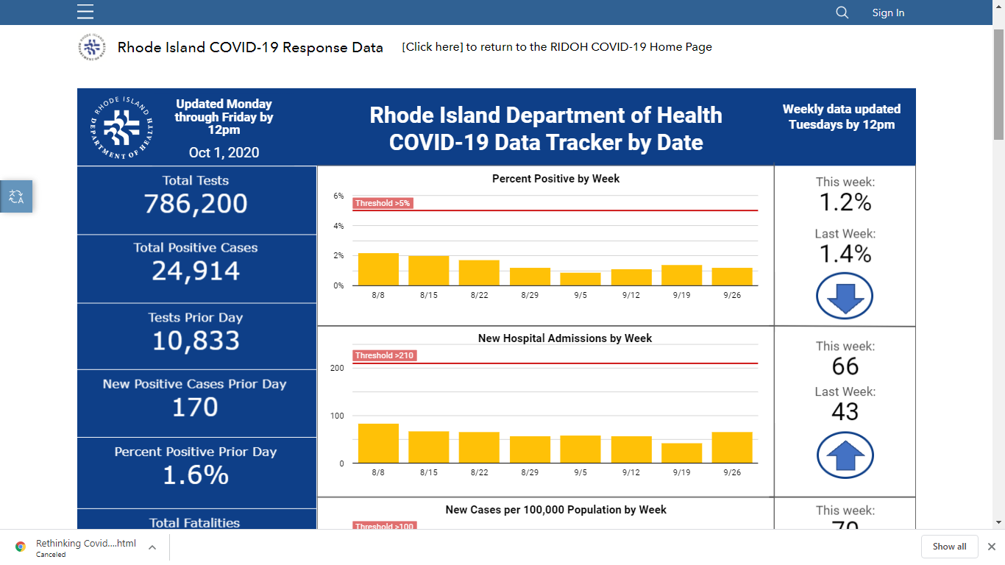
Pandemic – DATA – yes we have DATA
hospitiliations
Notes:
Oxy 30

Slide 6
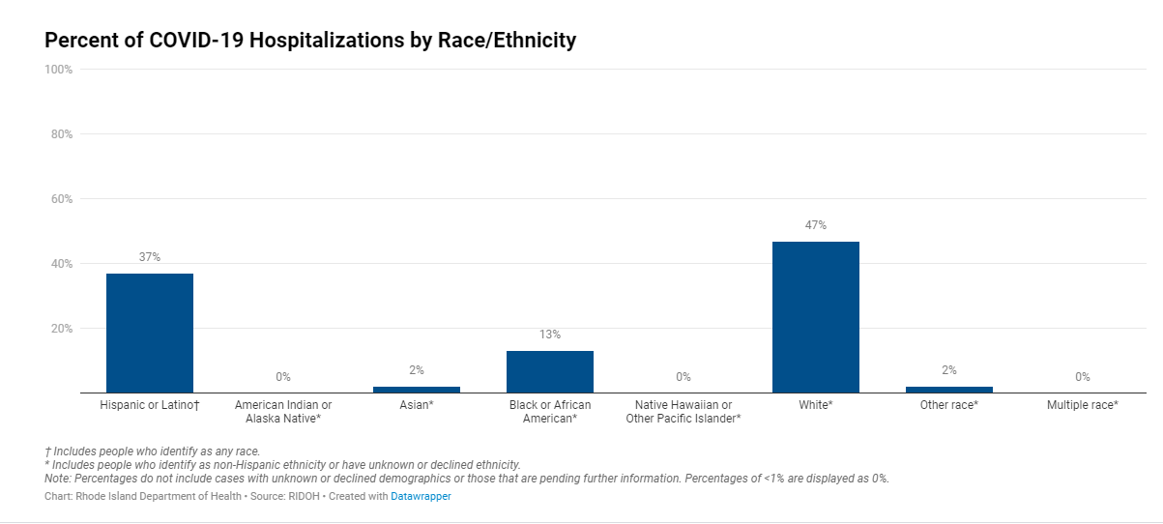
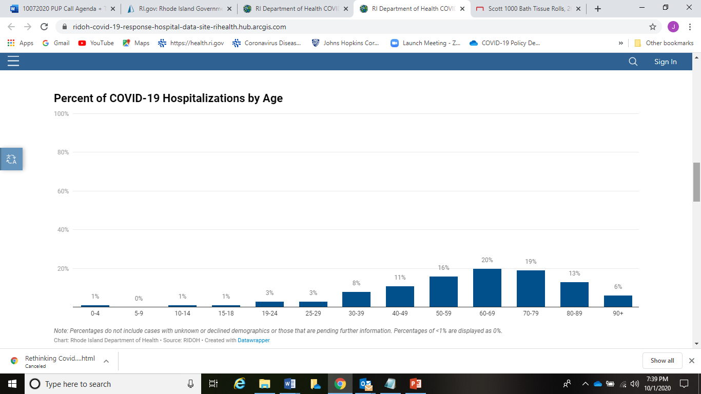
Pandemic – who is in the hospital?

Slide 7
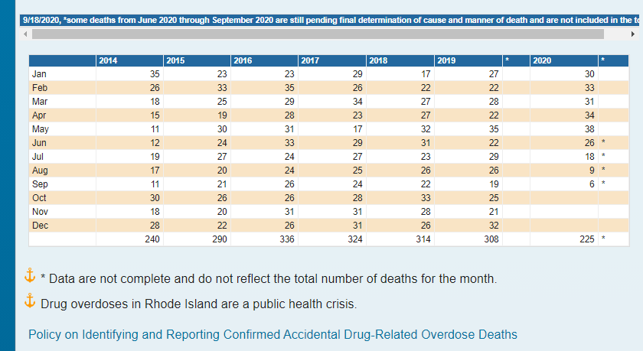
Historical Trends in Fatal Overdoses in Rhode Island
2020 is on pace to be the worst year in recorded history in Rhode Island for overdose deaths

Slide 8
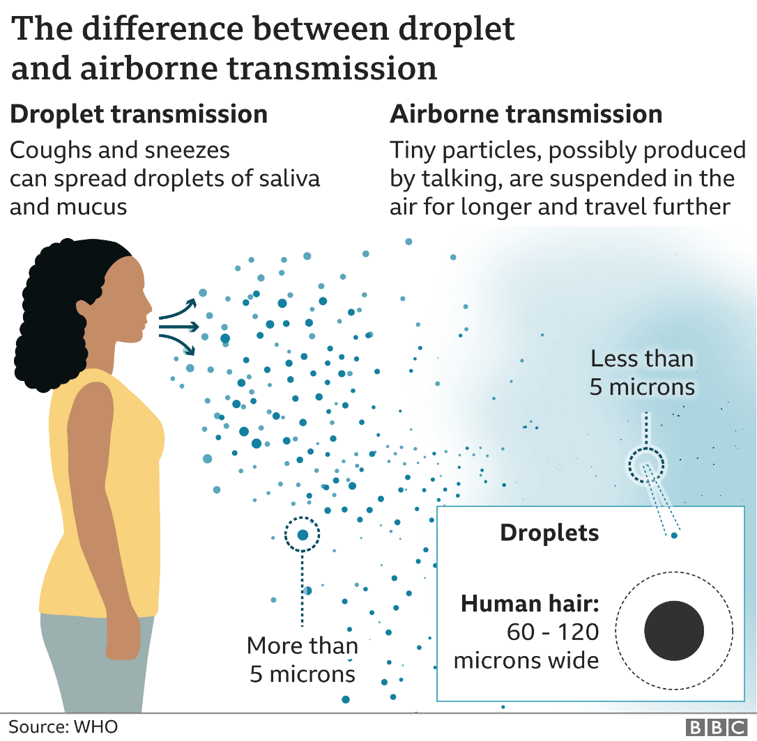
Air quality… All I need is the Air that I breathe……The Hollies
Air Exchanges
Relative Humidity 40-60%
Filtration of Air
Health.ri.gov/airflow

Slide 9
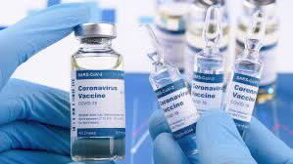
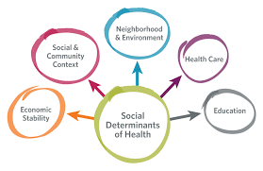
A Vaccine will solve everything right?

Slide 10
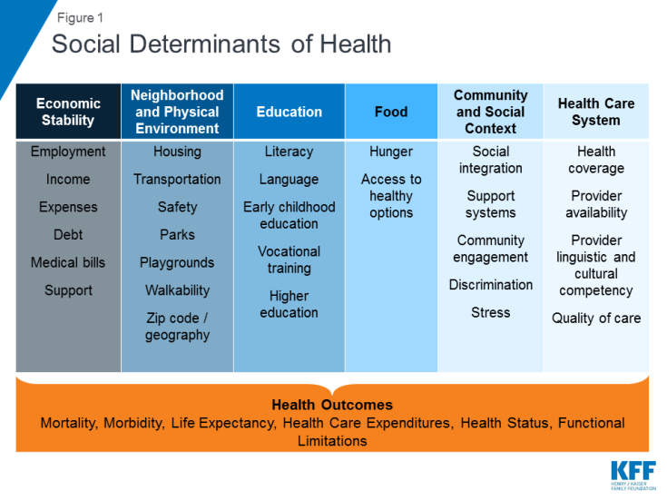
What are:
Social Determinants of Health - conditions in the places where people live, learn, work and play affect a wide range of health outcomes

Slide 11

Time for Dialogue…..

