Slide 1
Community Leadership
&
Service Above Self
Membership Handbook
2021 - 2022
Critical Membership Components
Membership
Commitments
Meetings:
What to Expect
Club Leadership
By Laws &
Club Fiscal Year
Extras
Rotary Lingo
Org Chart
Website, App & Social
Rotary Intl Info
Planned Giving

Slide 2
Membership – What Is In It For Me?
What does it mean to be a Rotarian?
Fellowship = Rotary is a place where friendships grow locally and may grow worldwide
Rotary is a place whereby developing friendships, you will discover resources to help your business grow
If you have challenges, there is likely a Club Rotarian who has experienced similar challenges & can help you create solutions!
Service = Become involved with a Club Service Project & realize the benefits
Get to know and develop friendships with other members
Get to know your community & business leaders
Get to know Rotarians from other Clubs & Districts
Learn your Rotary pin identifies you as a member of a world-wide organization, you are never far from another Rotarian.
Leadership = How does Rotary lead?
International Goal: Eliminate Polio & other Causes (Slide 17)
Local Club Goal: Literacy Initiatives. We work with a Club in South Africa & with Save the Children to deliver books that impact children’s literacy
Share your talents & lead, there is an opportunity for you to pick a Cause or create one!
Want more leadership opportunities? Get involved in Club/ Foundation leadership.
Getting the Most Out of Your Membership
Attend meetings regularly
Be engaged & open to new opportunities
Be available & connect with your fellow Rotarians at meetings, over a ‘get to know you’ coffee or participate in a team service project
Above all….Have Fun!

Slide 3
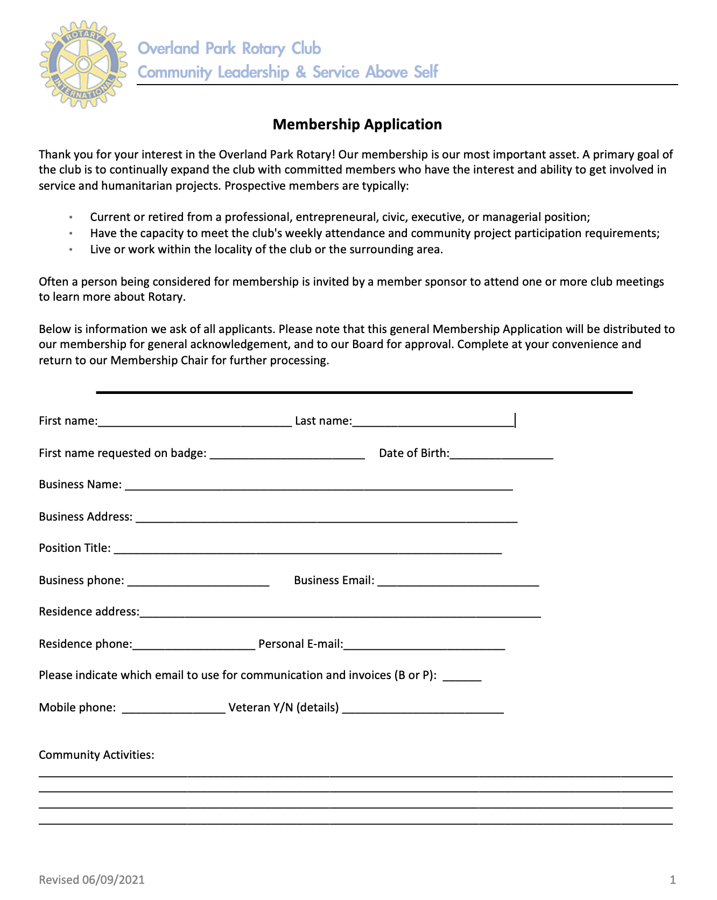
New Membership Process
Prospective members are invited to visit the Club Lunch as often as they’d like.
The Club will cover the cost of three (3) visits.
When a Prospect is ready to join the Club, they are asked to complete a Membership Application and submit the Application to the Membership Chair.
The Membership Chair will meet with each prospective member in person to outline expectations of membership and ensure the new Rotarian fully understands the requirements of membership in our Club.
After application, the prospective member is listed in the e-Spoke (Club Newsletter) for two weeks. With no objections, the Club Board will vote on a prospect’s membership. Upon approval, the member is inducted at the next Club meeting.
Club Online Membership Form
Notes:
https://portal.clubrunner.ca/4405/sitepage/thinking-of-joining

Slide 4
New Member Orientation
New members who become engaged as soon as possible tend to be more committed members and find the experience more fully rewarding. Join in!
New members are encouraged to complete the following checklist of activities within their first year of membership, under the supervision of their Club Sponsor.
1. Serve on a Club committee
2. Attend a Member Focus Group in the Spring or Fall
3. Give a Classification Talk
4. Maintain regular meeting attendance during the first six months of membership
Have a meeting with your sponsor at 6 months of membership
6. Serve as the club’s Greeter or give the Invocation
7. Volunteer at the Johnson County Christmas Bureau with the Club (Nov/ Dec)
8. Participate in Kansas City Day (April)
9. Accept an Invitation to a Rotary Board Meeting or Foundation Board meeting from a fellow member.

Slide 5
Commitments – Financial Obligations
Belonging to Overland Park Rotary Club has the following financial responsibilities:
Yearly Full-time Membership • $240 = Annual Club Dues (invoiced quarterly) • $ 0 = Meeting Room Charge
• $504 = Boxed Lunch Meal Charge (invoiced quarterly), $14/ Meal
• $250 = Voluntary Annual Commitment to:
Rotary International Foundation ($100 suggested minimum)
OP Rotary Foundation ($100 suggested minimum for Every Rotarian Every Year, EREY)
Polio Plus Donation ($50 suggested minimum)
$994 = Yearly Rotary Club Financial Commitment (~$83/ month)
Additional Commitments
$1 = $Happy Bucks – members are encouraged to contribute each meeting to the $HappyBucks bucket on the table (Funds go to Club Foundation)
Good News: When you make a Good News announcement, members are encouraged to celebrate with a donation to the Club Foundation.
The amount is up to you. These funds support our local Foundation projects & grants.
Greater Kansas City Day: Club members have the opportunity to sell newspapers/ flags to support the Rotary Youth Camp in MO
and the Club Foundation.
Note: Bills are sent out quarterly by Club administrative assistant Pam Holmes. Meals charges are included on every bill.
Notes:
Meeting Room & Meal Charge: The club is picking up the room cost at present, may need to retink down road?

Slide 6
Commitments – Club Obligations
The Object of Rotary is to encourage and foster the ideal of service as a basis of worthy enterprise. This ideal is fostered through: • The development of acquaintance as the opportunity for service • The promotion of high ethical standards in business and the professions • Service in one’s personal, business and community life and • The advancement of international understanding, goodwill and peace.
The ideal is an attitude of being a thoughtful and helpful person in all of one’s endeavors.
Standard of Conduct: The Four Way Test The Four-Way Test should be known and followed by Rotarians: 1. Is it the Truth? 2. Is it Fair to all concerned? 3. Will it build Goodwill and Better Friendships? 4. Will it be Beneficial to all concerned?
Participation Meetings are held weekly on Mondays (except for the first Monday of each month), regular attendance is encouraged. However, attendance can be achieved by attending the weekly luncheon, committee meetings, fellowship events, hands-on service projects, online or by making up at another club’s weekly meeting.
Service Opportunities Rotary’s commitment to “Service Above Self” means that Rotarians are expected to not only attend meetings, but also serve their club, community, vocation, world and youth.
Opportunities for service include:
Club leadership (Board, Foundation, Committees)
Community service, including club projects with the Johnson County Christmas Bureau, WIC Community Garden, Kansas City Day, and Rotary Reads.
Youth service through our Interact Club at Shawnee Mission South High School, Rotary Youth Leadership Academy, and Rotary Youth Exchange program.
International service through our Club’s partnership to provide mathematics workbooks to school children in South Africa.

Slide 7
Meetings – What to Expect
The Overland Park Rotary Club meets on Mondays at Matt Ross Community Center (8101 Marty Street, Overland Park, KS 66204),
except for the first Monday of the month, which is “First Monday Mingling.”
On “First Mondays Mingling,” members are encouraged to meet with other Rotarians in small groups to get to know each other better, visit another area Clubs that week or perform a service project on behalf of Rotary.
Schedule
11:30 AM: Meeting Room Opens
12:00 PM: Business Meeting Begins
12:30 PM: Speaker Begins
1:00 PM: Meeting Ends
Business Meeting Specifics
Welcome
Moment of Inspiration
Pledge of Allegiance
Recognize Visiting Rotarians
Recognize Guests
Announcements or Foundation/ Committee Reports/ Civic Updates
Share Good News
Roundtable Break Out Sessions (optional)
Intro of Speaker
Guest Speaker Presents (20-minute Presentation w 10 minutes Q&A)
Meeting Ends: Group Recitation of Rotary 4 Way Test
Adjournment

Slide 8
Commitments – Member Meeting Duties
General Meeting Duties
Greeters
Please welcome our members and guests from 11:30 am – 12 noon. You will find at the reception table a Greeter badge to wear.
Moment of Inspiration (Non-denominational)
This is the first agenda item of the meeting. If you are providing the Moment, please sit near the head table. When the President rings the bell, make your way to the podium.
Please stay within 2 minutes for your Moment of Inspiration delivery.
Here are guidelines & examples that will provide guidance
Economic Report, City Report or Committee Report
Be informative, be direct, be brief.
Classification Talk
You will also find Classification Talk guidelines under the Members tab of the homepage of our Club website.
Out of respect to our meeting and guest speaker, Classification Talks are limited to five (5) minutes.
Notes:
LINK for Moment of Inspiration/ put on member page

Slide 9
Commitments – Classification Talk
Classification Talk
You will also find Classification Talk guidelines under the Members tab of the homepage of our Club website.
Out of respect to our meeting and guest speaker, Classification Talks are limited to five (5) minutes.
Notes:
Classification Talk Doc Link: http://www.clubrunner.ca/Data/5710/4405/HTML/168965/ClassificationTalkGuidelines.docx
Alt Doc Link: http://bit.ly/OPRotaryClassification

Slide 10
Club Leadership
Club Leadership
Foundation Board
Club Leadership
You will find Club Leadership under the About Us/ Executives tab of the homepage of the Club website.
You will find the Club Foundation Leadership under the About Us/ Club Foundation on the homepage of the Club website.
Contacting the Board & the Club Administrator
The Club Board and Foundation board meet monthly, and can meet more often if needed. The Board will also occasionally conduct votes via email.
If you have an issue you’d like to bring to the Board, contact the Club President or Secretary in person, via phone or email and you will be added to the agenda.
Mandy Sheldon is the Administrator for the OP Rotary. She coordinates billing, reports to Rotary International, attendance, budget and much more. You can contact Mandy via email at rotary5710exec@gmail.com.
President | Jameia Haines
President Elect | Laurie McCormack
Treasurer | Doug Davidson
Secretary | Donna Lauffer
Vice President | William Gladhart
Immediate Past President | Cris Smith
Foundation President | Erik Rome
Member at Large | Dustin Lewis
Member at Large | Tracey Osborn Oltjen
Member at Large | David Austin
Member at Large | Chad Welter
Membership Chair | Laurie McCormack
Family of Rotary | Carol Watts
International Youth Exchange | David Austin
Speaker Coordinators | Patrick McCartney
Website/ Digital Member Services/ Admin | William Gladhart Mandy Sheldon
President | Erik Rome
Vice President | Tim Steele
Treasurer | Trent Dansel
Secretary | John York
Past President | Tim Steele
Current Club President | Jameia Haines
Club President Elect | Laurie McCormack
Trustee | Tam Singer
Trustee | Mike Meyer
Trustee | Jeff Ellis
Notes:
Club Executives Link: https://portal.clubrunner.ca/4405/sitepage/club-executives
Foundation Executives Link: https://portal.clubrunner.ca/4405/sitepage/club-foundation/overland-park-rotary-foundation

Slide 11
Club Bylaws & Fiscal Year
Club Bylaws & Fiscal Year Schedule
You will find the Club Bylaws under the About Us/ Executives tab on the homepage of our Club website.
Notes:
Executives Link: https://portal.clubrunner.ca/4405/sitepage/club-executives
ByLaws Document Link: http://bit.ly/OPRotaryByLaws2013
Fiscal year Document Link: http://bit.ly/OPRotaryFY2020

Slide 12
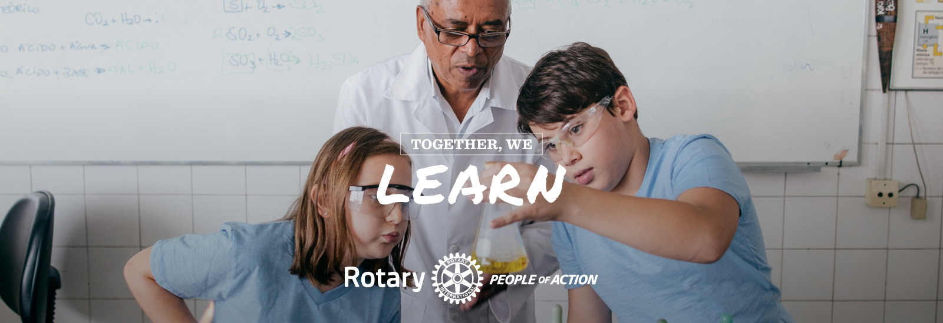
Rotary Lingo
Rotary is full of terms & acronyms, here are a few tips!
Notes:
Lingo Document Link: http://bit.ly/OPRotaryLingo

Slide 13
Rotary Organization Chart
Rotary International
Zone 27
District 5710
OP Rotary Club Members
Board of Directors
Executive Committee
Member at Large
Member at Large
Member at Large
OP Rotary Club Foundation
Foundation Board
President
Past President
President Elect
Vice President
Secretary
Treasurer
Member at Large
Learn more about District 5710 here

Slide 14
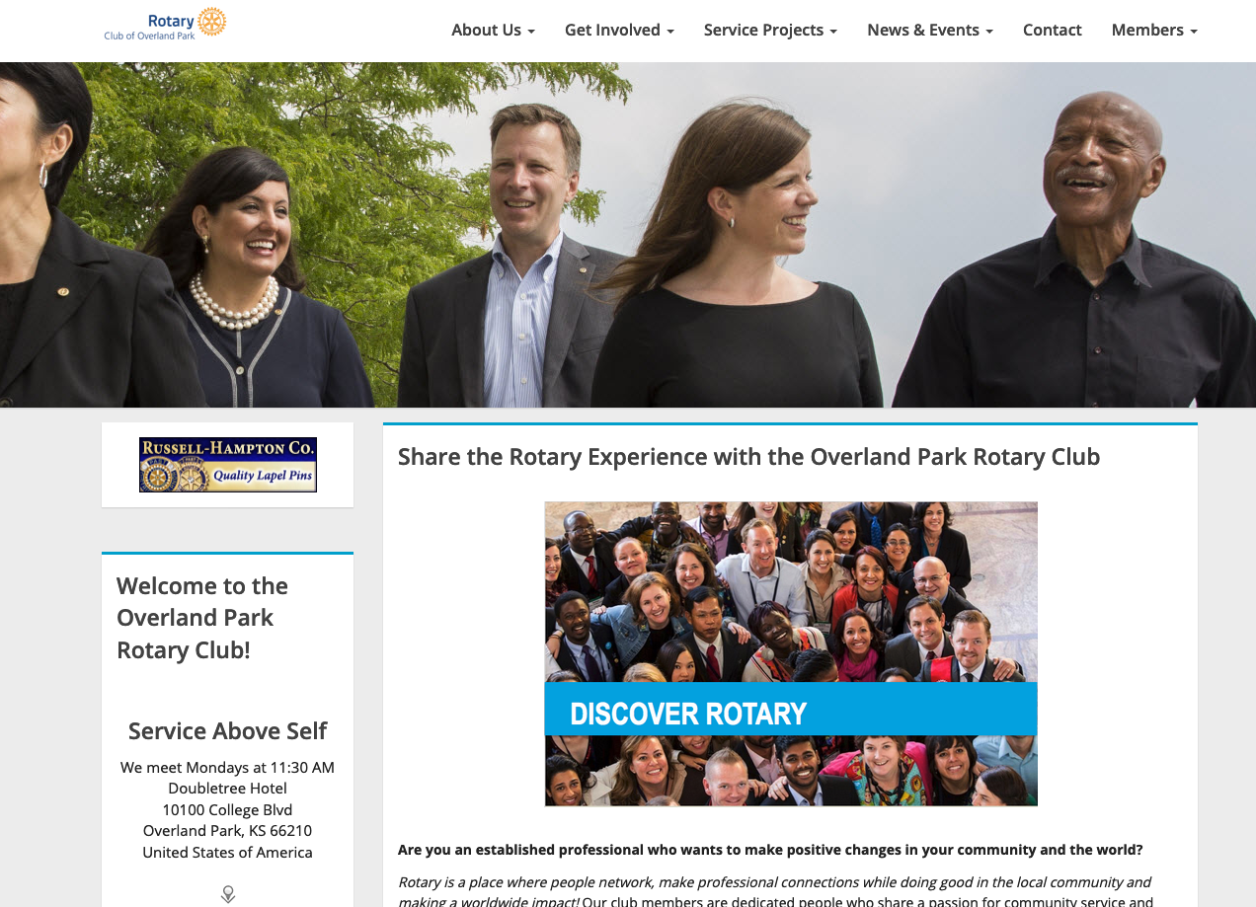
ClubRunner Website
Get to Know Your Club
Create a Profile
& Log In
Learn how to log into your Member Portal here.
Additional ClubRunner Resources are
Available at the Support Center.
Speaker presentations are recorded at in person meetings & available to view on the Club Website.
Notes:
Member Portal: https://www.youtube.com/watch?v=d2XRXZIE6cQ
ClubRunner Support Center: https://www.clubrunnersupport.com/

Slide 15
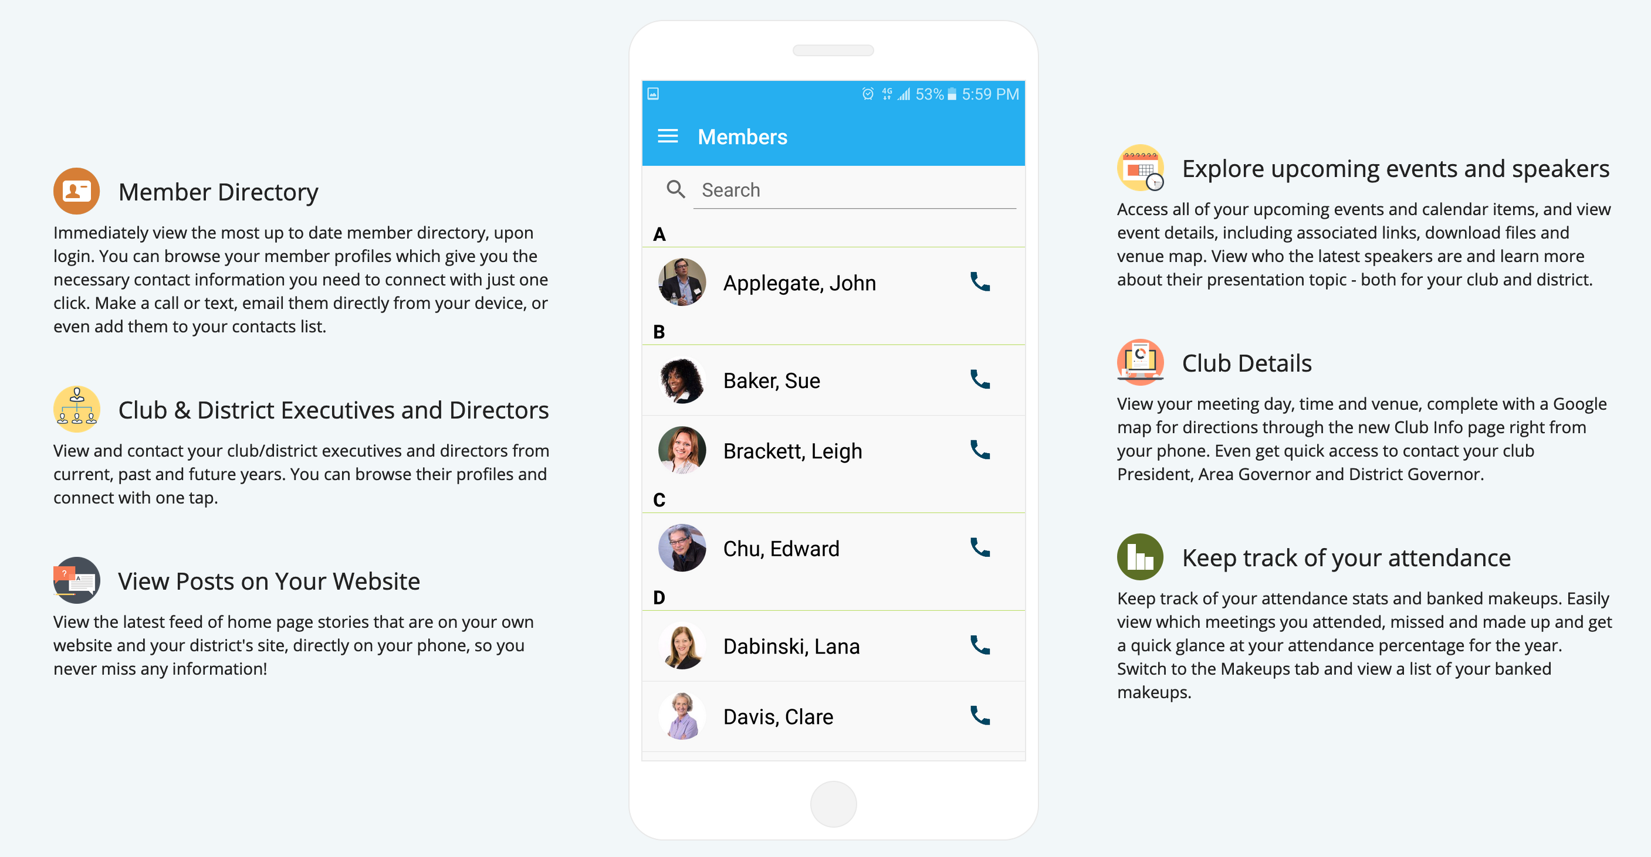
ClubRunner Mobile Phone App
Find Your Club & District Members on the Go!
Download the App for Android or iPhone
Click the Image to
Watch App Video Tutorial
Notes:
Download App: https://site.clubrunner.ca/page/clubrunner-mobile-app-now-available
App Tutorial: https://youtu.be/PFLu08meAHI
Image Link: https://youtu.be/PFLu08meAHI

Slide 16
Club Social Media
Get Connected on Social & Follow Real-Time Club Activities
Notes:
https://www.facebook.com/oprotary/
https://www.linkedin.com/groups/12017944/
https://www.instagram.com/overlandparkrotary/

Slide 17
Learn About Rotary International
Learn About Your Purpose & Worldwide Impact with Rotary International
Rotary’s 2021-2022 Theme: Serve to Change Lives
Global Projects & Causes
Ending Polio
Providing Clean Water
Supporting Education/ Literacy
Promoting Peace
Growing Local Economies
Other Causes
Discover more at the RI Website.
Notes:
https://www.rotary.org/en/our-causes
https://www.rotary.org/en/our-causes/ending-polio
https://www.rotary.org/en/our-causes/providing-clean-water
https://www.rotary.org/en/our-causes/supporting-education
https://www.rotary.org/en/our-causes/promoting-peace
https://www.rotary.org/en/our-causes/promoting-peace

Slide 18
Planned Giving
Consider the option of making a final contribution to sustain your Rotary Club Foundation
or Rotary International.
Learn more about Planned Giving Options at
the Rotary International Website
Or
Speak with the Club Foundation President.
Notes:
https://www.rotary.org/en/donate/planned-giving

Slide 19
Data Collection & Confidentiality
Anonymity & Data Collection Disclosure
The Overland Park Rotary Club is committed to a data collection approach that is confidential. No names, email addresses or personal information is requested or collected at any time except for internal membership reporting processes. All information collected about Members is not shared with any organization or outside the Club or outside of Rotary International.
Data Maintenance & Integrity
All data is maintained in a secure third-party storage facility (Amazon Web Services (AWS)) with full back-ups that comply with industry security/ privacy policies.
The Club website/ membership platform is run on the ClubRunner analytics and website platform provided by Clubrunner.ca.
You may learn more about ClubRunner services and products at their website.
Notes:
https://site.clubrunner.ca/
https://site.clubrunner.ca/page/about-us

