Slide 1

SLiding into home
John Margida, Sr., akron Rotary Club president 2018-2019

Slide 2
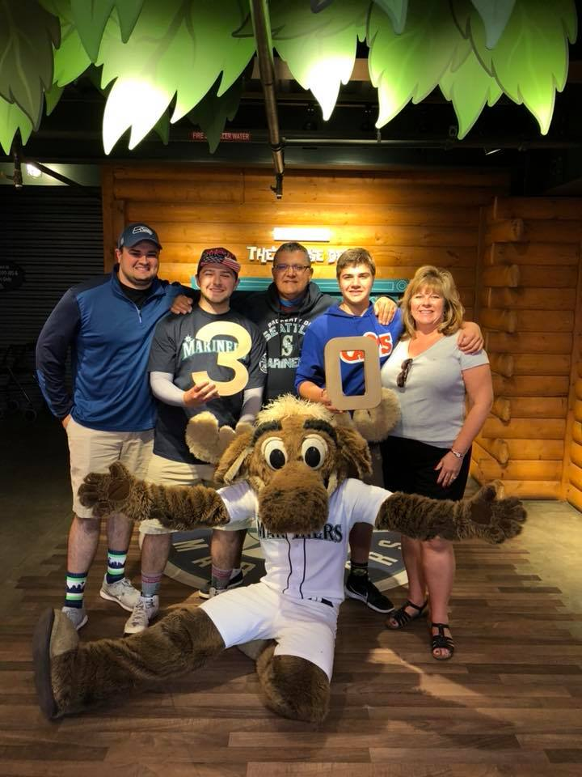
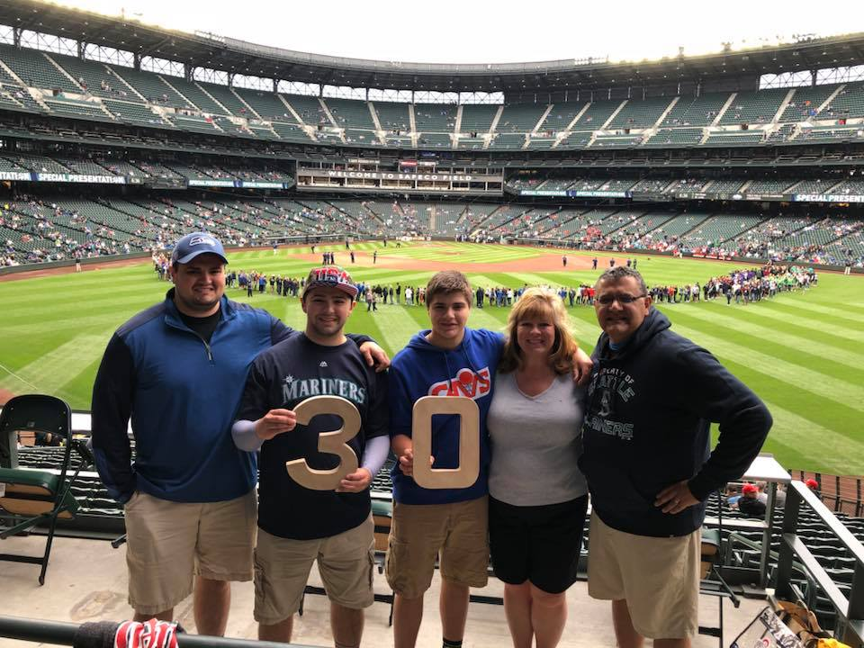
If you take your whole family on a pilgrimage to every major league ballpark, you must like baseball – or at least I was hoping!

Slide 3
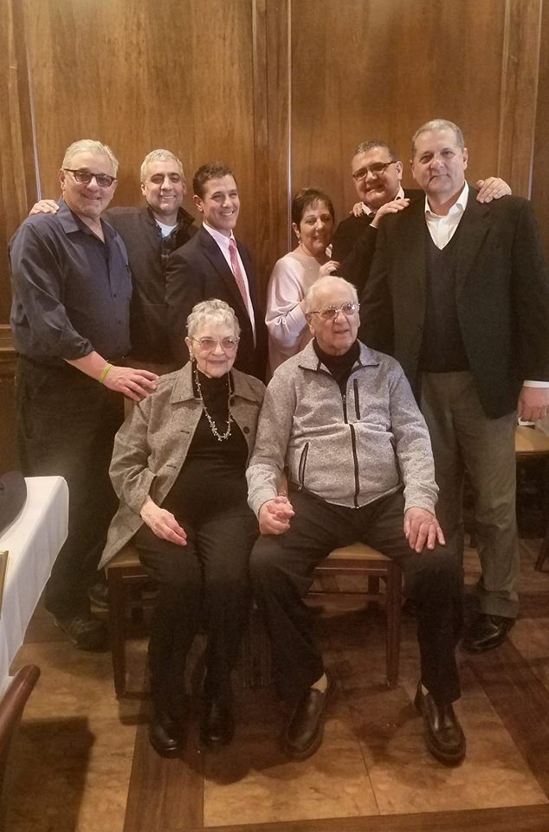
What I really wanted to do was a slide show on john's family and especially his parents – but that’s not the point of tonight

Slide 4
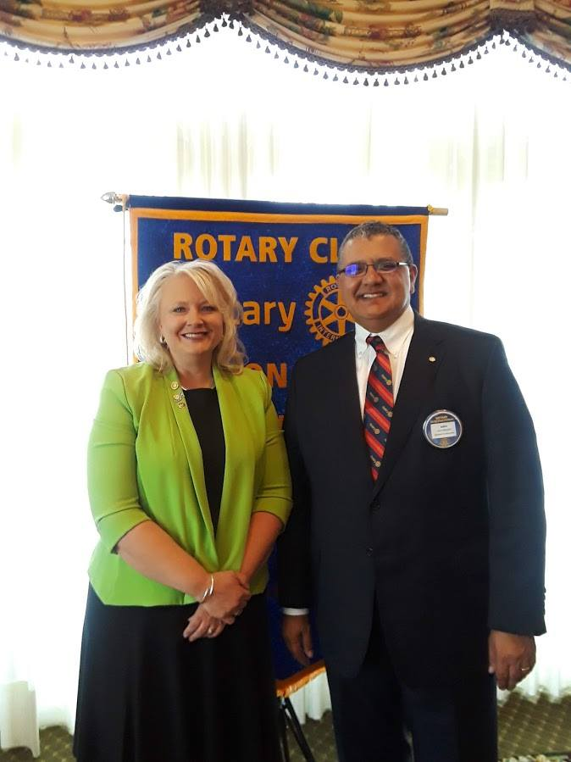
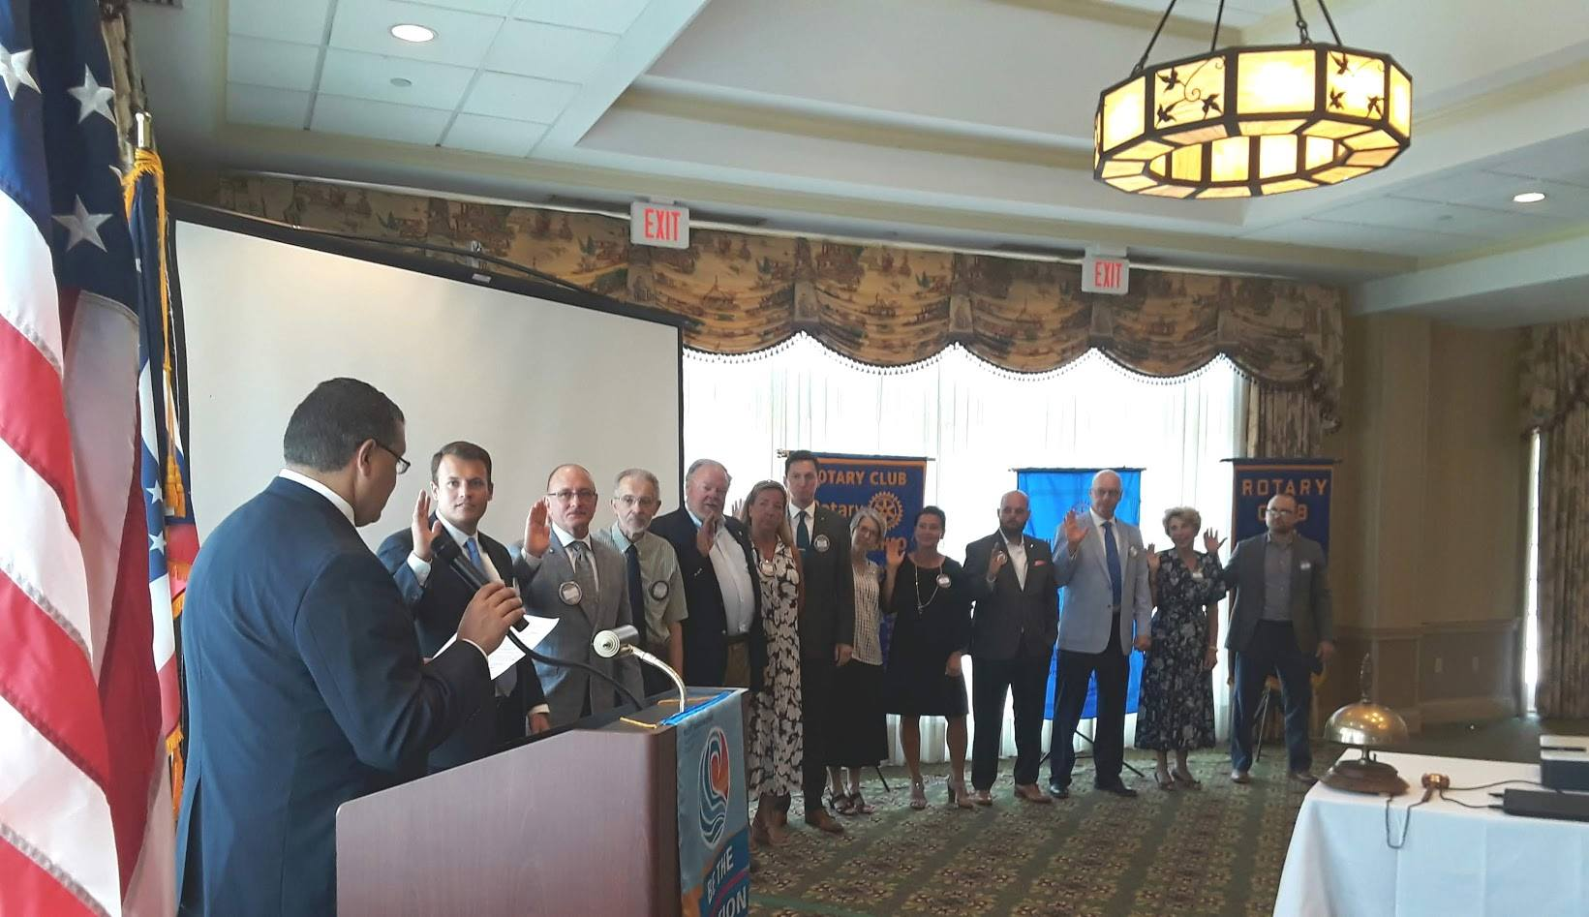
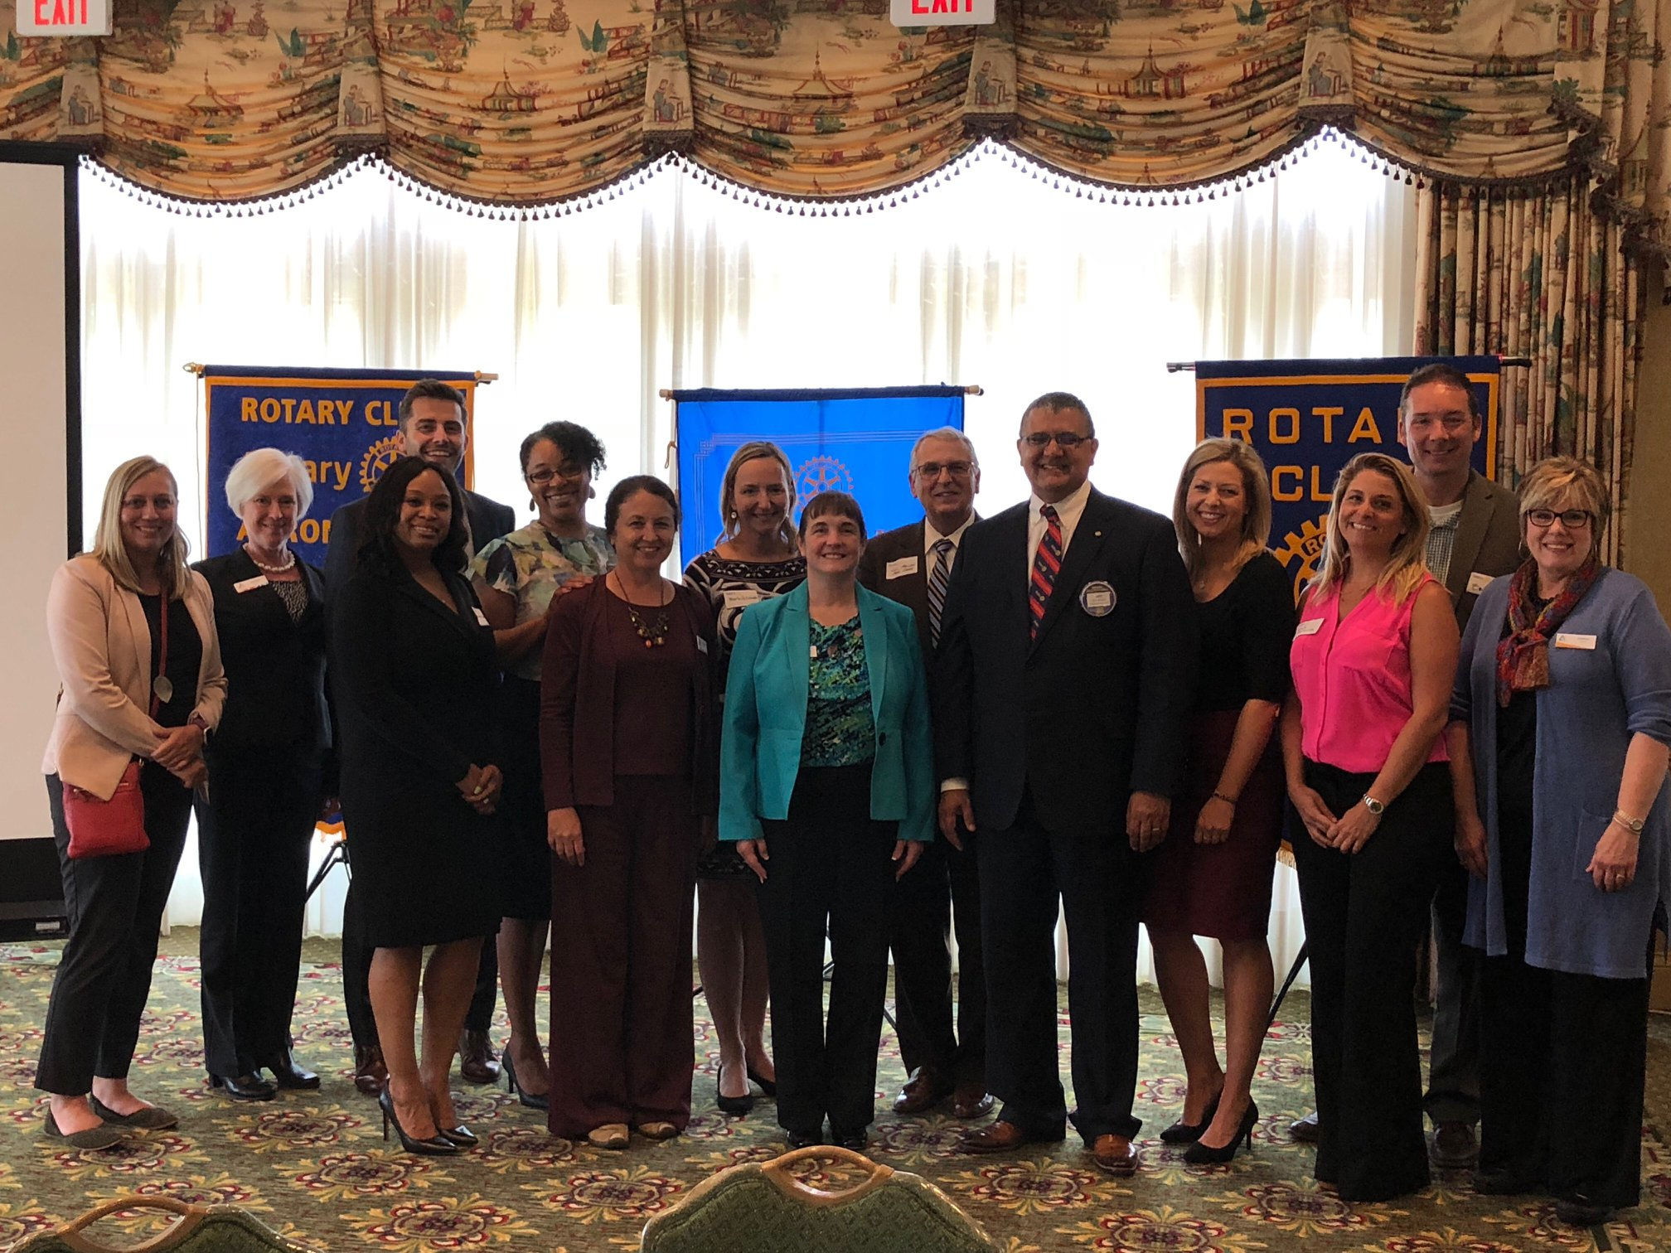
Tonight we thank john for his commitment to Rotary and serving as our club president this year!

Slide 5
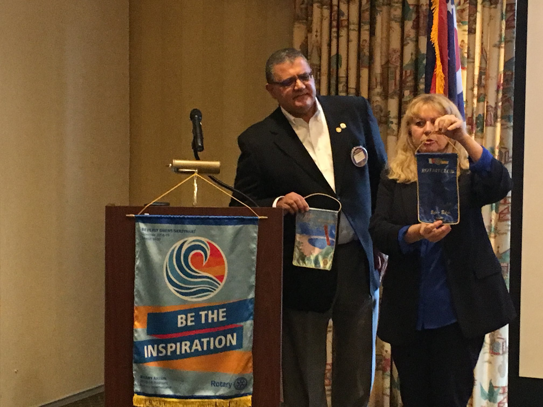
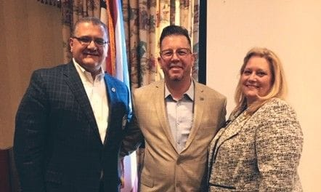
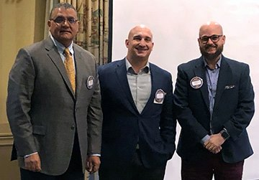
He has shown us a range of emoti0ns...as much as an accountant is able I imagine...there has been wonderment, surprise, excitement (?)

Slide 6
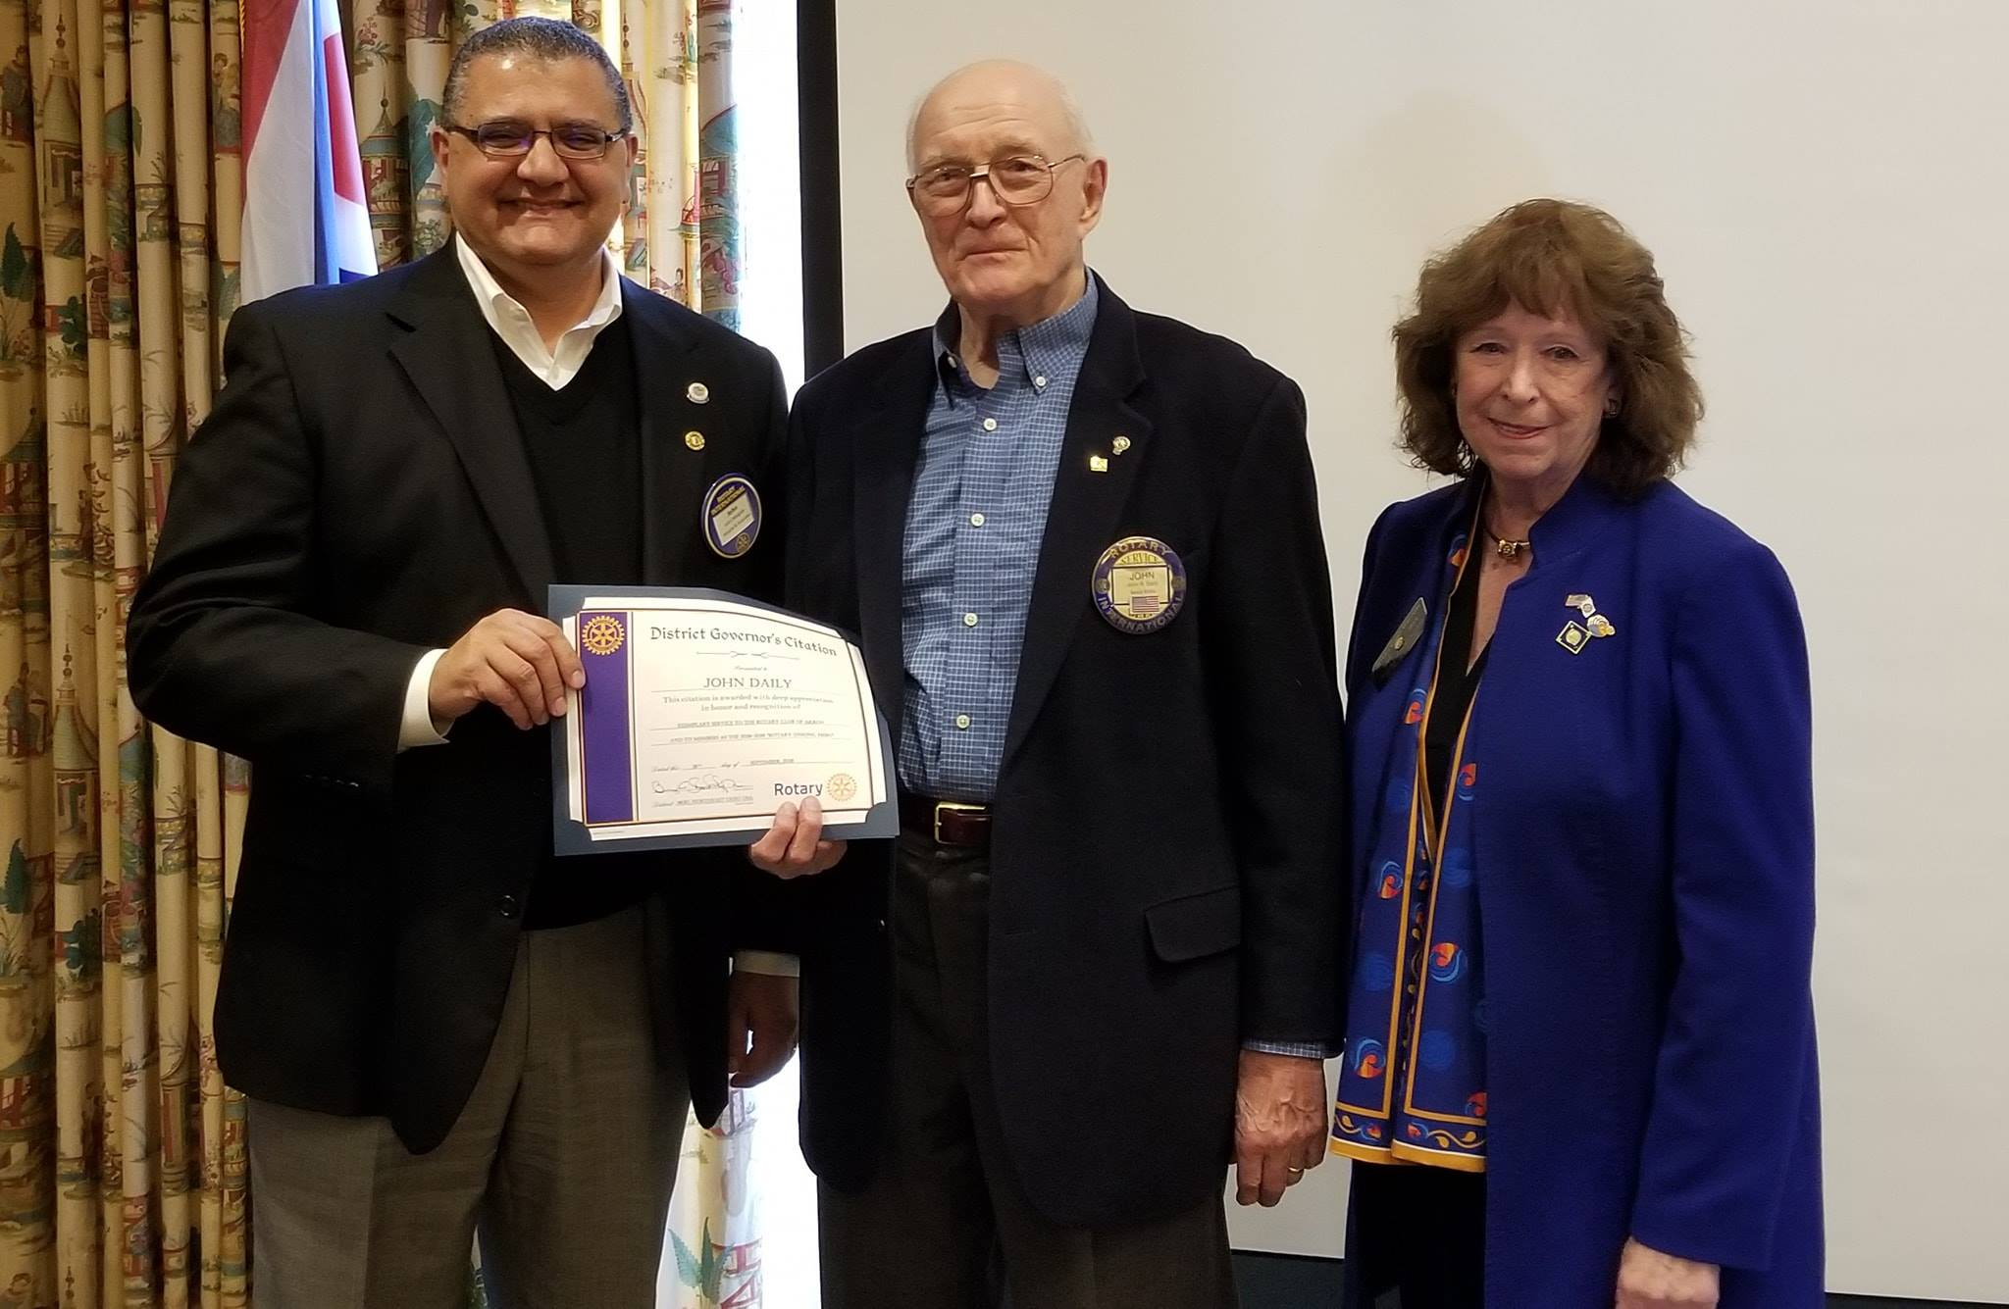
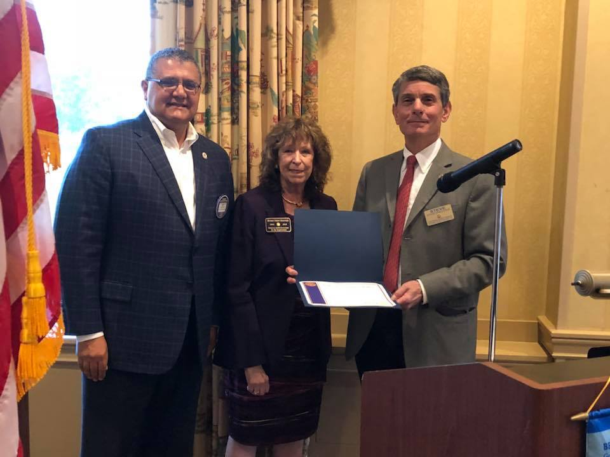
He recognized senior members of our club for their awesomEness!

Slide 7
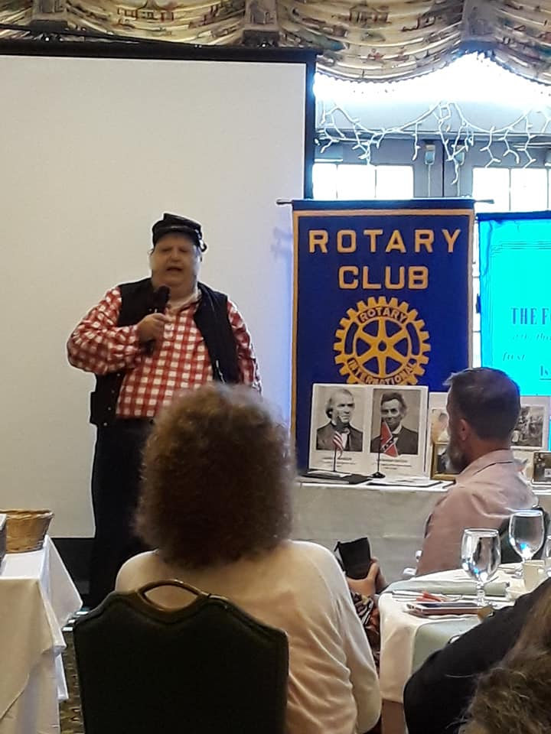
We had some interesting speakers...

Slide 8
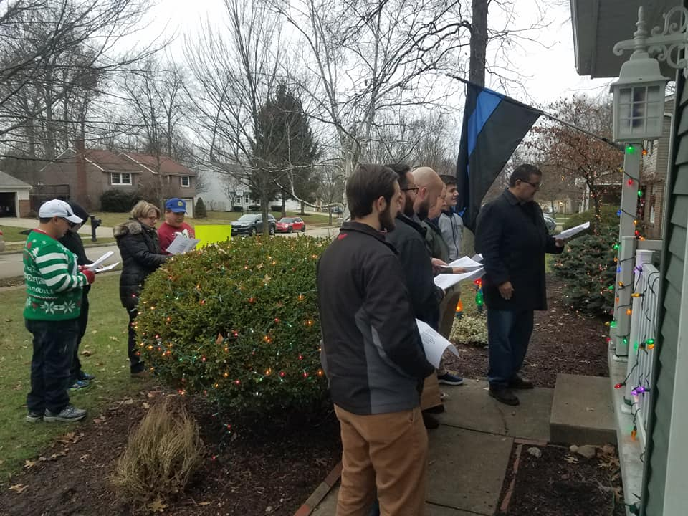
He sang...

Slide 9
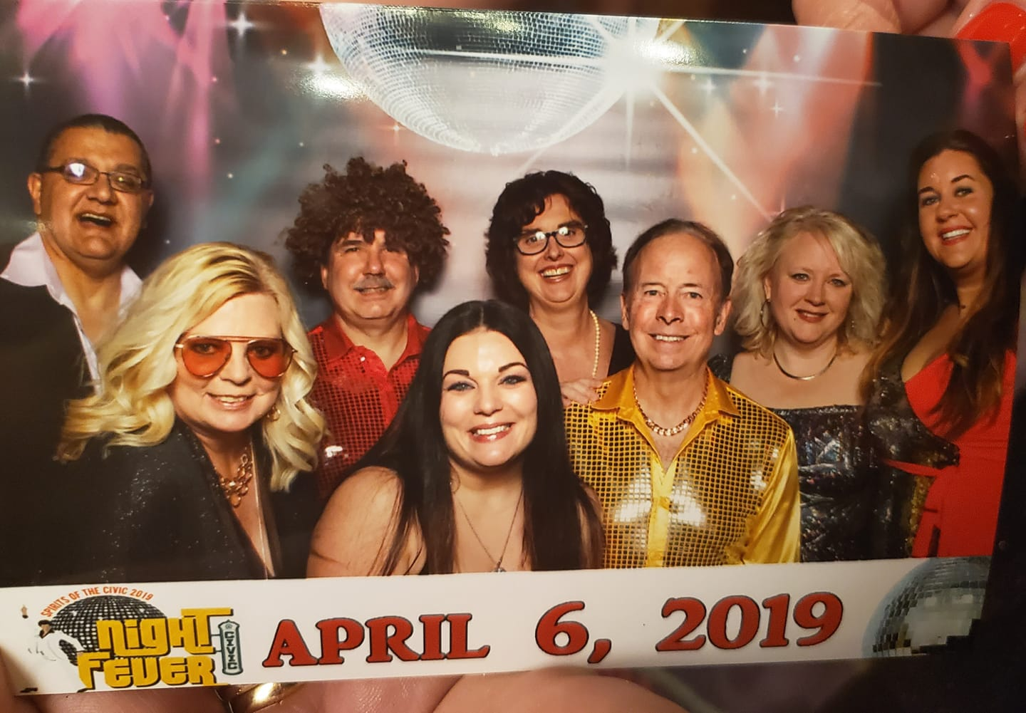
He danced...

Slide 10

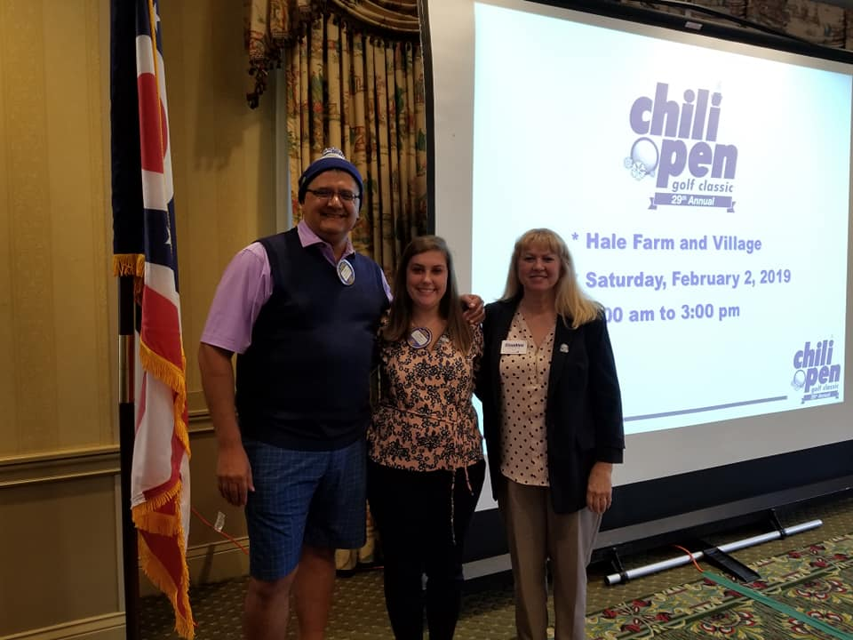
He was definitely at the top of his fashion game.

Slide 11

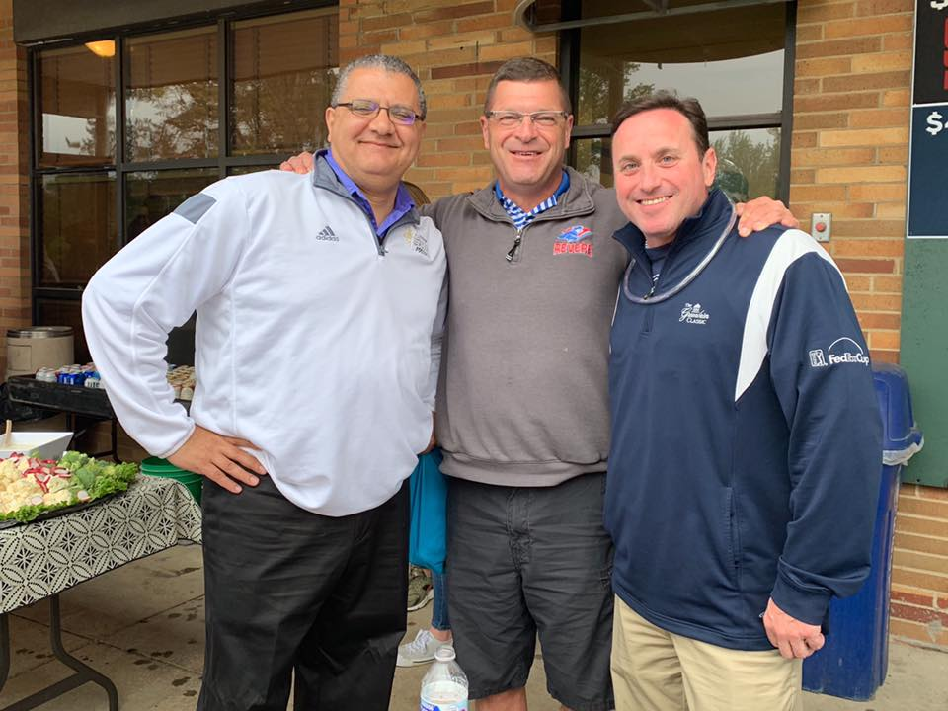
He golfed...

Slide 12
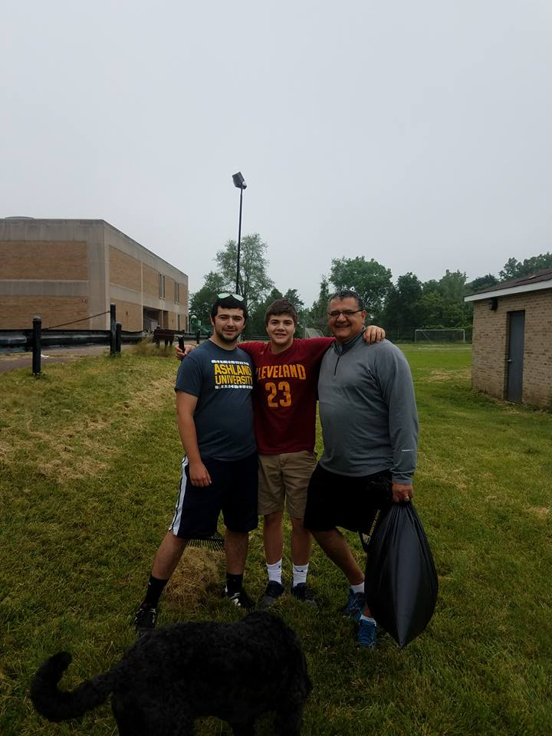
He served...

Slide 13
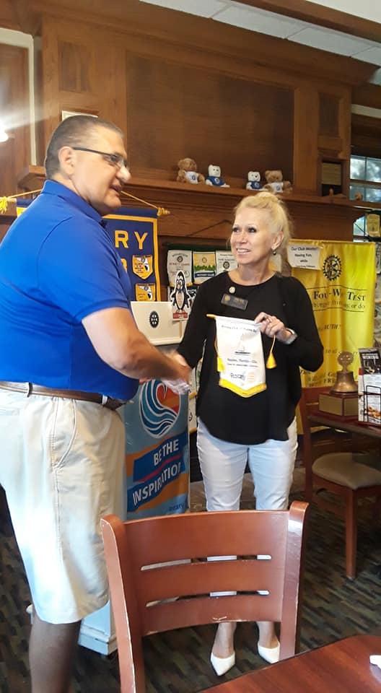
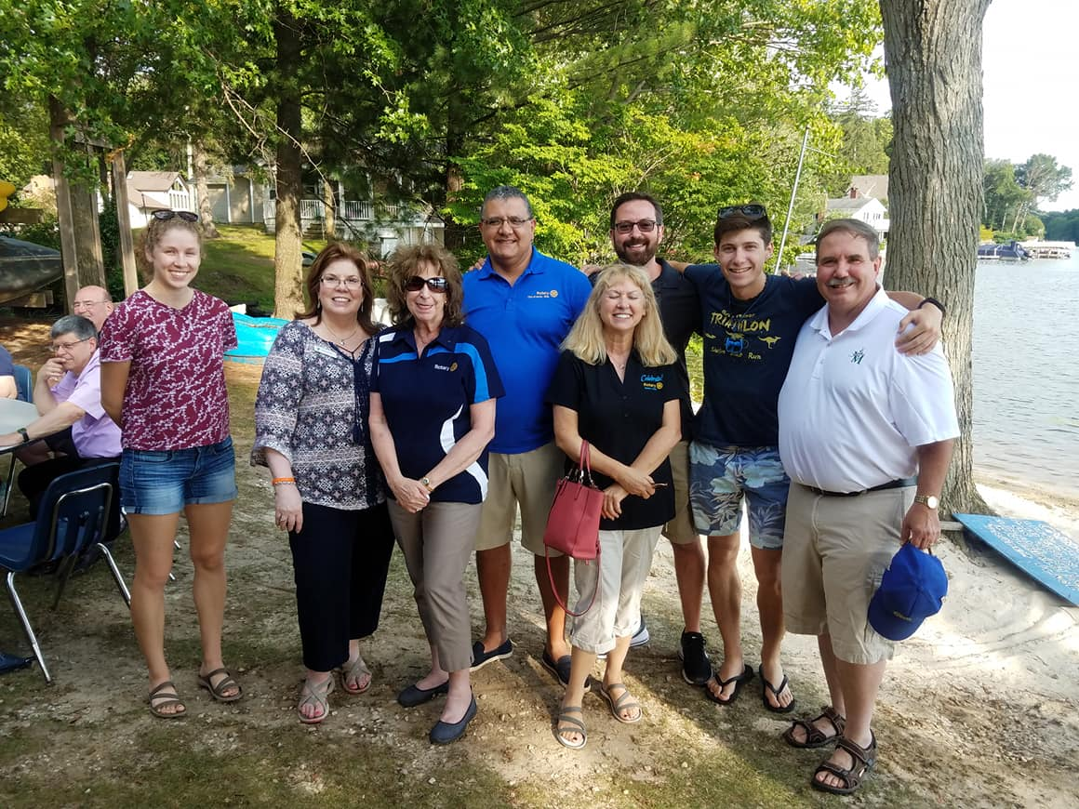
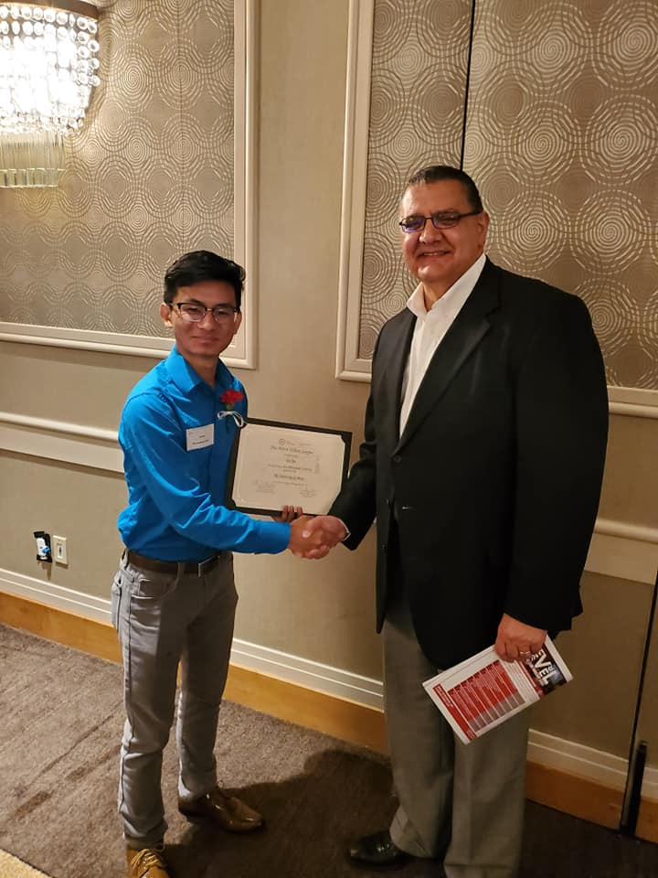
He laughed and shook hands...

Slide 14
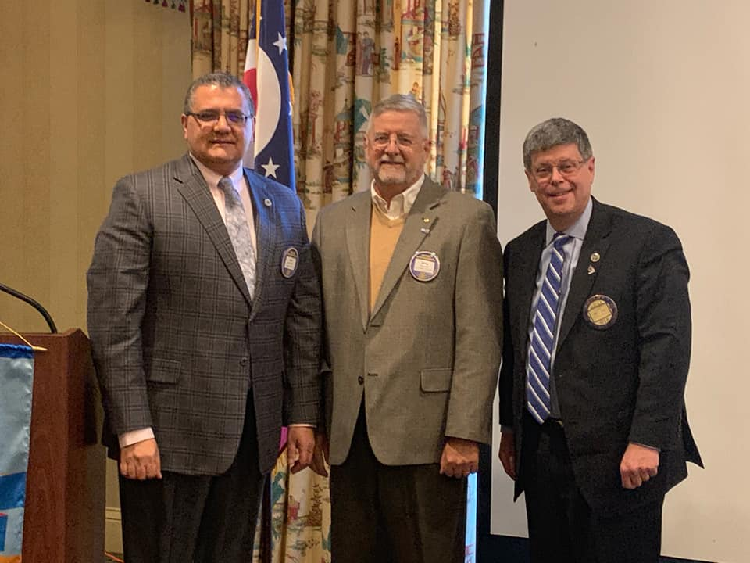
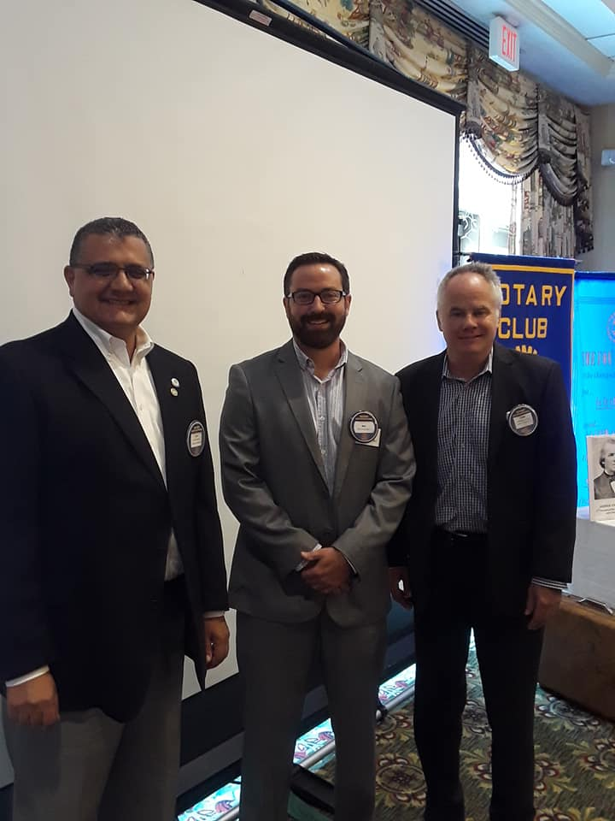

hE SHOOK a lot of hands!
We added 15 new members!

Slide 15

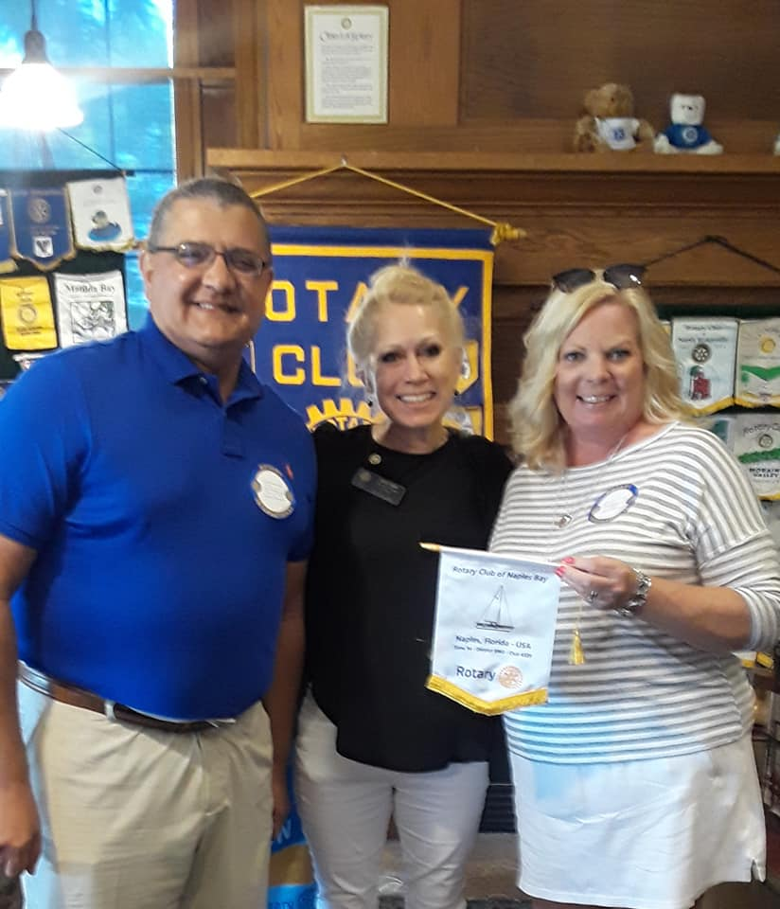
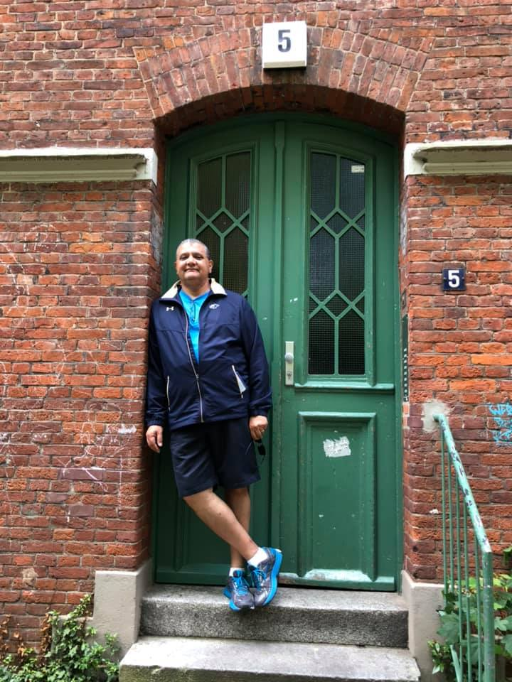
He travelled

Slide 16
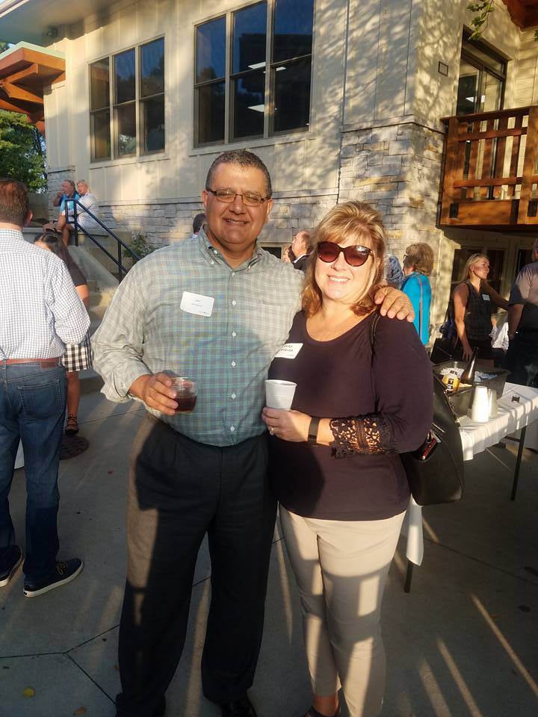

But I'm sure there is nowhere he would rather be than home...thank you mary margida for holding down the fort at work and home and letting us borrow him for the year!

Slide 17
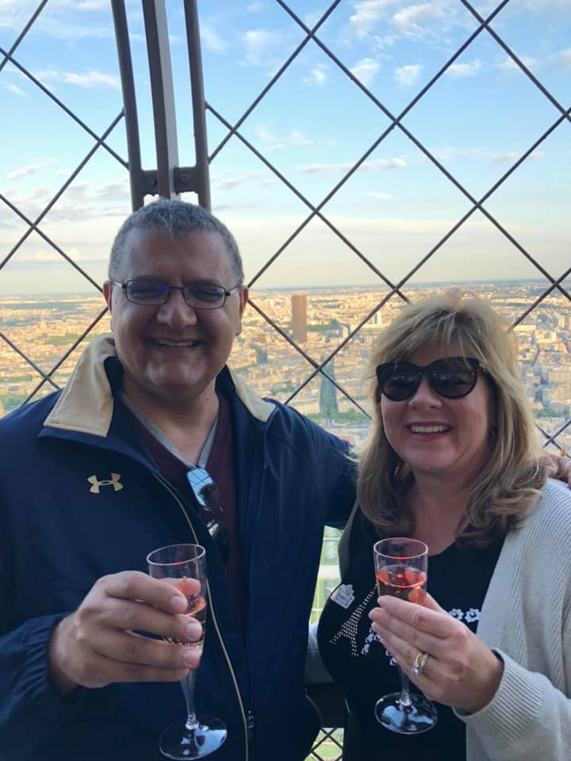


Let's raise our glasses and Congratulate john on a successful rotary year!

