Slide 1


Slide 2
Salvation Army
Bell Ringing
2025 Photo Contest
Results:
THREE FIRST PLACE
TWO RUNNER-UPS
ONE SPECIAL RECOGNITION

Slide 3
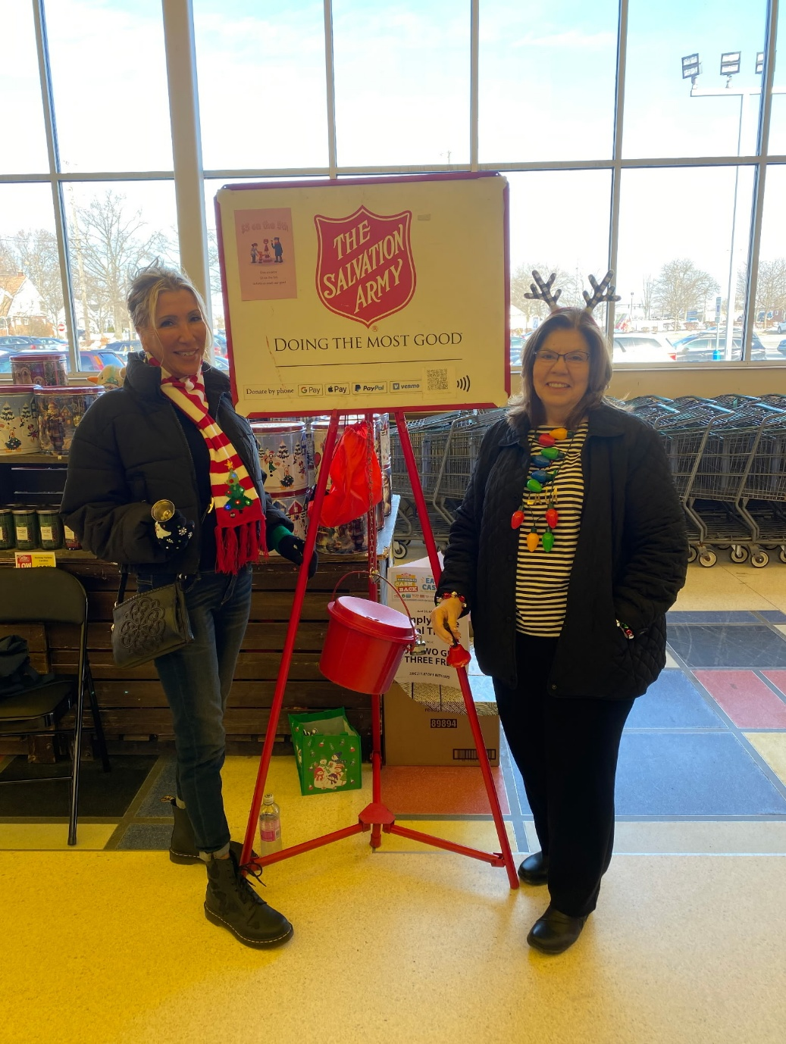
FIRST PLACE
Angie Claypool and Mella Castner
The judges said:
Having fun; definitely in the spirit of the event.

Slide 4
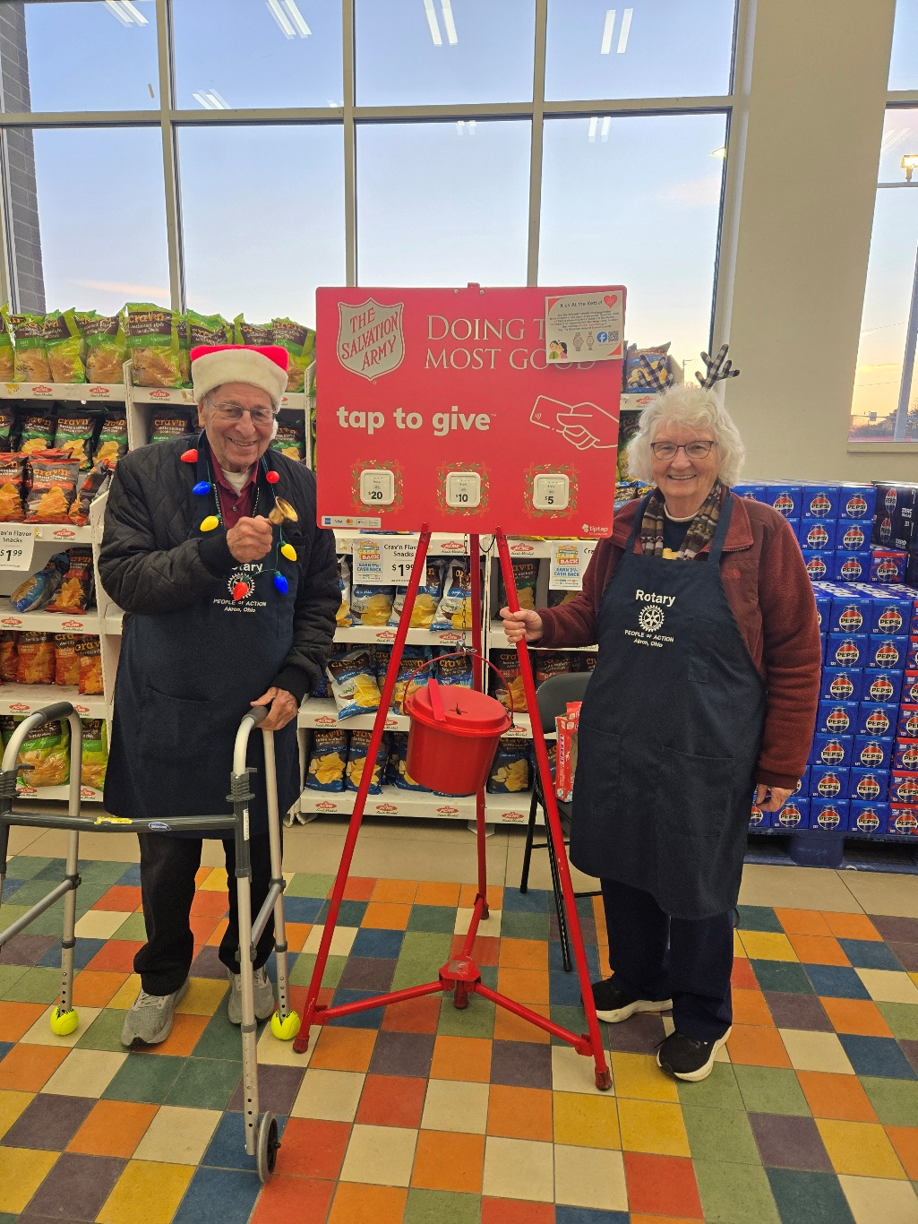
FIRST PLACE
Stew and Cheryl Buchanan
The judges said your spirit really came through the lens!

Slide 5
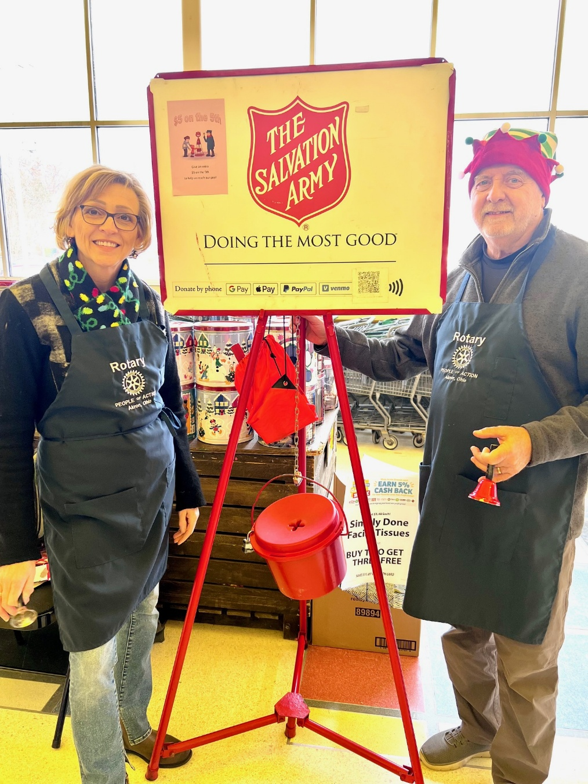
FIRST PLACE
Cyndi Kane and Doug Kohl
The judges said the hat and scarf sell it!

Slide 6
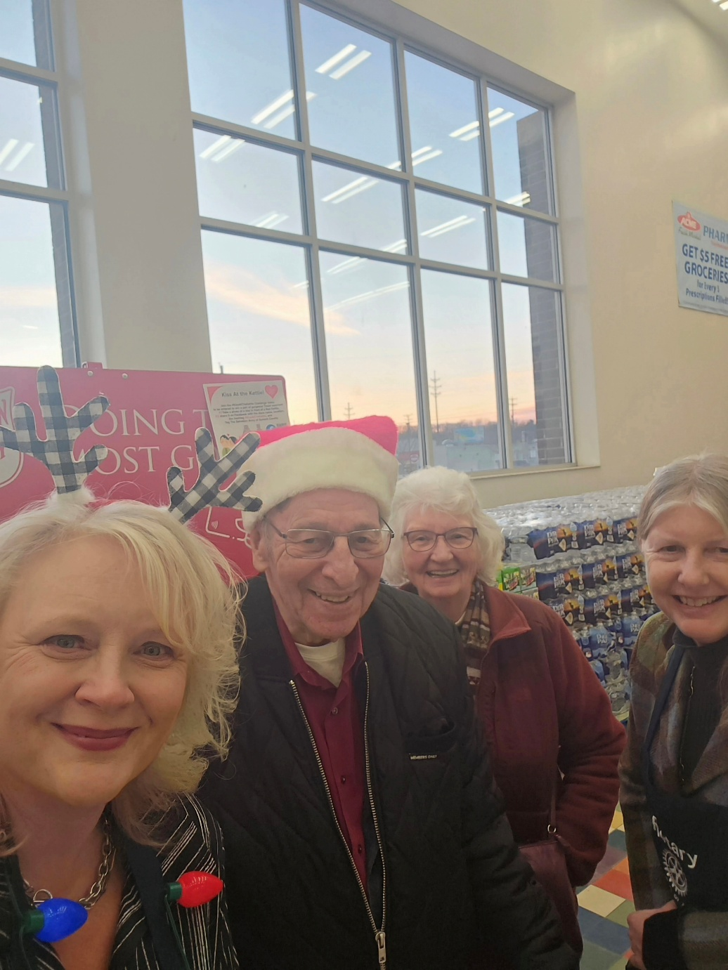
RUNNER UP
The Joyful Foursome
Julie Brandle, Stew and Cheryl Buchanan, Karen Dorn

Slide 7
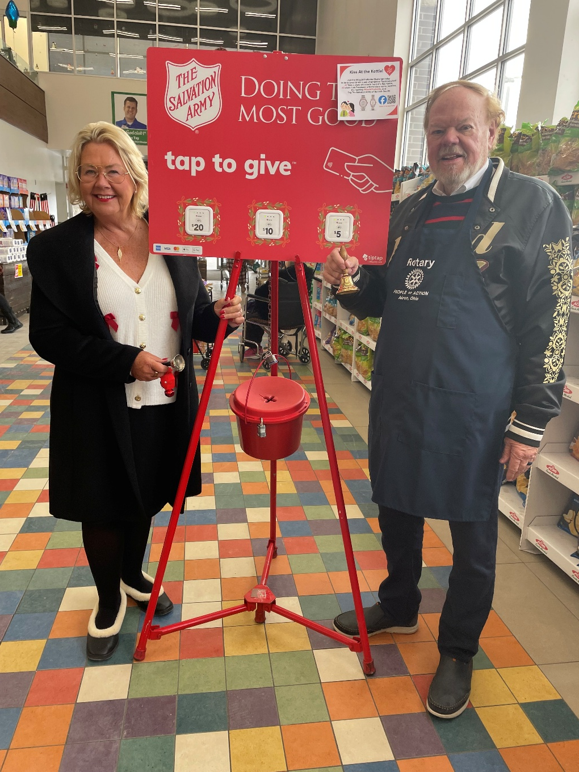
RUNNER UP
Judges love your shoes Karen!
Karen Taylor and Hugh Alpeter

Slide 8
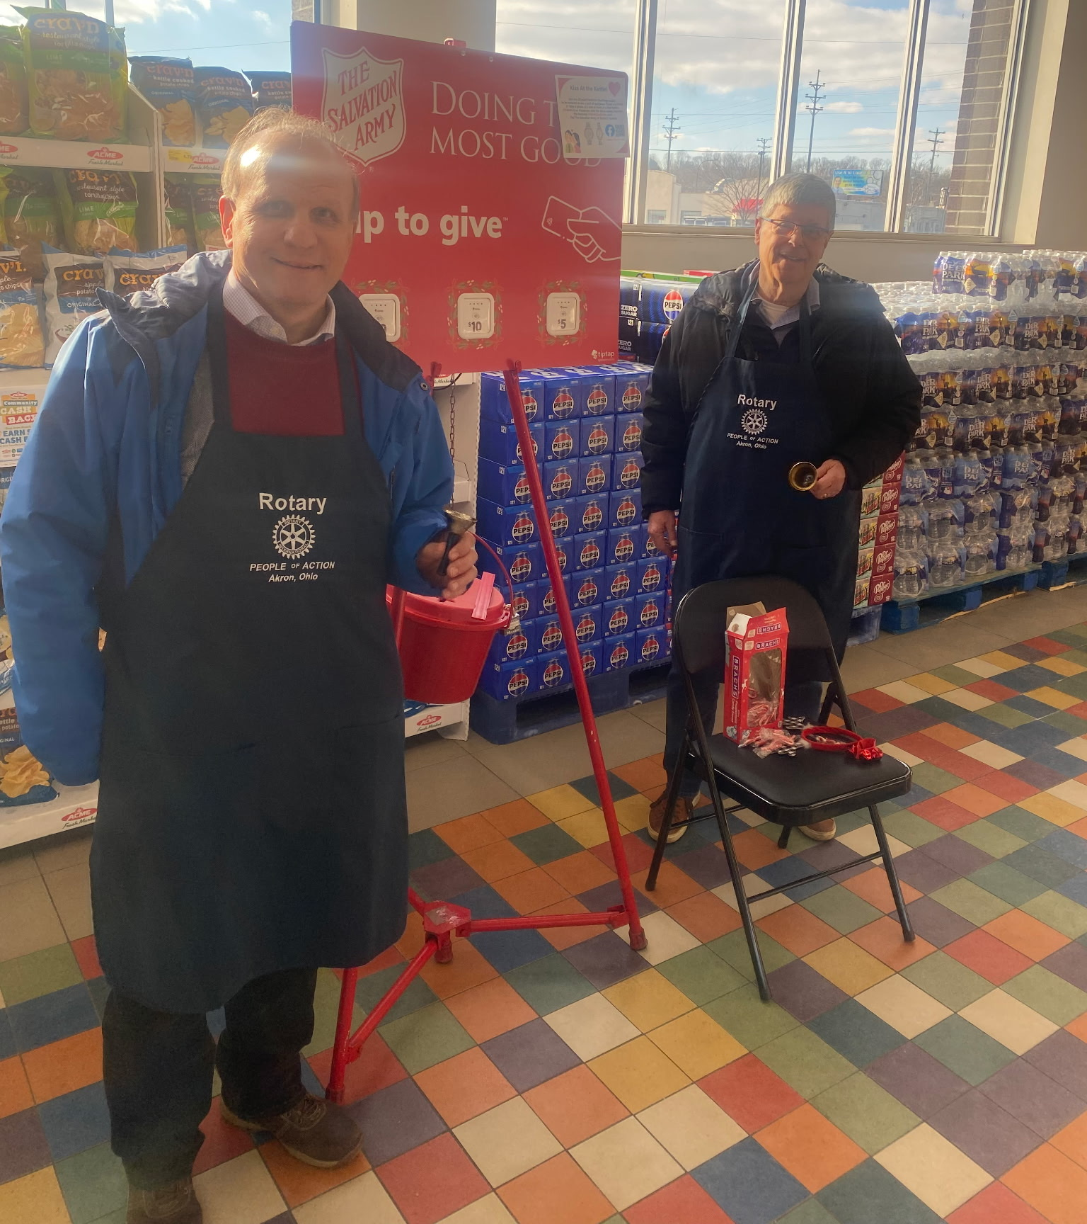
SPECIAL RECOGNITION
All three judges noted that there are halos or an interesting aura appearing on/around you both. One judge said “are those halos or just AI?”
Mark Seward and John Reyes

