Slide 1
Akron Rotary the Ohio Alliance for Arts Education
Presenting to
Jarrod Hartzler, Executive Director
Tuesday, June 20, 2023

Slide 2
The mission of the Ohio Alliance for Arts Education is to ensure the arts are an integral part of the education of every Ohioan.
Our Mission, Values, Actions
We accomplish this through ADVOCACY | CONNECTING | CONVENING | LEADING via shared resources, communications, teaching artists, professional development, and outreach to students, communities and schools.

Slide 3
Our core beliefs inform all actions of the Ohio Alliance for Arts Education:
Our Mission, Values, Actions
• All Ohioans should have access to high quality arts learning experiences. • All students in schools must have high quality arts education opportunities taught by licensed arts educators. • All arts and cultural organizations, and artists play a critical role in arts education. • Teaching artists play a critical role in arts learning. • Partnerships are vital to achieving our goals.

Slide 4
Three Foundational Partnerships Ohio Arts Council Ohio Department of Education Professional Arts Organizations
Advocating, Connecting, Convening

Slide 5
The Ohio Teaching Artist Roster is a collaborative partnership with the Ohio Arts Council, Ohio Alliance for Arts Education, Art Possible Ohio, and Ohio Dance.
Connecting and Convening
The Roster selects >50 accomplished teaching artists who share their talents in teaching residencies in Ohio schools and communities– in visual arts, dance, music, poetry and writing, theater and other disciplines. Teaching Artists receive ongoing professional development and resources to support their growth as artists and educators.
Learn more, visit: oac.ohio.gov/Resources/Ohio-Teaching-Artist-Roster

Slide 6
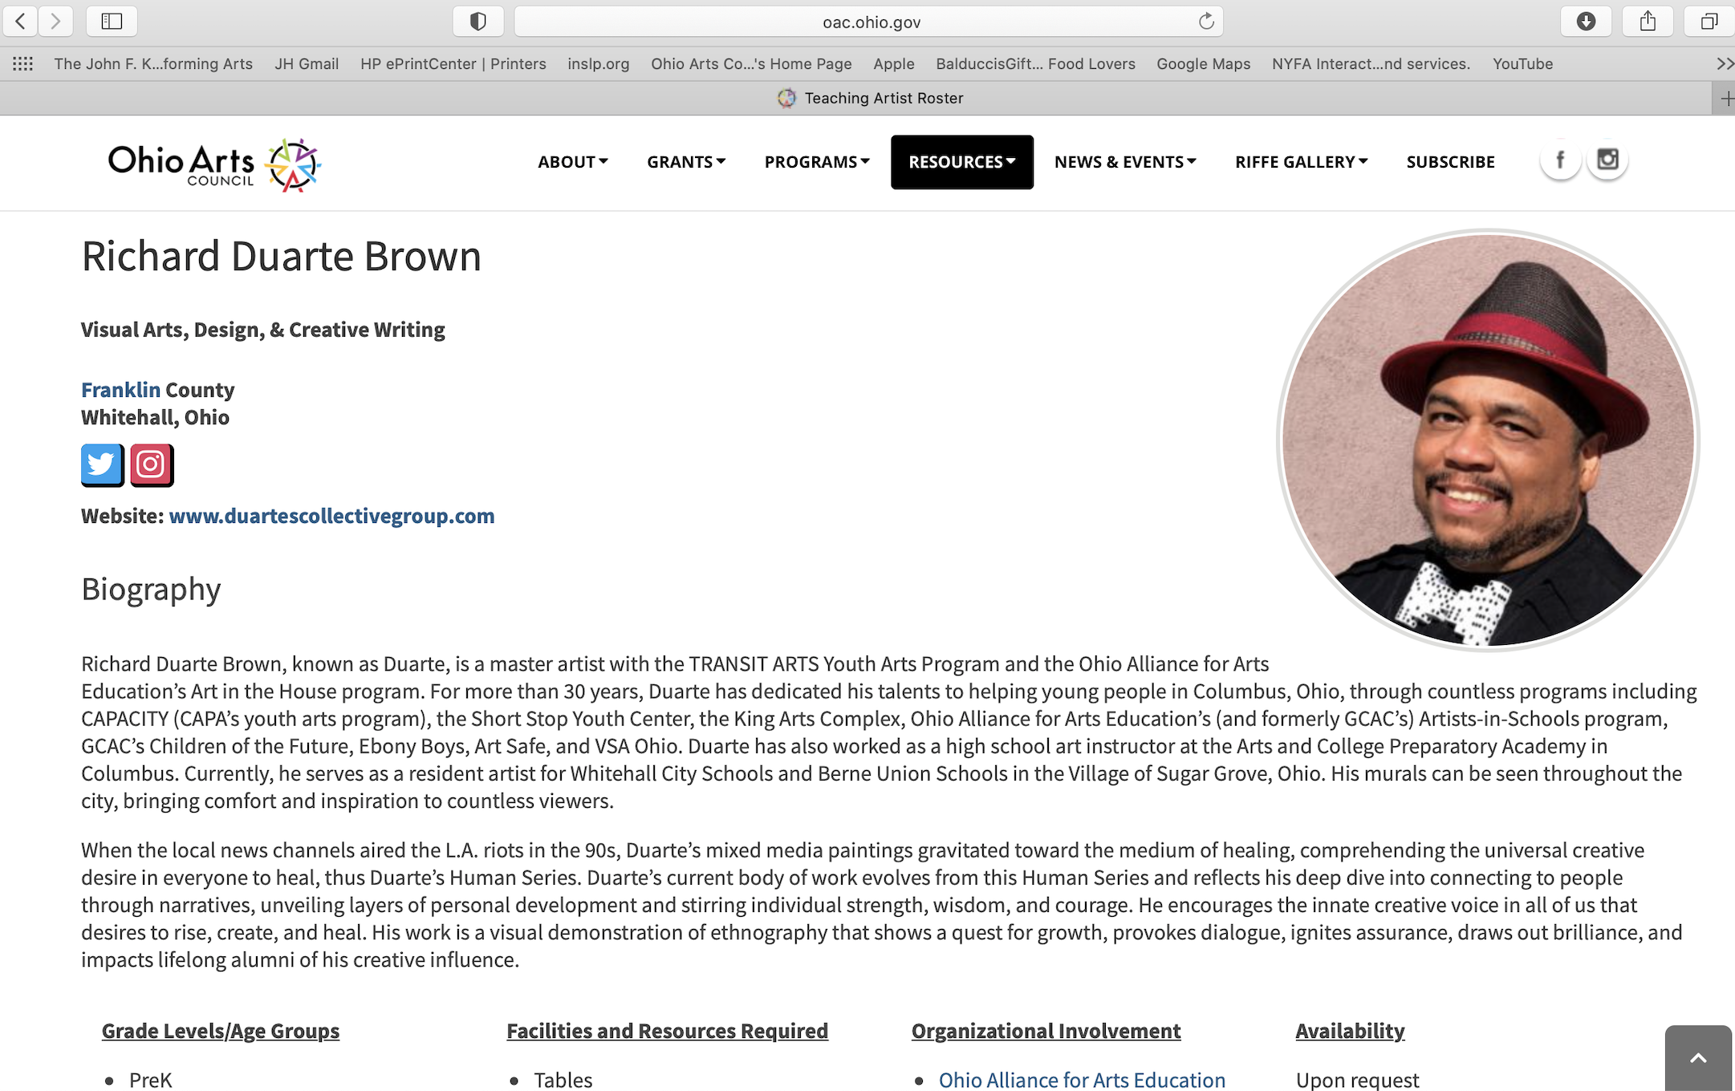
Connecting and Convening

Slide 7
TeachArtsOhio The Ohio Arts Council, TeachArtsOhio, awards grants that provide artist residencies that can be customized for PK-12 students in Ohio schools. This program connects schools, community organizations and teaching artists to share personalized, high caliber and engaging arts learning experiences.
Connecting and Convening
Learn more, visit: https://oac.phio.gov/Portals/0/grants/Guidelines/TeachArtsOhio..pdf

Slide 8
Arts Partnership Grant Program The Arts Partnership Grant Program, awards arts education projects that address the needs of individual learners and their communities. Grant recipients engage in collaborative planning. They emphasize comprehensive study of the arts, and use arts-learning outcomes, and established, standards-based arts education practices. By supporting these projects, the Ohio Arts Council strengthens arts education locally, regionally and statewide.
Connecting and Convening
Learn more, visit: https://oac.phio.gov/Portals/0/grants/Guidelines/Arts-Partnetship.pdf

Slide 9
Helen Buck Pavlick Ohio Department of Education Donna Collins Ohio Arts Council Jane D’Angelo Ohio Dance Patricia Santanello Ohio Educational Theatre Association Dan Ruckman Ohio Music Education Association Gayle Trueblood Ohio Art Education Association
Convening Partners, People and Organizations
The Ohio Alliance for Arts education brings together Statewide Education Leaders

Slide 10
• Blurred Borders for Arts Education • Building Bridges for Arts Education • Collaborative for Arts Education in Ohio • Ohio Kennedy Center Collaborative • Workshops, presentations and annual professional development conferences
Convening Partners, People and Organizations
Leaders providing support and resources for Ohio Arts Educators

Slide 11
Ohio’s Kennedy Center Collaborative Ohio is proud to host three Kennedy Center Partners in Education teams in: Mansfield • Springfield • Wooster and one Any Given Child site in: Warren-Youngstown These partnerships of arts organizations and schools provide professional development for classroom teachers for training to gain expertise in arts Integration.
Connecting and Convening

Slide 12
Each year, the Ohio Alliance for Arts Education (OAAE), the Ohio Arts Council (OAC), and all four Kennedy Center sites partner, to present a powerful, two-day arts integration conference and training. The 2023 conference will take place Wed.- Thur., August 9-10, in Springfield. Participants from all across Ohio will attend.
Connecting and Convening

Slide 13
Ohio Arts Education Data Project is a new, robust tool which offers agile reporting and rich data collected by the Ohio Department of Education’s EMIS system, This data supports best practice decision-making and advocacy.
Advocating
Multiple views are available to explore data and comparisons for every school district in Ohio. Views include: participation overviews and deep-dive information, course offerings and more. Find and explore the Dashboard on our OAAE website: https://oaae.net/ohio-arts-education-data-project/
in partnership with

Slide 14
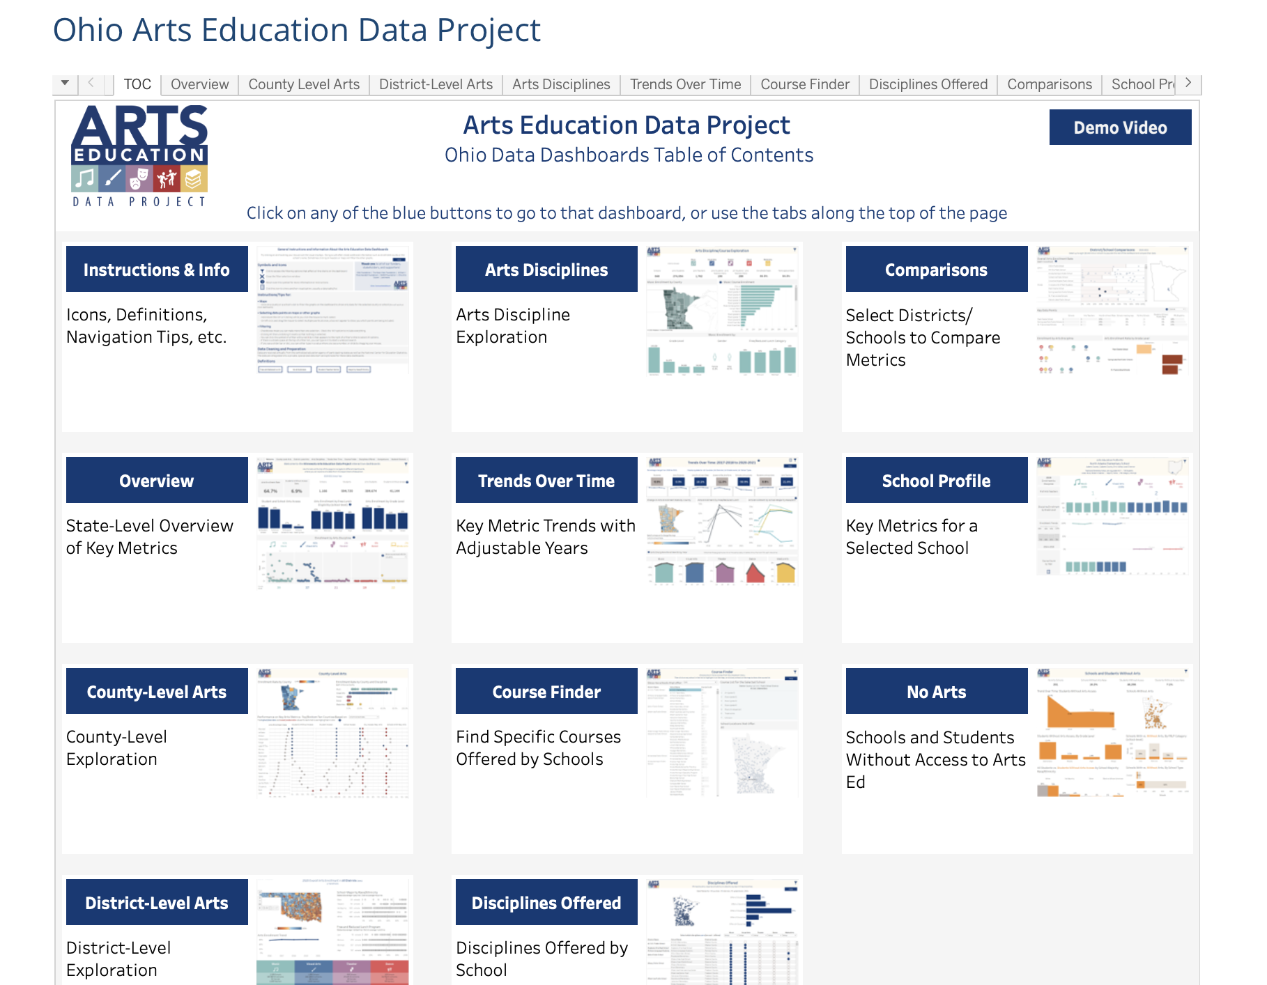
Advocating

Slide 15
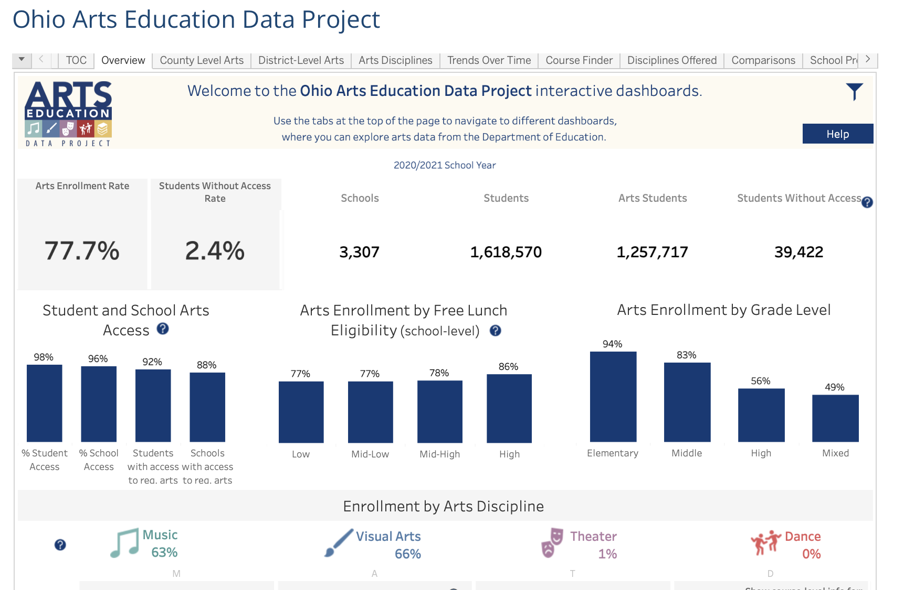
Advocating

Slide 16
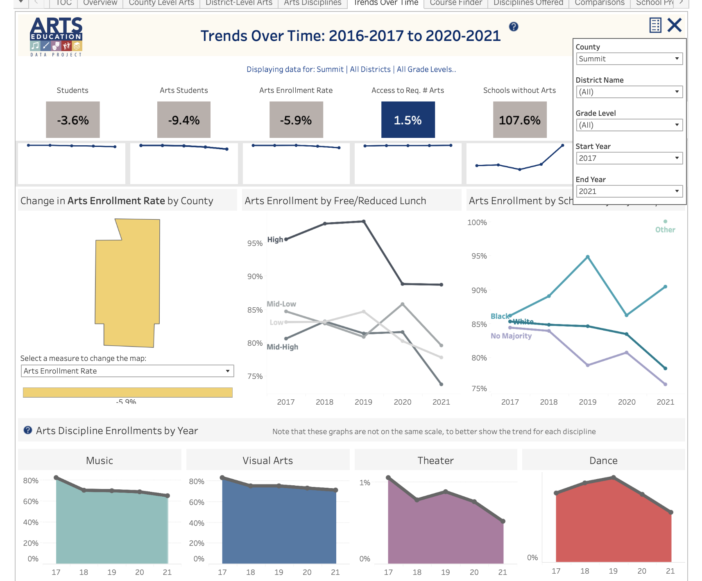
Advocating

Slide 17
The Arts Online Newsletter is filled with critical arts legislation, arts news and interests. We gather, distill and deliver it to you weekly in easy-to-digest bites. It’s free and you will stay informed.
Advocating, Connecting, Leading
Sign up here: oaae.net/join-our-mailing-list/

Slide 18
As legislation and news that impact the arts in Ohio evolve, we have easy-to-use tools to help you contact and advocate for the arts, to the appropriate people at the right time. Together, we can make a difference!
Advocating, Connecting, Leading
Arts Allies ACTION ALERTS
Sign up here: oaae.net/join-our-mailing-list/

Slide 19
• Arts Online Newsletter • Arts Allies Action Alerts and communication tools • Website access to advocacy materials - Talking points - Supporting documentation to value the arts - Interview questions for legislators and candidates - Conditions required for effective and excellent arts education
Advocating
Ohio Alliance for Arts Education provides you with tools and information to support your arts advocacy all available to you…

Slide 20
• Subscribe to and read Arts Online and stay informed. • Take action on Arts Allies Action Alerts which subscribers will receive. • Write letters, emails and post on social media in appreciation of art teachers, advocates and legislators. • Write letters, emails and post on social media to legislators and administrators about issues impacting arts education. • Practice and share talking points provided on our website. • Attend arts programming in your communities and beyond. • Invite friends and family to discuss issues impacting arts education.
Advocating
What you can do…

Slide 21
• Clarify, write down the message you want to share. Have a goal for your message and state it directly. • Be informed on your message topic; familiar with background, history and current information. • Use advocacy tools we provide. • Make, take opportunities to interact, network and meet with policy-makers, board members, peers, anyone who will listen! • Be persistent. Advocacy is a process. Be an arts advocate! • We’re here to help, contact us!
Advocating
Prepare for great advocacy work

Slide 22
info@oaae.net
Thank you for your time and interest!
Please let us know how we can support you.
Jarrod Hartzler, Executive Director

