Slide 1
On the Road to a Polio Free World
Stephen Zabor

Slide 2
Iron Lung
In 1959, there were 1,200 people using tank respirators in the United States.
In 2017 there were still at least 3 people in an iron lung.

Slide 3
Brief History
1955 -- Jonas Salk’s vaccine approved
1963 -- Albert Sabin’s oral vaccine approved
1979 -- Last Indigenous case in US
-- First 3H grant approved for the Philippines
-- Don Kwait was on the R. I. Board
1980 – Jonas Salk spoke to the RI Convention
1985 – Rotary declares the eradication of polio as a corporate goal
1988 -- The Global Polio Eradication Initiative Formed

Slide 5
Four Reasons to travel to India for an NID
Inspire and boast the morale of the local Rotarians and health workers
Demonstrate to those refusing the importance of vaccination
Raise awareness and be an advocate for the task at hand
4. I had been donating to PolioPlus since 1988
Notes:
Three reasons
. We were there to provide a morale boast for the Rotarians, WHO and UNICEF workers and local health workers who have been toiling for years to eliminate the threat of polio in India. A second reason was to demonstrate to those who were refusing the vaccine that it is important enough for us to travel around the world at our own expense to maintain India polio free.
When polio was active in India in one NID initiative there were
640,000 vaccination booths
191 million homes visited
172 million children vaccinated

Slide 6
India
One third the size of the United States
1.3 Billion people
Four times the number of people in the United States
15 official languages
80% Hindu and 14% Muslim
$6,200 per capita Gross Domestic Product
One eighth the US per capita GDP
300,000,000 without electricity

Slide 7
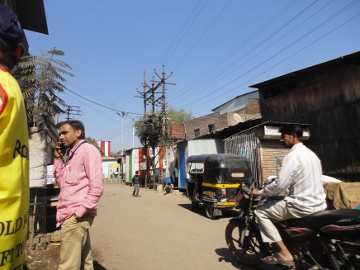
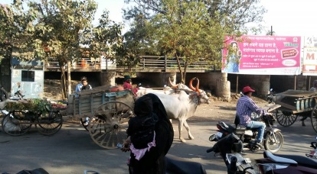
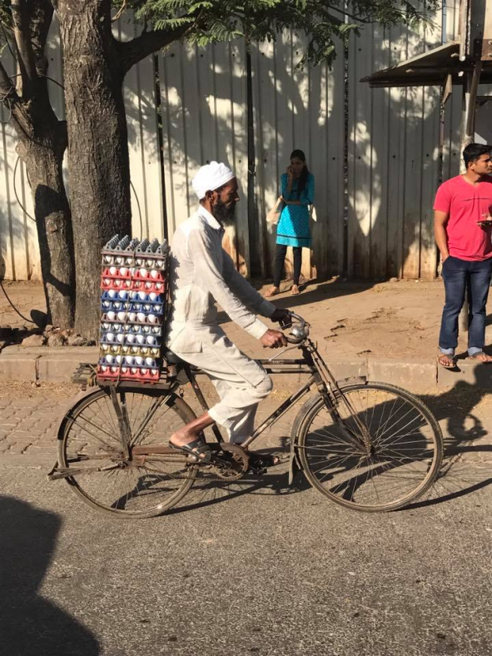
Modes of Transportation

Slide 8
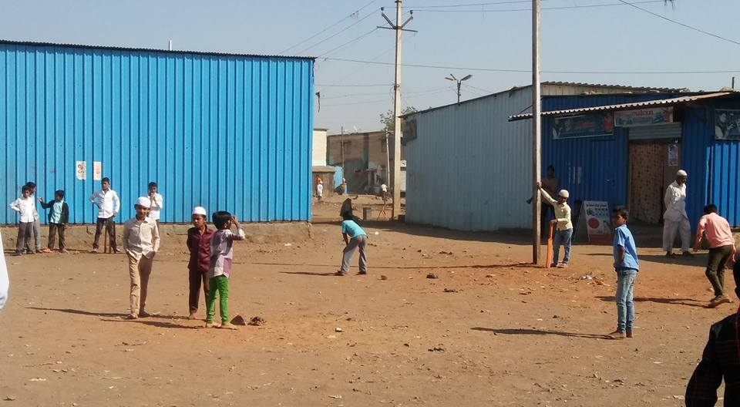
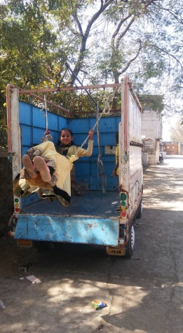
Children at Play

Slide 9
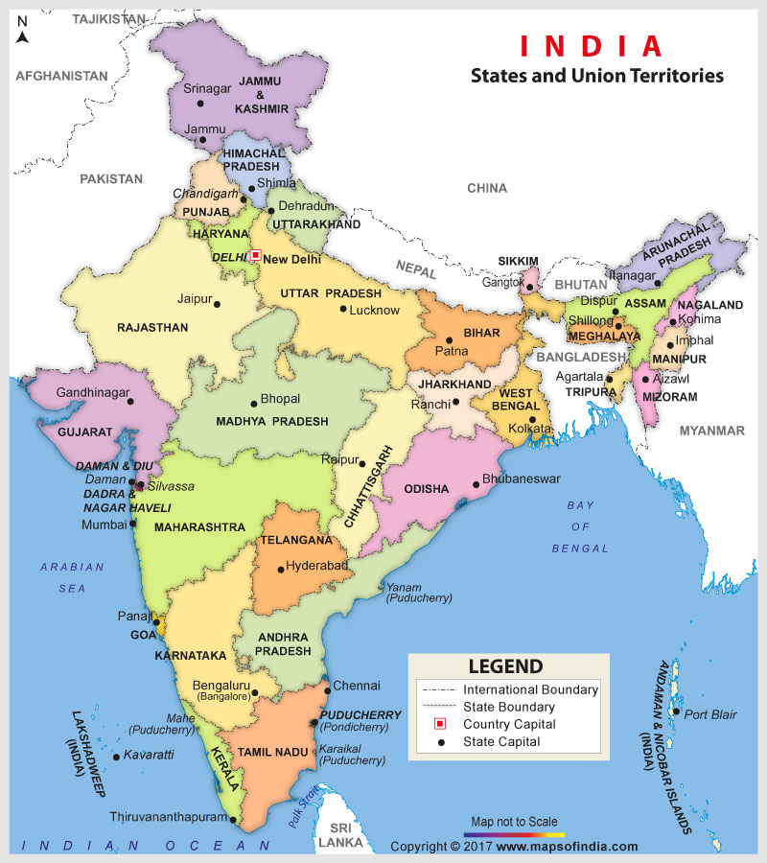
Mumbai and Malegaon

Slide 10
Sociodemographic Data - Malegaon, India
Total Population | 637,297
Total Population 0-6 years | 126,065
Literacy Rate | 73.27%
Muslim Population | 80%
% below poverty line | 65%
Power Looms | 250,000

Slide 11
Hathras
Mumbai and Malegaon

Slide 12
Hathras
2011 Census
Population = 161,289
Literacy rate = 78.05
77% Hindus
21% Muslim

Slide 14
National Immunization Days
When polio was active in India in one NID initiative there were
640,000 vaccination booths
191 million homes visited
172 million children vaccinated
Each NID involves 2.5 million vaccinators

Slide 17
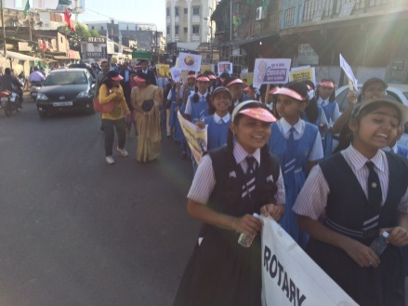
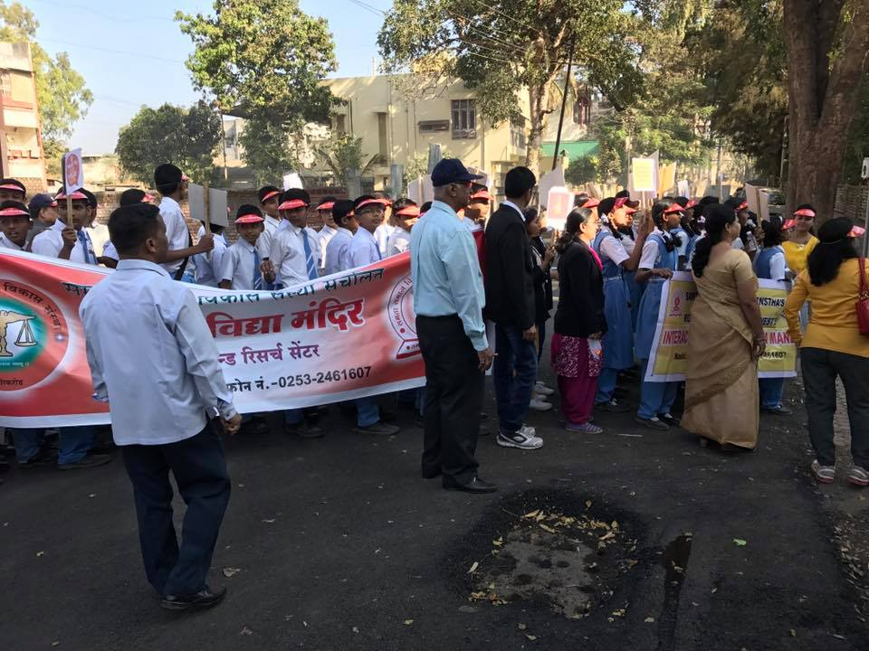
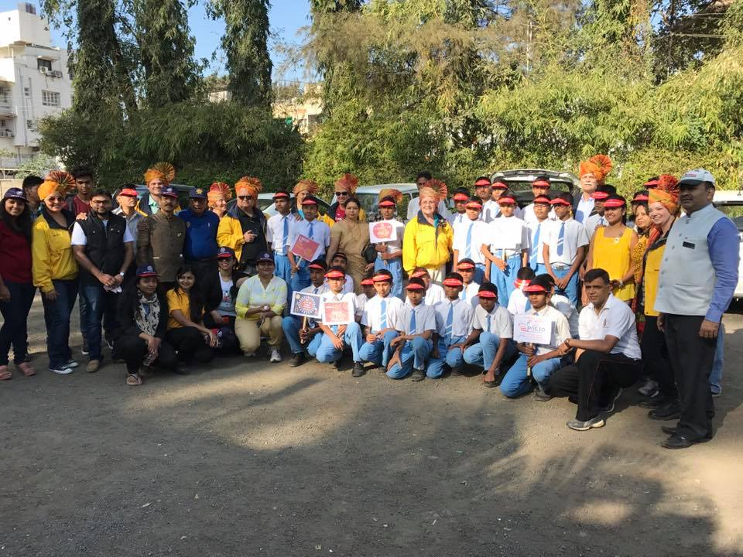
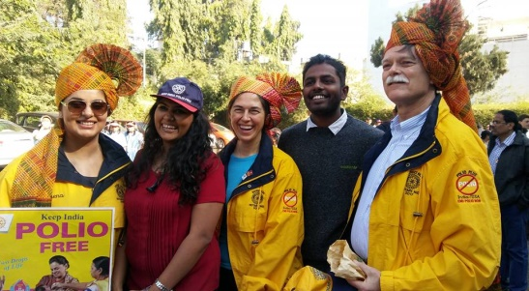
NID Rally

Slide 18
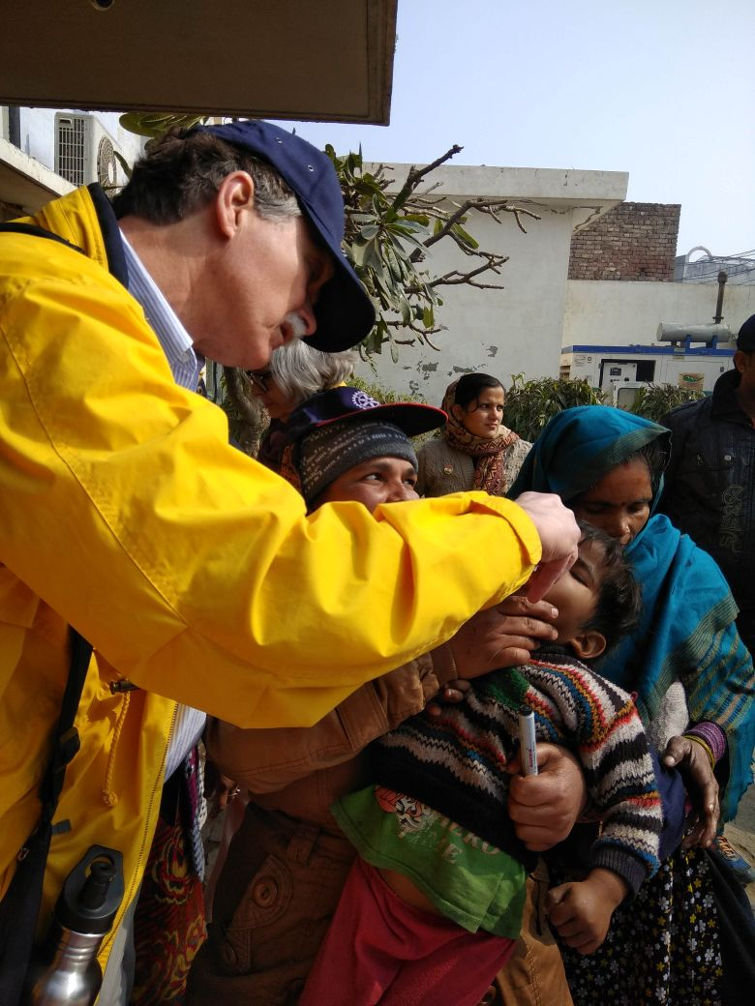
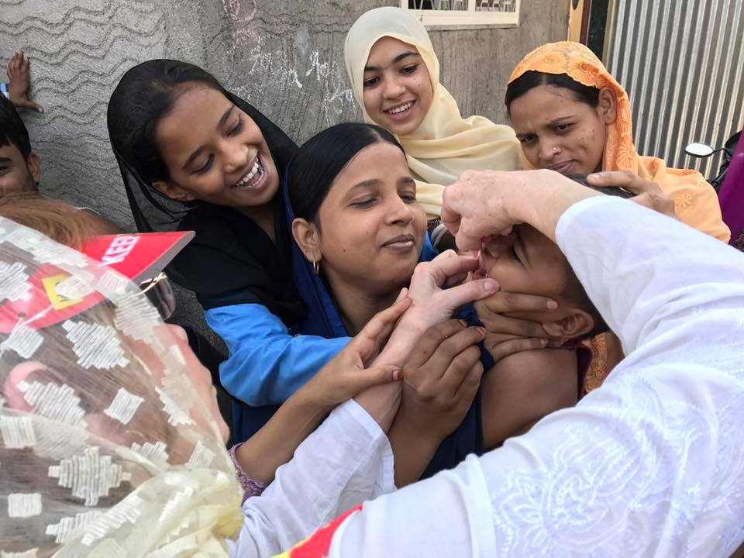

Slide 19
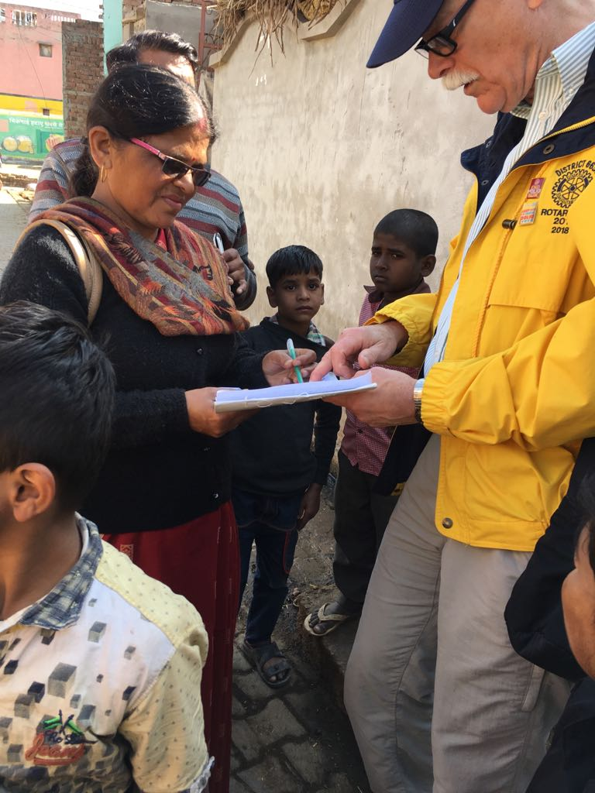
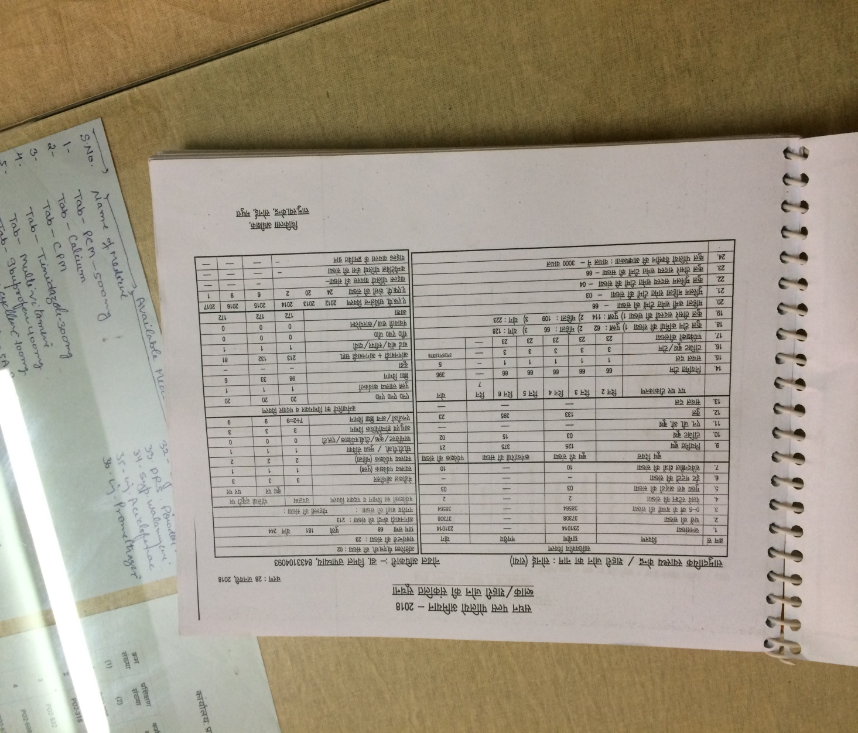

Slide 21
Need to continue the work
Three countries, Afghanistan, Pakistan, and Nigeria, Each with
challenging geographic isolation,
poor public infrastructure,
armed conflict and
cultural barriers.
Notes:
Rotary has helped to vaccinate 2.5 billion children in 122 countries
Spent $1.6 billion and countless volunteer hours
Advocacy efforts have yielded over $7.2 billion in governmental contributions

Slide 22
Bill and Melinda Gates Foundation Challenge

Slide 23
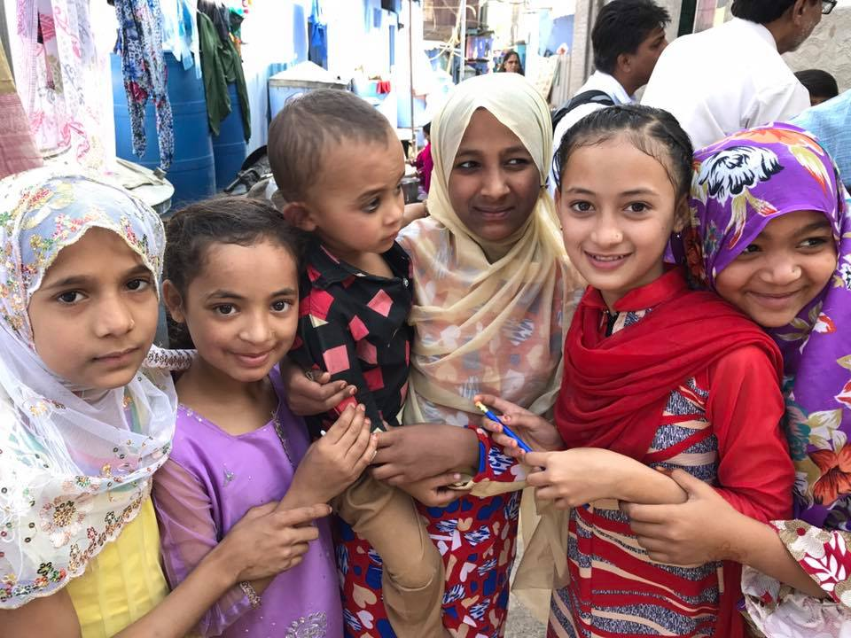
Thank you for listening.

