Slide 1
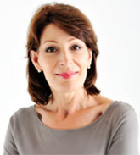
Training
With Yvonne
Join us to get fit…
 first time walker
 seasoned walker
 first time runner
 seasoned runner
Everyone is welcome .
Yvonne has a broad program for all us
TRAINING: Thursday’s 6.15 am
16 October
23 October
6 November
13 November
MEET: Albert Park Lake BBQ’s
Aughtie Drive opposite the Golf Driving Range
IINTERESTED? Let us know Contact Kerry Kornhauser
( Yvonne is currently away)
Training for 1 hour then coffee!!
Sunday 16 November 2014
www.thecity2sea.com.au

