Slide 1


www.rotaryimpactsummit.org

Slide 2
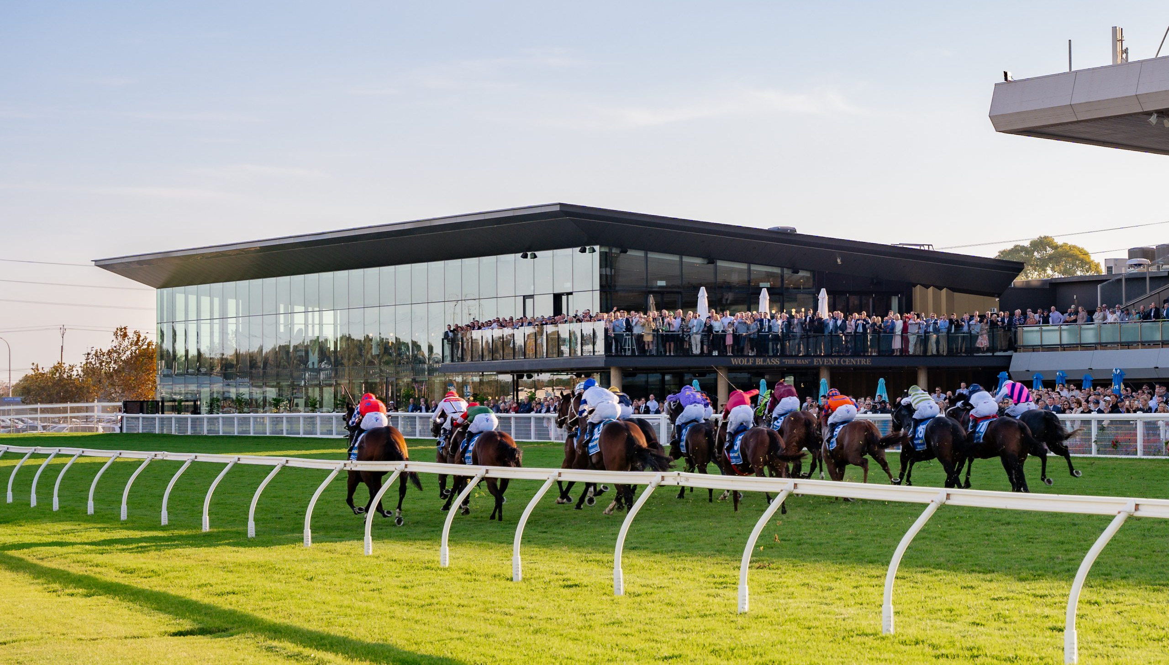
16th to 18th May 2025
Morphettville Racecourse
79 Morphett Road, Morphettville, South Australia.
www.rotaryimpactsummit.org

Slide 3

WHY A SUMMIT?
To connect with Rotarians
and Rotaractors from
Districts 9800 and 9510.
To share ideas and stories
of our collective impact.
To learn from each other.
www.rotaryimpactsummit.org

Slide 4
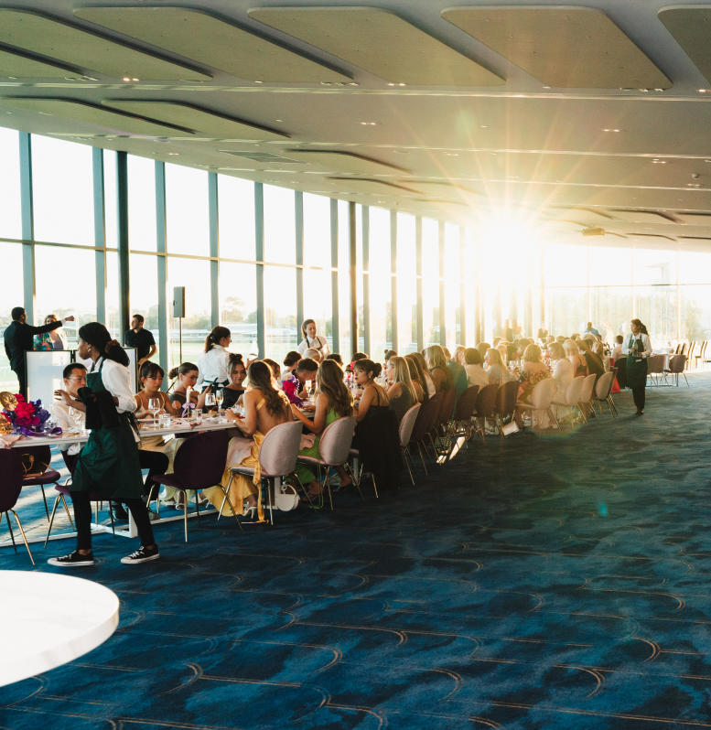
ONE VENUE.
A single VENUE for all events.
The Wolf Blass “The Man” Event Centre opened in 2024.
A multipurpose facility at the Morphettvile Racecourse.
Breathtaking views to the Adelaide Hills.
www.rotaryimpactsummit.org

Slide 5
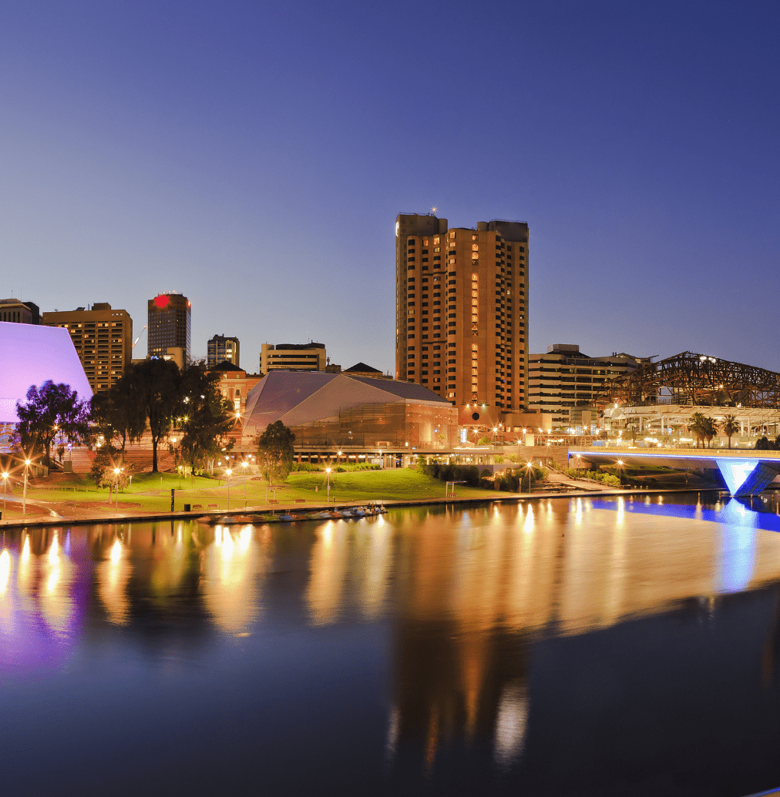
ACCESSIBLE.
15 minutes from Adelaide CBD, River Torrens and Adelaide Oval.
5 minutes to beachside suburb
of Glenelg.
Choice of 5-star Hotels, Motels, caravan parks and holiday units.
An hour to the Barossa Valley, McLaren Vale and Adelaide Hills.
www.rotaryimpactsummit.org

Slide 6
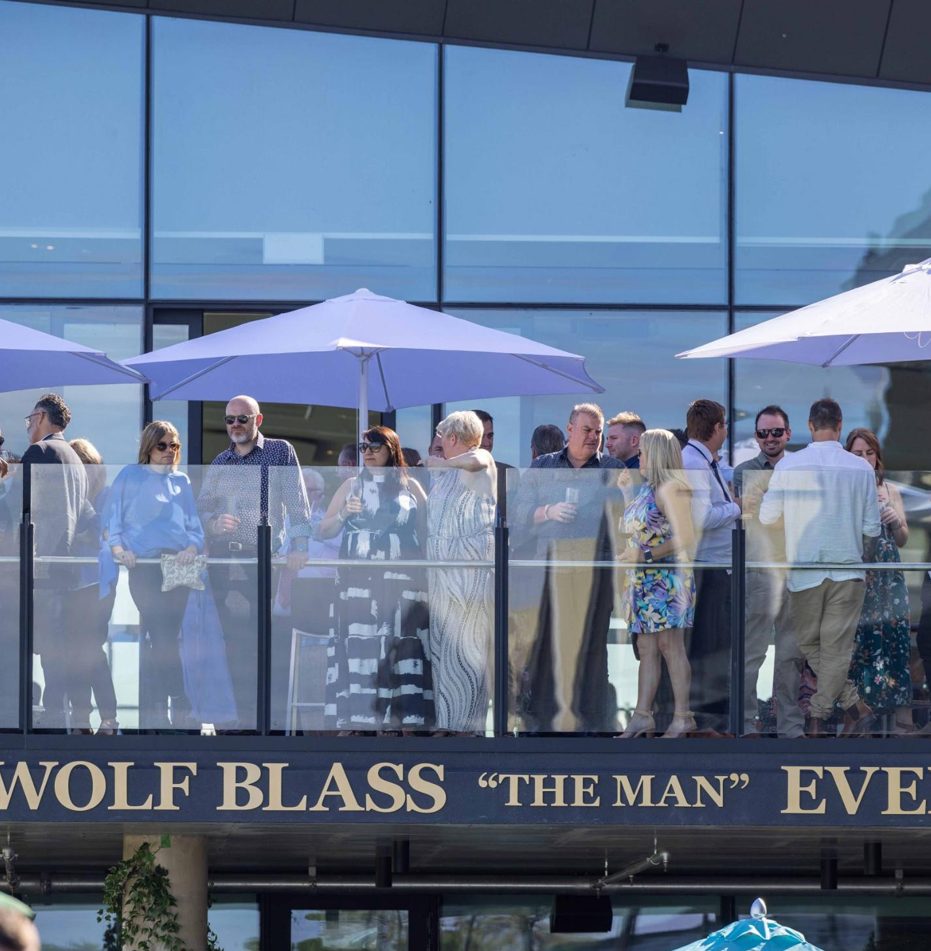
PROGRAM.
Plenary sessions, community project panel, hands on projects.
Showcase.
Gala Dinner and entertainment.
Foundation Breakfast.
End Polio Walk.
Family friendly, kid’s activities.
www.rotaryimpactsummit.org

Slide 7
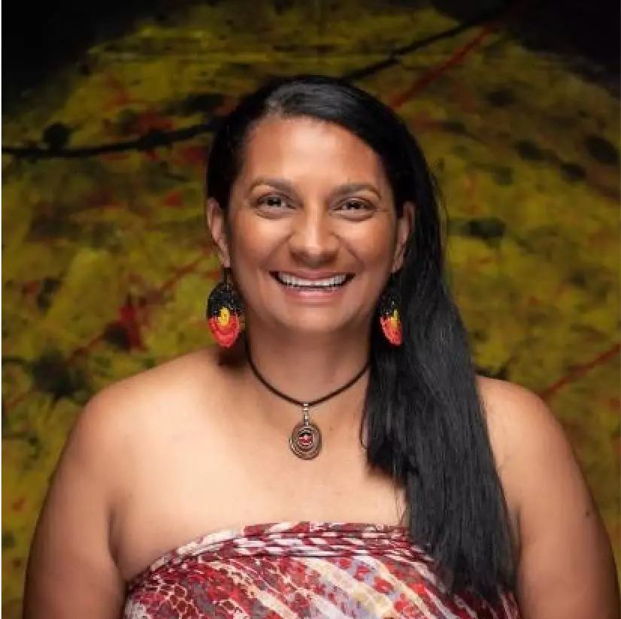
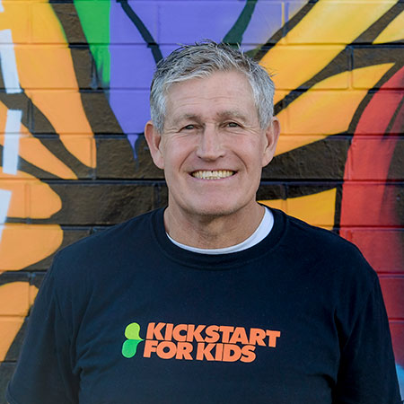
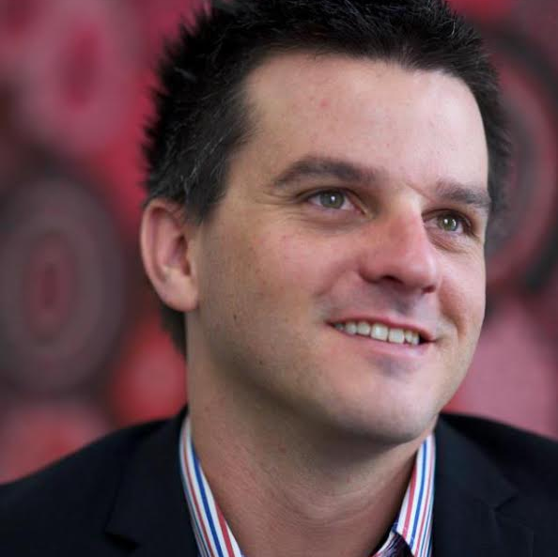
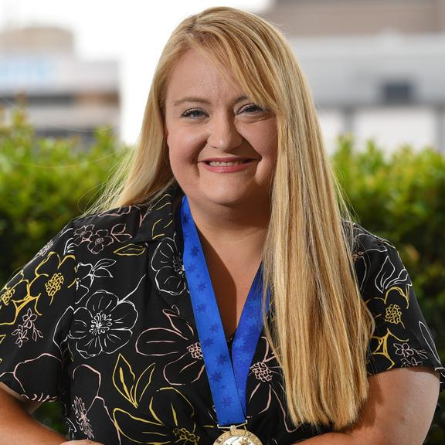
SPEAKERS.
Nova Peris OAM former senator/Dual Olympian.
Ian Steele OAM, Kickstart for kids.
Brad Chilcott AM, Welcome Australia.
Melanie Tate, Puddle Jumpers.
Faith Coleman, Environmentalist.
www.rotaryimpactsummit.org

Slide 8
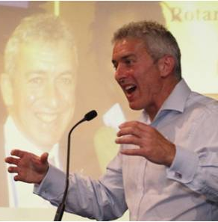
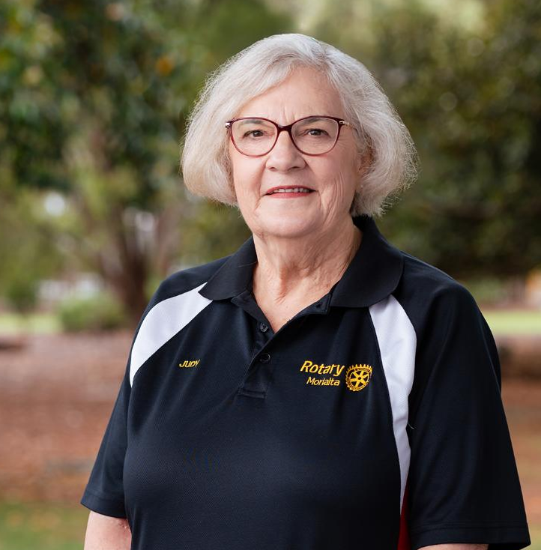

FOUNDATION
BREAKFAST.
7:30 to 8:45am Sunday.
Speakers:
- Charlie Allen, Peace Scholar.
- Judy Brown,
Leader VTT programs.
End Polio Walk
8:45 to 9:15am Sunday.
www.rotaryimpactsummit.org

Slide 9

SHOWCASE.
20 sites
for club project displays.
Open to the public.
Honour Roll with stories
of service about our Rotarians called to higher service.
www.rotaryimpactsummit.org

Slide 10

VALUE.
Conference Registration
and all events separately
priced for all budgets.
An investment in you
and your club.
Establish relationships.
Networking across Districts.
Sharing of tools to achieve impactful community outcomes.
www.rotaryimpactsummit.org

Slide 11
REGISTER NOW.
www.rotaryimpactsummit.org

Slide 12
www.rotaryimpactsummit.org

