Slide 1


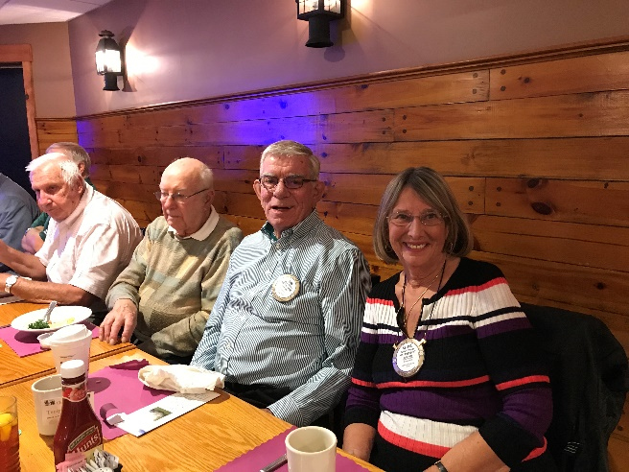
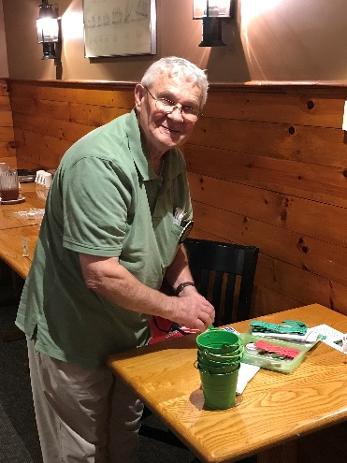
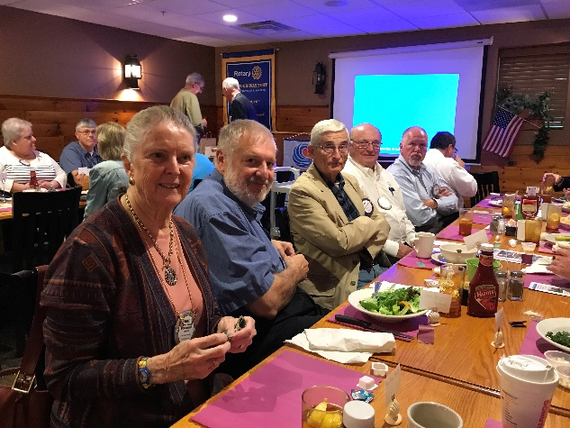
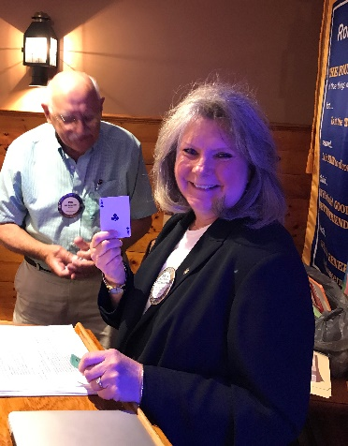
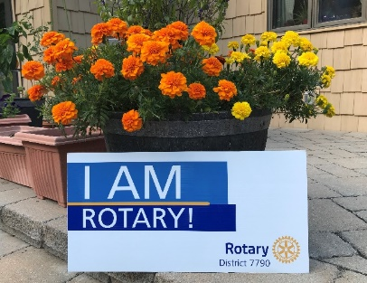
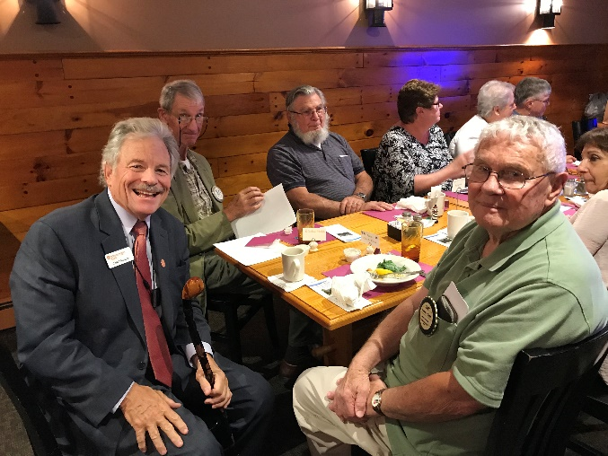
L-A Rotary Ripple
October 4, 2018
Volume2 Issue 15
39 Members strong plus 5 Honorary!
Lewiston-Auburn Rotary Club - Meets Thursdays noon to 1 p.m. The Village Inn, Auburn
President, Tom MacDonald – Email: tmacdonald@mechanicssavings.com & Patsfan4@maine.rr.com
Cell: 207.420.0273
Web: http://www.lewistonauburnrotary.org/ Facebook: https://www.facebook.com/lewistonmainerotary/
Recaps to Date
June 28: Presidents Message
July 12: Chamber Spotlight
July 26 DG Visit
August: Balloon Festival
Sept 22: Fellowship @ Don Grants
Sept 29: Sandcastle Donations
Coming Soon!
Oct 13: Kids That Care
Oct 24: Pints for Polio
Dec 01: Boston Bus Trip
Dec 20: Gift of Song ~
Happenings
October Speakers
04: Joelle MacDonald ~ First Lady Unveils?
11: Mike Moore, Tanzania Water Project
18: Hillary Barter, Healthcare Navigator
25: Rachel Desgrosseilliers, LA Museum
October Rotary Anniversaries
01: Stuart Price (20 years)
18: George Bell (45 years)
19: Joanne Bollinger (1 year)
21: Morgan Thorndike (4 years)
28: Dennis Barriault (36 years)
October Birthdays
14: Raymond Martel
15: Edward Leveque
23: Jackie Majerus-Collins
27: Thomas MacDonald
October Volunteer Activities:
13: Kids That Care & Trinity Jubilee
27: Sandcastle Donations
October Board Meeting
October 25th
11:00am
Village Inn
Good food, warm fellowship and interesting guest speakers continue to be on the agenda every Thursday!

