Slide 1
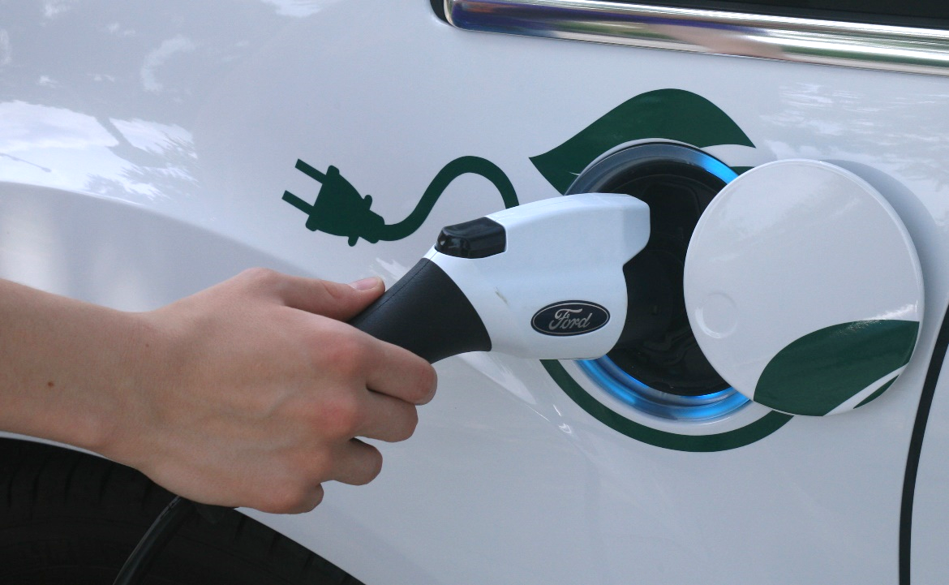
Electric Vehicles and Efficient Electrification
Jeff Springer
Manager, Innovation and Efficient Electrification

Slide 2
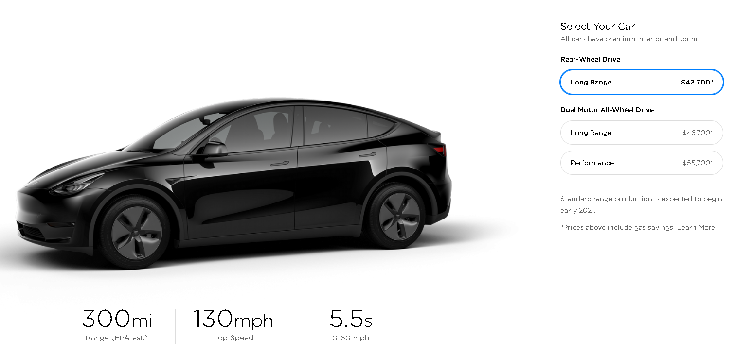
Tesla
Tesla Model Y is available completing the S3XY model lineup

Slide 3
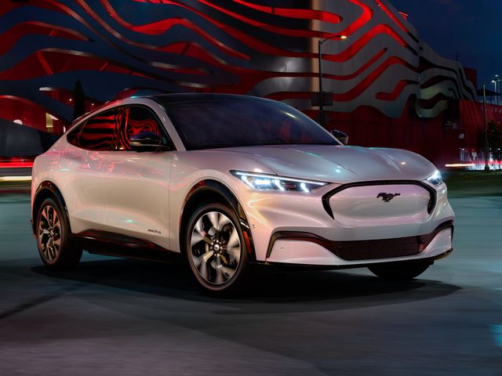
Ford to bring high performance electric SUV with 300 mile range in 2020
40 electrified models by 2022
2021 Ford Mustang Mach E

Slide 4
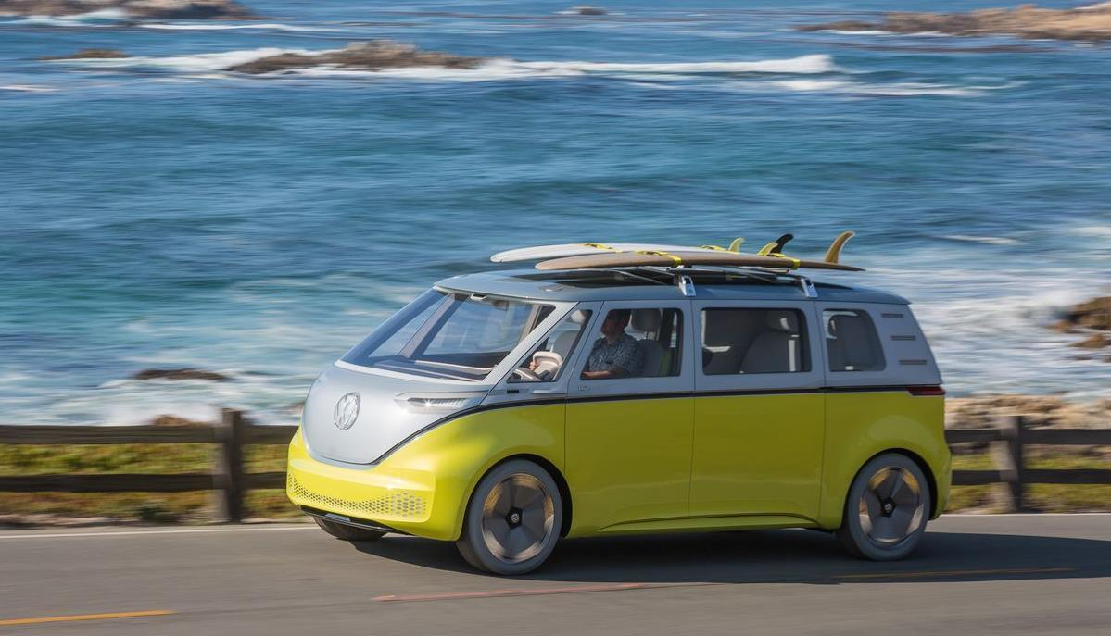
VW ID Buzz Confirmed for US in 2022… hp? who cares man

Slide 5
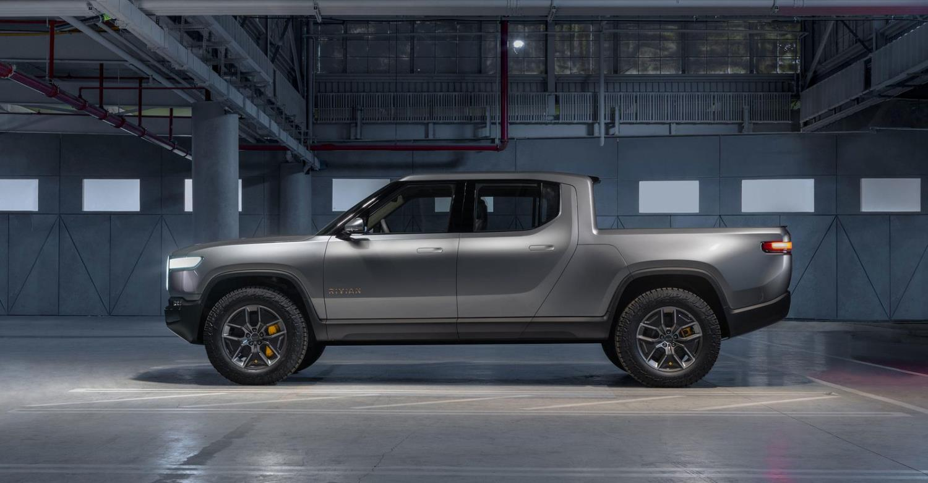
Rivian R1T – Battery Electric Truck
400 mile range 0-60mph in 3 seconds 700hp and 860lb-ft torque
Tows 11,000 pounds Targeting 2021 availability
Amazon and Ford investments

Slide 6
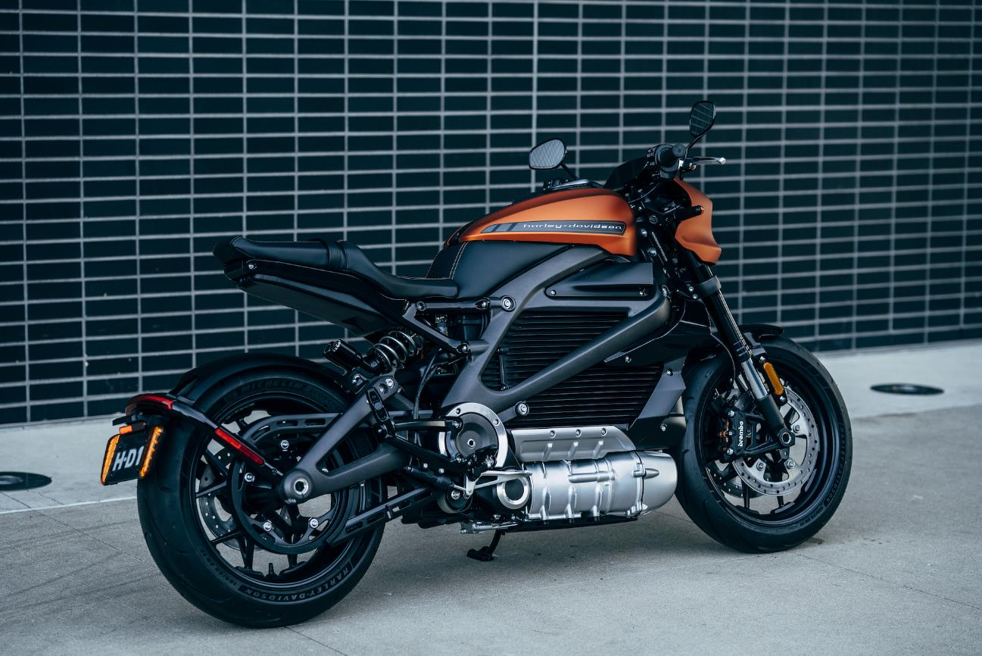
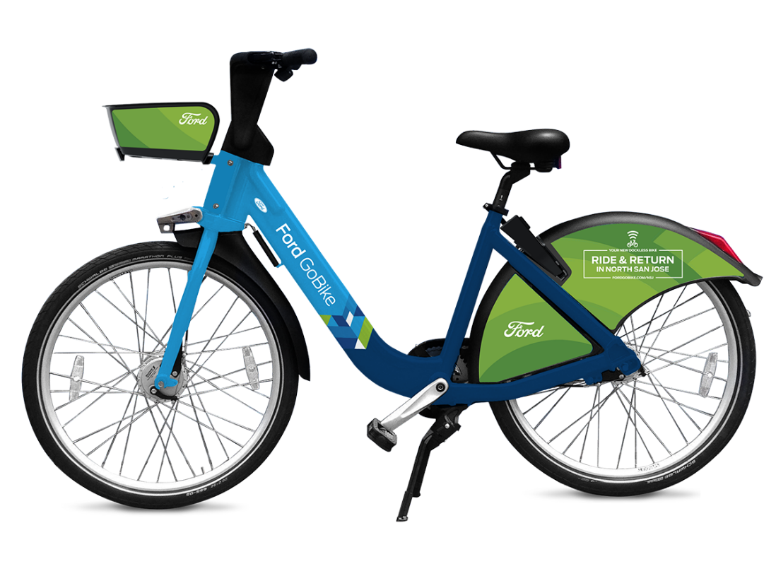
Electric Motorcycles & Bikes?

Slide 7
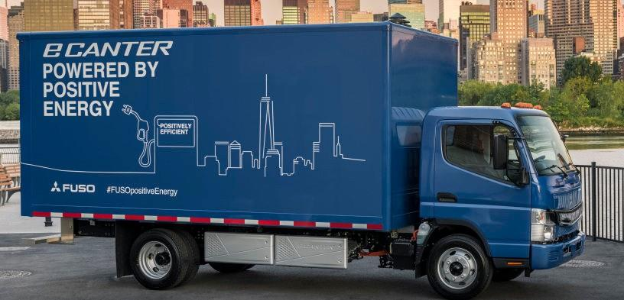
Daimler – Mitsubishi FUSO

Slide 8

Tesla Semi

Slide 9
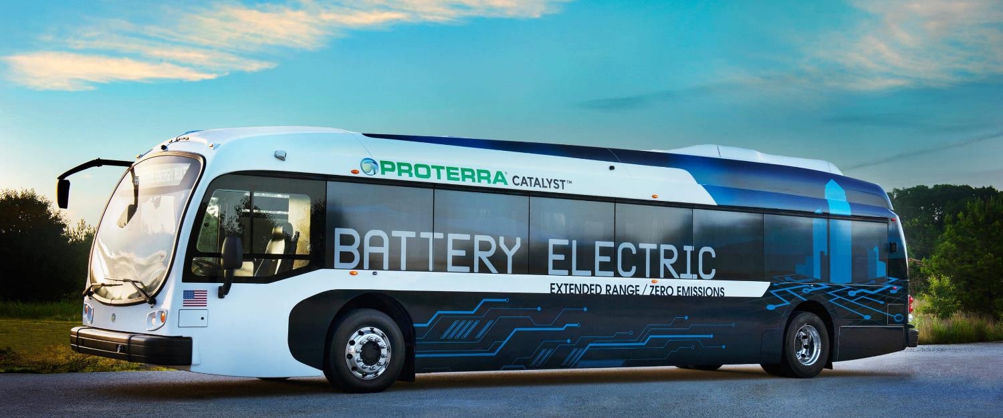
Don’t like to drive?
Ride the electric bus! (coming soon to La Crosse)
Range anxiety? This one just set a record with 1,100 miles on a single charge

Slide 10

Electric Backhoe

Slide 11
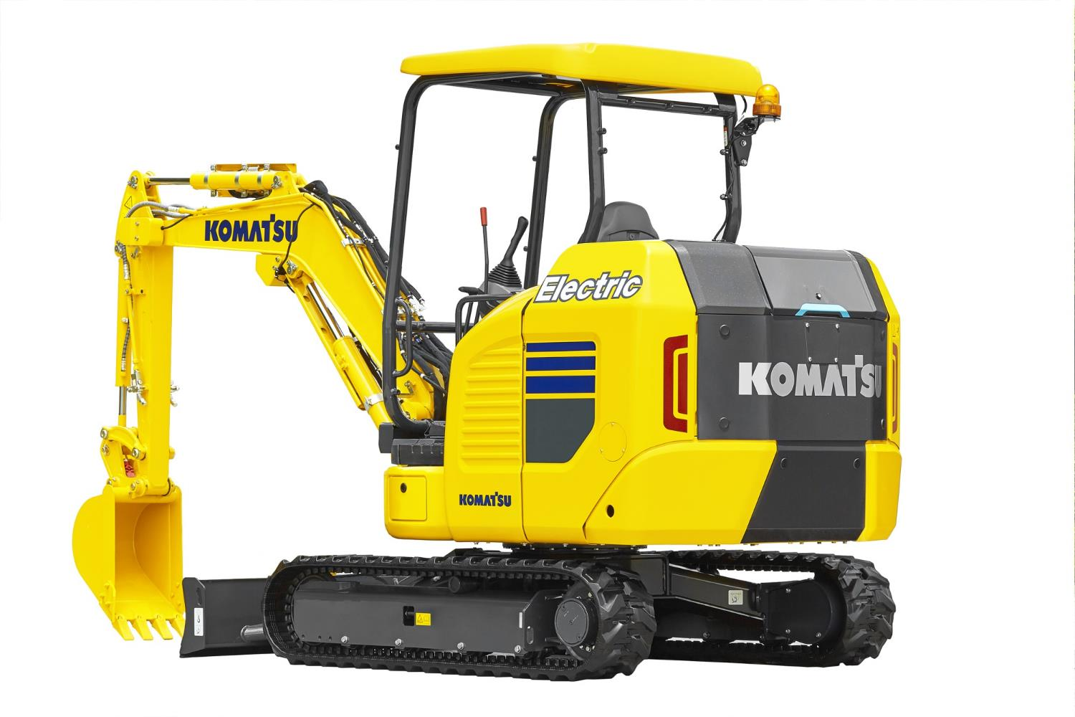
Electric Excavator

Slide 12

Robotic Feeding System
Saves labor
Uses 8,000 kWh/year
Replaces 1,260 gallons diesel
16,000 lbs. CO₂ reduction/year

Slide 13
No More Natural Gas for Homes?
As electricity becomes greener, there is increased interest in using it instead of fossil fuels
Berkley, California eliminated the availability of natural gas service for new homes with a building code change… could be adopted for all of California
Easier in their moderate climate than it would be here with our winters

Slide 14

How would you do without gas in a home?
Heating and cooling can be done with an electric heat pump or a geothermal heat pump
An inductive range can duplicate that “chef preferred” gas range performance
High efficiency heat pump water heater for hot water

Slide 15
Comments and
Questions

