Slide 1
Rotary Fellowships

Slide 2
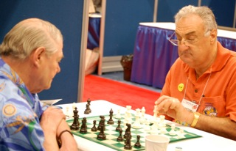
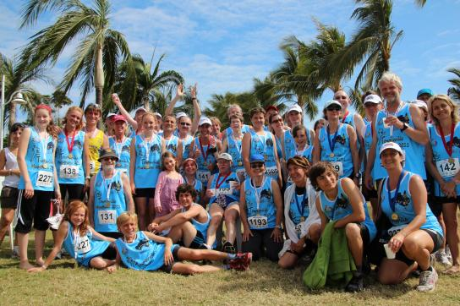
Rotary Fellowships
What is a Rotary Fellowship?
Examples of Fellowships
Why join a Fellowship?
How to get involved?
Individual
Club
Propose a new Rotary Fellowship
Process
Rules
Resources
International Chess Fellowship of Rotarians
Marathon Fellowship of Rotarians
Notes:
Rotary Fellowships are international, independently organized groups of Rotarians, family members of Rotarians, and program participants and alumni who share a common vocation or recreational interest. Rotary Fellowships give their members the opportunity to have fun, make new friends around the world, and enhance their experience in Rotary. Today we will review what constitutes an official-Rotary Fellowship, review a few examples, discuss the benefits of becoming an official Rotary Fellowship, how to get involved, and at the end I’ll point you towards some of the resources that Rotary International has made available.

Slide 3
What Are Rotary Fellowships?

Slide 4
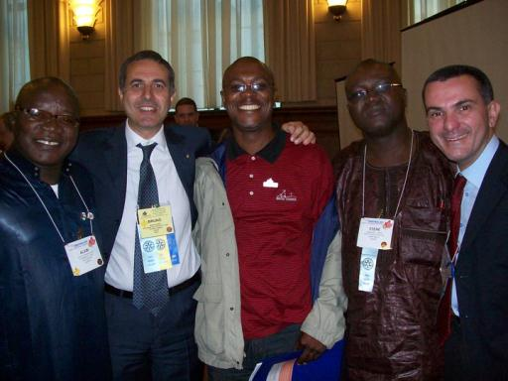
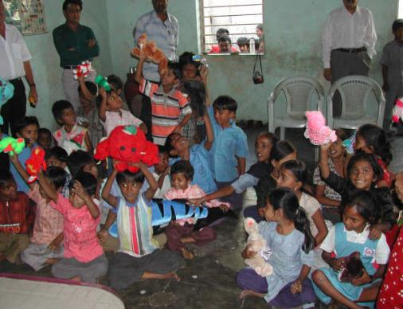
What are Rotary Fellowships?
Groups of Rotarians, their family members as well as participants and alumni of all Rotary programs who connect to explore shared interests in:
Recreational Activities
Hobbies
Sports
Vocations
Rotary History & Culture
Rotarian Lawyers Fellowship
Doll Lovers Fellowship
Notes:
Rotary Fellowships began informally in 1928 when Rotarians with a shared interest in the international language Esperanto joined together. In 1947, a group of Rotarian boating enthusiasts began flying the Rotary flag from their crafts, calling themselves the International Yachting Fellowship of Rotarians — which now holds the distinction of being the oldest continuing fellowship. The scope of fellowships has changed significantly over the years, but their purpose remains the same: to unite Rotarians in friendship and provide opportunities to enjoy favorite recreational activities, hobbies, sports, vocation, and most recently Rotary history and culture.

Slide 5
Examples of Rotary Fellowships

Slide 6
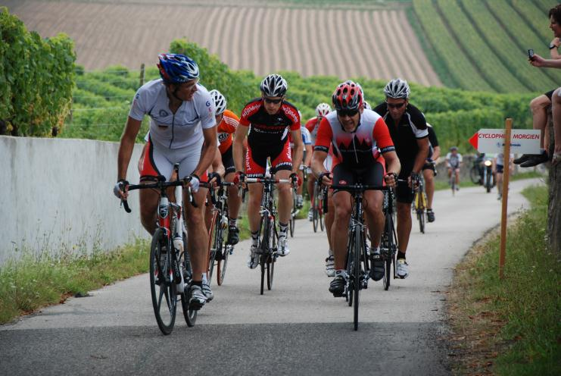
Examples of Rotary Fellowships
Over 70 Rotary Fellowships are now officially registered with Rotary International.
Fellowship Cycling to Serve
Notes:
Many fellowships also use their special interests to serve others. For example, the Fellowship of Canoeing Rotarians has organized cleanups of polluted rivers; members of the International Computer Users Fellowship of Rotarians has conducted training sessions for Rotarians and others in their community; and members of the International Fellowship of Rotarian Scuba Divers join local Rotary clubs to undertake service projects on each of their diving trips. Currently, there are more than 60 official Rotary Fellowships registered with RI. One really good example of Rotary Fellowships organized around both a recreational activity and community service is the Fellowship Cycling to Serve. Through cycling activities, this Fellowship works to promote international understanding and peace.

Slide 7
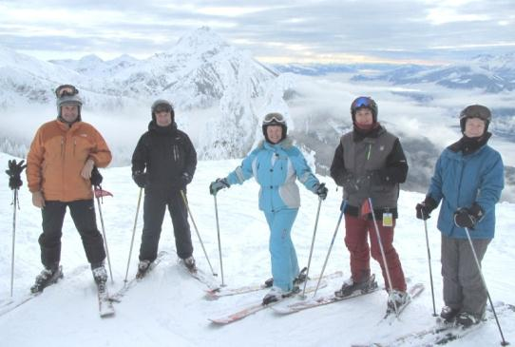
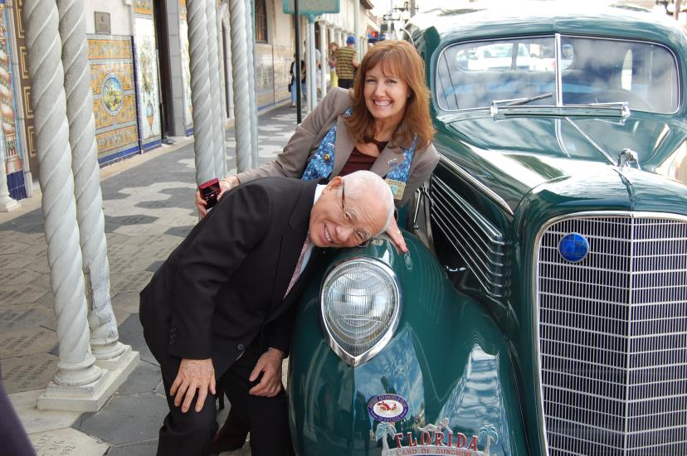
Examples of Rotary Fellowships
Skiing Fellowship
Antique Automobiles Fellowship
Yachting Fellowship
Notes:
Here we see just a small sampling of Rotary Fellowships:
Skiing Fellowship
Antique Automobiles Fellowship
Yachting Fellowship

Slide 8
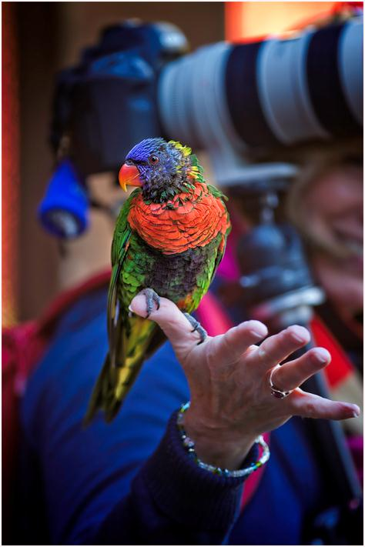
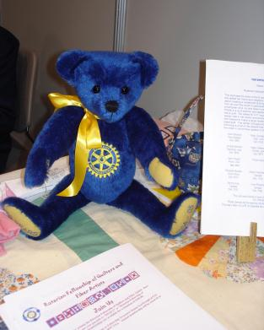
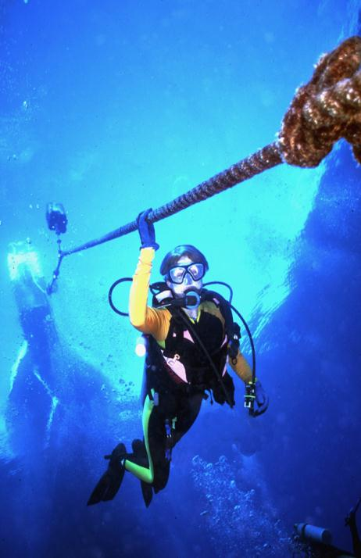
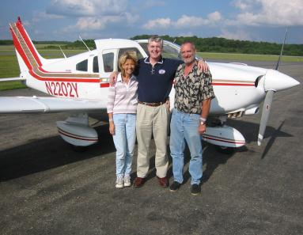
Examples of Rotary Fellowships
Rotarian Fellowship of Quilters and Fiber Artists
International Fellowship of Rotarian Photographers
Fellowship of Rotarian Photographers
International Fellowship of Rotarian Scuba Divers
International Fellowship of Flying Rotarians
Notes:
….and a few more.
Photography Fellowship
Fellowship of Quilters and Fiber Artists
Fellowship of Scuba Divers
International Fellowship of Flying Rotarians

Slide 9
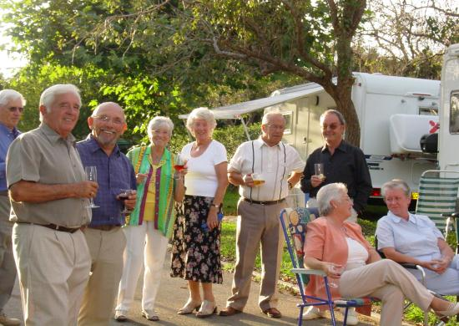
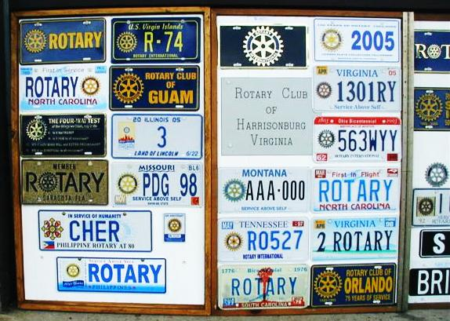
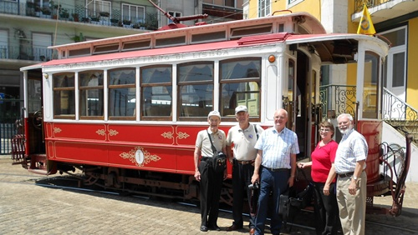
Examples of Rotary Fellowships
International Caravanning Fellowship of Rotarians
Rotarian Automobile License Plate Collectors Fellowship
Fellowship of Railroading Rotarians
Notes:
….and even a few more.
Automobile License Plate Collectors Fellowship
International Caravanning Fellowship of Rotarians
Fellowship of Railroading Rotarians

Slide 10
Examples of Rotary Fellowships
Offers Rotarians an opportunity to learn more about wine, food pairings and a litany of other topics related to the appreciation of wine.
Rotarian’s Wine Appreciation Fellowship
Notes:
The Wine Appreciation Fellowship is a learning tool for those who are interested in expanding their knowledge and sharing ideas regarding all aspects of wine appreciation.
The fellowship has an email newsletter and members are encouraged to visit our interactive wine website (www.rotarywine.net) frequently for updates, features, articles and information on wine events and trips. Annual meetings are held at the RI International Conventions and are some of the most popular events of the whole Convention.

Slide 11
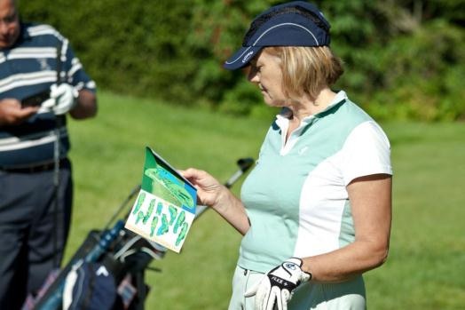
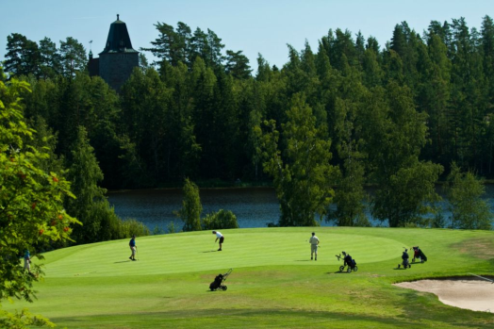
Examples of Rotary Fellowships
The International Golfing Fellowship of Rotarians(IGFR) hosts tournaments around the world.
Golfing Fellowship
IGFR maintains connections with 13 different chapters from Lithuania to the United States.
Golfing Fellowship
Notes:
While most day-to-day fellowship activities may take place online or through correspondence, the most successful fellowships facilitate regular opportunities for members to interact in person. For example, sporting fellowships hold regional matches and world tournaments, fellowships related to travel or excursions plan destination trips, and vocational fellowships often plan get-togethers at professional conferences and seminars. These types of activities will help maintain existing members’ interest in the fellowship and also attract new members.

Slide 12
Join a Rotary Fellowship

Slide 13
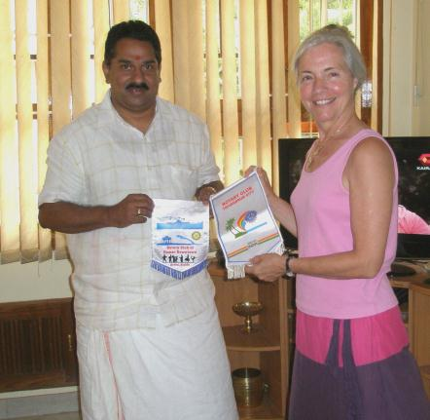
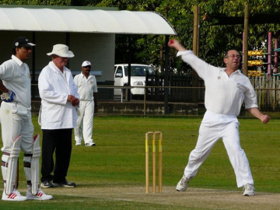
Benefits of Rotary Fellowships
Opportunities for Rotarians to make lasting friendships outside of one’s own club, district and country
Contribute to the advancement of world understanding and peace
Serve as an incentive for attracting new members and for retaining existing members
BREW: Beers Rotarians Enjoy Worldwide
Cricket Fellowship
International Travel and Hosting Fellowship
Notes:
There are number of benefits to Rotary Fellowships. They offer:
Opportunities for Rotarians to make lasting friendships outside of one’s own club, district and country
Contribute to the advancement of world understanding and peace
Serve as an incentive for attracting new members and for retaining existing members
Further vocational development through acquaintance with others of the same profession.
Make new friends around the world
Explore new opportunities for service

Slide 14
Take Action

Slide 15
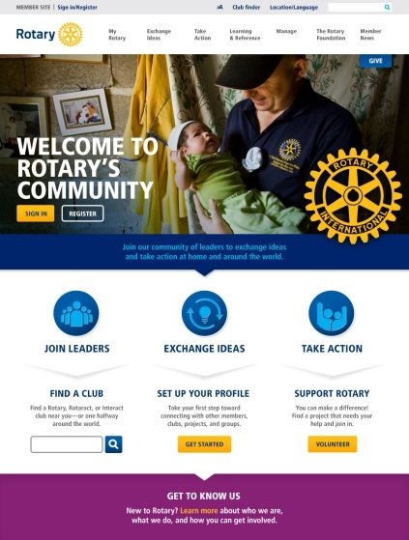
Individual
Contact a group that interests you directly using contact information found online at www.rotary.org/fellowships
Contact your district Rotary Fellowships chairperson for further guidance.
Create your profile on Rotary.org and connect with other Rotarians and Rotaractors.
Start or join an online group or simply correspond with other Rotarians and Rotaractors
Notes:
Using your MyRotary account you now have access to an array of new social tools that will enable you to converse and collaborate with other Rotarians and Rotaractors. You can use these tools to find, start or further your goals for Rotary Fellowships… You can search Rotary’s Discussion Groups where you can exchange ideas with other Rotarians and Rotaractors who share your interest. If you find that a group already exists, reach out to them. But if not, consider starting a new one!

Slide 16
Promoting Fellowships
Publicize local fellowship-sponsored events on your club or district website
Invite local Fellowship officers to speak to your weekly club meeting about their activities and related service work.
Connect with Rotarians and Rotaractors around the globe by creating a public or private group on Rotary.org.
Publicize local fellowship-sponsored events on your club or district website
Seek out Rotarians who are outstanding in their professions or are enthusiastic about a hobby and encourage them to join fellowships or develop new ones.
Notes:
Rotary International looks to District Governors and District Rotary Fellowships chairs to facilitate communication and promotion of Rotary Fellowships, but that doesn’t prohibit you from helping to promote them as well. Whether it is between two Fellowships, Rotary clubs within the district, or even the broader public, there are numerous ways to help out. Promoting Fellowships is a responsibility that we can all share as a way both to grow and promote Rotary.

Slide 17
Propose a New Rotary Fellowship

Slide 18
Starting A Fellowship-Process
If a group for your interests does not currently exist, contact RI Staff for information on how to start a new group.
You will need a…
• Completed application form with a clear explanation of the group’s purpose
• Copy of the group’s proposed bylaws or constitution
• List of proposed officers and their responsibilities
• Roster of potential members, representing at least three countries
Notes:
Rotary International has established specific policies for forming a Rotary Fellowship. RI rigorously evaluates each prospective group before deciding whether to formally recognize it. However, each fellowship operates independently of RI, with its own rules, dues requirements, and administrative structure. Membership is open to all Rotarians, Rotaractors, and their spouses. Here we show just a few of the requirements in the application process. We encourage Rotarians interested in starting a Rotary Fellowship to work closely with their District Chair and RI staff members.

Slide 19
Resources

Slide 20
Resources
For general program information, visit www.rotary.org/fellowships, where you can access the following downloadable resources:
Rotary Fellowships E-Flier
Rotary Fellowships Officer Directory
Rotary Fellowships Application Form
International Fellowship of Rotarian Photographers
Notes:
Outside of the resources listed here, you should look into contacting: Rotary Fellowship Officers-Officers of existing fellowships can provide a wealth of advice to organizers of new groups. Many fellowships have been in operation for decades, and their leaders are knowledgeable about the best ways to promote fellowships and resolve problems. Consult the Rotary Fellowships Officer Directory for contact information. District Rotary Fellowships chairs are appointed by district governors to facilitate communication between fellowships and the Rotary clubs within the district, and to promote participation in fellowships Rotary Fellowships Committee-Rotary Fellowships Committee provides guidance and advice to the Board on all aspects of the Rotary Fellowships program, assists prospective fellowships with the application process, and makes recommendations to the Board concerning recognition of prospective fellowships. Consult the Official Directory or contact Rotary Service staff for committee contact information.
Rotary Service Connections-Staff handle general inquiries about the Rotary Fellowships program and refer interested Rotarians to specific fellowships. In addition, staff members regularly contact fellowship officers with news about the program; offer advice on issues such as promotion, recruitment, and event planning; and help publicize Rotary Fellowships activities around the world

Slide 21
Questions?

Slide 22
Contact Rotary International
Rotary Service Connections
Phone: 1-847-424-5294
Email: rotaryfellowships@rotary.org

