Slide 1
Fighting for Equality in Western Wisconsin
231 Copeland Ave
La Crosse, WI 54603
(608) 881-6418
hoperestoreswi@gmail.com
www.hoperestoreswi.org
Co-Directors:
Shy Jackson
Shamawyah Curtis

Slide 2
What is Hope Restores?
Resource Center for African Americans
Connection to services
Office and meeting space
Drop-in Childcare
Transportation
Mini-pantry
Support groups

Slide 3
Women of Melanin Support Group
Sisterhood
Mental health and wellness
Skills building education: financial literacy, business skills
Understanding and coping with trauma
Self-advocacy

Slide 4
Brothers Battling Barriers Support Group
Masculinity
Communication skills
Relationships
Parenting
Substance use
Aggression and stress

Slide 5
Black Student Leaders Youth Mentoring
Advocacy
Outreach to students of color
Black Excellence Celebration
Youth Closet
Life-skills
Fundraising for club activities and youth resilience building

Slide 6
Diversity Training
Recognizing racism
Uncomfortable conversations
Being a white ally
Using your circles of influence to create change

Slide 7
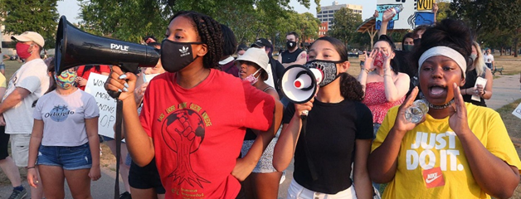
Amplifying Black Voices
Partnership with the Greater La Crosse Area Diversity Council
Waking Up White Collaborative
Better Together in La Crosse County
Peter Cheng Moua Films

Slide 8
Fighting for Equality in Western Wisconsin
231 Copeland Ave
La Crosse, WI 54603
(608) 881-6418
hoperestoreswi@gmail.com
www.hoperestoreswi.org
Co-Directors:
Shy Jackson
Shamawyah Curtis

