Slide 1
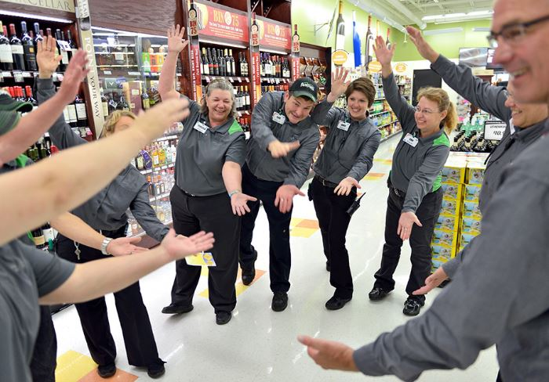
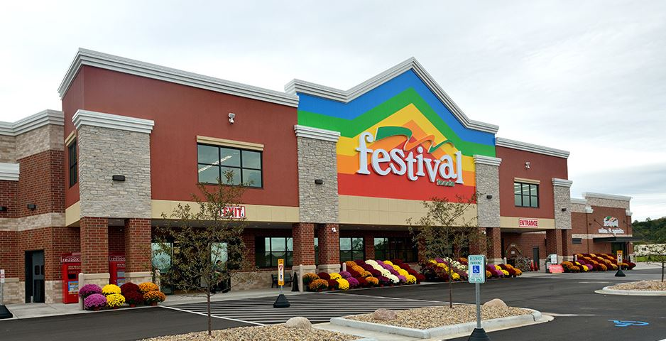
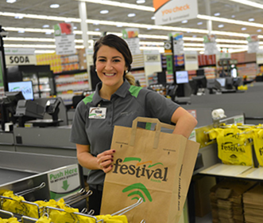
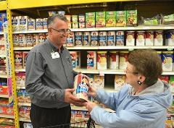
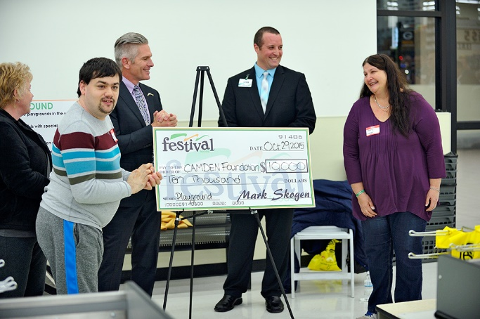
Our Awesome Culture
Dani Stuhr– Assistant Director of HR
Festival Foods

Slide 2
who WE are
THE BEGINNING
1946
32
To develop a team of associates dedicated to providing our guests with a clean store, friendly people, quality products, exceptional value and an enjoyable shipping experience.
ONE MISSION
OUR VALUES
Servant Leadership
Execution
Community Involvement
Associate Development
Service
STORES
CURRENT
ASSOCIATES
7,327
Notes:
The Boomerang Principle is at the heart of everything we do at Festival Foods.
Simply stated, we treat customers as guests, listen and respond to their needs so they want to come back.
Think of our 27 Boomerang Basics as our instruction guide to executing our vision, mission and values.
The Basics define how we relate to our guests, each other, and our communities.
They’re who we are and what drive our extraordinary success.

Slide 3
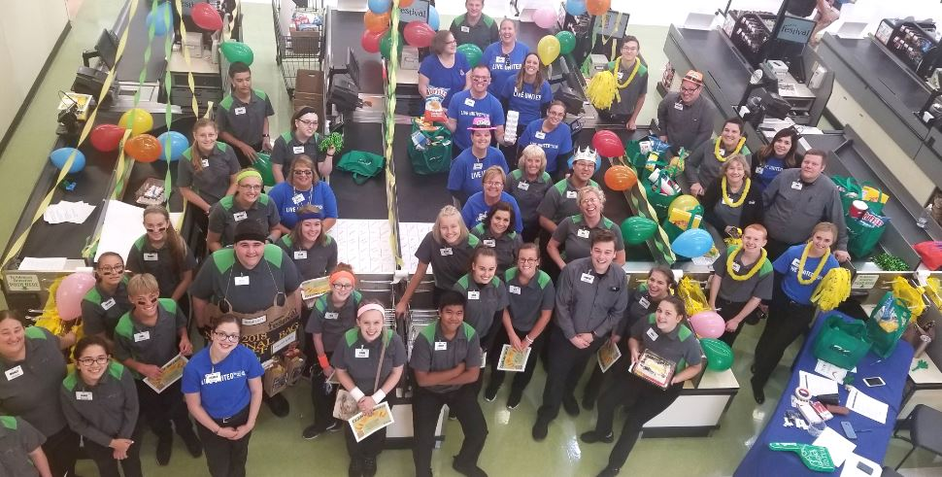
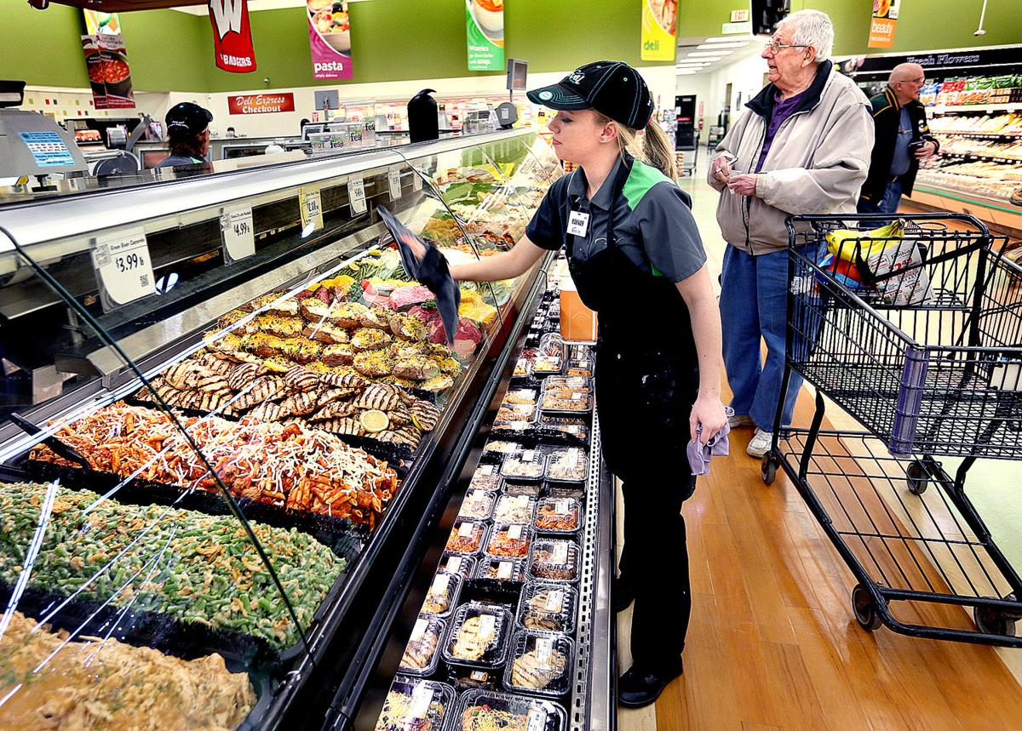
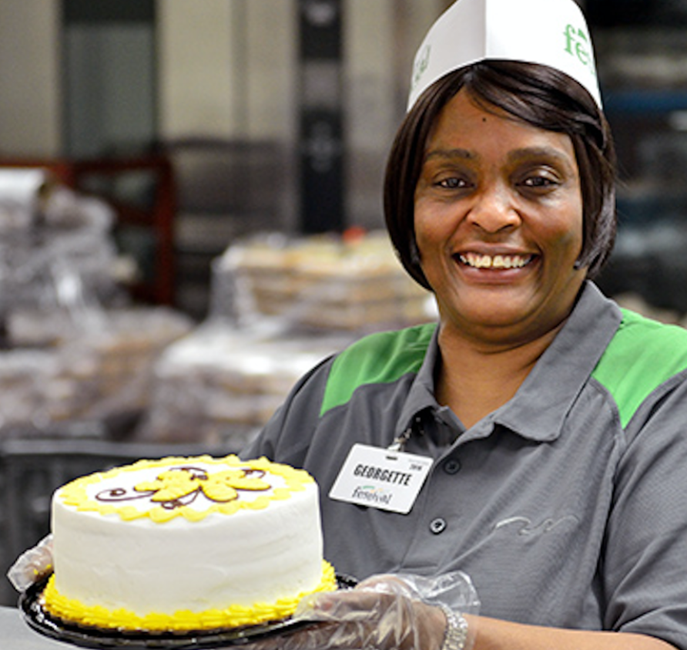
CULTURE: The commonly-held set of principles and values that show up in the everyday behavior and actions of our people.
Essentially, how we do things at Festival Foods

Slide 4
We’re in the people
business, we just
happen to sell groceries.

Slide 5
Top Reasons I love Festival’s

Slide 6
BIRTHDAY AND ANNIVERSARY
CARDS & HUDDLES
We Know How
to Celebrate!
SILVER AND GOLD
BOOMERANGS
NICE GOING
CARDS
CULTURE WINS

Slide 7
ALL LEADER
MEETINGS
We Share
Information
SR. LEADER
ACCESS
INSIDER LOOK
AT FINANCIALS
DEPARTMENT
HUDDLES

Slide 8
Meetings with a Purpose
ASM’s and ISM’s
Daily Huddles
ISM: Weekly leadership meetings in the stores
ASM: All leaders participate in a company wide leadership meeting every other week hosted by our CEO or another member of our Senior Leadership Team
Every store, every department, every day!
Review Boomerang Basic of the day
Share critical team updates
Celebrate Good Times!
Store Success
Birthdays
Anniversaries

Slide 9
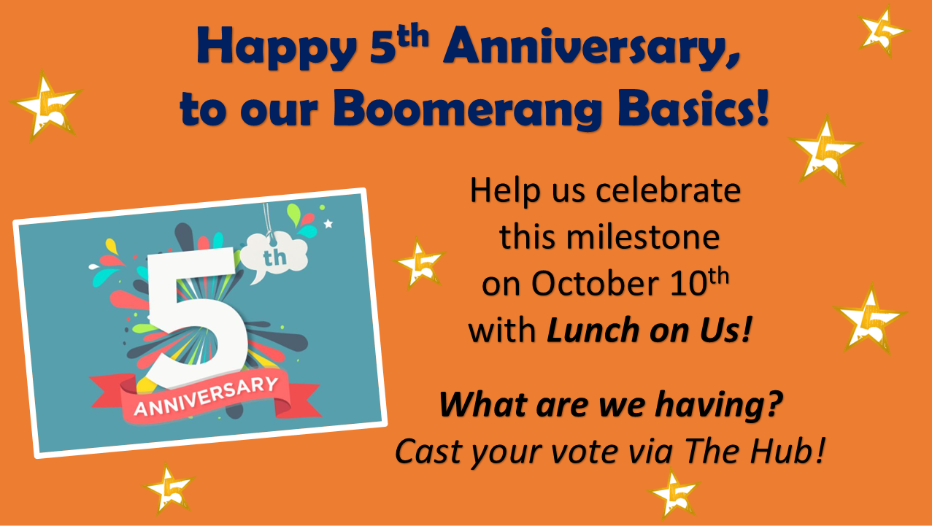
Fest TV:
Survey:
Associates have the opportunity
to share with us in our Annual Engagement Survey!
Company Newsletter:
We still invest in a traditional newsletter to all associates homes, complete with a
coupon for associates to enjoy a product on us while becoming an expert for our guests!

Slide 10
We Take
Development
Seriously
FESTIVAL
COLLEGE
GOLD
PROGRAM
THE HUB
COUNTLESS LEADER
DEVELOPMENT PROGRAMS

Slide 11
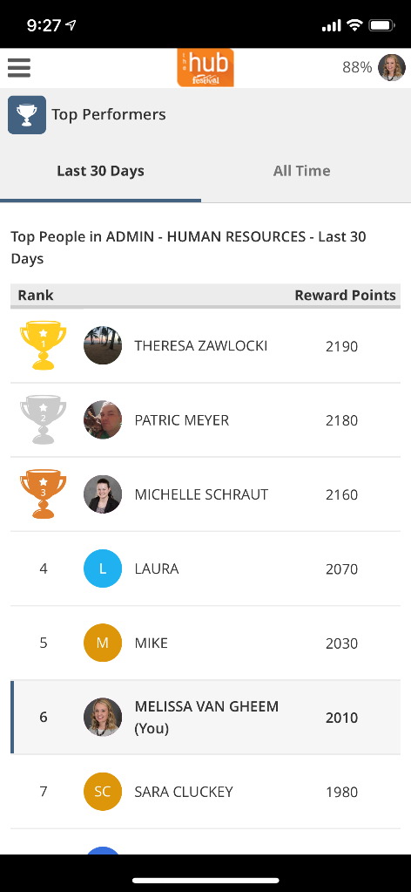
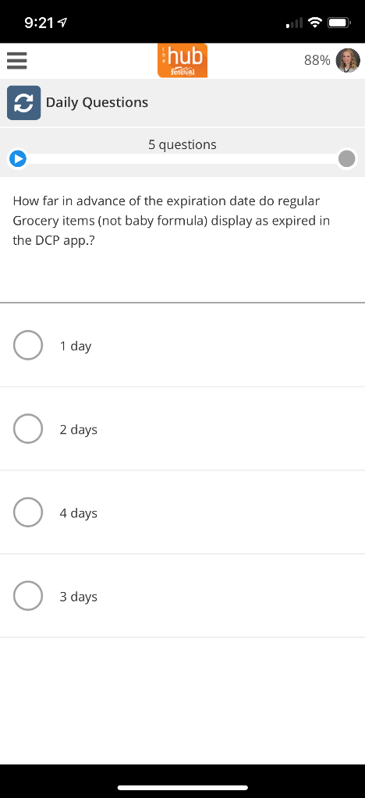
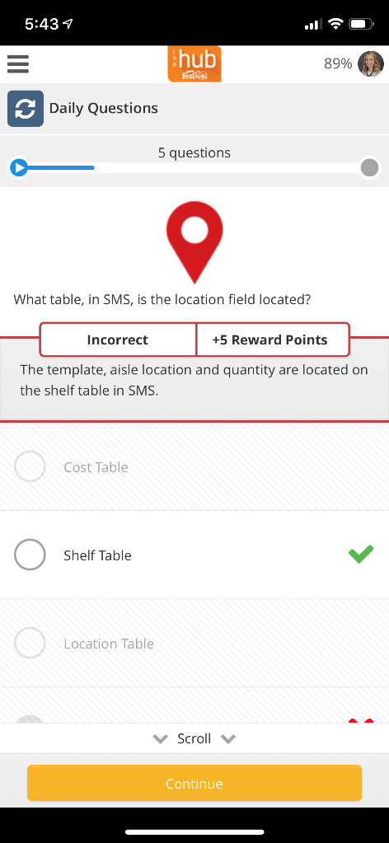
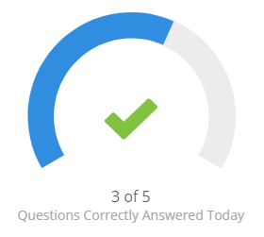
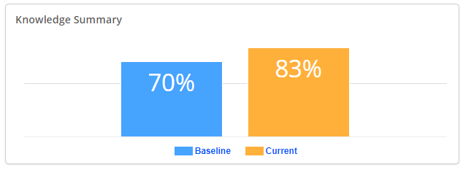
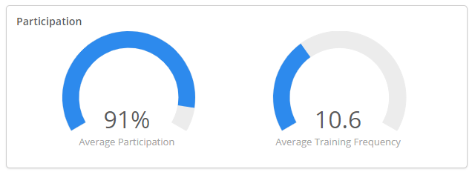

Slide 12
Our Leadership Philosophies
SERVANT LEADERSHIP
COLLABORATIVE LEADERSHIP
A leadership style in which the leader meets the legitimate needs of others to allow everyone to better focus on and accomplish the mission as a team.
Collaborative leadership is a leadership style that is focused on the leadership skills across functional and organizational boundaries.
Collaboration develops when entities recognize that none can succeed without the others.

Slide 13
College
Established in 1996
Annual three day conference for all leaders
Held in the Wisconsin Dells
Leadership workshops, building expertise, making connections,
and notable key note speakers
Servant Leader Awards Ceremony

Slide 14
CULTURE
MEETINGS
We build relationships
ELIMINATING
THE “REVIEW”
STARTS WITH
ONBOARDING
DEPARTMENT
HUDDLES

Slide 15
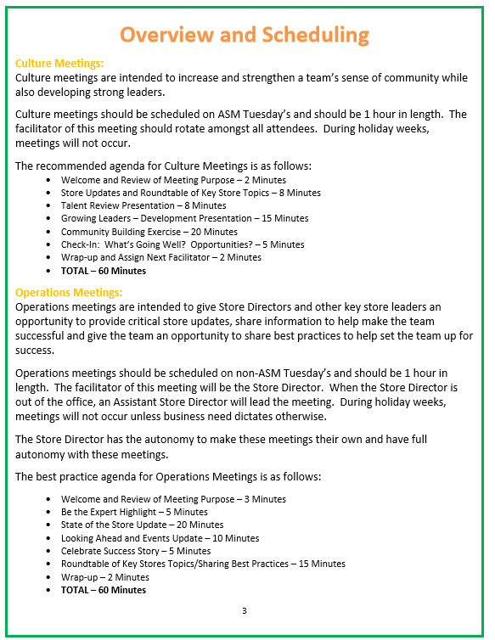
Culture Building
Meetings

Slide 16
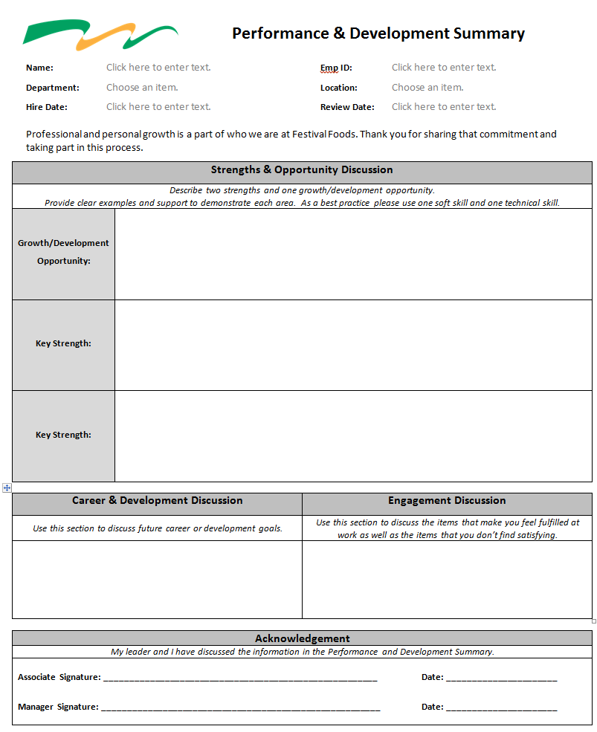
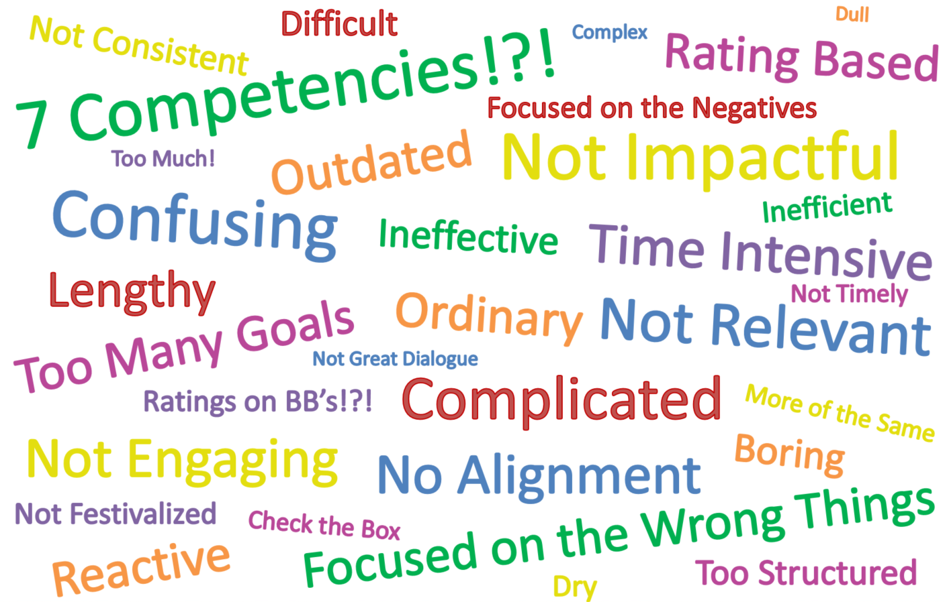
“Reviews” Reinvented!

Slide 17
ANNUAL BAG OFF
COMPETITION
We have fun!
UNITED WAY
FESTIVITIES
FUN AT FESTY
“FESTS”
BB #27

Slide 19
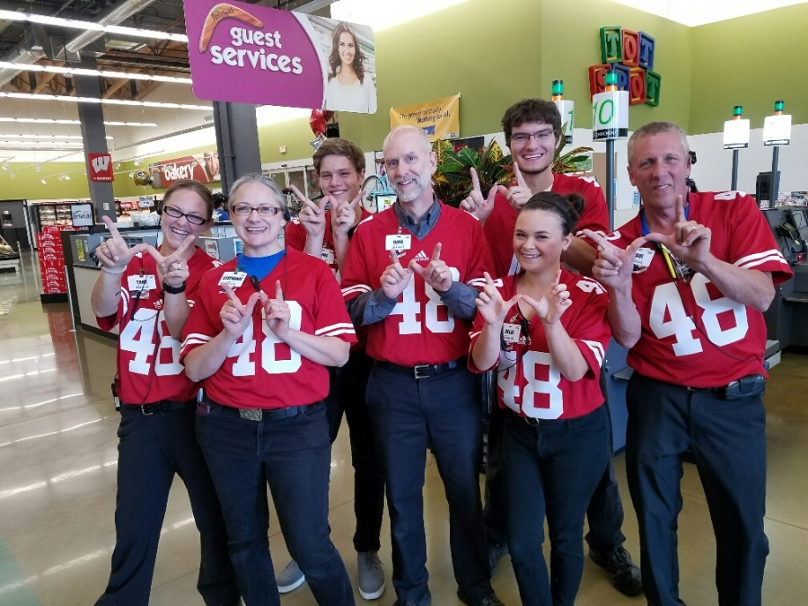
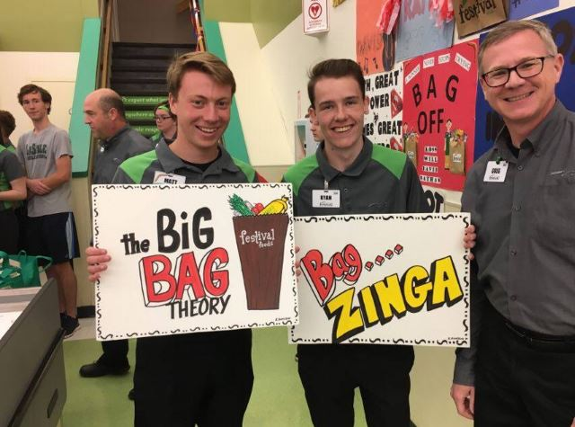
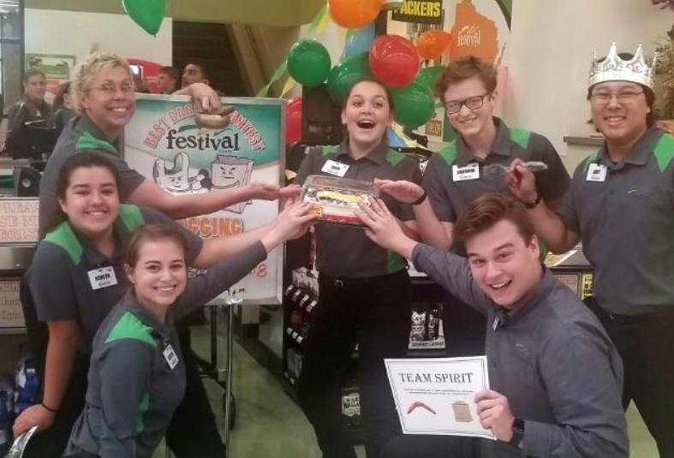
Go Team!!
Revamped
Orientation!
Bag Off!

Slide 20
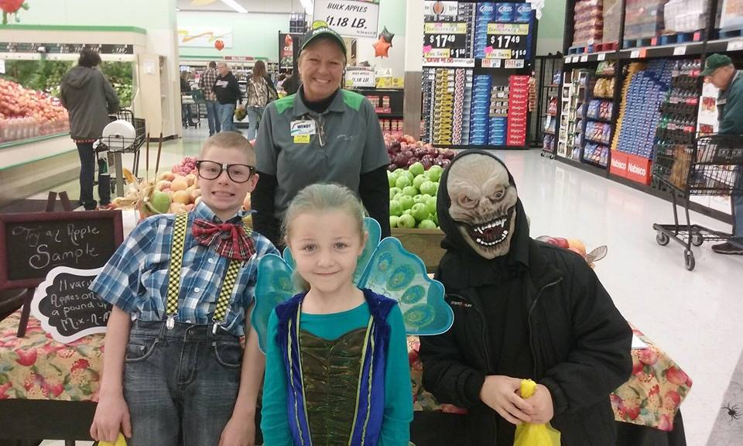
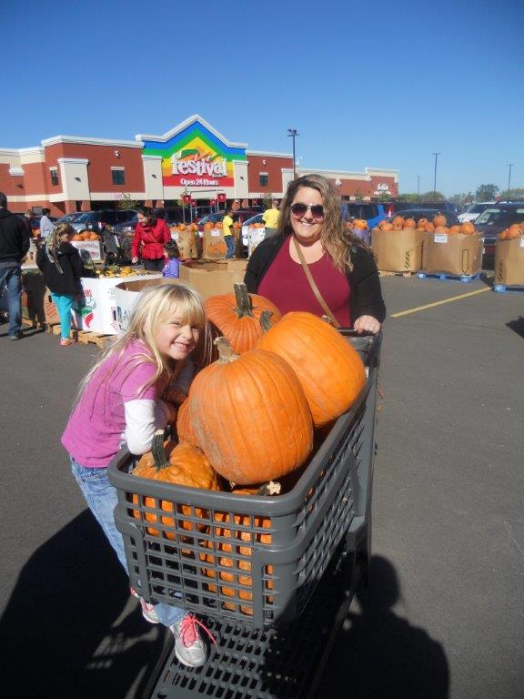
We celebrate
with our guests!

Slide 21
EVOLVING
BENEFIT PROGRAMS
We Care
SUNSHINE
FUND
INNOVATIVE
PROCESSES
TEAMWORK

Slide 23
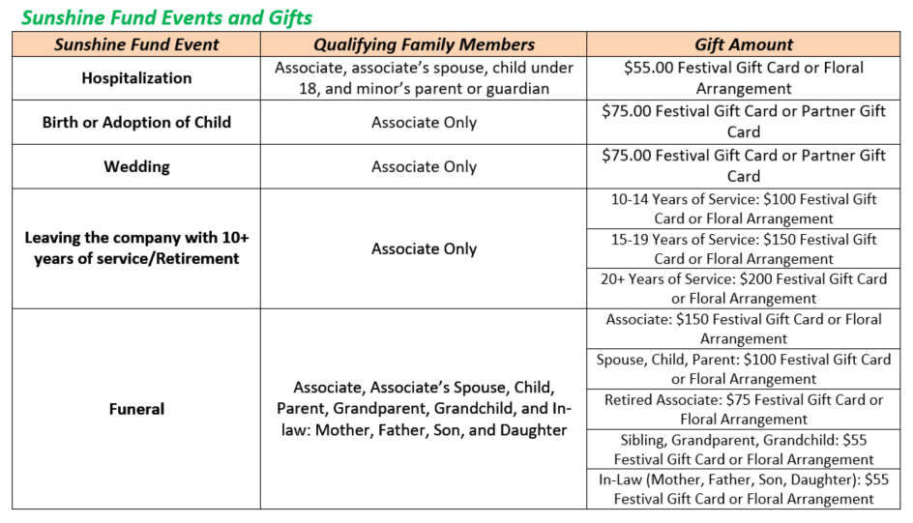
We Take Care of Our Festival Family
BENEFITS
SUNSHINE FUND
Unique Benefit Offerings
Auto & Home Insurance Discount
Pet Insurance
PTO donations for those in need
Adding vision insurance for part-time associates
Associate Discount

Slide 24
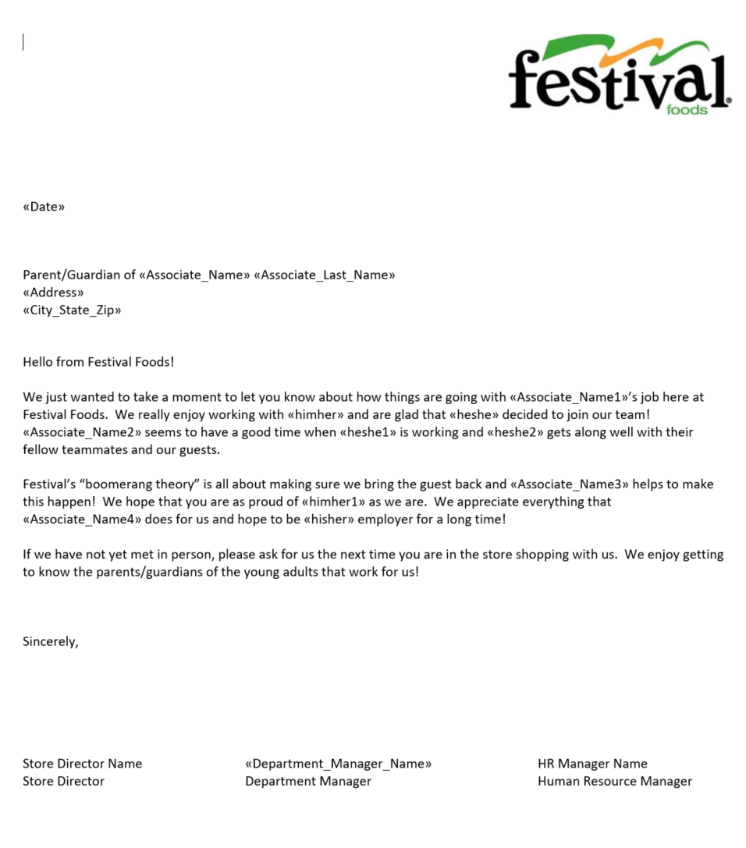
Family Involvement
Family members are invited to attend New Hire Orientation with their child and hear from our CEO
Letters home!

Slide 25
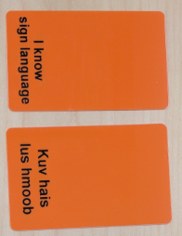
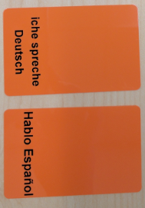
More Than a Name Badge

Slide 26
ANNUAL STORE
INVESTMENTS
We create an experience
EMPOWERMENT
PROGRAM
GUEST vs.
CUSTOMER
ENCOURAGE
INNOVATION

Slide 27
We
Execute
THE ANSWER IS YES,
NOW WHAT’S YOUR ?
APPRECIATE EFFORT,
REWARD RESULTS
EMPLOYER OF
CHOICE
FUSSY ABOUT THE
DETAILS

Slide 28
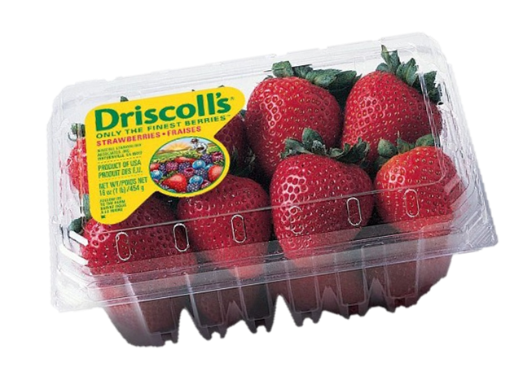
the STATS
Program Since
July 2017
$140k
26,104
Top Stores
Days Made
Dollars Given
Top Reason
QUALITY

Slide 30
We Love Community
VOLUNTEER
OPPORTUNITIES
PROGRAMS
TO GIVE BACK
PART OF OUR
VALUES
PROUD TO BE
WISCONSIN

Slide 31
Not just in your community, but
part of it.

Slide 33
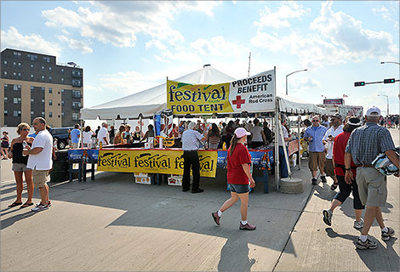
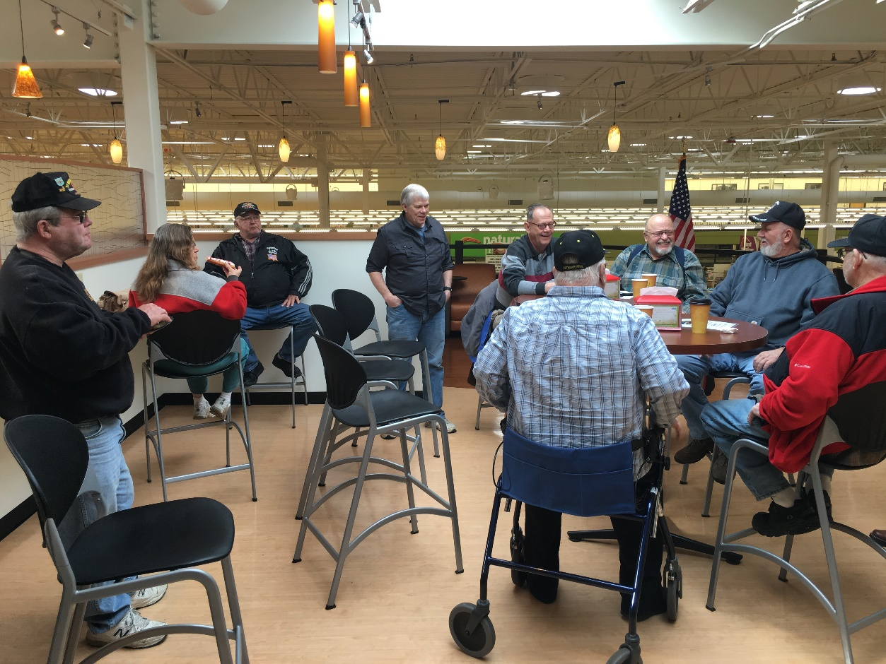
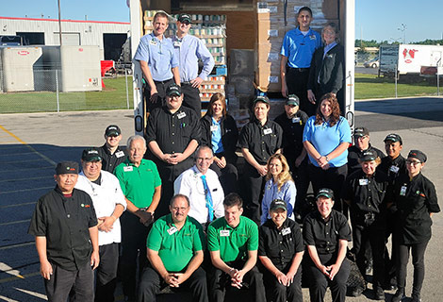
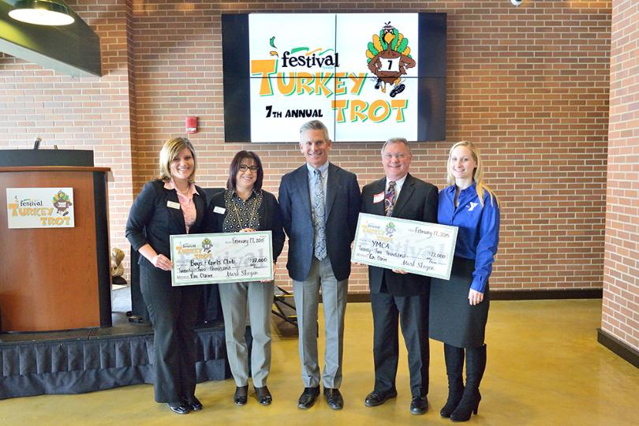
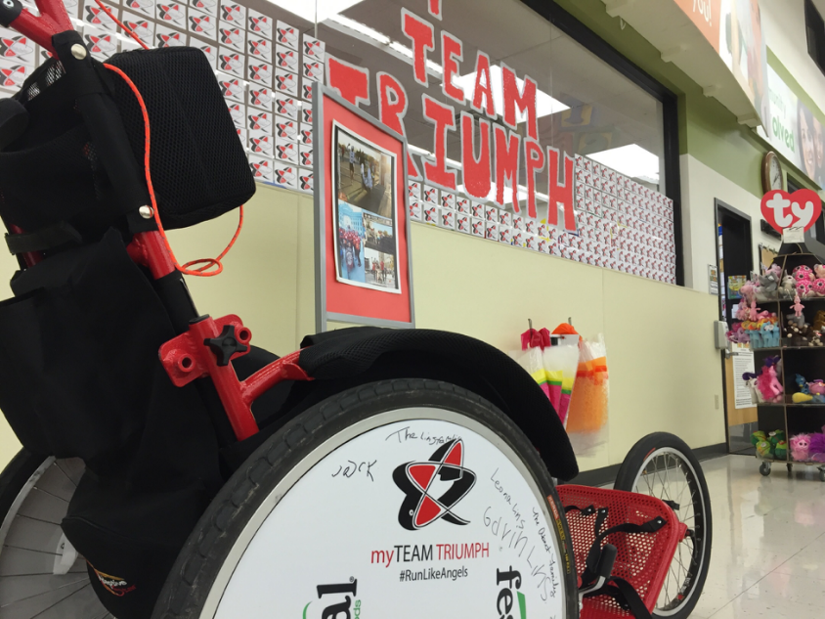

Slide 34
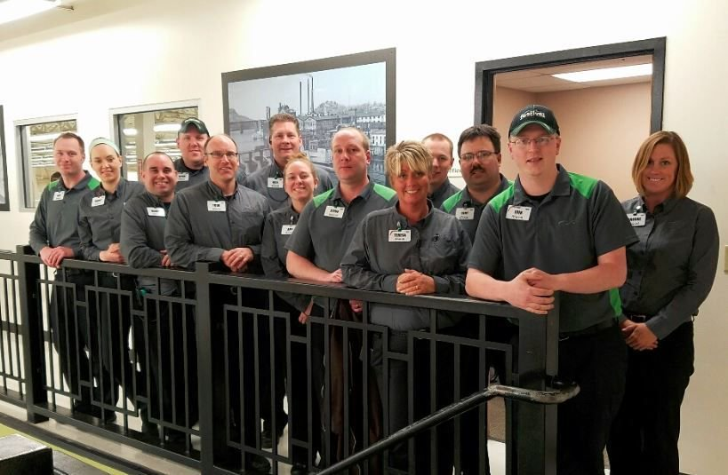
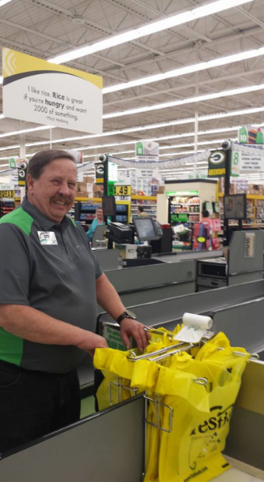
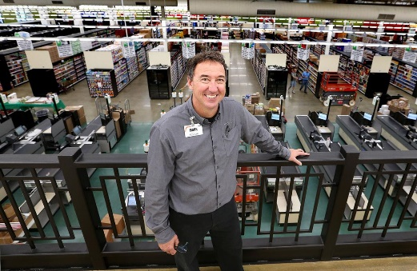
PRIDE.
We’re Owners.
THIS IS OUR
COMPANY
OWNERSHIP.
SHARE IN THE
SUCCESS

Slide 36
Dani Stuhr
dstuhr@festfoods.com
(608) 779-2775

