Slide 1

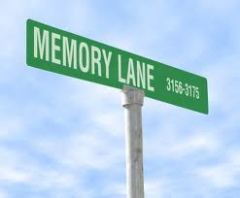
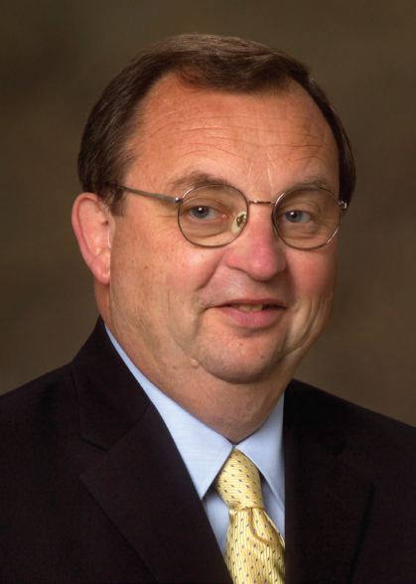
A Walk Down Memory Lane
Jerry Arndt Classification Talk
November 16, 2017

Slide 2
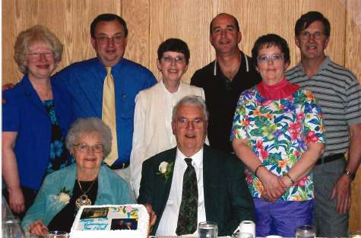
Family Background and Childhood
Gerald Earl Arndt born July 29, 1948 in Wisconsin Rapids, WI
Parents: Earl and Marion (Schroeder) Arndt
Siblings: 2 younger sisters, Judy and Linda
Family and extended family has always had huge impact on my life
Maternal and paternal family tree has deep German roots
  Maternal grandparents were German immigrants
  Strong German influence especially during pre-school years

Slide 3
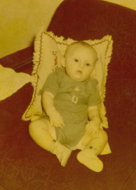
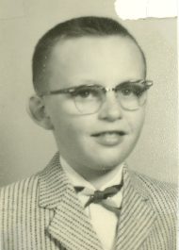
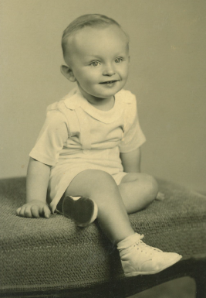
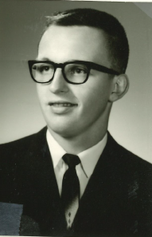
Jerry Through The Ages
6 months
9 years
2 years
High School graduation
What the heck happened to that cute kid ???

Slide 4
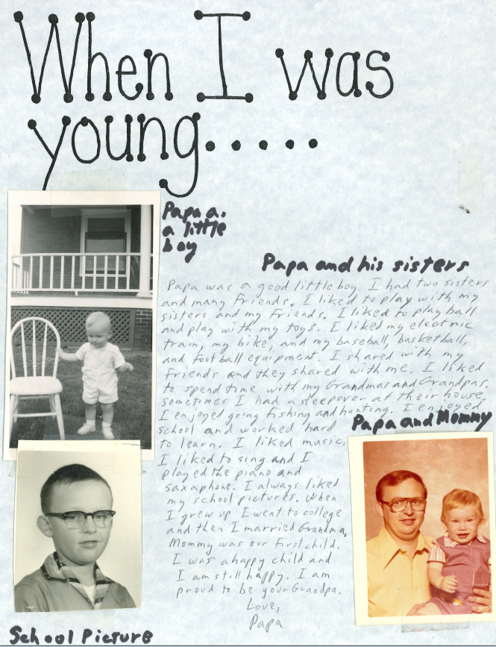
My Childhood
Born and raised in Wisconsin Rapids
Typical little boy – note to my grandson for a school project says it well

Slide 5
The School Years
Elementary School: Immanuel Lutheran
High School: Lincoln High School
College: Michigan Technological University (BSME)
Continuing education in business and management through many educational institutions

Slide 6
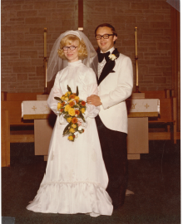
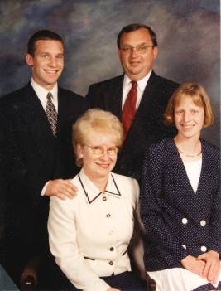
Family – A High Priority
Married Marilyn Hicks September 21, 1974
Two children: Brenda and Brian

Slide 7
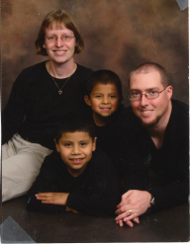
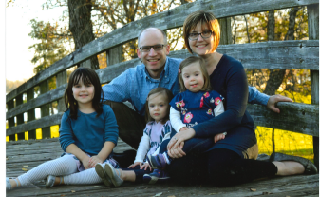
Family – A High Priority
Brenda lives in Onalaska, works as an MA at Gundersen and has two adopted sons ages 11 and 12 from Guatemala
Brian and his wife Kim live in Middleton, both are
physicians at UW-Health, and they have three daughters
ages 6 and twin 3-year-olds
Our kids and grandkids have always been and continue to be our priority.

Slide 8
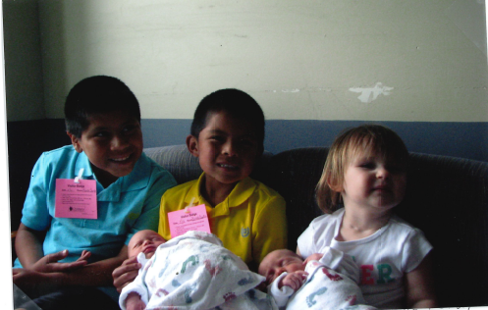
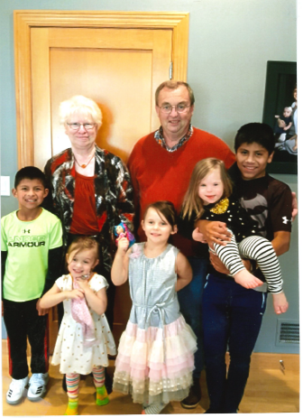
Five Wonderful Grandchildren
First
Most recent

Slide 9
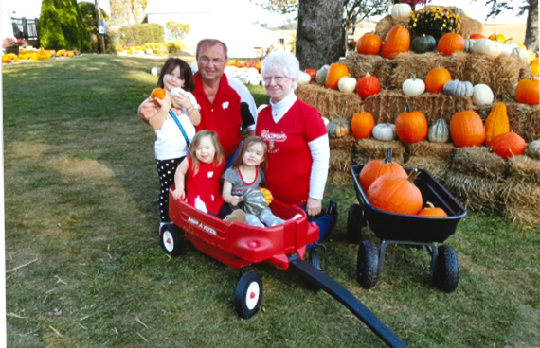
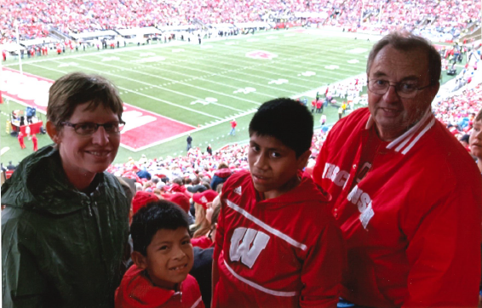
Grandkids are Special

Slide 10
Activities and Interests
Family
Faith
Spectator sports – avid fan of Badgers, Packers, Brewers, and especially Grandkids teams
Hunting, fishing, hiking, cross-country skiing and almost any outdoor physical activity
Recreational property in Richland Center
Yard work
Music and theater
Seasonal decorating of our home and yard
Travel
Community Service
Service on several Boards
Being “Santa’s Helper”

Slide 11
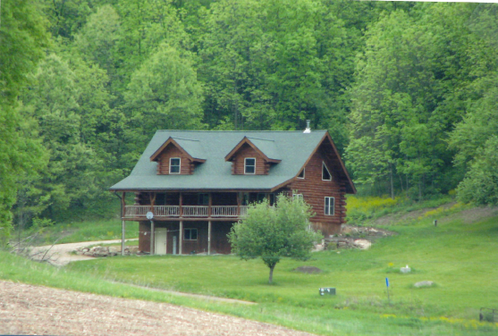
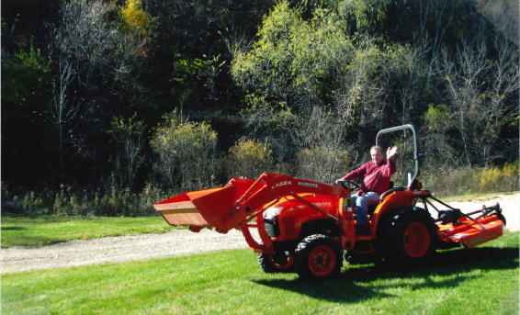
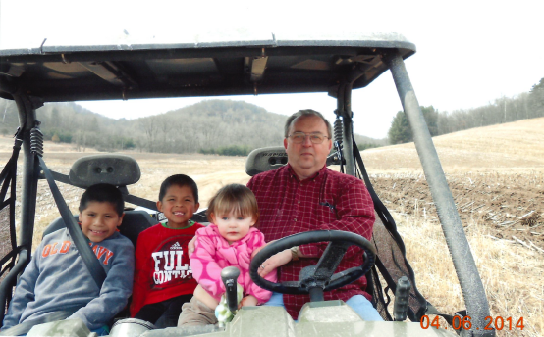
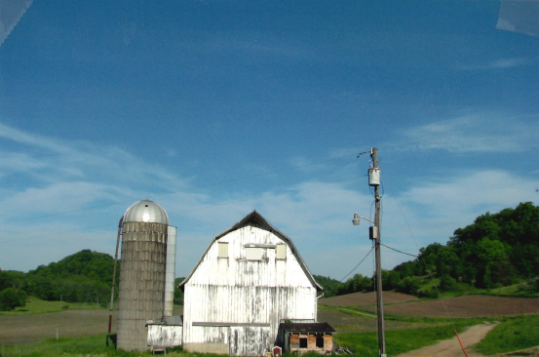
Richland Center Recreational Property

Slide 12
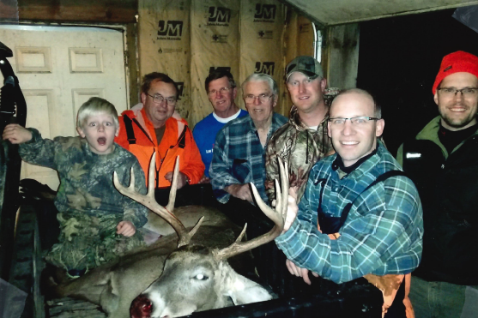
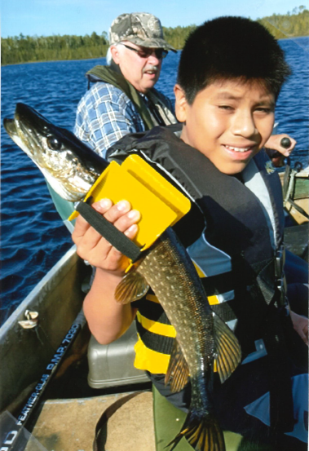
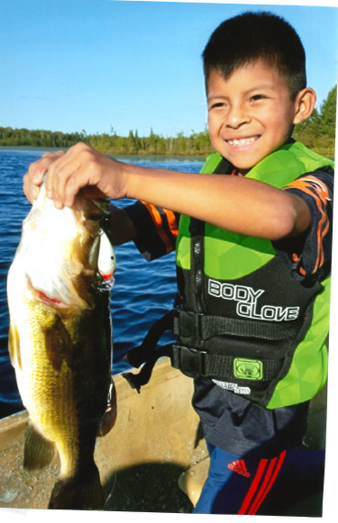
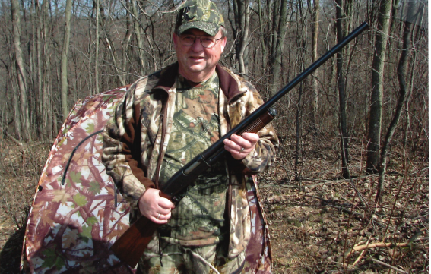
Hunting and Fishing – A Family Affair

Slide 13
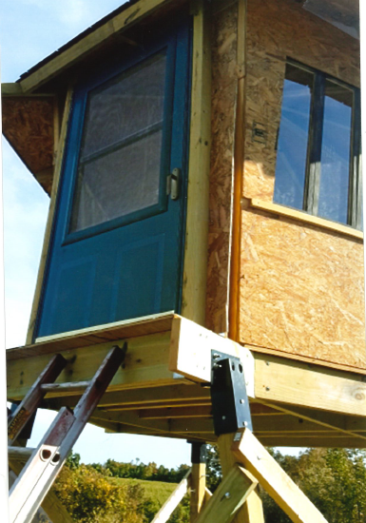
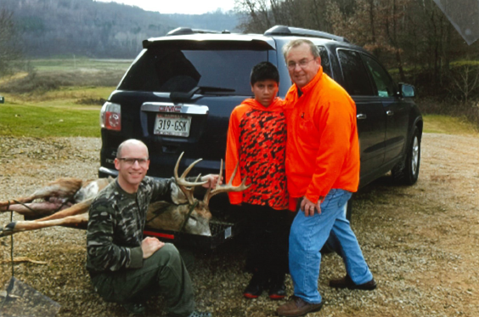
Hunting and Fishing – A Family Affair

Slide 14
Many Fond Travel Experiences
Extensive travel in 5 continents
Travelled for business, education, pleasure
Our travel “in a nutshell”
  Our world is amazing, but there is no place like home
  The many places we have been, the many thousands of pictures and all the memories are overwhelming
  What makes travel special? The PEOPLE and the CULTURES

Slide 15
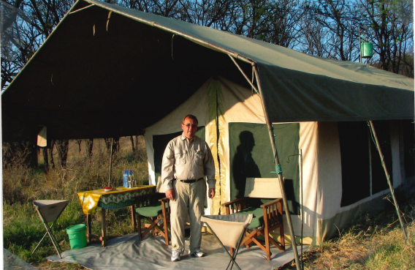
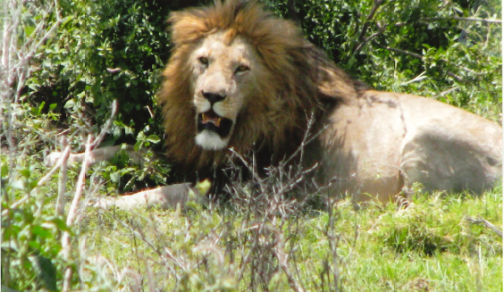
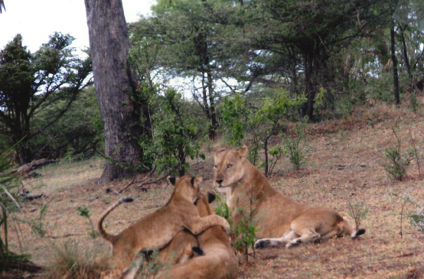
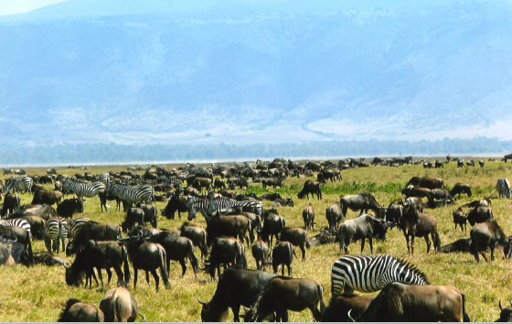
Many Fond Travel Experiences - Tanzania

Slide 16
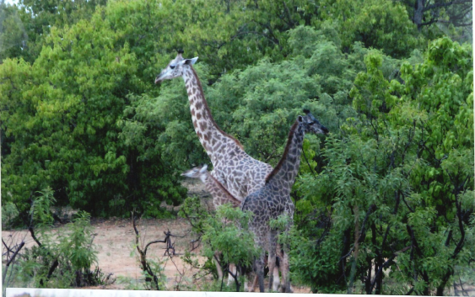
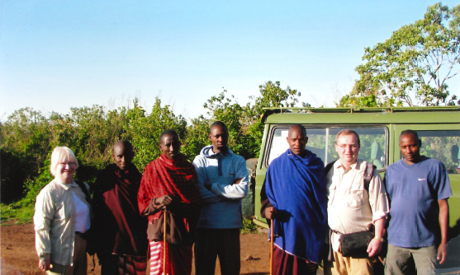
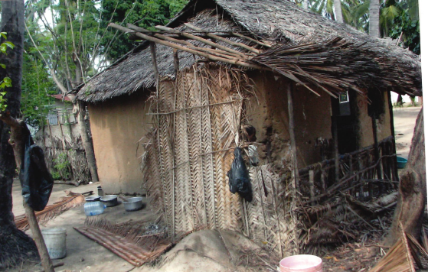
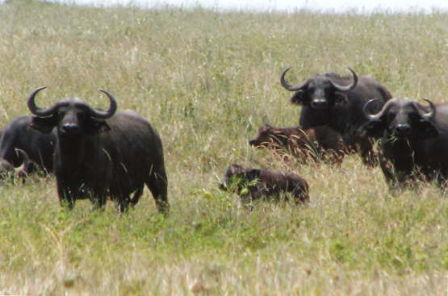
Many Fond Travel Experiences - Tanzania

Slide 17
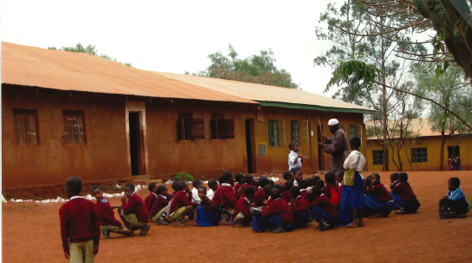
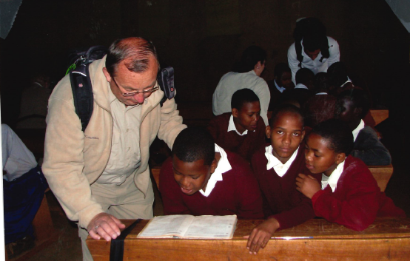
Many Fond Travel Experiences - Tanzania

Slide 18
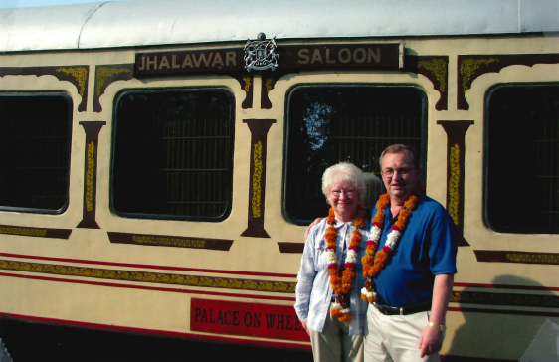
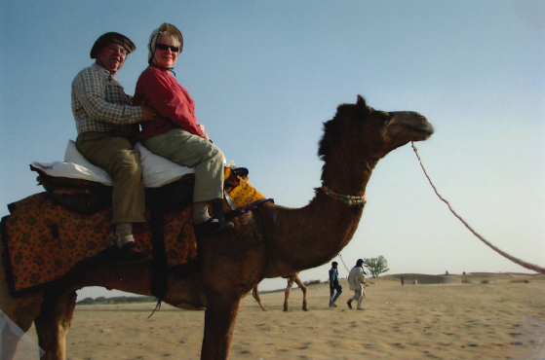
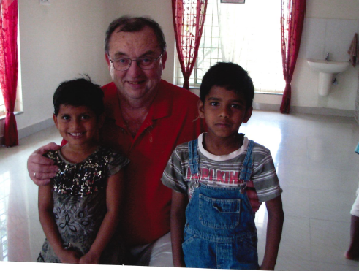
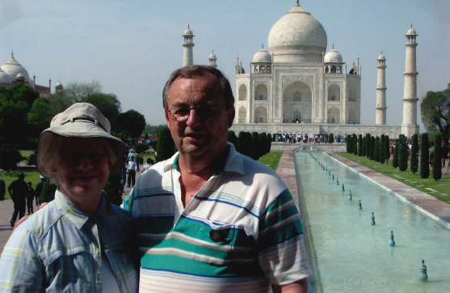
Many Fond Travel Memories - India

Slide 19
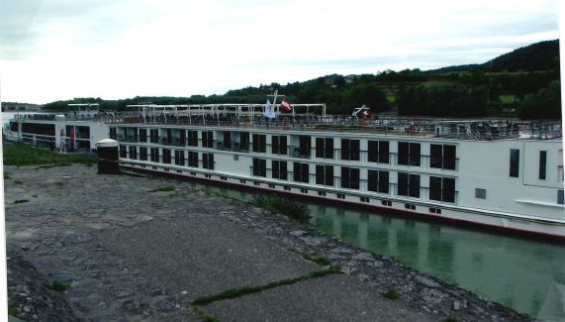
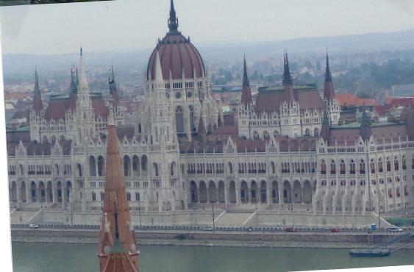
Many Fond Travel Experiences - Europe

Slide 20
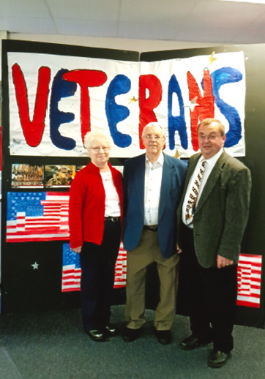
Veteran Advocacy

Slide 21
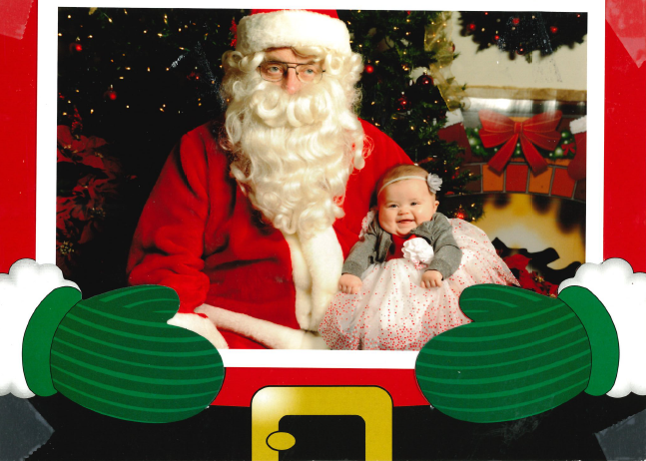
Santa’s Helper
‘Tis the Season!

Slide 22
So is VACATION my only VOCATION?

Slide 23
Work Experience
Strong work ethic since very early childhood
  Chores and responsibilities at home
  Tasks to help neighbors – got the idea of how to make a little money
  Lemonade stands and the typical kid attempts to make money
  Volunteer work – parents emphasized doing the right things for the right reasons in the right way. Not just about the money
Great opportunities to learn about business
  Family owned and operated Arndt’s Restaurant
  Helped dad manage his small contracting businesses
Summer jobs and learning opportunities throughout school years

Slide 24
The Trane and Gundersen Years
Trane: June 1970 – April 2005
Gundersen: April 2005 – December 2015

Slide 25
The Trane Years
Joined Trane in 1970 as a Manufacturing Engineer immediately after graduation from Michigan Tech
Was absolutely blessed with opportunities to gain broad technical, business and management experience
  Multiple plants, multiple products, multiple roles (Manufacturing Engineering, Quality Control, Development Engineering, Supply Chain, Operations Management, General Management, Executive Management)

Slide 26
The Trane Years
Had a lead role in development and manufacture of some flagship products (CenTraVac, scroll compressor, screw compressor, new chiller lines, many more)
Had strong support from many awesome people
  Trane leaders that took a chance on me
  Teams of people that I led were loyal and supportive

Slide 27
The Trane Years
Some of the most memorable highlights
  My First project
    No clue what to do
    Learned that I needed the people I was leading in the project much more than they needed me
    Relationships built during that project became the model for my whole career
  Learning about “chain of command”
  Getting fired and re-hired the same day
  Relationships
    Employees
    Labor/Management
    Suppliers
    Business Partners
  Doing deals
  Making a positive difference
Retired from Trane in 2005

Slide 28
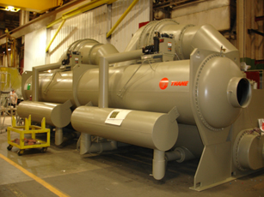
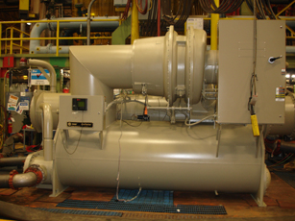

MANUFACTURING TO HEALTHCARE

Slide 29
My Migration Path
Long-standing curiosity and interest in healthcare.
Intensified interest in healthcare as healthcare costs became an increasingly important factor in the competitiveness of U.S. business and industry.
Personal engagement as a business leader in collaboration with Healthcare providers to address healthcare quality and cost issues.
  Some joint projects between Trane and our healthcare providers
  A “Business Partner” in the WCHQ (Wisconsin Collaborative for Healthcare Quality)
An invitation to join Gundersen Lutheran as an employee.
A new career in healthcare began April 19, 2005.

Slide 30
Some Key Healthcare Issues
Improvement of quality and cost-effectiveness in healthcare delivery.
More enlightened and responsible healthcare consumption.
More understanding and collaboration between healthcare providers, consumers, payers and government.
More proactive approach to healthcare – focus on wellness and proactive disease management.
    And the list goes on…

Slide 31
My Healthcare Career Objectives
Learn about and understand the opportunities.
Bring the perspective of the healthcare consumer and payer into clearer focus (former outsider now inside healthcare).
Find ways to apply manufacturing and business experience to healthcare improvement.
Just make a positive difference in anyway I can

Slide 32
The Gundersen Years – An unplanned second career
How did I get to Gundersen?
  Long-standing relationship with Gundersen through my Trane role
  Served as business partner with Jeff Thompson on Wisconsin Collaborative for Healthcare Quality
  Constantly challenged Gundersen about high cost of healthcare and the need for better business practices
  Dr. Thompson asked me if I would come over to Gundersen for “a while” to help with the stuff I had been fussing about
  I committed to 2 years

Slide 33
The Gundersen Years – An unplanned second career
What was my position description and role?
  TBD. Whatever is needed
  Dr. Jeff Thompson (CEO) and Kathy Klock (VP HR and Clinical Operations), Dr. Julio Bird (EVP and CMO) and I (SVP Business Services) served as the Senior Leadership Team
  Sorted out the roles and I came away with – Finance, Revenue Cycle, Marketing & Business Development, Supply Chain, Facilities, Government Relations & External Affairs, Process Improvement, Health Plan…
  Initially had 19 direct reports. Reorganized that into a very high functioning team

Slide 34
The Gundersen Years – An unplanned second career
The “table was set” with challenges and opportunities
A few highlights
  Built the organization and infrastructure for Business Services
  Healthcare cost containment
  Campus Renewal: Regional clinics, new hospital, new in-patient Behavioral Health, ICE House, Gund Loft Apartments, parking structures, major renovations and remodels..

Slide 35
The Gundersen Years – An unplanned second career
  Government Relations and External Affairs
  Community and neighborhood relationships
  Envision
  Insurance and payment transformation
  Mergers and acquisitions
  Partnerships
  ….
Blessed with opportune timing to make a difference
“Retired” at the end of 2015

Slide 36
Key Learnings From My Career
It’s all about relationships
A connection between people and processes
Recognize and pursue opportunities when they happen; they don’t last forever
You don’t have to be the strongest technical individual contributor to be the best leader
  I was “blessed to not be the best”. I needed my people and teammates more than they needed me
  Creating the environment for individuals and teams to be as good as they can be is the work of a good leader

Slide 37
Rotary Experience
Member of Downtown Rotary about 11 years
Chuck Hanson was my sponsor and easily convinced me about why I should be a Rotarian. Opportunity to serve and give back
Joined with the right intentions and still have them
My self-assessment as a member: Mediocre to Poor
  Spotty attendance
  Weak participation in club activities
  Under-performance vs. my potential
The many reasons for past performance are irrelevant to future involvement
“Giving back” is my priority at this stage of life
Rotary provides the perfect venue to do that
As Karen and Richard Carpenter said in one of their 1970’s hits “We’ve Only Just Begun”

