Slide 1
GROWING HEARTS ACROSS THE WORLD
Celebrating 100 years of Rotary in the Region

Slide 2
Overview of the Centennial Project
Centennial Committee
Riverside International Friendship Gardens Committee
History
Committee
Social, Event Dedication & Party Committee
Art
Committee
Fundraising Committee
Volunteer Committee
Marketing & Media
Commemorative
Coin Committee

Slide 3
The First Fon…the Traditional Leader

Slide 4
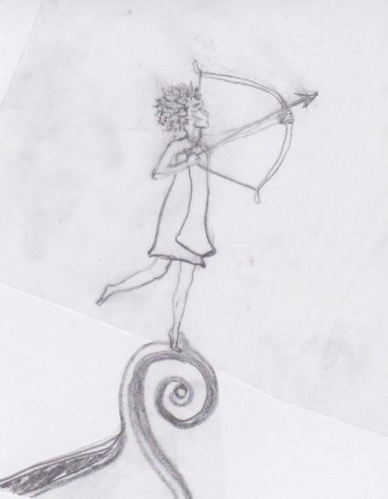
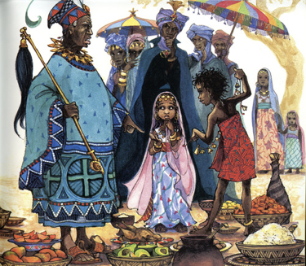
Sense Pass King…a Story from Cameroon

Slide 5
Water Mommy (Jenju)

Slide 6
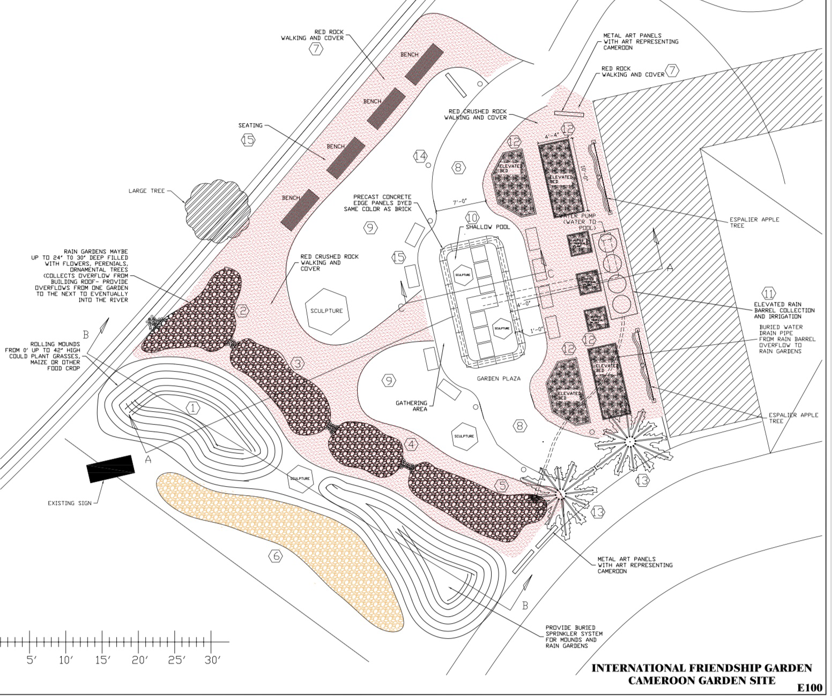

Slide 7
The Impact of 100 Years of Service to Our Region
Nine Rotary Clubs with 520 members
Seven Interact Clubs with more than 140 active members
We are reaching out to each of the area Rotary Clubs, asking them to become cosponsors and join in the Centennial celebration
To date, our efforts in reaching out for support through Rotary has received $56,500 in pledges and contributions!

Slide 8
Your Help Is Needed!
Growing Hearts Donors:
$100 per year, two yer pledge
Abundant Hearts Donors:
$500
$1000
$5000

Slide 9
Your Help Is Needed!
Naming opportunities will be available:
benches: $5000
Sculptures: TBD

Slide 10
Hearts To Schools
Community donors will help to fund the Growing Hearts Across the World garden.
Donors will have an option of supporting schools in Cameroon, called Hearts To Schools.
Donations received for Hearts To Schools will have 10% allocated for maintenance of the garden…and 90% allocated for books, iPads and laptops for schools in Cameroon

Slide 11
Your Help Is Needed!
Donations to Growing Hearts Across the World can be made to:
Rotary Works Foundation, P.O. Box 1571, La Crosse, WI 54602-1571

Slide 12
Thank you for your service through Rotary!

