Slide 1
GROWING HEARTS ACROSS THE WORLD
Celebrating 100 years of Rotary in the Region

Slide 2
Rotary Service to Our Region
In 1919, the first area Rotary Club was founded…the Rotary Club of La Crosse.
Today, we have eight more area Rotary Clubs…La Crosse East, La Crosse Valley View, La Crosse After Hours, La Crescent, Caledonia, Onalaska, Onalaska Hilltoppers and Holmen…more than 520 members.
Seven high School Interact Clubs (Central, Logan, Aquinas, Onalaska, Holmen, West Salem and Caledonia) with more than 140 active members.
Independent Clubs, with combined efforts through the Rotary Works Foundation.
All are committed to Service Above Self!

Slide 3
Serving Community and Across the World
A sample of local projects include: Rotary Lights, Kids Coulee, Moon Tunes, The Brain Game, iFeed and numerous scholarship and charitable events!
On the global stage: Polio Plus as well as projects in Russia, Brazil, Central and South America, Uganda, Romania, India and Cameroon
Nearly 200 international student exchanges, representing more than 30 nations.
It is not possible to adequately list the centennial impact of Rotary!

Slide 4
Growing Hearts Across the World…a Collaboration
Develop a garden to honor the Sister City relationship between La Crosse and Kumbo, Cameroon.
A Collaboration…Partnering with the International Friendship Gardens, the La Crosse Friends of Cameroon and the City of La Crosse.
Located in Riverside Park, La Crosse, adjacent to the International Friendship Gardens…a prominent location where the Mississippi, Black and La Crosse Rivers meet.
An attractive, visitor-friendly garden design with ample seating in an overlook setting.

Slide 5
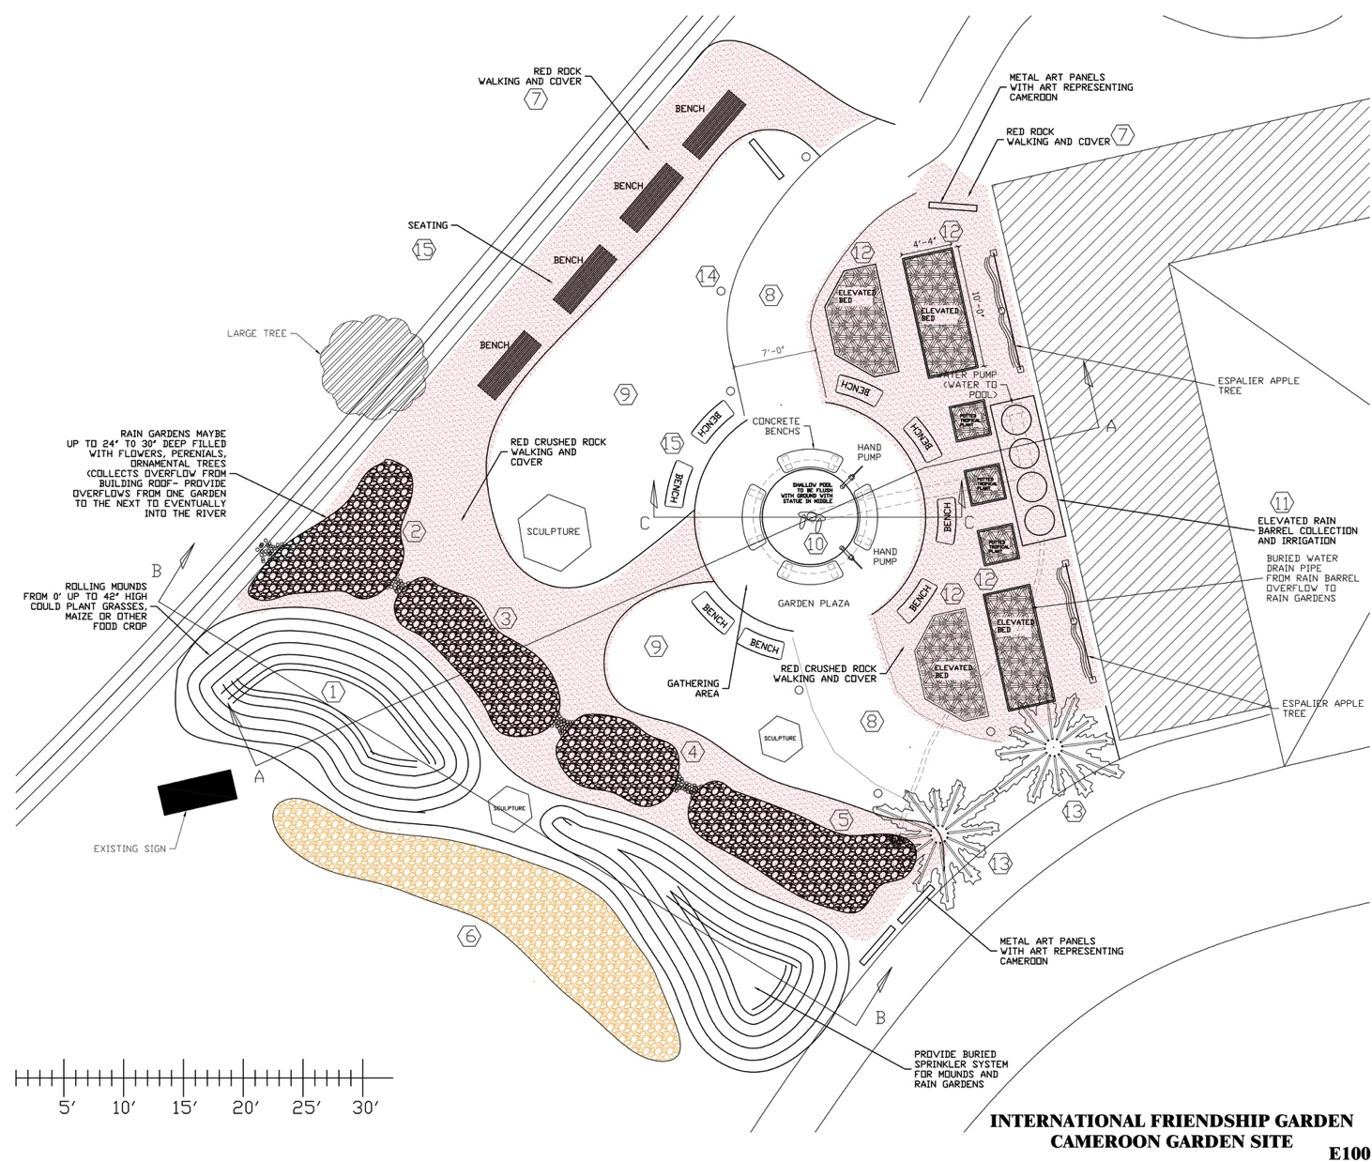

Slide 6
Hearts To Schools
Community donors will help to fund the Growing Hearts Across the World garden.
Donors will have an option of supporting schools in Cameroon, called Hearts To Schools.
Donations received for Hearts To Schools will have 10% allocated for maintenance of the garden…and 90% allocated for books, iPads and laptops for schools in Cameroon

Slide 7
Your Help Is Needed!
Donations to Growing Hearts Across the World can be made to:
Rotary Works Foundation, P.O. Box 1571, La Crosse, WI 54602-1571

