Slide 1
Board & committee overview
July 1, 2024
Title Page Option

Slide 2
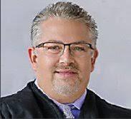
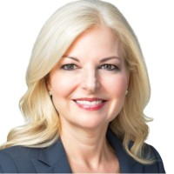
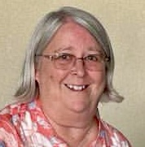
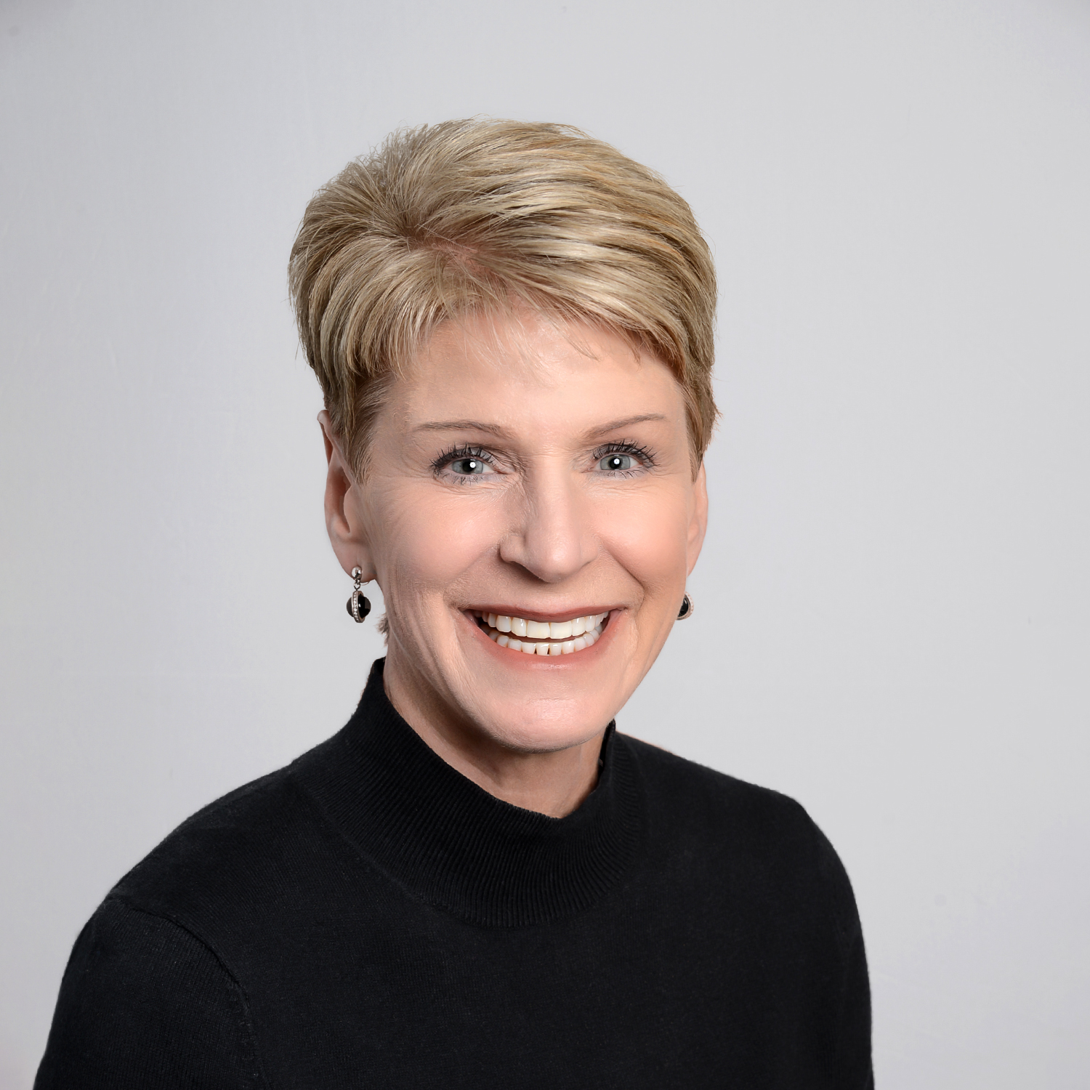
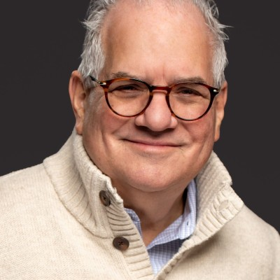
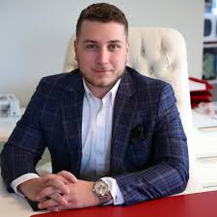
Board Members – Titled Positions
Mick Petrucci
Chairman of the Board
Provides strategic leadership and oversight
President
Treasurer
Secretary
President Elect
Next Gen Director
Debra Porter
Ginny Kownurko
Jennifer Ceslak
Steve Sabel
Nathan Breece
Lead the club's activities, initiatives, and meetings, ensuring alignment with Rotary's mission and goals
Manage the club's finances, ensuring accurate financial records, budgeting, and compliance with financial policies
Maintain records, club communication, newsletter, website, and ensuring compliance with Rotary's policies
Prepare for upcoming term by learning about club operations, participating in training, and planning initiatives
Engage younger members, foster leadership development, and to drive club growth
Notes:
https://pixabay.com/illustrations/ai-generated-man-business-suit-7849612/
https://pixabay.com/photos/woman-white-headshot-blonde-female-1460150/
https://pixabay.com/photos/woman-smiling-portrait-7338402/
https://pixabay.com/photos/woman-business-fashion-young-3060784/
https://pixabay.com/photos/woman-portrait-headshot-female-4525646/
https://pixabay.com/photos/young-clever-faces-people-happy-4549901/
https://pixabay.com/photos/business-man-man-portrait-male-805770/
https://pixabay.com/photos/startup-person-man-business-4859737/
https://pixabay.com/photos/black-man-portrait-kenya-headshot-7368384/

Slide 3
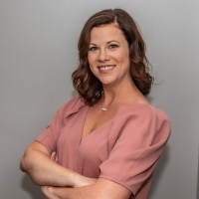
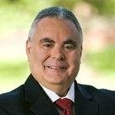
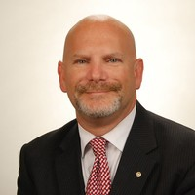
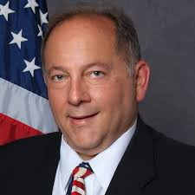
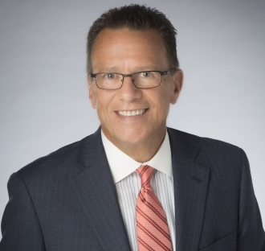
Board Members – Members at Large
Public Image Director
Grants & Fundraising Director
Sergeant at Arms
Club Growth Officer
Corporate Sponsorship Director
Finance Director
Stephanie Eubanks
Charlie Quattrone
Jeff Saperstein
Mark Craig
Paul Salvatore
Rick Rogers
Public Image and
Signature Fundraising Event (Hope on the Vine)
Grants & Fundraising Leadership
Club Promotional Materials, Attendance Management
New member recruiting & onboarding
Donation requests, Corporate Engagement, Community Outreach
Oversee Specific Projects & Committees, Interact
Notes:
https://pixabay.com/illustrations/ai-generated-man-business-suit-7849612/
https://pixabay.com/photos/woman-white-headshot-blonde-female-1460150/
https://pixabay.com/photos/woman-smiling-portrait-7338402/
https://pixabay.com/photos/woman-business-fashion-young-3060784/
https://pixabay.com/photos/woman-portrait-headshot-female-4525646/
https://pixabay.com/photos/young-clever-faces-people-happy-4549901/
https://pixabay.com/photos/business-man-man-portrait-male-805770/
https://pixabay.com/photos/startup-person-man-business-4859737/
https://pixabay.com/photos/black-man-portrait-kenya-headshot-7368384/

Slide 4
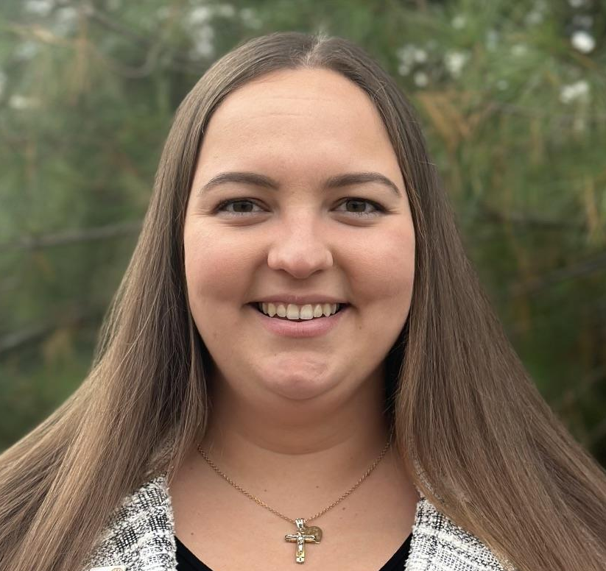
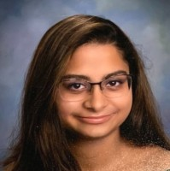
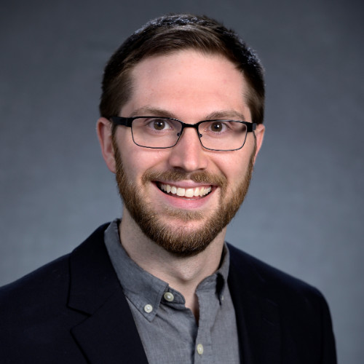
Board Members – NextGen
President
Treasurer
Secretary
Vice President
Kira Altomari
Nathan Breece
Ria Agarwal
Joe Adelmann
Lead the club's activities, initiatives, and meetings, ensuring alignment with Rotary's mission and goals
Manage the club's finances, ensuring accurate financial records, budgeting, and compliance with financial policies
Maintain records, club communication, newsletter, website, and ensuring compliance with Rotary's policies
Support the president in leading the club, and often overseeing specific projects or committees.
Notes:
https://pixabay.com/illustrations/ai-generated-man-business-suit-7849612/
https://pixabay.com/photos/woman-white-headshot-blonde-female-1460150/
https://pixabay.com/photos/woman-smiling-portrait-7338402/
https://pixabay.com/photos/woman-business-fashion-young-3060784/
https://pixabay.com/photos/woman-portrait-headshot-female-4525646/
https://pixabay.com/photos/young-clever-faces-people-happy-4549901/
https://pixabay.com/photos/business-man-man-portrait-male-805770/
https://pixabay.com/photos/startup-person-man-business-4859737/
https://pixabay.com/photos/black-man-portrait-kenya-headshot-7368384/

Slide 5
Committee Overview
Diversity, Equity & Inclusion
Environmental Sustainability
Fellowship
Senior Accountants
Chairperson:
Chairperson:
Chairperson:
Shikha Prashar
Vacant
Landen Swain & Vacant
Primary Goal:
Primary Goal:
Primary Goal:
Ensure the club is inclusive and welcoming
Focus on environmental conservation efforts.
Create fellowship interest groups based on members' hobbies and interests to foster club camaraderie
Importance:
Importance:
Creating a welcoming and inclusive environment attracts a diverse membership, fostering a rich exchange of ideas and perspectives which strengthens the club’s community impact.
Addressing environmental issues helps preserve the planet for future generations, aligns with global sustainability goals, and positions the club as a leader in eco-friendly initiatives.
Importance:
Strong fellowship bonds enhance member retention and engagement, creating a supportive network that makes club activities more enjoyable and effective.
Introduction
Notes:
https://unsplash.com/photos/7aakZdIl4vg

Slide 6
Committee Overview
Finance & Allocation
Fundraising & Development
Senior Accountants
Chairperson:
Chairperson:
Rick Rogers & Vacant
Ehab Abousabe
Primary Goal:
Primary Goal:
Hope on the Vine:
Develop and manage the club’s budget.
Plan and execute fundraising activities.
Stephanie Eubanks & Danielle Witting
Importance:
Importance:
Sound financial management ensures the club can sustainably fund its projects and initiatives, maintaining financial accountability
Effective fundraising supports the club’s philanthropic efforts and community projects, allowing for growth and expanded impact.
Paul Salvatore, Jerry Agasar, Charlie Quottrone, Stephanie Eubanks
Corporate Outreach & Engagement
Paul Salvatore
Introduction
Members:
Members:
Mick Petrucci, Ginny Kownurko, Paul Salvatore, Charlie Quattrone, Steve Sabel
Notes:
https://unsplash.com/photos/7aakZdIl4vg

Slide 7
Committee Overview
Government & Community Relations
Governance
Grants
Senior Accountants
Chairperson:
Chairperson:
Chairperson:
Allen Fidler
Paul Salvatore & Jerry Agasar
Charlie Quattrone
Primary Goal:
Primary Goal:
Primary Goal:
Build and maintain relationships with local government officials.
Ensure understanding of club history and leadership selection process.
Identify potential grant opportunities
Importance:
Importance:
Importance:
Strong relationships with local government facilitate advocacy for policies beneficial to the community and ensure the club is informed and influential in local decision-making.
Good governance practices ensure transparency, accountability, and continuity in leadership, fostering trust within the club
Securing grants provides additional funding sources for projects, enhancing the club’s capacity to make a significant impact in the community.
Introduction
Members:
Members:
SA Vaneswaran
Mark Craig, Allen Fidler
Notes:
https://unsplash.com/photos/7aakZdIl4vg

Slide 8
Committee Overview
Historian
Marketing & Community Outreach
Membership
Senior Accountants
Chairperson:
Chairperson:
Chairperson:
Mark Craig
Jennifer Ceslak
Mark Craig
Primary Goal:
Primary Goal:
Primary Goal:
Document and update the club's history.
Enhance Rotary’s visibility, promote its mission and activities, and engage the community.
Develop strategies to recruit and retain members.
Importance:
Importance:
Preserving the club’s history honors past achievements, educates new members, and maintains a legacy that inspires future initiatives.
Importance:
A growing and engaged membership base is crucial for the club’s vitality and ability to achieve its goals, ensuring sustained involvement and fresh ideas.
Creating public awareness and support for Rotary's initiatives drives membership growth & community eng
Introduction
Members:
Members:
Members:
Paul Salvatore
Stephanie Eubanks (Public Image), Debbie Verwoerd
Steve Sabel
Notes:
https://unsplash.com/photos/7aakZdIl4vg

Slide 9
Committee Overview
Meetings, Programs & Events
Service Projects
Chairperson:
Chairperson:
Danielle Wittig
Jerry Asgar & Cathy Asgar
Holiday Projects:
Primary Goal:
Primary Goal:
Paul Salvatore
Enhance member engagement through well-organized and impactful meetings and events.
Orchestrate community service projects that address local and global needs
Inter Club / Non-Profit Showcase
Importance:
Importance:
High-quality programs and events keep members engaged, informed, and inspired, driving the club’s mission, and enhancing its relevance in the community.
Meaningful community engagement drives lasting positive impacts through well-coordinated service initiatives.
Nathan Breece
Introduction
Members:
Paul Salvatore, Nathan Breece
Notes:
https://unsplash.com/photos/7aakZdIl4vg

Slide 10
Committee Overview
Sunshine Outreach & Senior Engagement
Technology & Innovation
Youth Services & Literacy
Senior Accountants
Chairperson:
Chairperson:
Chairperson:
Mick Pettrucci
Kyle Davis
Donna Miller, Susan Schino, Rick Rogers
Primary Goal:
Primary Goal:
Enhance the club's use of technology.
Primary Goal:
Support members during times of illness, loss, or personal challenges.
Engage and support young people in the community.
Importance:
Importance:
Leveraging technology improves communication, streamlines operations, and ensures the club remains current and efficient in the digital age.
Importance:
Providing emotional support strengthens the club’s community, fostering a sense of care and solidarity among members.
Focusing on youth services and literacy invests in the future, empowering the next generation and fostering a culture of learning and service.
Introduction
Members:
Bindu Agarwal, Ryan Krocke (Senior Engagement)
Notes:
https://unsplash.com/photos/7aakZdIl4vg

