Slide 1
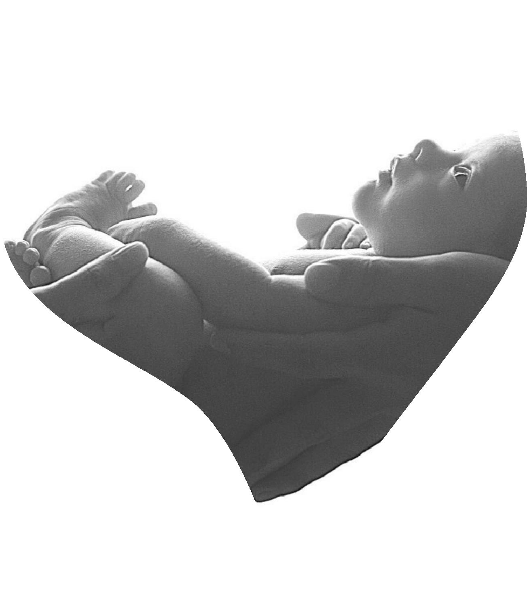
ROTARY DISTRICT 3131
THRUST PROJECT FOR RY 2023-24
“Gift of Life – Nanha Sa Dil”
Paediatric Cardiac Surgery and Maternal health Project
20
21st April
23

Slide 2
The Problem
Approx 240,000 children (8 out of 1000 live births) are born in India with Congenital Heart Disease (CHD)
Higher incidence in weaker socio- economic segments
CHD is the most common cause of infant mortality (3-10% of infant deaths)
Life expectancy of CHD afflicted children is typically < 5 years
Malnutrition during pregnancy is an important cause for pediatric CHD
“Gift of Life – Nanha Sa Dil”
rt

Slide 3
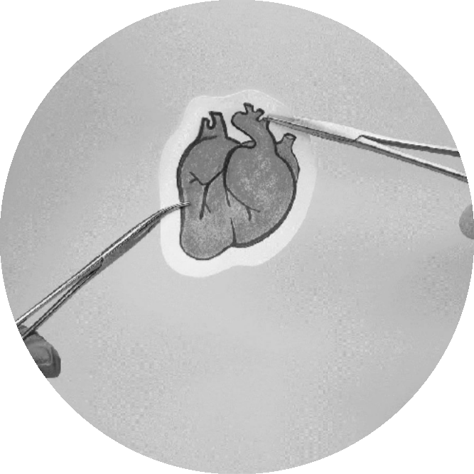
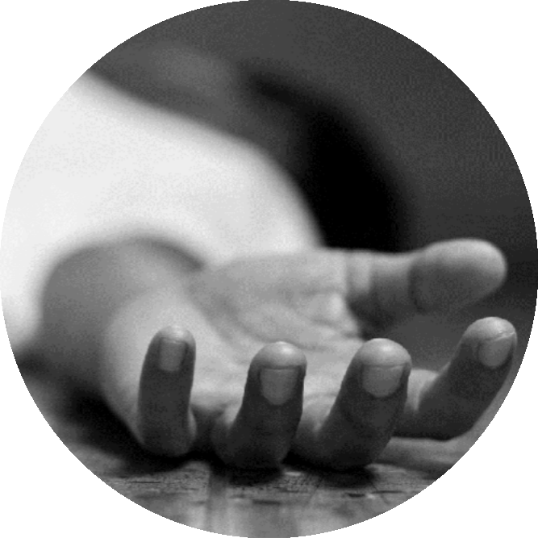
Need for the Project
The need - treatment gap
“Gift of Life – Nanha Sa Dil”
2-3%
Despite acute need, pediatric cardiac services & care remains inadequate and beyond reach
Currently, only 2-3% of infants requiring congenital heart surgery undergo it, as the condition remains undetected, or facilities are
unavailable or unaffordable.
Result - thousands of infants die every year.

Slide 4
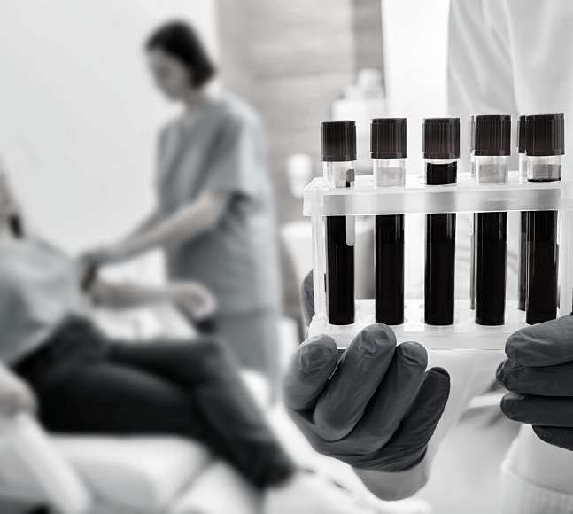
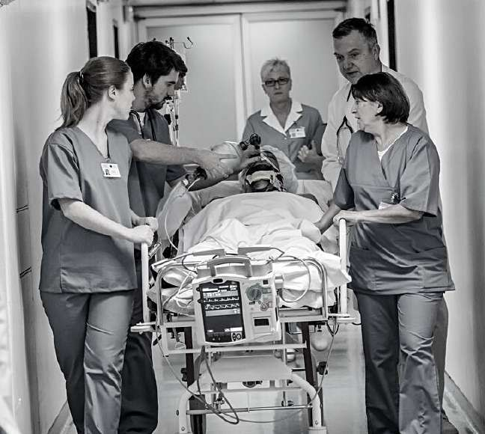
Objectives & Scope of the Project
Scope: fund the cost of the surgery and cover all related expenses such as
“Gift of Life – Nanha Sa Dil”
Hospitalization including surgery costs, medicines and consumables
Accommodation and food expenses for the parents accompanying the child
Post-surgery recuperation (including ICU stay), follow-up checks etc.
Pre-surgery tests and diagnostics

Slide 5
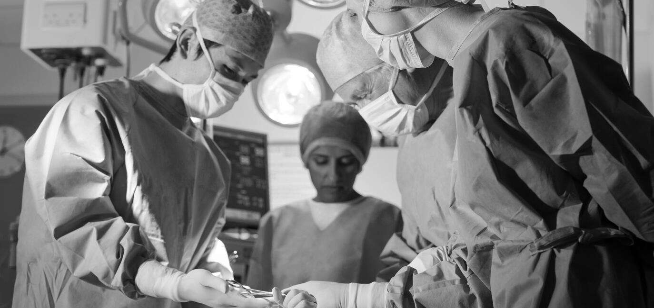
Project Implementation Partner & their Credentials
Shall engage with areputed hospital as an implementation partner:
“Gift of Life – Nanha Sa Dil”
Sri Sathya Sai Sanjeevani Hospital at Kharghar, Navi Mumbai, dedicated to paediatric CHD corrective surgeries:
Having capacity to perform 130 surgeries per month ranging from simple ASD to complex TAPVC, Arterial Switch etc.
Notified by MH Govt as an apex centre for CHD referral & treatment.
Having a waiting list of >600 cases.
Post-surgery mortality is <1.5%.
Included in the project scope is follow- up consultation at interval of 1 month, 6 months and one-year after surgery.

Slide 6
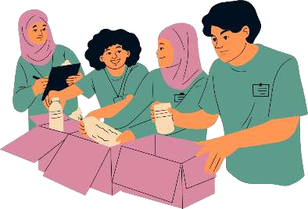
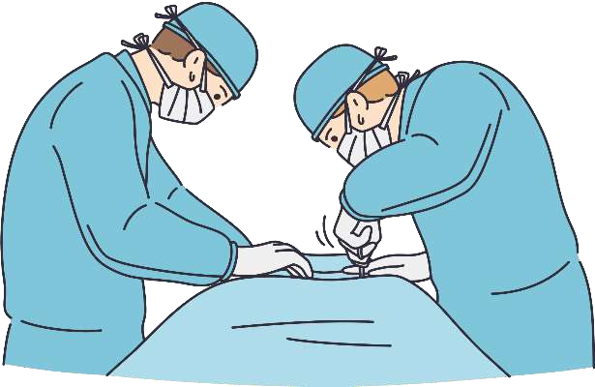
Beneficiaries of the Project
“Gift of Life – Nanha Sa Dil”
BPL families are scrutinized through various tools/mechanisms such as documentation, home visits, references by social &/or health workers, etc.
Upto 25 paediatric CHD corrective surgeries of children from BPL families
Health check-up and distribution of nutritional food packets & counselling for upto 50 expecting mothers
The project envisages treating all cases of non- affording paediatric CHD referred to us or to the partner hospital

Slide 7
Project Cost
Item
Unit
Cost, US$
Vendor
Quantity
Amount,
US$
“Gift of Life – Nanha Sa Dil”
L
Sai Sanjeevani Hospital, Kharghar, Navi Mumbai
Paediatric CHD corrective surgery
1,800
25
45,000
Sai Sanjeevani Hospital, Kharghar, Navi Mumbai
Ante-Natal Care
80
50
4,000
Contingency
500
Misc. Admin. Exp
500
Total Cost
$50,000

Slide 8
Proposed Funding
Source | District | Amount, US$
RC Pune Central (Sponsor) | 3131 | 15,000
Other Clubs | 3131 | 12,000
DDF | 3131 | 5,000
RC Morrisville-Yardley & Other clubs | 7430 | 5,000*
Overseas DDF | Under discussion | 5,000
World Fund Match (TRF) |  | 8,000
Total |  | 50,000
*Assistance requested

Slide 9
“Gift of Life – Nanha Sa Dil”
Rtn Manjoo Phadke District Governor – 2023-24 RID 3131
Cell: 9881498787
Email: dgmanjoo2324@gmail.com
Rtn Ravi Kapoor
District Director – 2023-24 Gift Of Life
Cell: 9881400201
Email: rkapoor216@gmail.com

