Slide 1


SHS Rotary-Interact
April 12, 2019

Slide 2
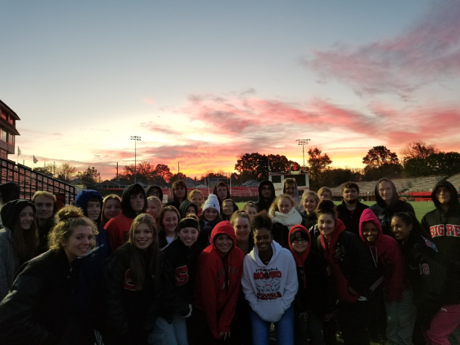
Introduction
Est. October of 2016
Scott Lane faculty advisor
80 Active Members

Slide 3
Where We’ve Been
Fall Projects
Christmas Projects
Spring Project

Slide 4
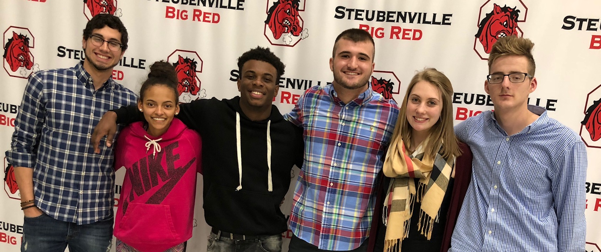
Officers 2019

Slide 5
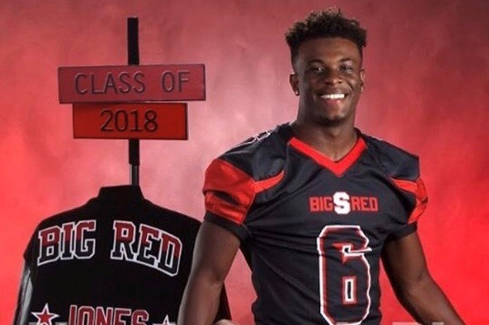
President
Makayla Crownover
State Champion
Track
Presidential Leadership
Associates Degree
Future Plans

Slide 6

Vice President
Donavin Thornton
University Scholars 3.7
Football (State Champion)
Active member of community
Associates Degree
WVU
Why Volunteer?

Slide 7
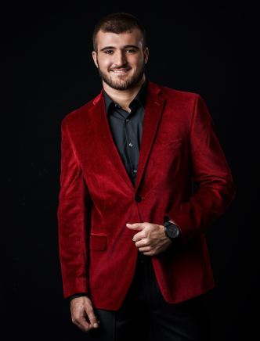
Treasurer
Paul Mastros
University Scholars
4.1 GPA
Golf (D1 bound)
Pres. Of Greek Orthodox Youth of America
Furman University
Why Rotary-Interact?

Slide 8
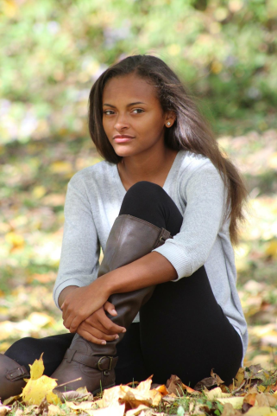
Secretary
Tia Rubish
University Scholars
4.4 GPA
Soccer, Cheering,
Key Club, Interact
Associates Degree
Possible future plans
Why Volunteer?

Slide 9
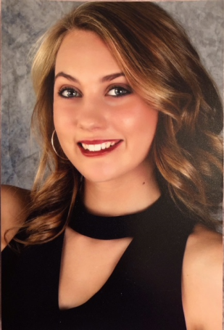
Ambassador
Dylan Cunningham
Football (State Champion), Baseball
3.75 GPA
Drama Club and A Cappella Choir
2 year member Interact
Why Interact?

Slide 10
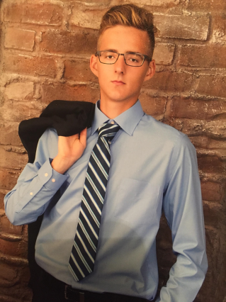
Consigliere
Maggie Fabian
Band
GPA
West Liberty
Why volunteer?

Slide 11

Our Meetings
2 Meetings per Month
Flexibility
Robert’s Rules of Order

Slide 12

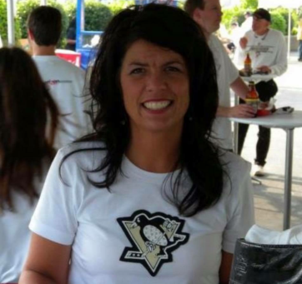
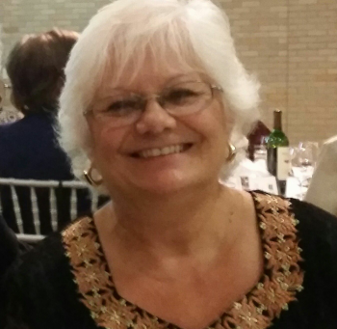
Our Contacts
Andrea Hale
Kathy Musso

Slide 13
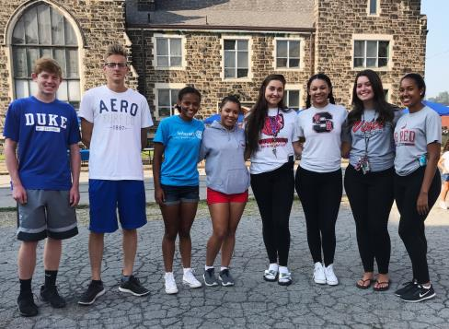
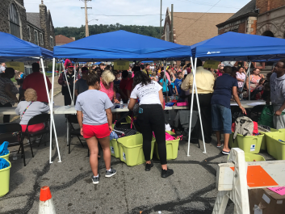
Painting Pico Park

Slide 14
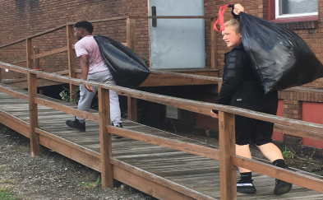
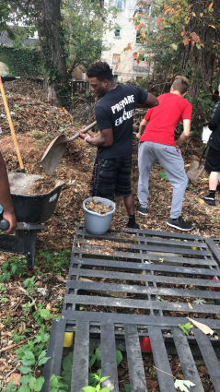
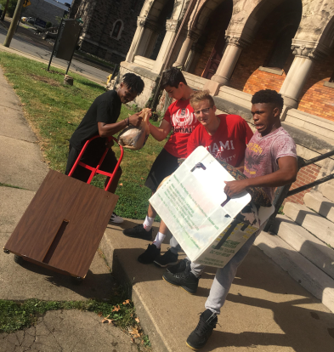
Pico

Slide 15
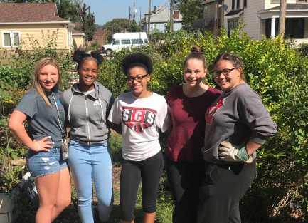
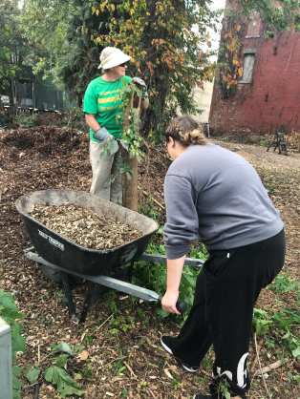
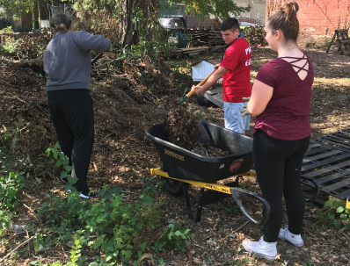
Together we care

Slide 16
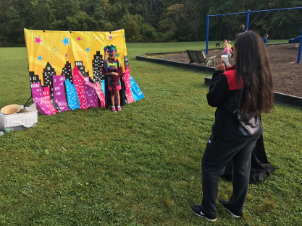
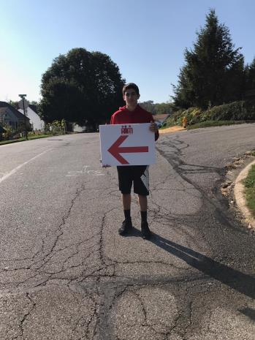
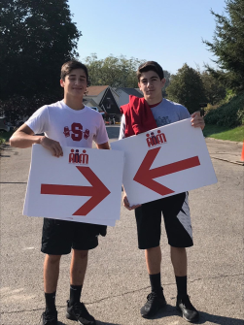
Hero 5K

Slide 17
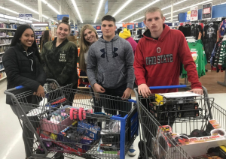
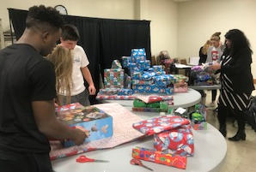
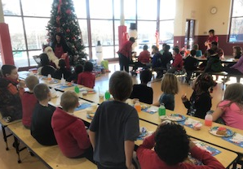
East
Elementary
Gifts

Slide 18
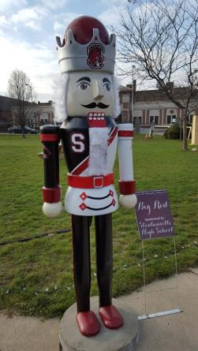

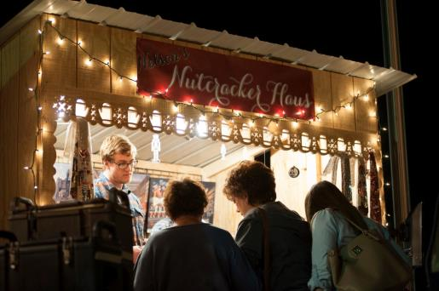
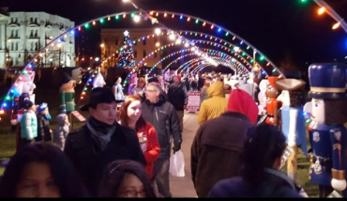

Slide 19
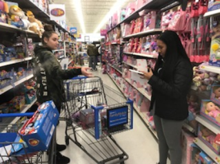
Winter Project
Give 2 SCS Students a life changing experience
Raise Money

Slide 20
Winter Project
$60 from our funds
Raised $600*
Sold at lunch

Slide 21



Winter Project

Slide 22
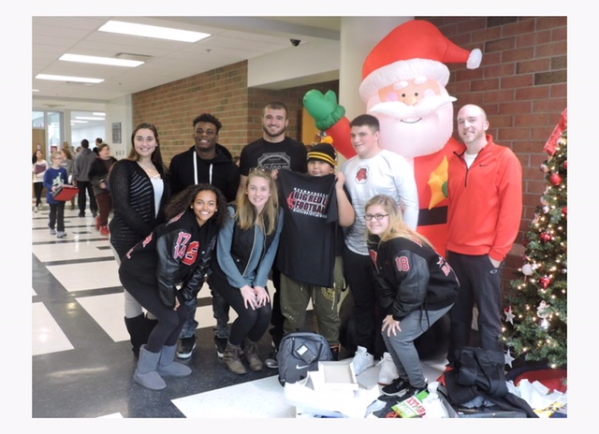
Winter Project

Slide 23
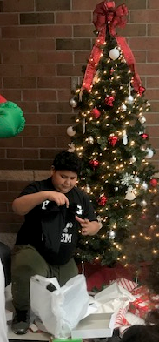
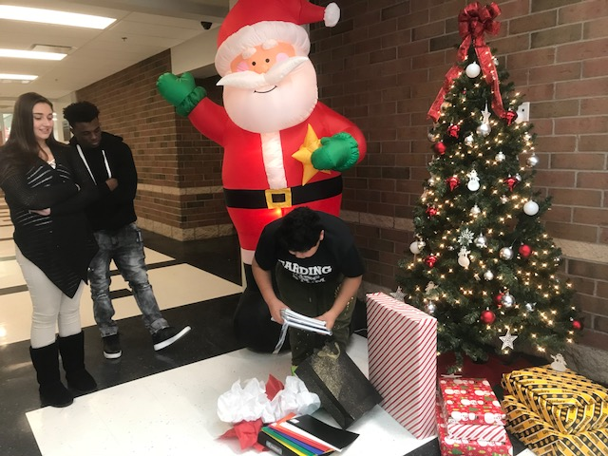
Winter Project

Slide 24
Spring Project
Relay for Life
Used to Be
What it is now
Last Year’s outcomes

Slide 25
Spring Project -
Relay for Life 2017
$7,461
Edison HS
  1st Place
$6,060 Harding
  2nd Place
$4,992
ICES
  3rd Place

Slide 26
Spring Project –
Relay for Life
Goal = $5,000
Walk with incentives
Dodgeball
New Fundraisers

Slide 27
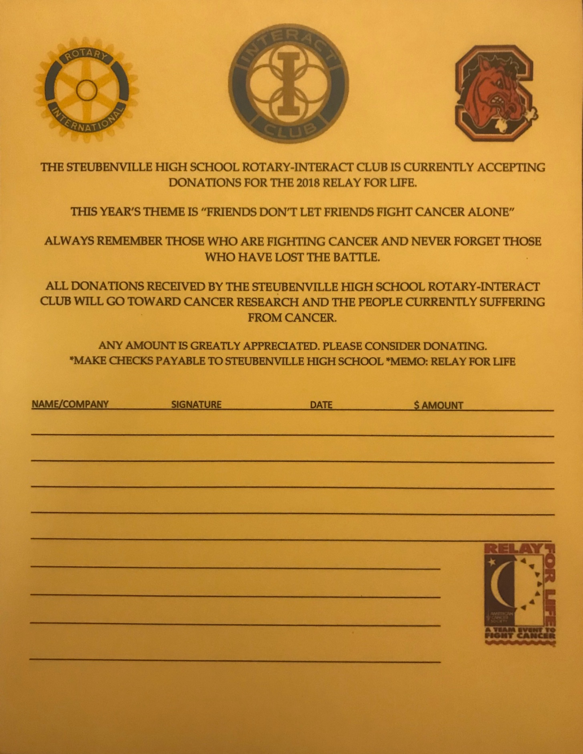
Spring Project – Relay for Life
May 10th
Donation Sheet

Slide 28


Future
Serve the Community
More International presence
Do good and have fun doing it!

