Slide 1

Emergency Sheltering
York County Emergency Management Agency

Slide 2

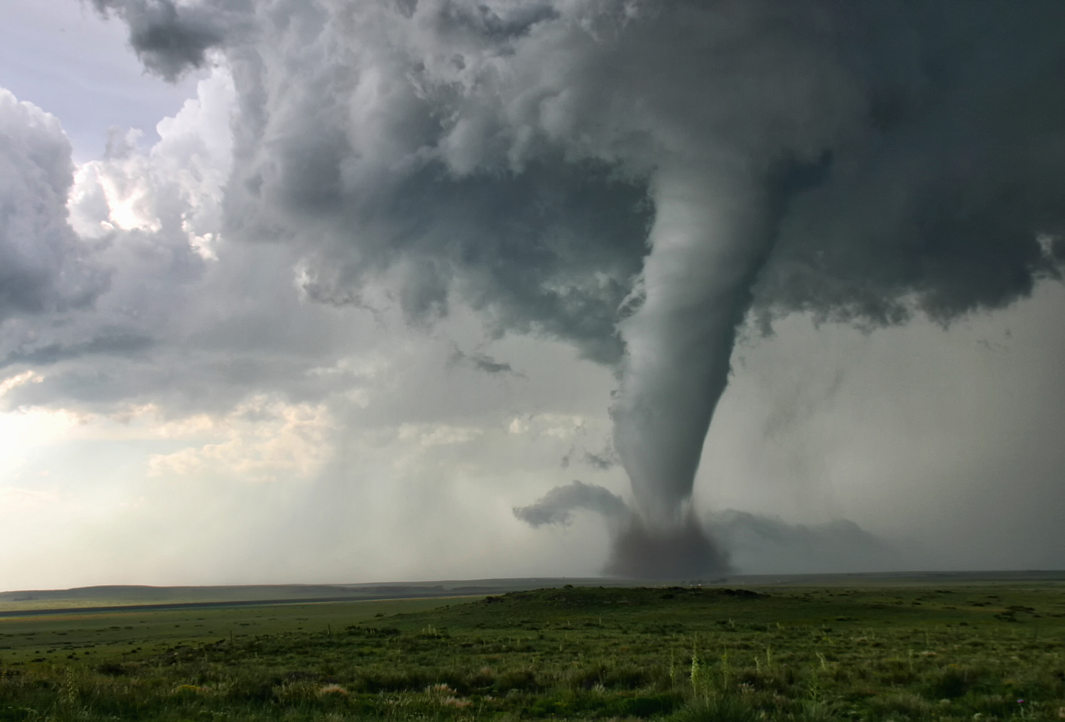
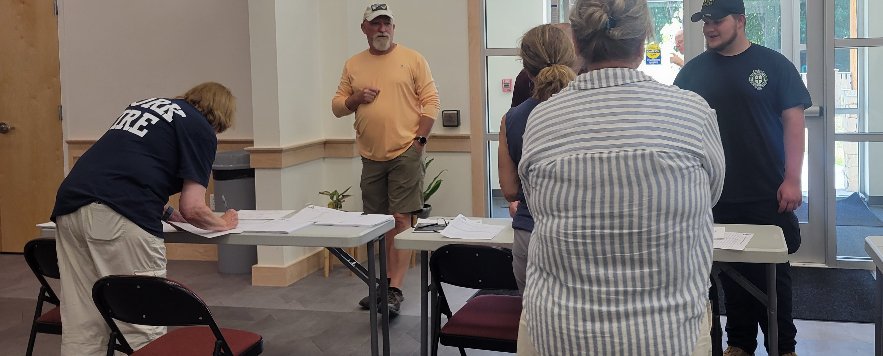
Agenda
Welcome
Emergency management
Who is YCEMA?
Preparedness overview
Sheltering
How to get involved
Questions and wrap up

Slide 3
Emergency Management
Preparedness
Response
Recovery
Mitigation
4 phases of emergency management
Facilitate/coordinate with towns, first responders, and other stakeholders
Liaison between local, state, and federal agencies
Local, county, state, federal, and private

Slide 4

York County Emergency Management Agency
Located in Alfred, ME
Part of York County Government
Work with 29 York County municipalities
7 full-time staff plus several part-time responders and volunteers
Contact us
ema@yorkcountymaine.gov
207-324-1578
Figure 1. York County EMA logo

Slide 5
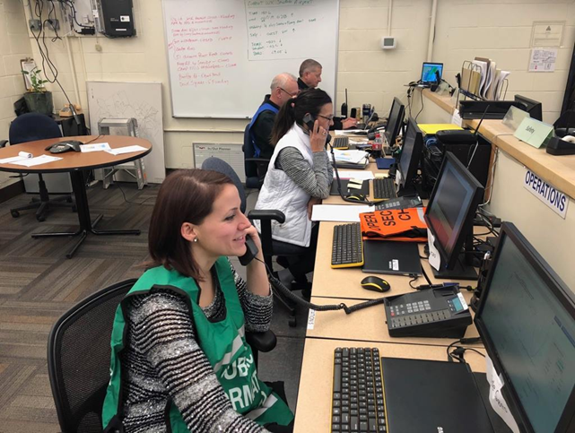
What We Do
Hazard analysis
Emergency planning
Training and exercise
Public education and outreach
Emergency operations center
Resources and coordination
Sheltering
Special Teams
Disaster recovery and resilience
Figure 2. York County EOC

Slide 6
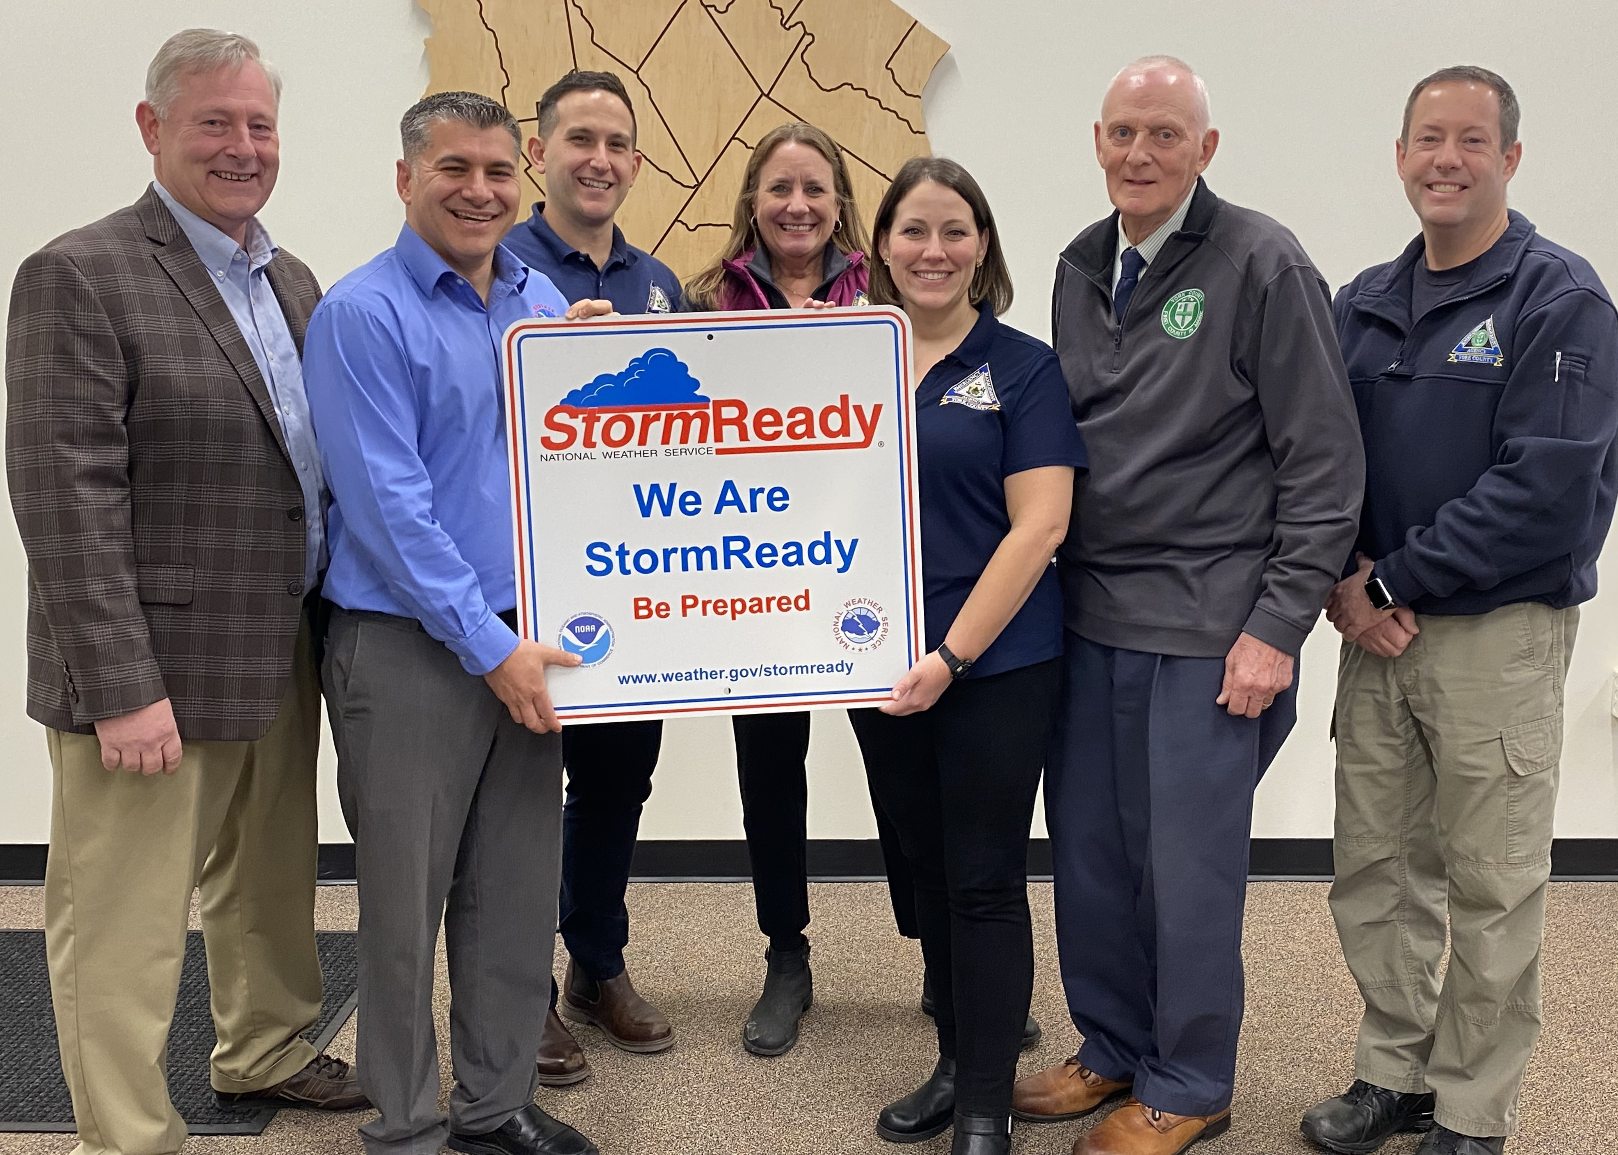
Emergency Preparedness
“The range of deliberate, critical tasks and activities necessary to build, sustain, and improve the operational capability to prevent, protect against, respond to, and recover from domestic incidents” (FEMA, 2023).
Figure 3. Storm Ready

Slide 7

Why Emergency Preparedness is Important
Reduces risk of injury and death and minimize damage to property
Empowers individuals and families
Reduces fear and anxiety in response to disasters, especially for children
Speeds up disaster recovery
Reduces disaster-related costs
Creates resilient communities
Figure 4. Hurricane Harvey (Taylor, 2017)

Slide 8
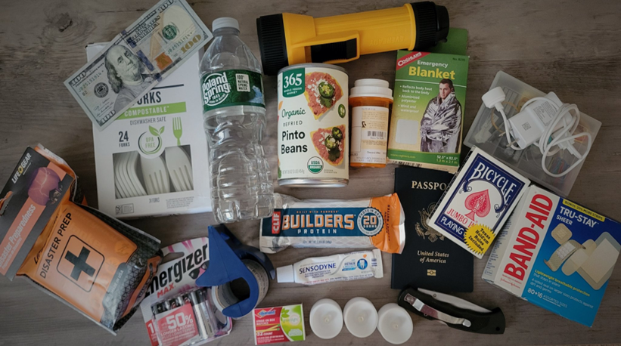
So, What Exactly Is It?
Know the hazards
What could happen, risk, specifics
Have a kit
3-7 days, updated, accessible, special needs
Make a plan
Tasks, communication, contacts, meeting place, evacuation, sheltering
Stay informed
Have multiple ways to receive info
Stay informed
Have multiple ways to receive info
Text YorkCountyAlerts to 226787
Know local resources
EMA Director, shelters, evacuation routes
Get involved
Train, educate, volunteer
Figure 5. Disaster kit items

Slide 9
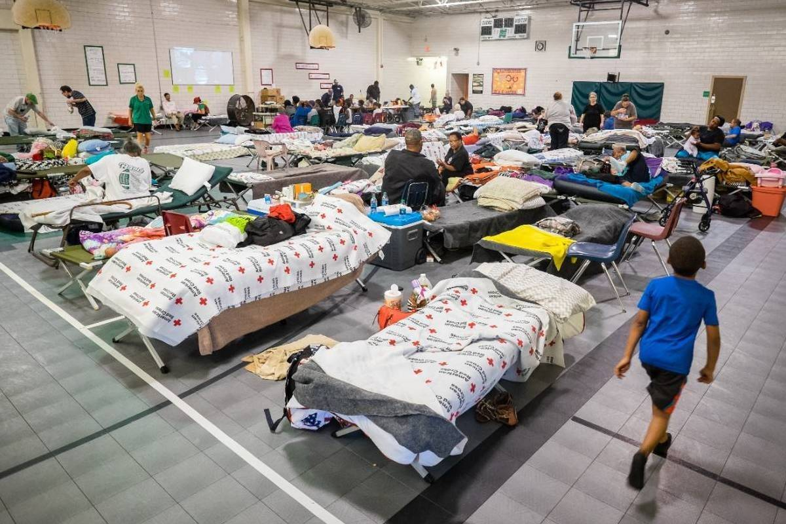
Disaster Sheltering
Temporary housing accommodations for individuals and communities who have been affected by an emergency incident
Typically organized and managed by government agencies, non-governmental organizations (NGOs), and humanitarian organizations​
Local responsibility and authority
Figure 6. Mass Care Shelter (American Red Cross, 2019)

Slide 10
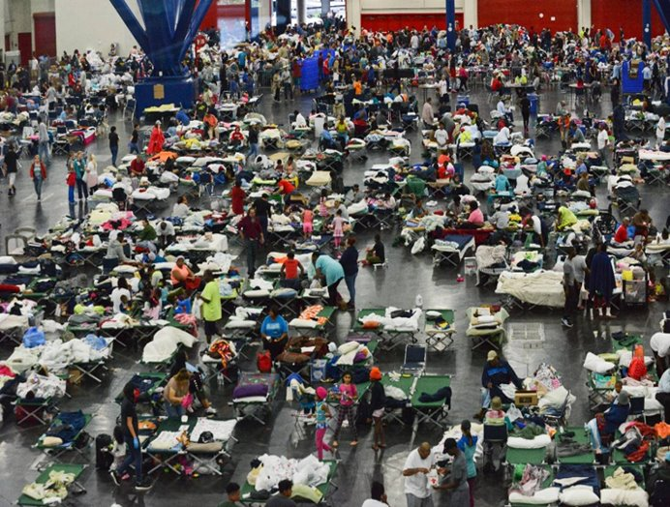
Types of Shelters
Congregate
Disaster shelters
Warming and cooling centers
Evacuation centers
Non-congregate
Hotels
Dorms
Figure 7. Hurricane Harvey (Taylor, 2017)

Slide 11
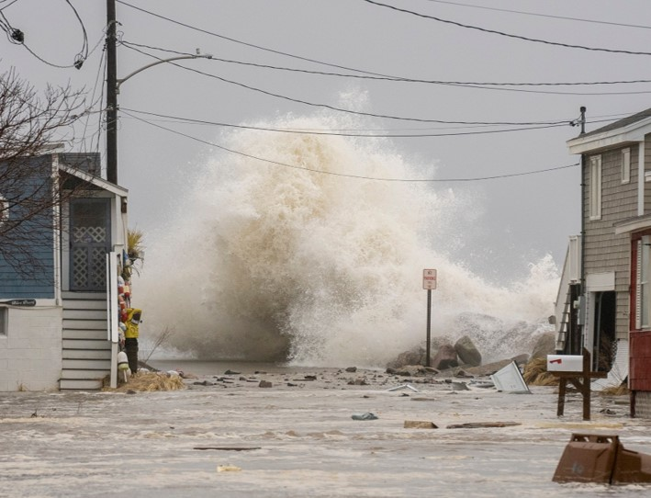
Scenarios That Could Open a Shelter in York County
We plan for “all-hazards” so almost any scenarios could trigger a shelter opening in York County:​
Floods
Hurricanes​
Snow/ice storms​
Fires
Extreme heat or cold​
Tornadoes​
Extended power outages​
HazMat incident
Figure 8. Camp Ellis January 2024 Storm

Slide 12
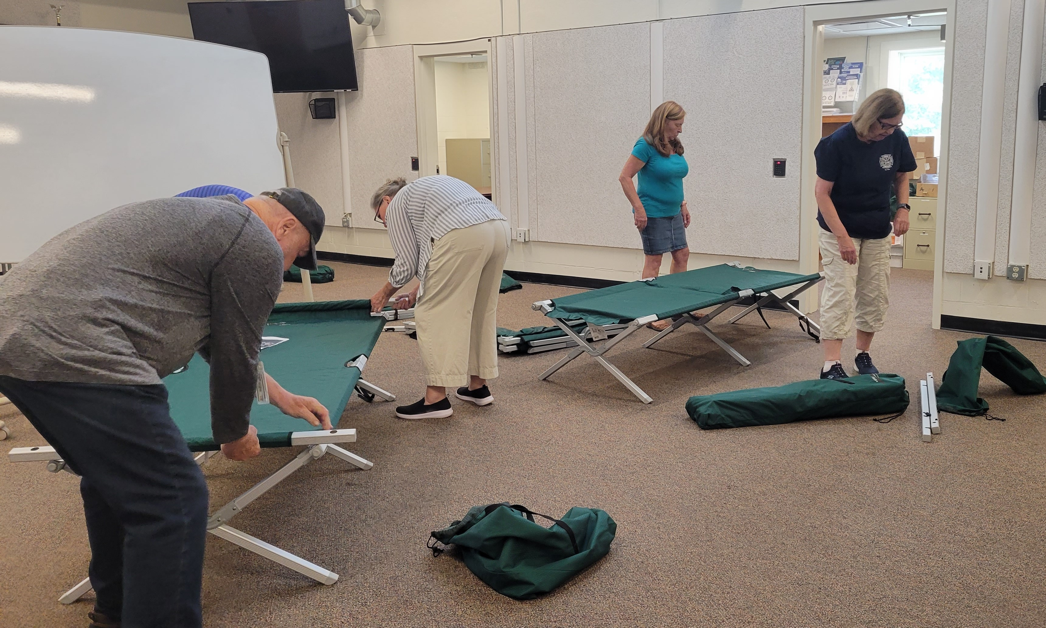
Who is Involved?
Local Emergency Management Director
Municipal staff
York County EMA
Local volunteers
Non-governmental agencies
York County Special Teams
You!
Figure 9. Shelter Set-Up

Slide 13
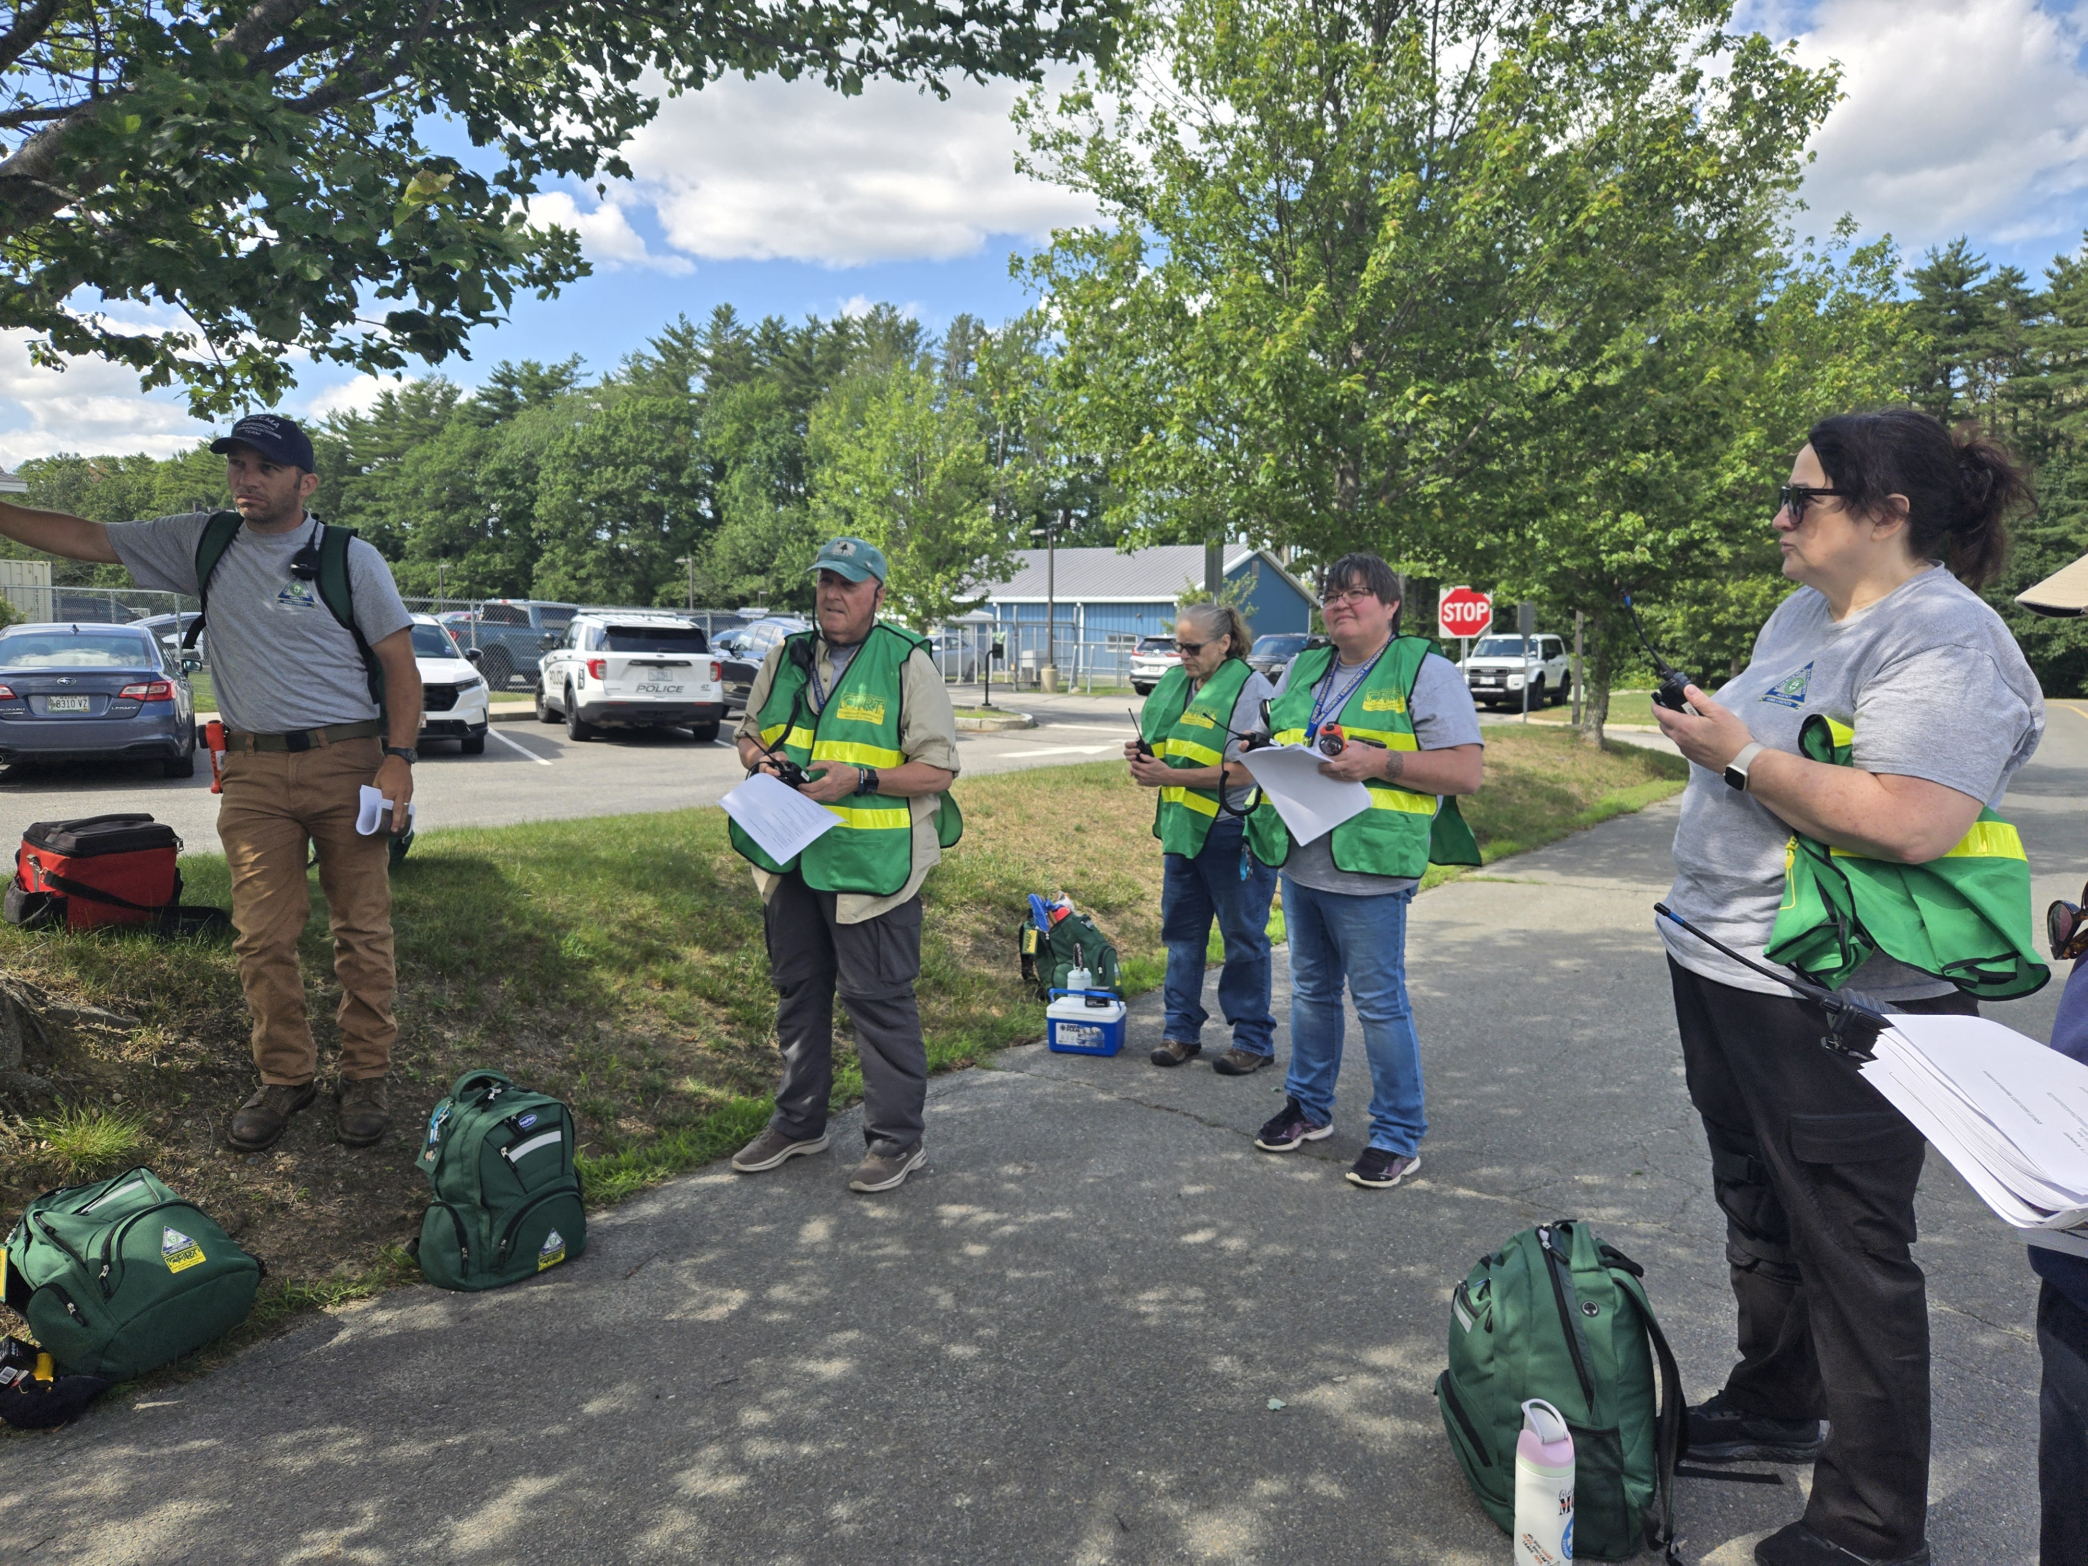
How to Get Involved
Determine your capacity to help and your interests
Establish yourself with an agency
Go through the credentialing process
Participate in shelter training
Deploy to assist with sheltering
Continue training and exercising
Figure 10. York County CERT Briefing

Slide 14
More Specifically…
Local EMA
York County EMA
NGO
Reach out to your Local EMA Director
Kennebunk: Justin Cooper, jcooper@kennebunkme.us
Others: yorkcountymaine.gov/local-emergency-management
Apply to join the York County CERT
Fill out Volunteer Interest Form
Brief interview
Volunteer application and background check
Complete CERT Basic Academy
Red Cross
Faith based-groups
Other organizations
14

Slide 15
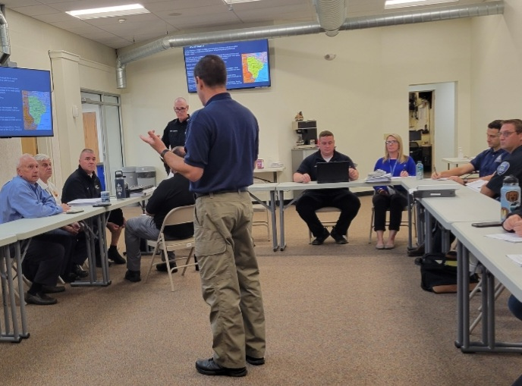
Shelter Training
ICS 100: Introduction to Incident Command System
ICS 200: Incident Command System for Initial Response
ICS 700: Intro to National Incident Management System
ICS 800: National Response Framework, An Introduction
Shelter Survey Course
Disaster Shelter Operations
Fundamentals of Emergency Animal Sheltering
De-escalation Training
Psychological First Aid
Others: Shelter Management Course, Food Safety for Disaster Shelters, Logistics Training, Incident Management
Figure 11. Training

Slide 16
Want to Be Involved, but Can’t Commit to Volunteering?
Know where your local shelter is located
Have a shelter plan
Mass care shelter
Shelter-in-place
Stay at home
Help educate others about preparedness and sheltering

Slide 17


Follow us for updates and emergency info!
Figure 12. YCEMA LinkTree and socials

Slide 18
Questions?

Slide 19
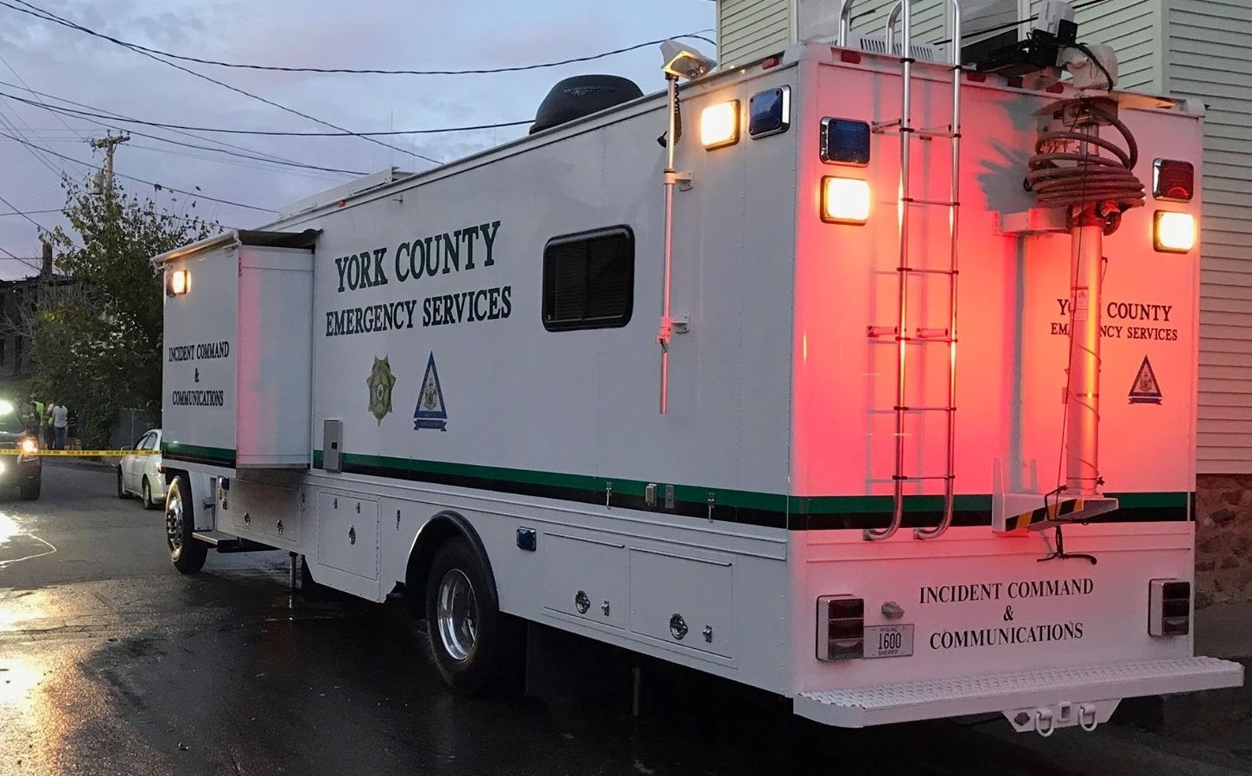
Thank you
Megan Arsenault
Deputy Director
207-324-1578
mearsenault@yorkcountymaine.gov
Figure 13. Command One

Slide 20
References
American Red Cross. (2019). Evacuation shelters vs. post-storm shelters: Knowing the difference [Digital image]. Retrieved from: https://www.redcross.org/local/florida/south- florida/aboutus/news-and-events/news/pre-storm-vs--post-storm-shelters.html
FEMA. (2023). Hazard specific resources. Retrieved from: https://www.fema.gov/flood- maps/products-tools/national-risk-index/resources
Taylor, A. (2017). Photos: Pet rescues in Harvey’s wake [Digital image]. Retrieved from: https://www.theatlantic.com/photo/2017/08/pet-rescues-in-harveys-wake/538368/

