Slide 1




Megan Ruttler, MS
Executive Director – Recruitment,
Dual Enrollment & Testing Services

Slide 2

High school option program (HSOP)
High School Students Age 15 - 18
Personalized Advisement
Learn How to Navigate College
Meet Requirements:
  High School Graduation
  College Degree
  Earn College Credits!
Increase College Readiness:
  Complete remediation
  (Educational Foundation courses)
Explore Career Pathways
→ Discounted tuition!

Slide 3

HSOP students receive a
Significant discount!
$75/Credit
No Fees!
In County or Out-of-County
=Same Price!

Slide 4
How Does It Compare??
HSOP – 3 Credit Courses – 225.00
RCSJ Enrolled Student – 3 Credit Courses – Approximately 600.00
Rowan High School – 3 credit course – Approximately 900.00
Rowan University – 3 Credit Course - Approximately 1750.00

Slide 5

What types of classes can I take?
General Education Courses
  Ex. English, Math, Science, History,
  Psychology, Art Appreciation, etc.
Degree-Specific Courses
  Ex. Business, Computer Graphics,
  Criminal Justice, among others
Pursue a Program of Study (unofficial)
  Over 100 degree and certificate programs on two campuses
  HSOP students have pursued: Engineering, Business, Nursing pathway, Science, Liberal Arts, Radio/TV/Film, Computer Graphics, Criminal Justice, Education, just to name a few

Slide 6
3+1 Programs
3+1 Bachelor's Degree | ​Start As (Associate Degree) | Offered At​ (Campus)
Business
Business Administration: Global Business/Leadership,(B.S) | Business Administration, (A.S​.) | ​Gloucester Cumberland
Communications
​Applied Professional Communications, (B.A.) | ​Arts and Science Communications Option, (A.A.) ​ | ​Gloucester
​Radio/Television/Film (B.A.) | ​Arts and Sciences: Radio/Television/Film Option, (A.A.) | ​Gloucester Cumberland
Education
​Inclusive Education, (B.A) | Education, (A.S​.) | ​Gloucester

Slide 7
3+1 programs
Health
​Fitness Management, (B.A. ) | ​Exercise Science, (A.S.) | ​Gloucester
​Nursing, (B.S.)​ | ​Nursing Generic Program, (A.A.S.) Gloucester* or Nursing Generic Program, (A.A.S.) Cumberland*​ or Nursing LPN to RN, (A.A.S)*​ | ​Gloucester Cumberland
​Psychology, (B.A.) | Psychology, (A.A.)​ | ​Gloucester Cumberland
Law & Justice
​Law and Justice Studies, (B.A.)​ | ​Criminal Justice, (A.S.) | ​Gloucester Cumberland​
​Disaster Preparedness​ & Emergency Management, (B.A.) | ​Emergency Management Option (A.S.)​​ | ​Gloucester Cumberland

Slide 8
3+1 programs
Technology
​Computing and Informatics (B.A.) | ​Cybersecurity (A.S.) | ​Cumberland
*indicates a Selective Admissions program

Slide 9
What If???
Tremendous Savings
Pathway to Associates Degree on your time
Stay with us and save 3rd year
One year at Rowan University to receive Bachelor's
Student Support

Slide 10
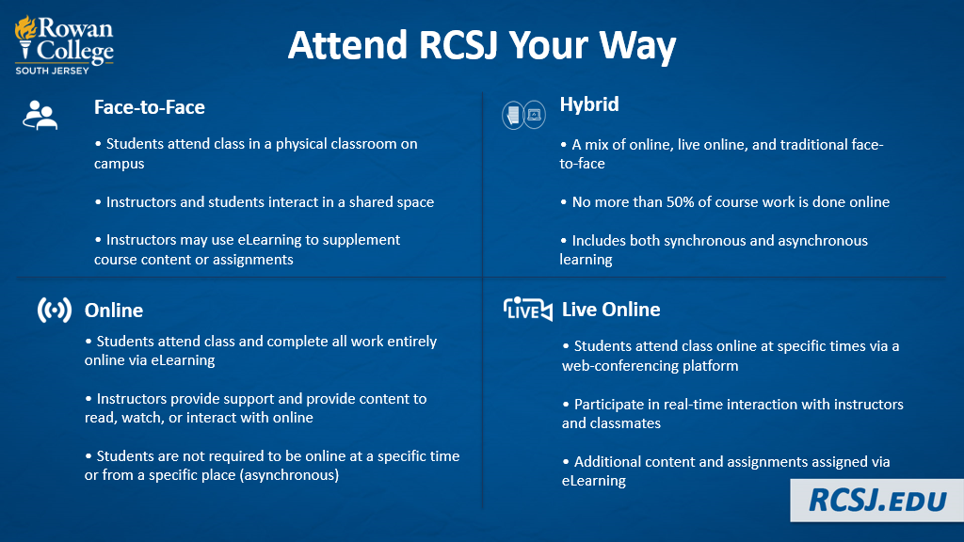
What class formats are available?

Slide 11
Are HSOP students treated as college students?
Yes!
You will be taking courses with traditional college students
Your professor will treat you as a college student
(no special treatment!)
FERPA, the federal law that protects student educational records, protects YOU and your information at the college*
*Parents cannot access RCSJ student records without the student’s written permission

Slide 12
Student Support Services
Academic Advising
Academic Support Center (Tutoring)
Internship and Career Planning
Counseling and Wellness
Student Life
Special Services
Transfer Services/University Partners

Slide 13

HSOP – Sign Me Up…
Easy As 1, 2, 3!
1. Complete High School
Participation Form
(Writeable PDF on our website)
Submit High School Transcript
2. Satisfy Testing Requirements
Submit Standardized Test Scores OR
Take the Accuplacer
3. Schedule an Appointment to
Register for Classes!
  RCSJ.edu/HSOP/Appointments
For more information:
RCSJ.edu/HSOP
Notes:
So, how do you enroll in the HSOP program?
Three easy steps!
First, complete our HS Participation Form, including submission of your preliminary HS transcript. (make sure you have your photo ID when you come in person so that you can receive your RCGC student ID number!)
Second, satisfy our placement exam requirements. For this, you will either take the Accuplacer at RCGC (for free!), or you will need to submit test scores that exempt you from the placement test, such as SAT, ACT, or PARCC.
Third, schedule an appointment with an HSOP advisor and start registering for classes!

Slide 14
Registration guide
HSOP Information:
RCSJ.edu/HSOP
View Courses:
RCSJ.edu/gc/Courses
Make an Appointment: RCSJ.edu/HSOP/Appointments
Meet with your Advisor
Phone  Zoom  In Person
Ms. Melanie Gaston
mgaston1@rcsj.edu
856-468-5000, x. 6481
Semester Timeframes:
    Fall- Sept. – December
    Winter- Dec. – January
    Spring- Jan. – May
    Summer- May - August
Registration Timeframes:
    Fall- March – August
    Winter- Nov. – December
    Spring- Nov. - January
    Summer- March – July

Slide 15
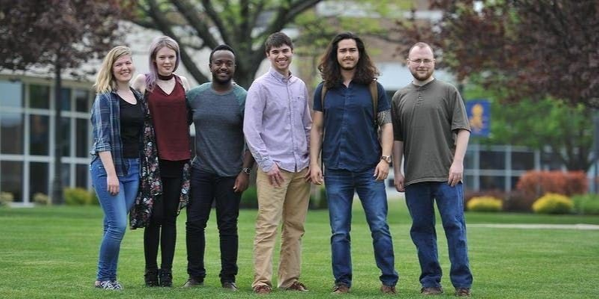

Thank you!

