Slide 1
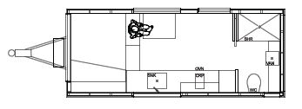
Emergency Accommodation Tiny House Project
A community-led pilot project to provide much-needed accommodation for vulnerable community members.

Slide 2
Emergency Accommodation Tiny House Project
Who:
This project is being led by the Rotary Club of Dromana and supported by various other local community members, groups and businesses. It also has the support of the local community support centres who are on the frontline of disadvantage on the peninsula.
New partners are welcome.

Slide 3
Emergency Accommodation Tiny House Project
Why:
The aim of this project is to provide a physical demonstration of what can be provided to meet the growing need for crisis accommodation for people experiencing or at immediate risk of homelessness. This rapidly expanding need is not currently being met on the Mornington Peninsula. The proposed unit is small, compact, affordable and can be located easily at a wide range of sites.
We will partner with a housing provider to house a person in need.

Slide 4
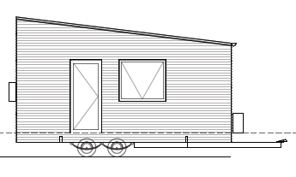
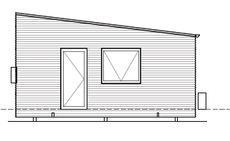
Emergency Accommodation Tiny House Project
How:
With skilled tradespeople, a project management team, and business and community contributions a demonstration unit will be delivered.
We have an engineered and costed design which can be either a tiny house on wheels (THOW) or a small class 1a dwelling. This provides flexible siting options.

Slide 5
Emergency Accommodation Tiny House Project
How you can help
We would welcome any contribution people and organisations may wish to provide, be it donated or discounted materials fixtures and fittings.
Alternatively donations can be made to the Rotary Club of Dromana: BSB: 633 000 Account Number: 140 896 705 Account name: Dromana Rotary Project Account
The project is aiming to raise $75,000 in donations, materials and/or services in lieu.
We will be actively acknowledging our partners in this project. It is a project by community for community.

Slide 6
Emergency Accommodation Tiny House Project
For more information please contact:
Greg Fitzgerald (Rotary) gregfitz51@gmail.com
0408 591 980
Simon Brooks (Dromana Association) simon@dromana.org.au
0418 542 816

