Slide 1
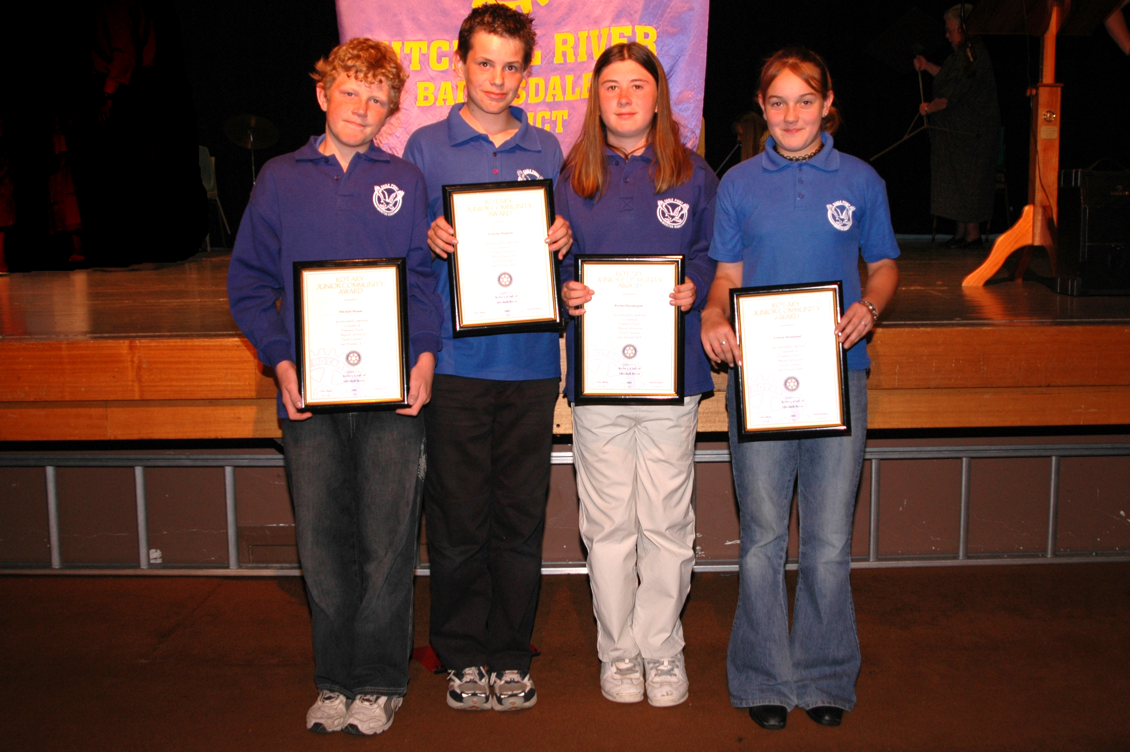
Small Rural School
Notes:
The children from this small rural school travelled over an hour for the presentations. They completed the Award 5 years ago and the young man 2nd from the left completed the Rotary Model United Nations weekend.

Slide 2

Starter Pack
One copy of diary
One Information leaflets
Information for School Councils
One copy of Handbook
One certificate
Press release information
Notes:
The Rotary Club of Mitchell River is prepared to assist any club anywhere in the world that wants to know more about the Award and would like to implement it.
To maintain the integrity of the program all materials used are monitored through Mitchell River.
This includes the official diary which must be used in Australia and can with approval and recognition of the Rotary Club of Mitchell River be adapted for overseas situations.

Slide 3

DVD Available
Notes:
A DVD is also available.

Slide 4
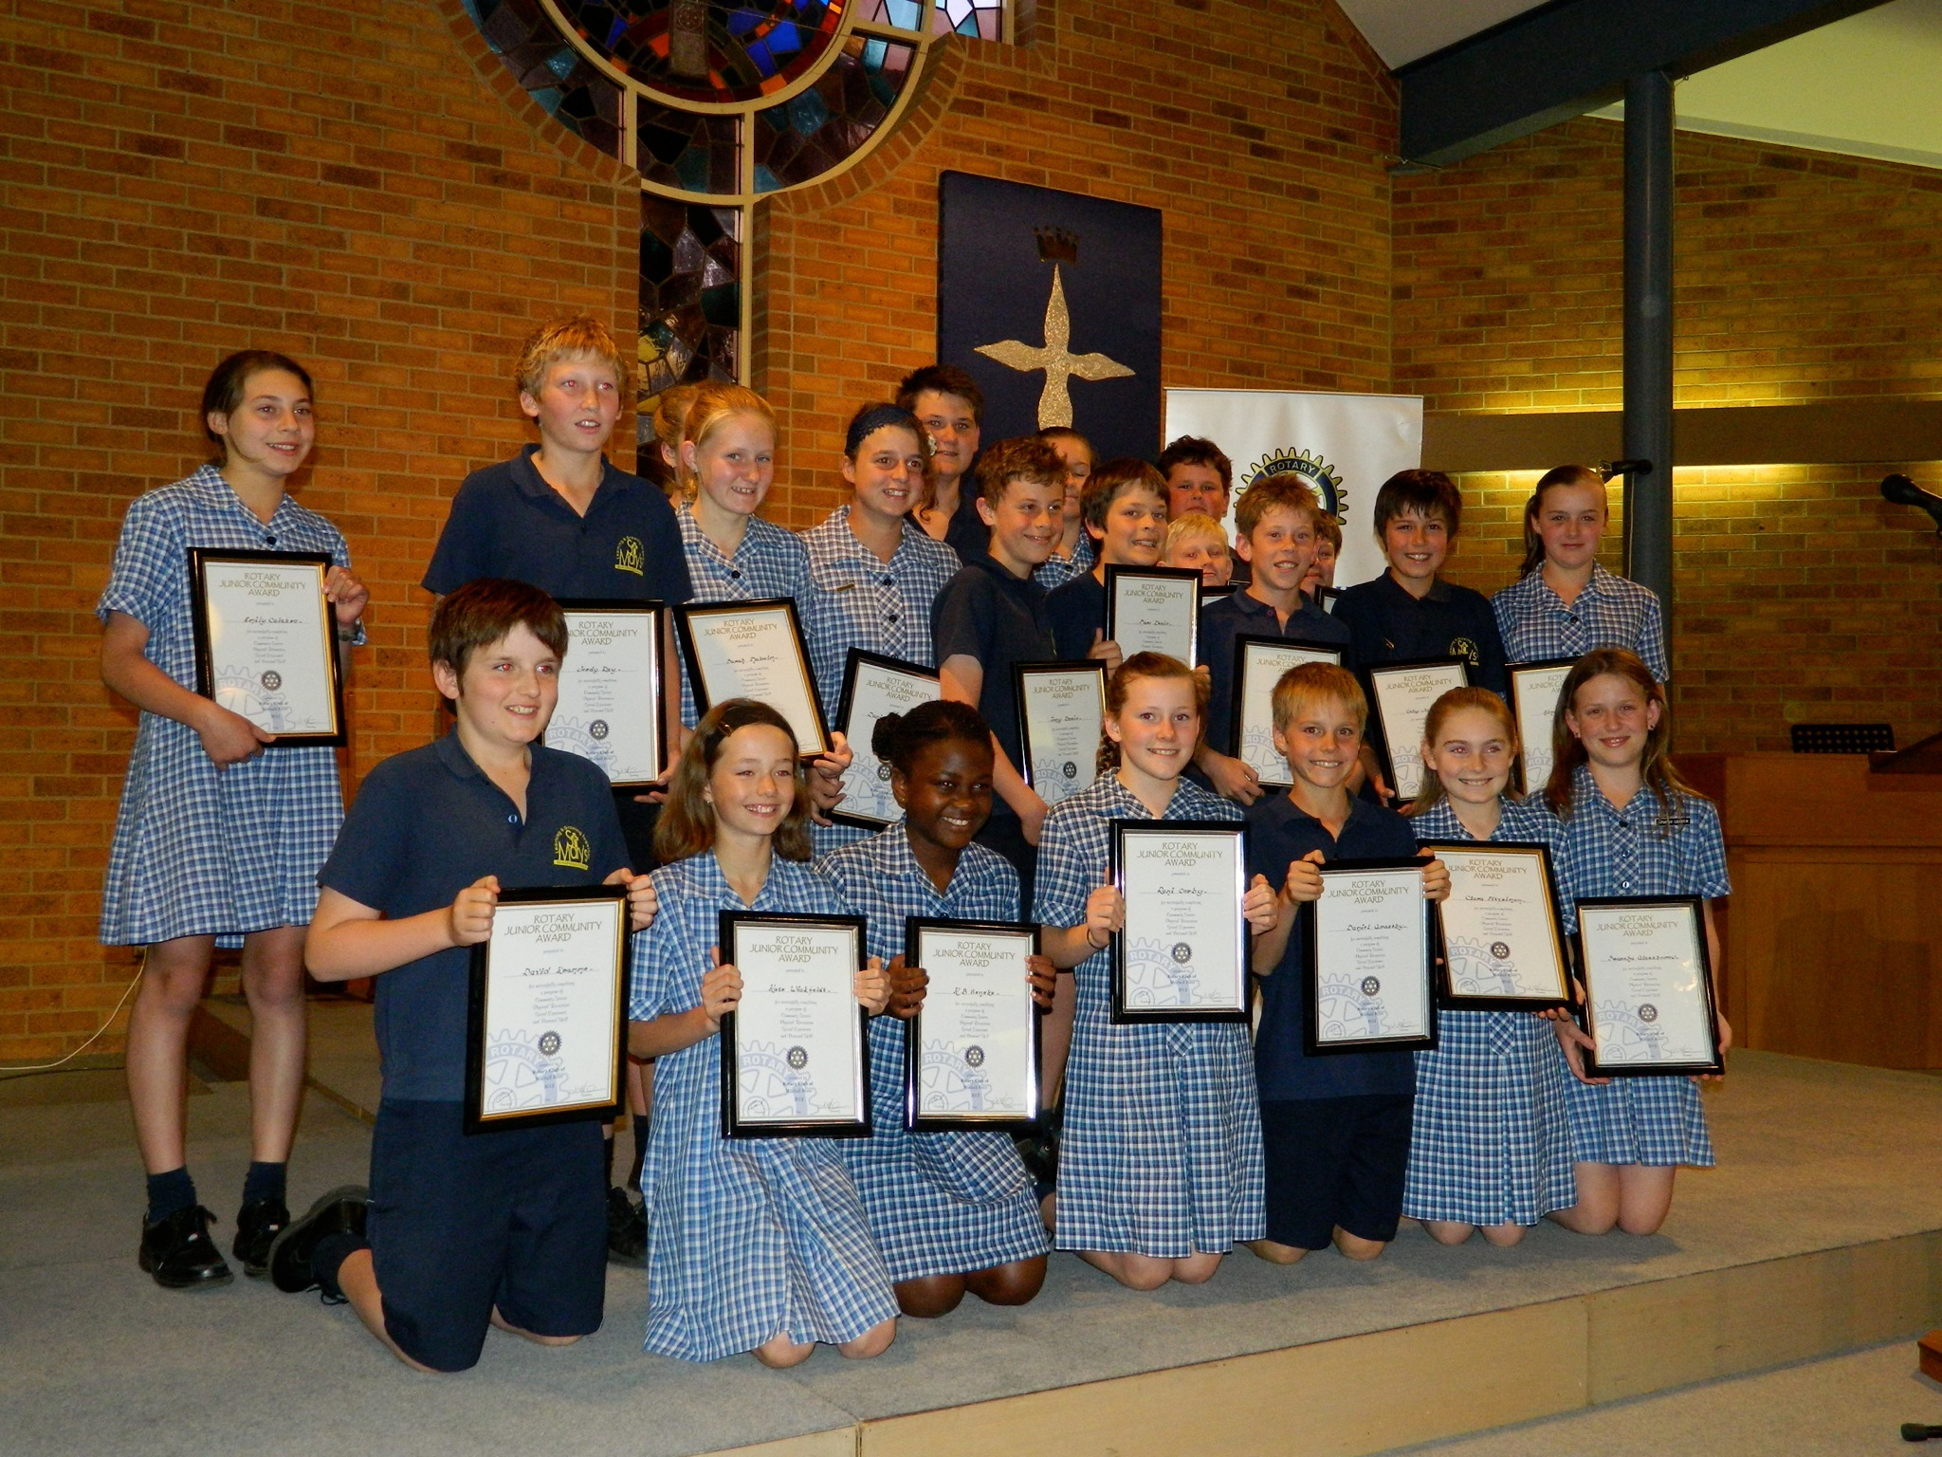
Rotary Junior Community Award
Notes:
Thank you for the opportunity to speak to you about this wonderful program.

