Slide 1

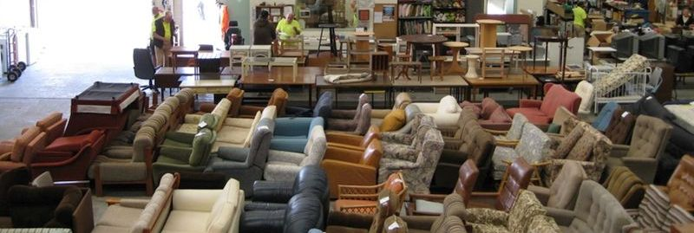
Eastern Emergency Relief Network (EERN)
Supporting the vulnerable in our community since 1995
Notes:
Thank you for giving me the time to talk about one of the amazing volunteer support agencies, Eastern Emergency Relief Network (EERN)
Mt name is ……..
And I am involved with EERN …………

Slide 2
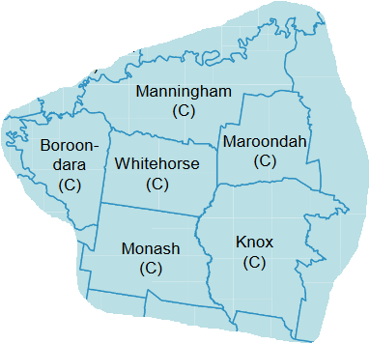
EERN covers the City of
Whitehorse and adjoining local
government areas, a total of
500 km².
Operates from 2 warehouses at 10-12 Thornton Cres, Mitcham
Notes:
In 1994 the Cities of Box Hill and Nunawading were amalgamated into the City of Whitehorse. This gave the opportunity to consider new programs to support its community. Keith Rooney proposed at the newly formed Whitehorse Emergency Relief Network (WERN) that a group be formed to establish a warehouse for the storage of food, furniture and clothing. To be made available to those in need in the community.
The Group formed to develop the proposal comprised Keith Rooney (Whitehorse Benevolent Society), Ray Freeman (Nunawading Lions) and Jan Mitchell (Vermont Lioness Club).
Then in August 1995 meeting of WERN a warehouse of just under 1000 square metres in Cook Road Mitcham was offered free of charge. The building was to be demolished in the following year so would only be a temporary option. And, it was decided to accept the offer as a trial and Eastern Emergency Relief Network was born and the first warehouse was opened on Tuesday 10th October 1995.
Since that time the network has expanded to cover all of the Whitehorse council area and the adjoining council areas, an area of nearly 500?square kilometres. Plus EERN does offer items to some agencies in the Yarra Ranges area.

Slide 3
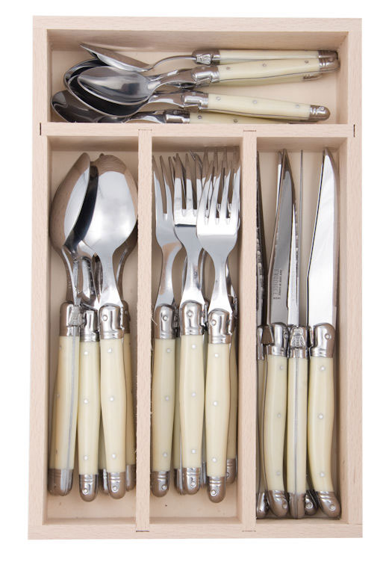
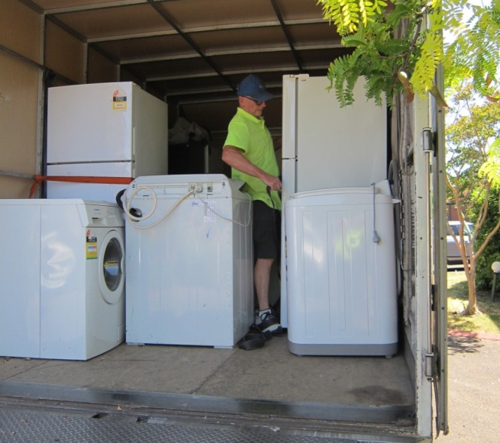
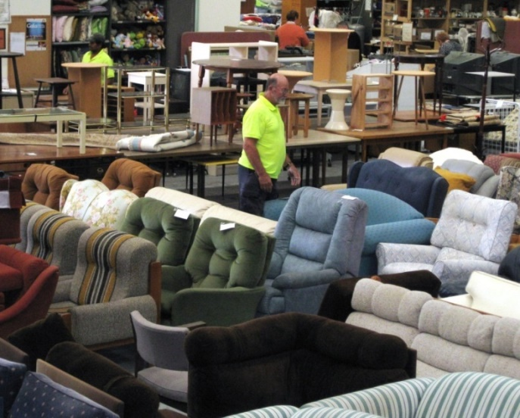
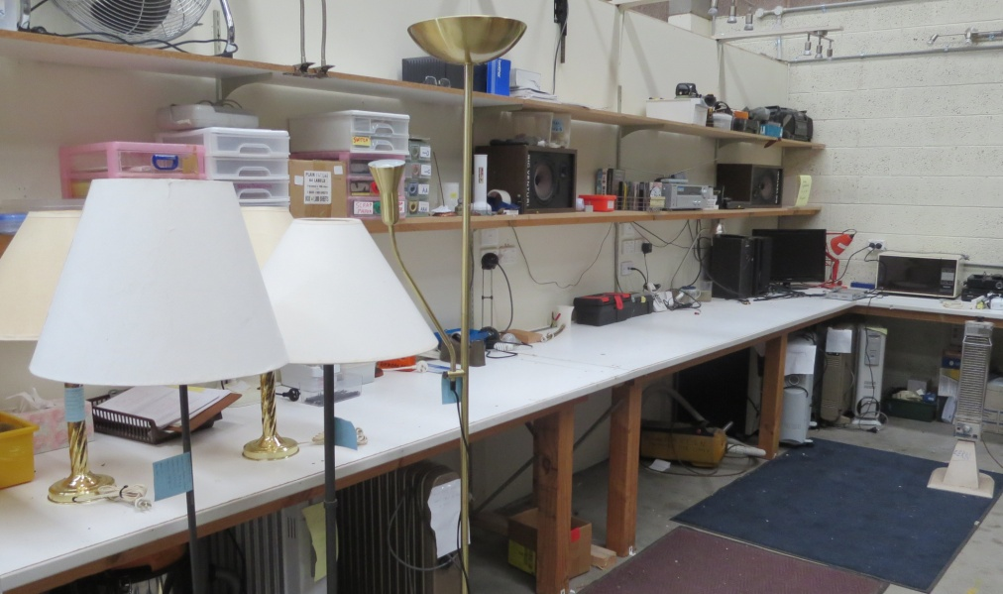
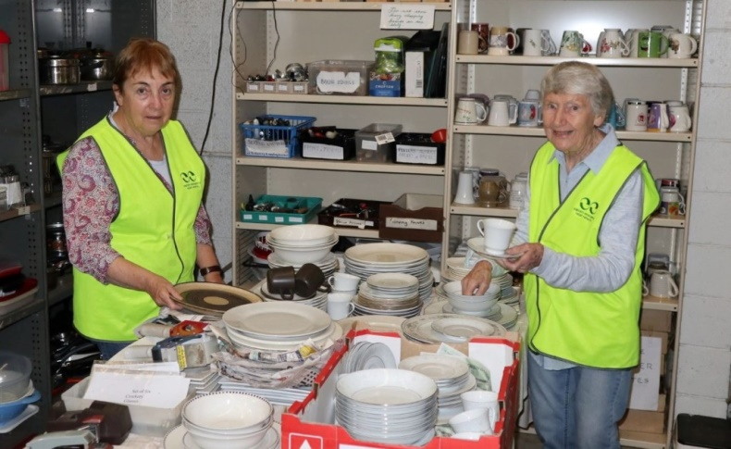
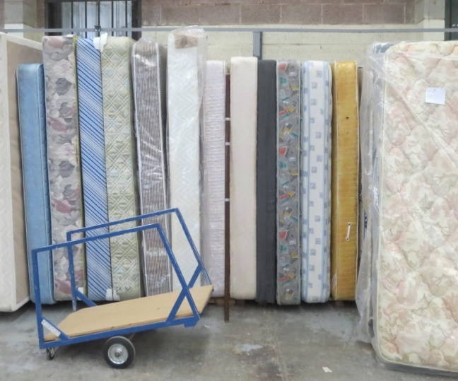
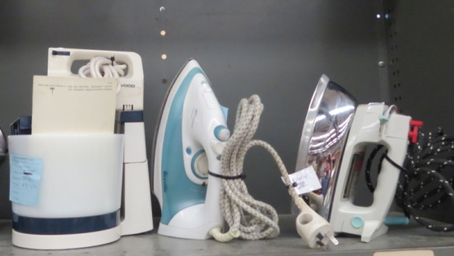
EERN reuses quality donated household
items
Everything needed
to make a home
Notes:
Furniture
Whitegoods (tested before being passed on)
Electrical goods (tested and tagged by volunteers in the EERN workshop
Manchester and mattresses (all clean with no stains or marks of any kind)
Kitchen items (cutlery, saucepans, crockery
Non perishable food items
Anything needed to make a home

Slide 4
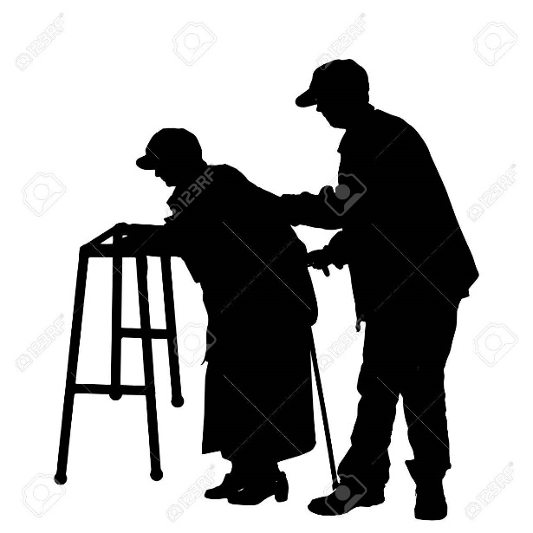
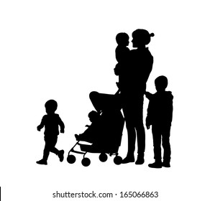

Who are our Clients?
More than 100 community agencies refer clients to the
EERN warehouse where they
choose what they need to
rebuild their lives.
Notes:
EERN has over 100 welfare agencies who bring their clients to the warehouse
EERN does not vet the people who are brought into the warehouse. That is the task of the welfare agencies But we do on some occasions hear the stories.
Some are single parents escaping a violent relationship. These families are brought in after an agency has found them a place to live. They come in with nothing and leave with a whole house full of furniture, bedding, kitchen items a fridge, washing machine and even a TV. Others may have medical conditions or physical or mental disabilities. Others have just fallen on hard times.
An example of a family we did hear about was a family of mother, father and 2 young school age children. The father had MS and was in a wheel chair so the mother had to work and support her husband and two young children. The mother was doing okay and even part time study knowing that she would eventually have to look after her children by herself. But then the washing machine stopped working. A welfare agency brought her to EERN and she was given a washing machine
Another story we heard about was a girl who had escaped a abusive father and was living in a friends garage. A welfare agency brought her in to choose a bed to sleep on while they found her a permanent place. She was then to be brought in to select more once they found a place to live.
Another interesting story which highlights the range of people who have used EERN was found when the wife of one of our volunteers visited the home of a Chen family. When she arrived she was surprised to see that they had a room with 3 couches of different colours. There were also several mothers sitting on the couches with their young children playing around them. The house had become a meeting place for Chen families thanks to the couches from EERN.

Slide 5

Member agencies
User pays model – EERN bills agencies once a year based on usage
Identify and undertake assessment of client need
Assist client/s with selection of items needed prior to attending warehouse
Attend warehouse with client/s to assist with making selections
Make sure a booking is make to pick up the items from our warehouse

Slide 6
Our Partnerships:
We have great partners – they support us to do what we do – here are just a few!
Foodbank Victoria
Whitehorse Business Group
Street Smart (the Charity arm of Sheridan)
Lions and Rotary service clubs
City of Whitehorse, City of Maroondah, City of Knox
Blackburn High School & Huntingtower School
Woodard's Real Estate and Philip Webb Enterprises
Local op shops, RSPCA and Animal Aid
Bendigo Bank - Blackburn South
Megamile Precinct Group
Local councillors, State & Federal members of Parliament

Slide 7
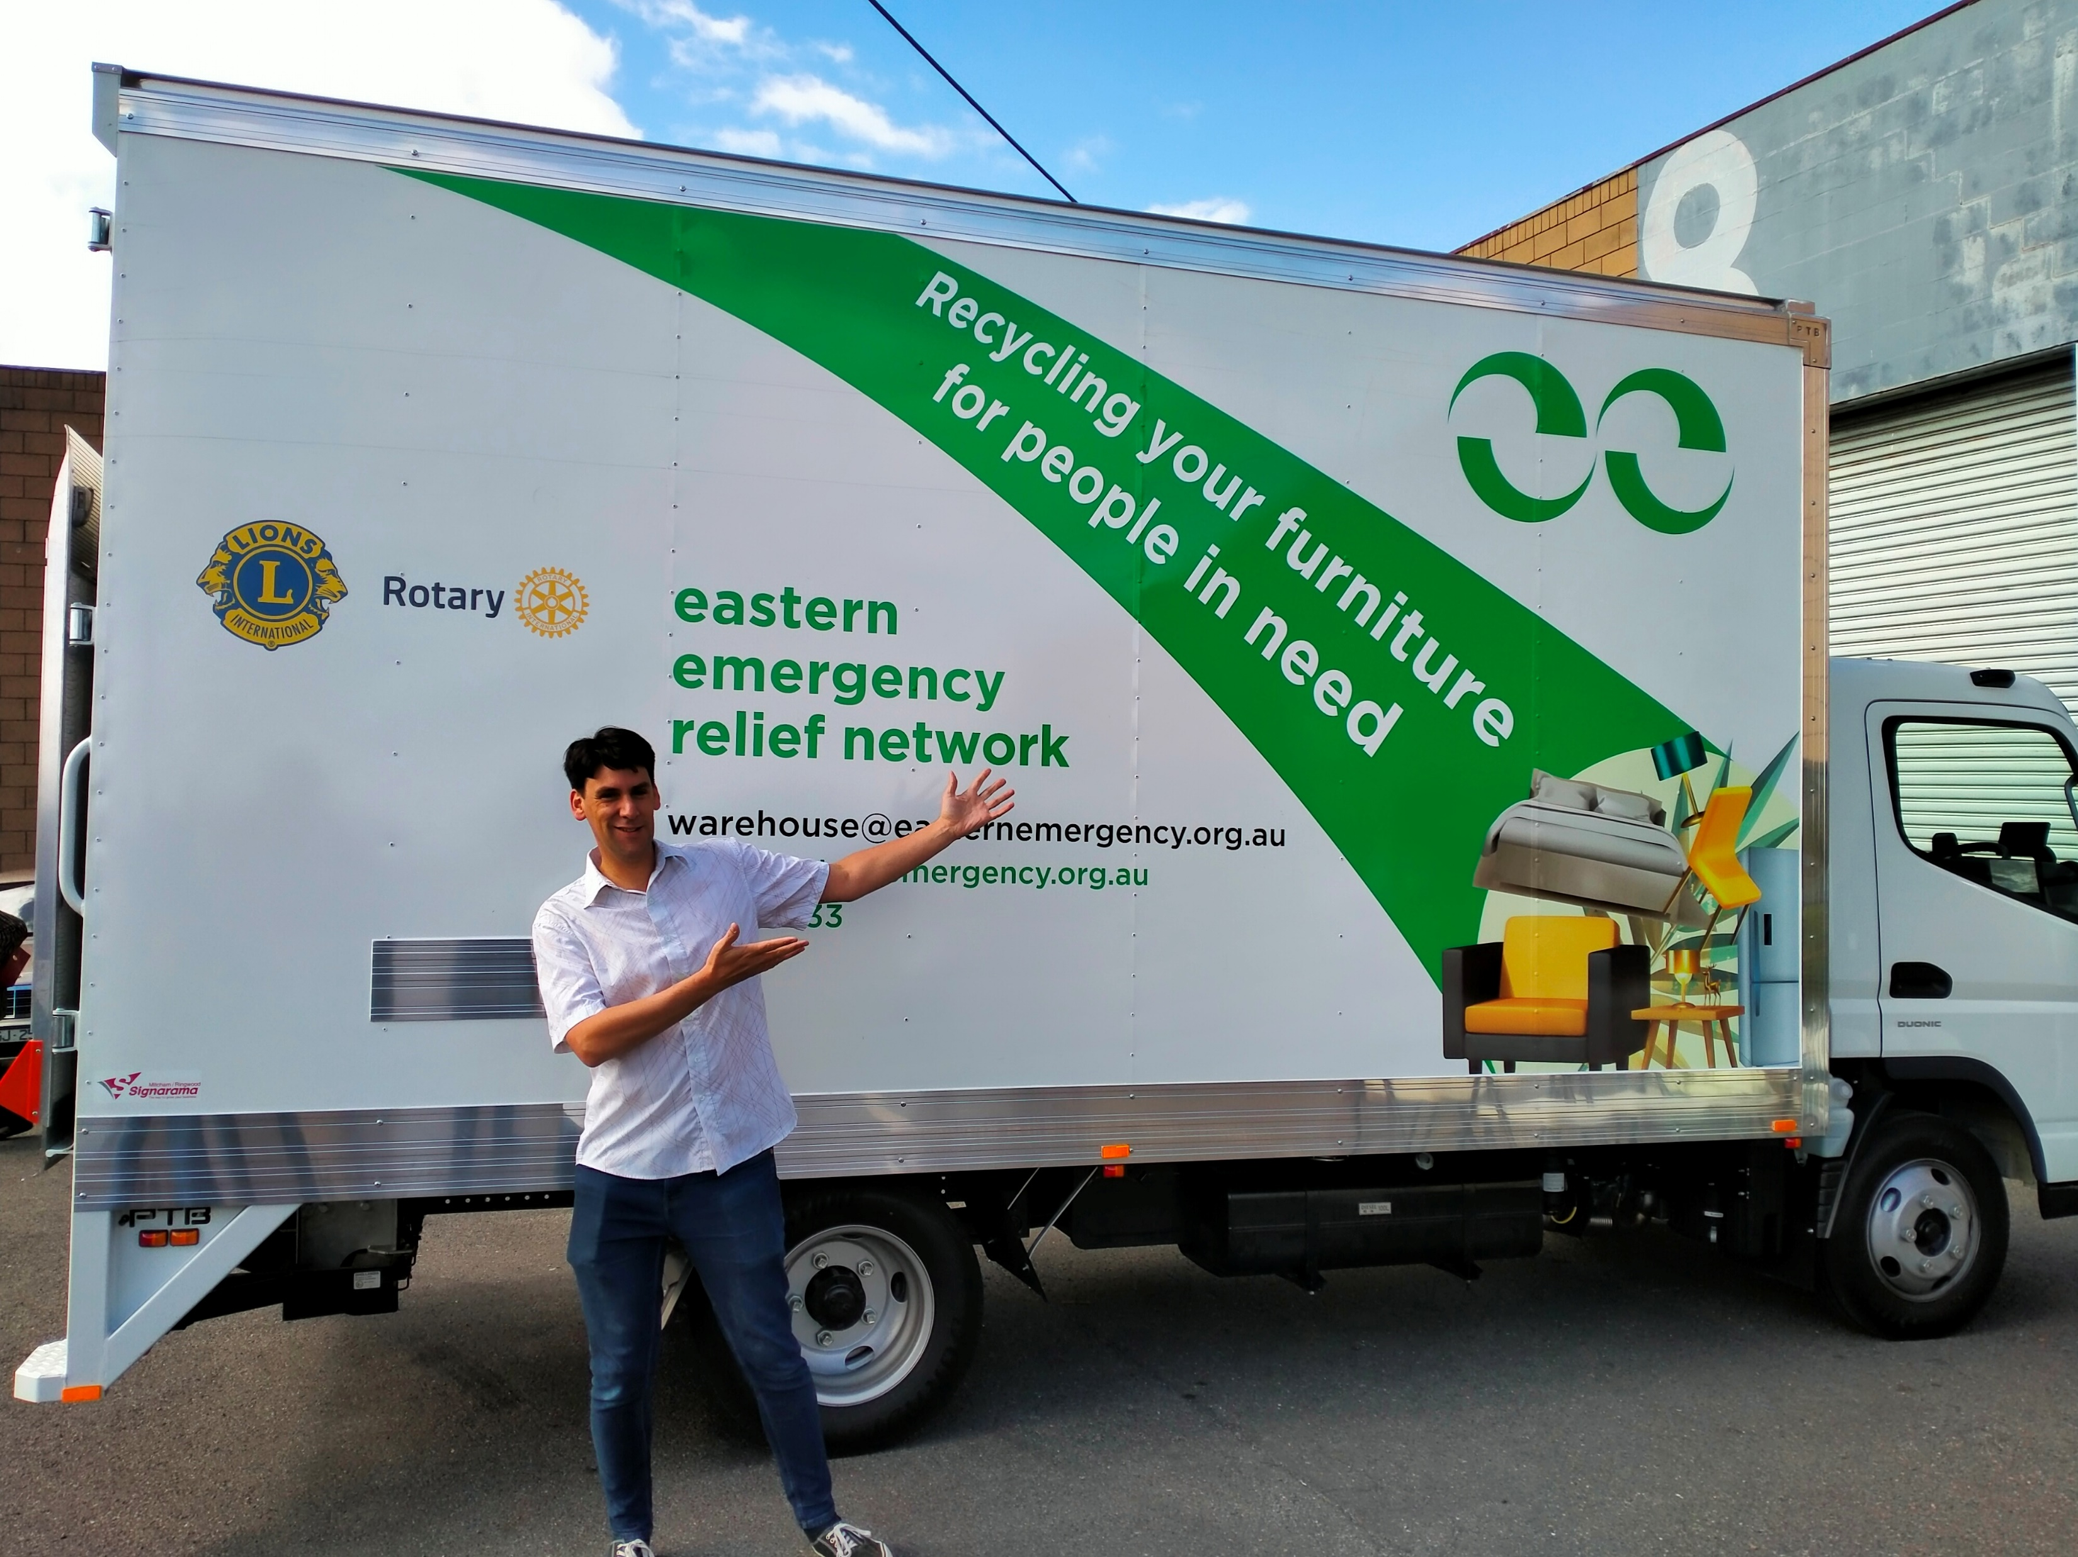
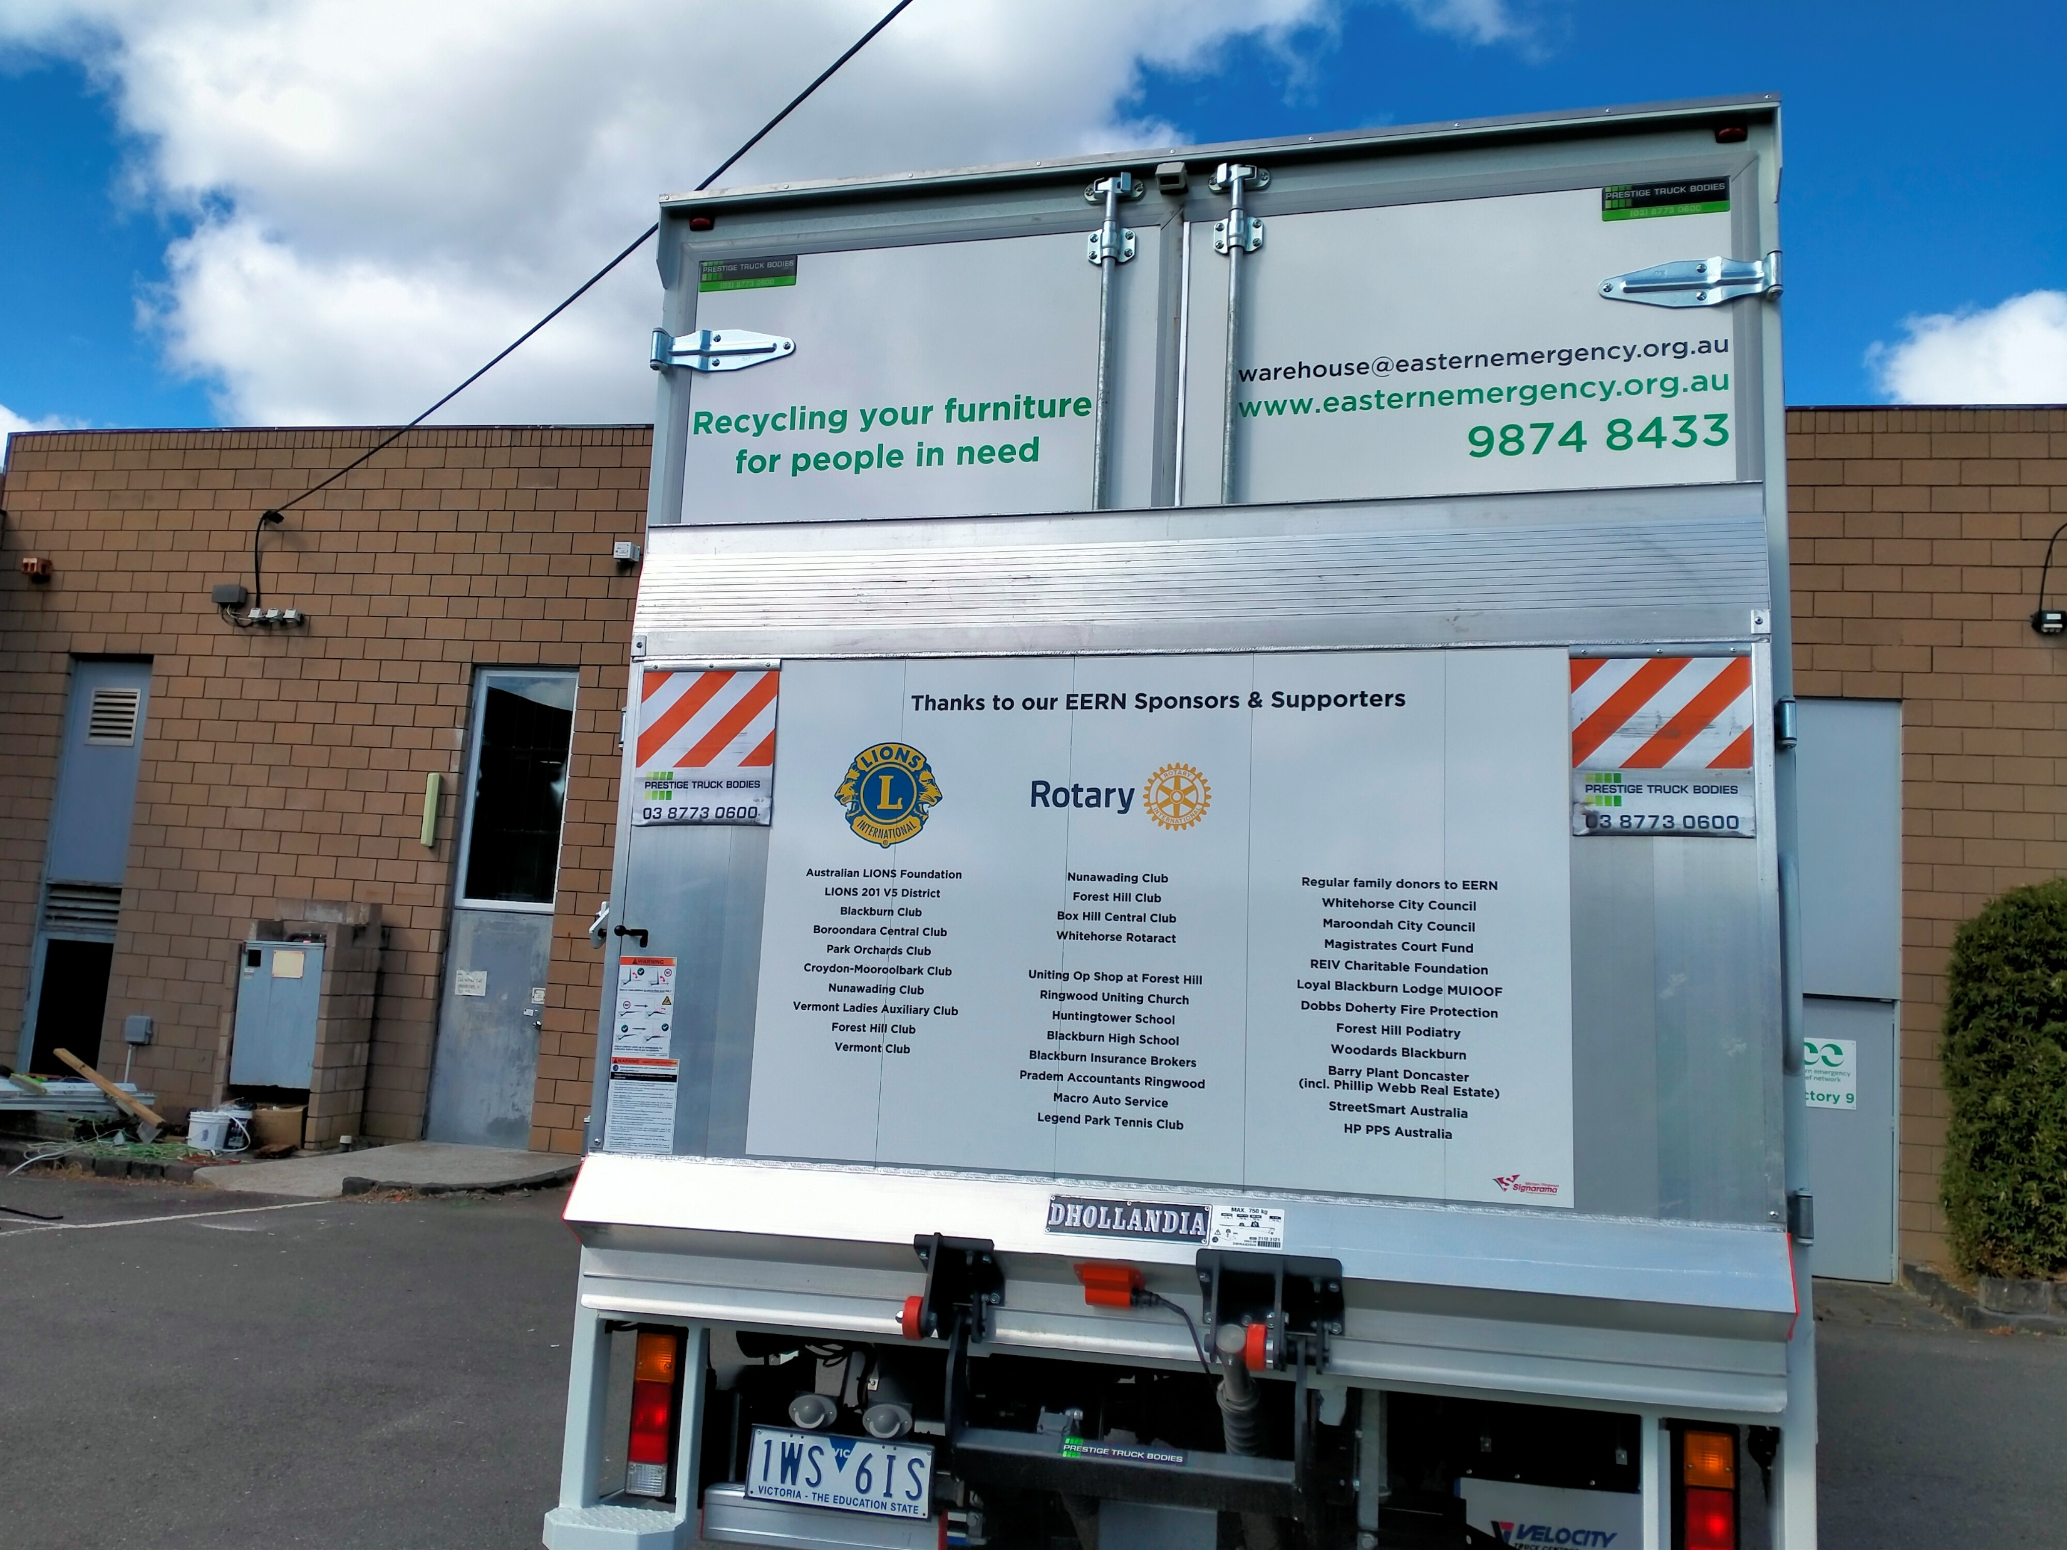
Our new truck launched in March 2023.
Several service clubs, other organisations & partners contributed to raising $83,000 needed to purchase it outright.

Slide 8
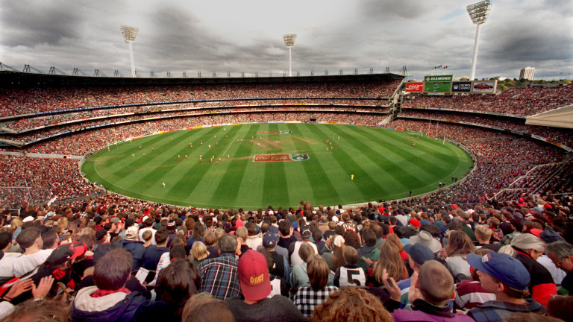
How many people has EERN supported?
At last count, EERN has supported over
55,000 client visits
Estimated to be
around
300,000
Individuals & families
Fills the MCG 3 times!
Notes:
Over the time EERN has been operating it has provided household goods to more than 50,000 households.
Some would be single people while others would be families with several children.
This means that around 150,000 people have been supported by EERN
That is the equivalent to one and a half MCG crowds on the day of the grand final.
And we are continuing to support families, including people recovering from the COVID lockdowns. In fact recently there seems to be a bit of an explosion in numbers coming in.

Slide 9
How we made a difference in 2025/2026
1709 bookings for visits by member agencies
12814 items distributed to those in need
1067 pickups and dropoffs of furniture and other donated items
On average, 12 volunteers rostered each day contributing around 4 hours of their time. Over the year, a minimum of 12,000 hours donated to operate EERN.
EERN was open for 240 days
Saved over 165 tonnes going to landfill
Received & distributed 8131kgs of food equating to 14650 meals from Foodbank

Slide 10
How we made a difference in 2025-2026
1941 electrical items
742 mattresses & beds with 794 sets of bedroom furniture
973 Lounge suites
917 Food/toiletry and laundry packs
3326 sheet sets/doonas/towels/blankets/pillows
2028 kitchen items
1760 miscellaneous & other furniture items
450 Christmas hampers and over 1500 Christmas gifts

Slide 11
Where do we get our funding?
We own both warehouses so don’t pay rent
We charge our Member agencies based on their usage – this funds our running costs
We recycle all metal, cans & bottles
We apply for grants from Councils, State and Federal Government, philanthropic organisations
We receive grants and donations from Lions, Rotary, Freemasons, Probus, the general public
Bendigo Bank- Blackburn South
We receive “in kind” donations like nonperishable food, toys and other gifts for Christmas
We do Bunnings BBQs twice a year!
Peoples Choice Community Lottery

Slide 12

Current projects and pilots
Partnering with Megamile Precinct, City of Whitehorse, Australian Bedding Stewardship Council and Bendigo Bank to divert great quality mattresses from landfill via retailers.
Pilot Partnership with Deakin University and City of Whitehorse to divert unwanted residential student furniture from landfill.
Proposal to use a partnership with Cleanaway to pickup good quality items to deliver to EERN.

Slide 13
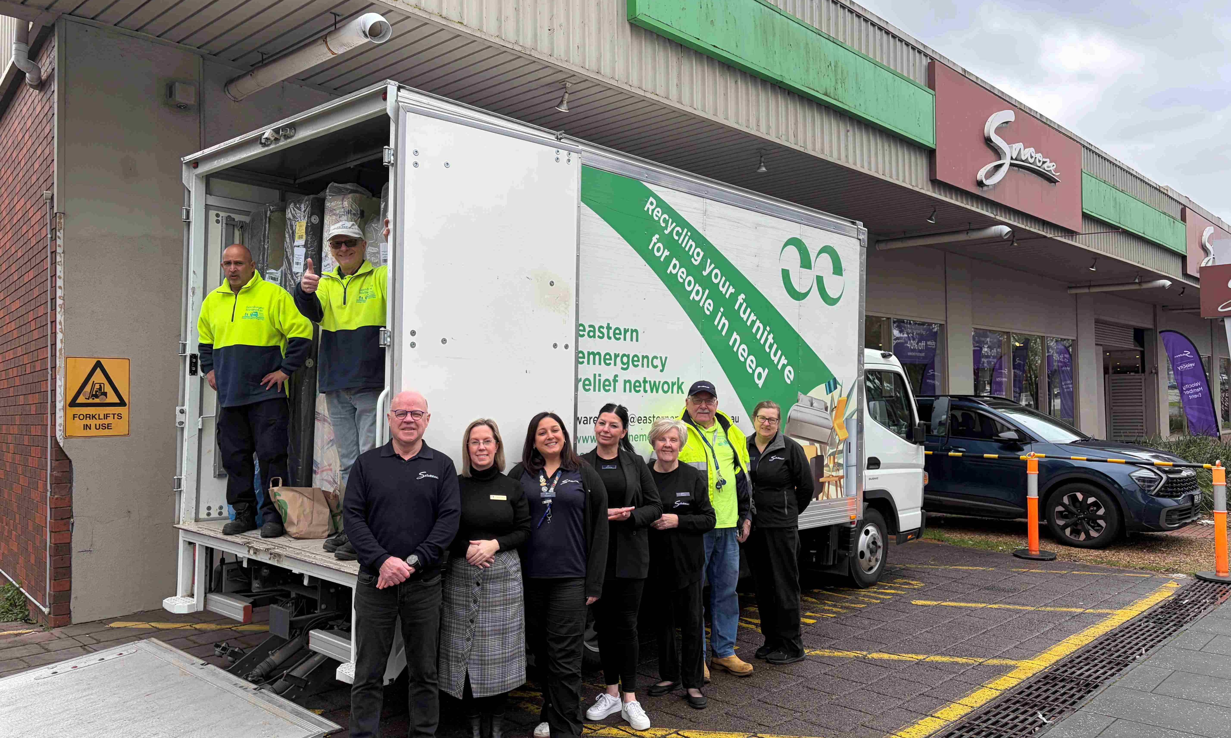
Pilot – pick up of repurposed mattresses from Snooze

Slide 14
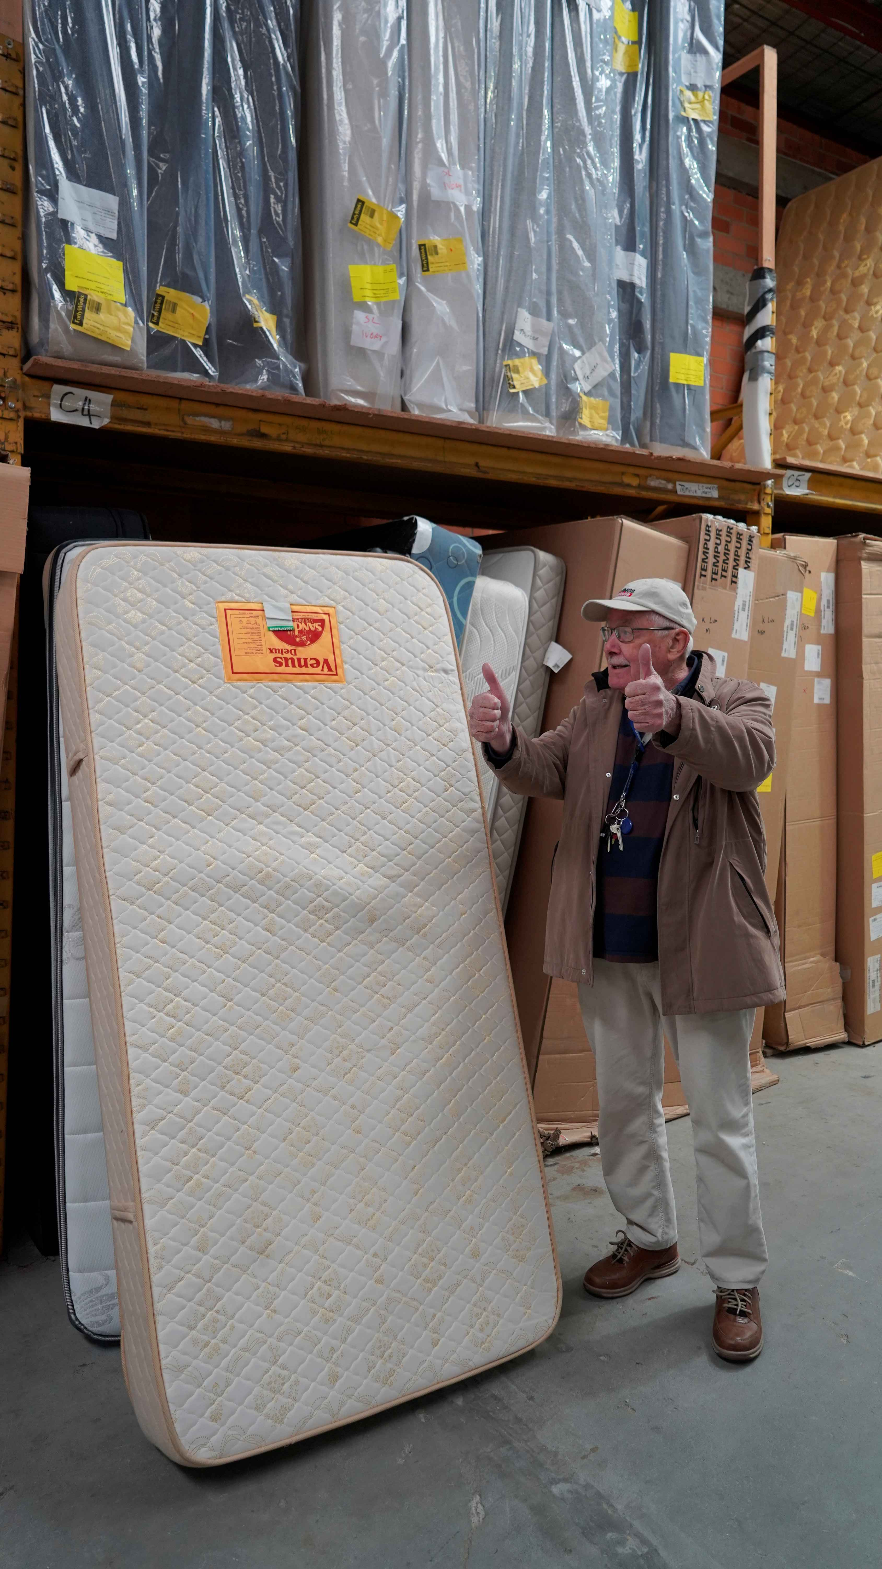
EERN Driver Phil checking a mattress at Forty Winks Nunawading. After giving it the all clear the mattress was loaded and taken to EERN.

Slide 15


Our sister Emergency Relief Networks
Western Emergency Relief Network (WERN)
Servicing the Western Suburbs
Rotary Inner Melbourne Emergency Relief Network (RIMERN)
Servicing Inner Melbourne

Slide 16

What can you do to help EERN?
Volunteer
Volunteer at EERN (and it will be fun and satisfying for you)
Spread the word through your networks about EERNs services.

