Slide 1


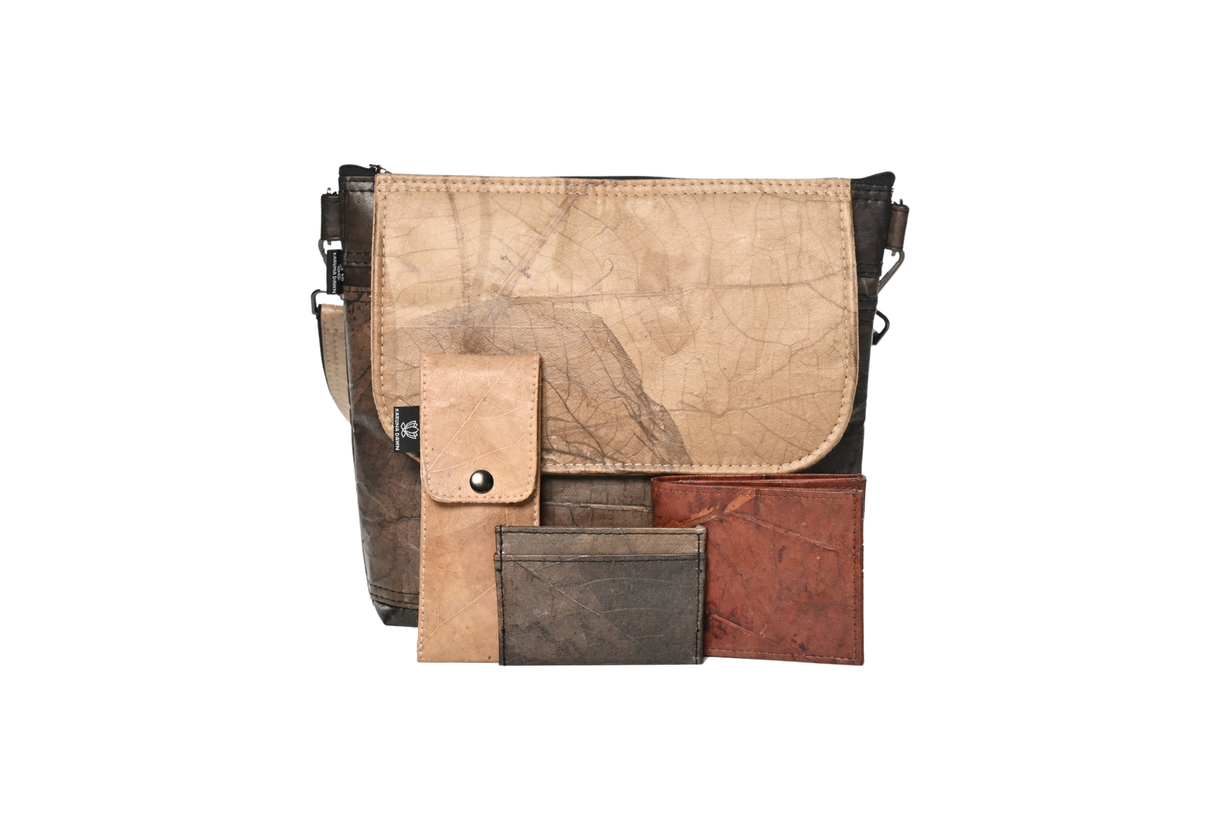
2026
Karuna Dawn
People & Planet First Certified
Sustainable - Ethical - Vegan - Cruelty Free
01

Slide 2
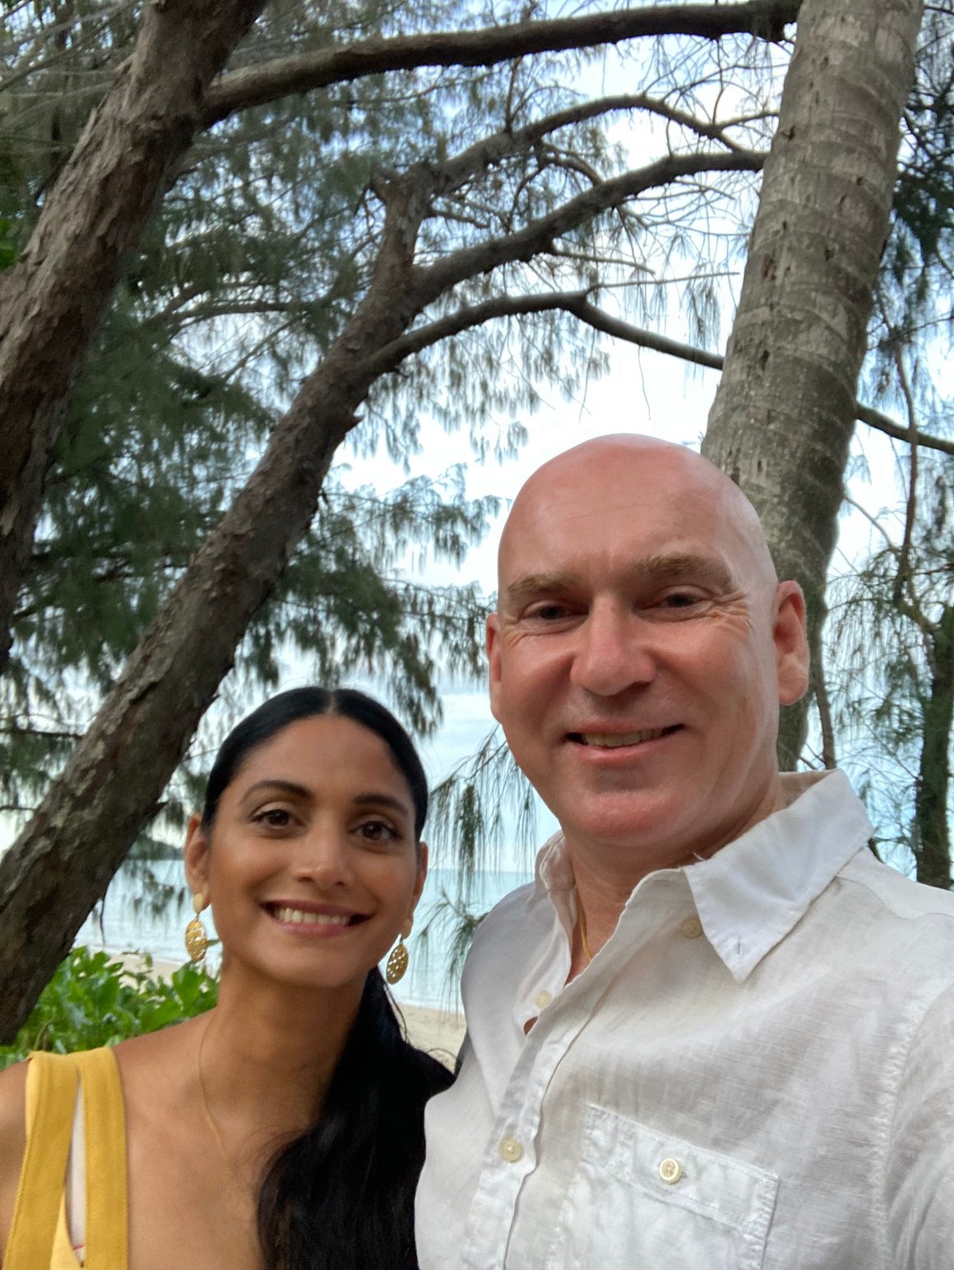
We are inspired to live a more compassionate, sustainable and conscious life where we aspire not just to make a living, but, to make a difference.
We believe our shared compassion has the power to move mountains and transform lives.
We collaborate for change and don't think in terms of competition but in terms of partnership in order to deliver positive impact.
Sri & Scott
02

Slide 3
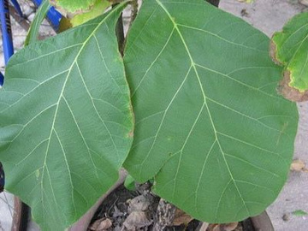
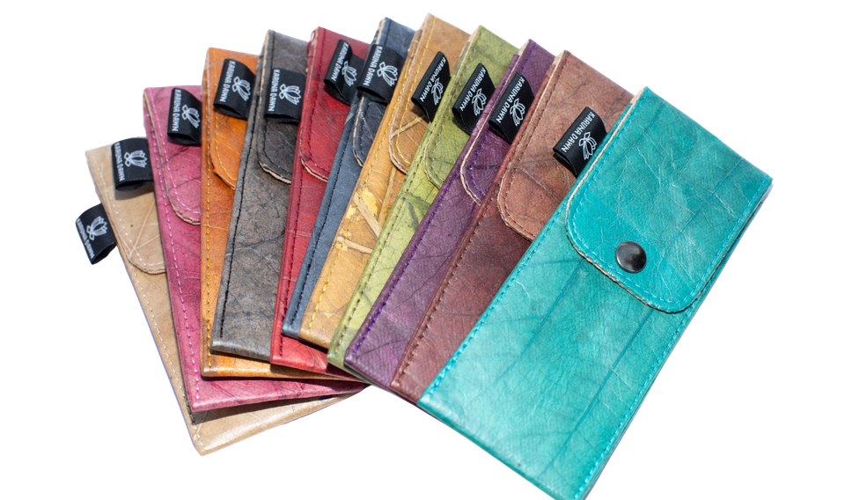
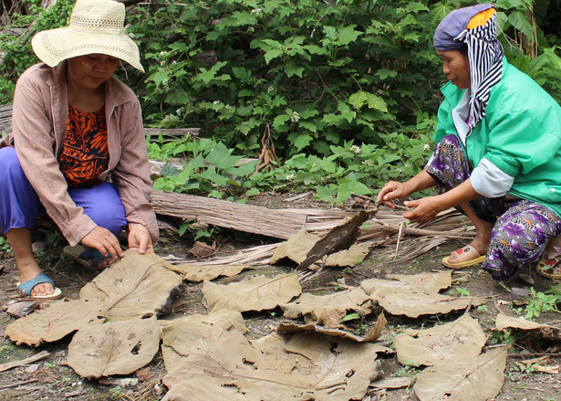
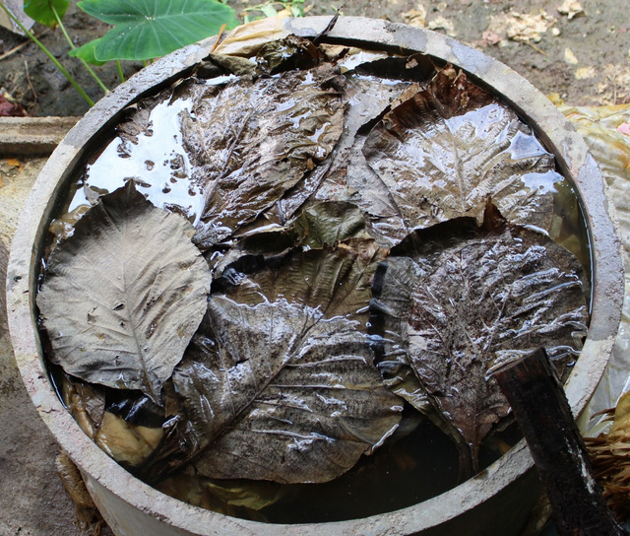
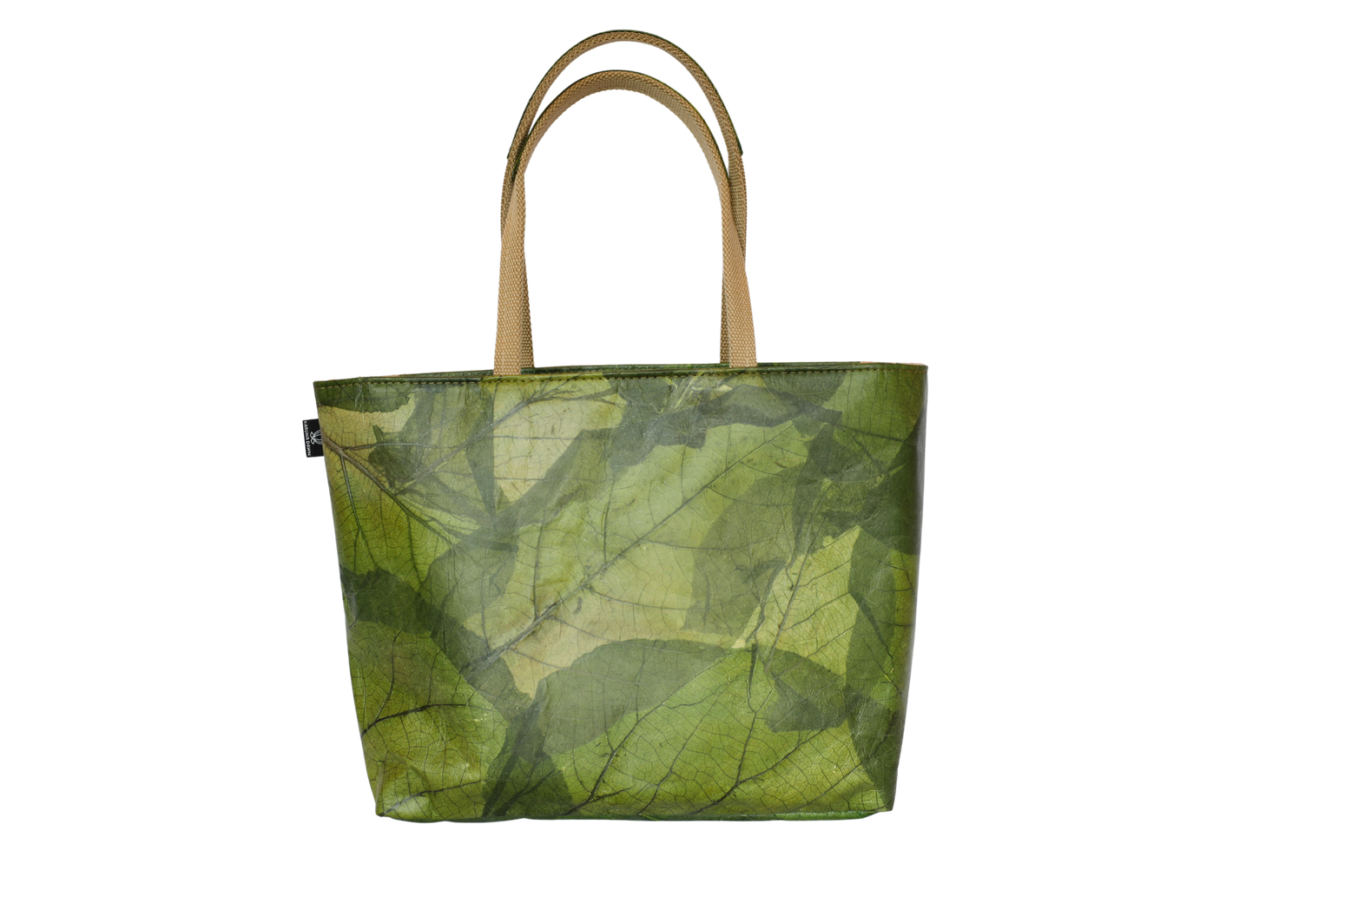
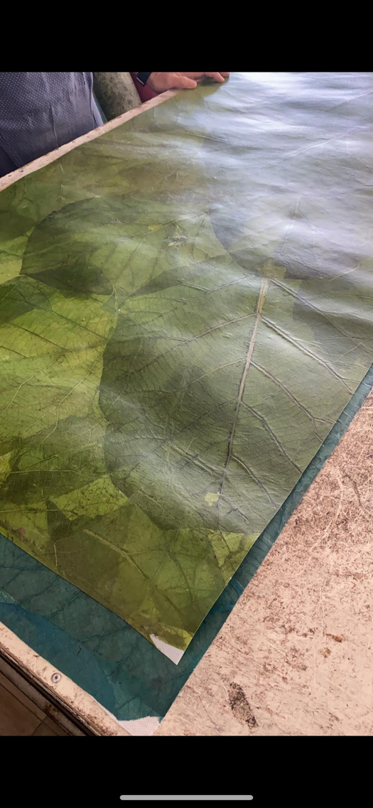
2022
The Mecca Customer
What is Leaf Leather
Unique Premium Plant Based Material
  Leaves are gathered from the forest floor
  Soaked, dyed & steamed
  Heat compressed & bonded onto non-woven fabric
  The sheet of leaves is ready to cut into different shapes and stitched together
Light Weight, Softens over time & Ages beautifully
03

Slide 4






Our Values
2022
Empower
  Freedom through fair trade
  Conscious choices through compassionate designs
Enrich
  The lives of workers
  The choices of our consumers
Elevate
  Compassionate and conscious living
  Sustainable, cruelty-free, vegan designs
Our Mission
To transform and uplift as many lives as possible - breaking cycles of poverty through education, training, employment and opportunity.
Our approach to production is overarching, recognising that a sustainable future has to take into account workers' conditions, fairness of deals with suppliers, impacts to communities, the environment and the empowerment of women, workers and artisans.
Our Purpose is to create beautiful, unique, high quality products that forward and support
a sustainable future.
04

Slide 5
Karuna Dawn x Rotary Proposal
Pilot Fundraising Model
How the Pilot Works
Dedicated Rotary Link
  A unique Rotary Nunawading link will be created and shared with members and supporters.
Supporters access full range of Karuna Dawn products.
  Supporters shop online as usual. No codes or additional steps required.
Automatic Tracking
  All purchases made through the Rotary link are automatically tracked.
Funds Generated
  Rotary Nunawading receives 25% of each product sale generated through the pilot.
Fulfilment Managed
  Karuna Dawn handles all ordering, shipping, and customer service.
  A fully managed, online fundraising model
  No need for stock, handling, logistics
  Zero risk for Rotary
  Rotary to receive 25% commission
Launch in time for Christmas
10 -12 week period (Oct - Dec)
Rotary Nunawading to share the Karuna Dawn Rotary Nunawading link via:
    Member newsletters
    Email communications
    Social channels
No financial or operation outlay by Rotary
No obligation to continue post Pilot
05

Slide 6

2022
Any Questions?
6

