Slide 1
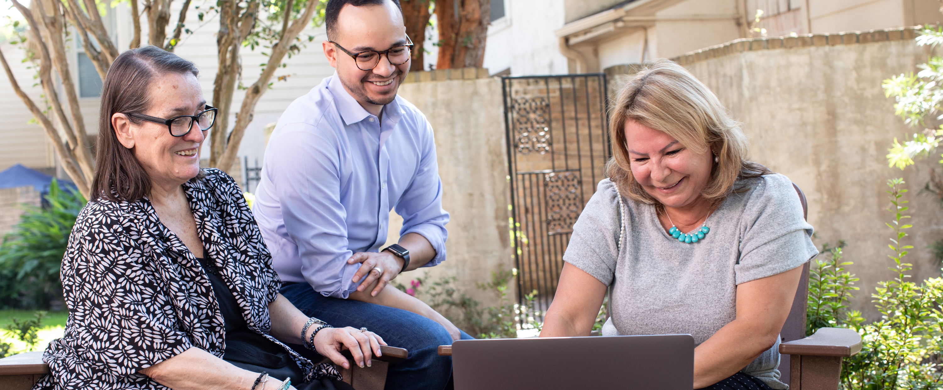
How to Work With Media Outlets to Get Coverage of Your Club
Notes:
<Introduce yourself: Say your name, your club name, your Rotary role, and your professional role if it’s relevant.>
Example: My name is <Name>. I’m a member of <club name> and I’m the <club and/or district roles>. Today, we’ll talk about how to work with media outlets to get coverage of your club.

Slide 2
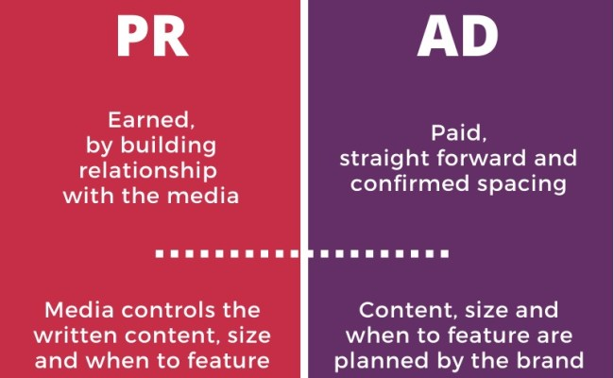
Media relations
Notes:
First, I want to define some terms:
With media relations, your aim is to reach people who aren’t involved in Rotary through editorial coverage, or what is called earned media.
Earned media is any material about your club that you haven’t paid for or created (unlike advertising messages).
For earned media, it’s important to cultivate relationships with news outlets and influencers so that they tell your story.

Slide 3
Building relationships
Trusted source
Visibility
Notes:
Reporters are interested in telling stories about topics that are relevant and meaningful to their audience.
As business and professional leaders who take action to improve your communities, you can offer journalists an important perspective, along with access to people and information they want to cover.
Building relationships with journalists and being a knowledgeable resource on community issues can lead to more coverage of your club’s projects and events.
Although you cannot control the content of media coverage, you can influence how the message is received and relayed.
If you are considerate, forthcoming, understanding, and trustworthy, your media contacts will recognize that and mirror it back to you.

Slide 4
Building relationships
Research
Engage
Share
Maintain
Notes:
There are four important steps to building relationships with the media.
Research:
Get to know the reporters in your area. Don’t forget bloggers and social media influencers.
Learn the topics each one of them covers and note what approaches they take on issues.
Understand the audience of each media outlet.
Determine your goals: Who you want to reach, what message you want to convey, and what you want your audience to do.
Engage:
Be proactive. Contact the media outlet and introduce yourself and your club to start establishing a relationship.
Ask questions to learn how they work, such as how far in advance they prepare stories and what their deadlines are.
Understand their constraints. If they contact you, respond as quickly as you can and always before their deadlines.
Have photos, videos, statistics, projects details, and background data available to provide.
Share:
Connect them to story opportunities that fit their interests or coverage topics.
Offer access to relevant sources such as prominent club speakers, members of the community doing extraordinary things, people who have benefited from your club project, and project partners.
Be accurate, brief, and clear. Speak only about what you know, be succinct, and avoid jargon or complex terms. If you don’t know something, let them know and be sure to follow up later.
Maintain:
Some media outlets have high turnover, so it’s important to establish a cadence of regular communication.
Invite journalists when speakers at your club will be addressing topics they cover, or ask them to be involved in a club activity, such as by moderating a panel discussion.

Slide 5

Case Studies
French Rotary clubs secured national media coverage of a project called Roses for a Beehive that addressed declining bee colonies and threats to biodiversity. They collaborated with local rose growers to plant and sell rosebushes, with the proceeds they contributed to establishing beehives nationwide. ​
All French district governors joined together on this project, and their districts aligned their communication activities. ​
The effort was covered by TV France 3, Le Figaro, and more than 50 other print and online articles.
Notes:
Next, we have two examples of how clubs or districts obtained quality media coverage through relationships and outreach.
French Rotary clubs secured national media coverage of a project called Roses for a Beehive that addressed declining bee colonies and threats to biodiversity. They collaborated with local rose growers to plant and sell rosebushes, with the proceeds then contributed to establishing beehives nationwide.
All French district governors joined together on this project, and their districts aligned their communication activities.
The effort was covered by TV France 3, Le Figaro, and more than 50 other print and online articles.

Slide 6

Case Studies
Public hospitals in Brazil were suffering from a lack of equipment to treat patients during the COVID-19 pandemic. ​
Rotary clubs worked together to collect donations for the hospital in order to provide lifesaving medical equipment. ​
Rotary members developed a news release and personalized their outreach to journalists, which resulted in coverage by the local affiliate of Globo TV — one of the nation’s largest broadcast networks.
Notes:
Here’s another example.
Public hospitals in Brazil were suffering from a lack of equipment to treat patients during the COVID-19 pandemic.
Rotary clubs worked together to collect donations for the hospital in order to provide lifesaving medical equipment.
Rotary members developed a news release and personalized their outreach to journalists, which resulted in coverage by the local affiliate of Globo TV — one of the nation’s largest broadcast networks.

Slide 7
rEsources
Resources for clubs
Public Relations and Your Club course
RI media relations specialists
Public relations page
Media crisis guide
Training sessions at events
News release templates
Media tips video
Notes:
The good news is that you have many resources available to help you obtain local media coverage of your club’s impact:
Take the “Public Relations and Your Club” course in the Learning Center.
Use the resources in the Brand Center, including the public relations page, the media crisis guide, and news release templates.
Attend public image sessions held at gatherings such as the Rotary International Convention, the International Assembly, governor training seminars, and club president training seminars.
Contact specialists at Rotary International World Headquarters or the international offices to obtain presentations on public relations and social media or for guidance on preparing for media interviews, developing your message, crisis communications, and more.

Slide 8

QUESTIONS?
Notes:
Thank you for your time and attention. Do you have any questions?

