Slide 1
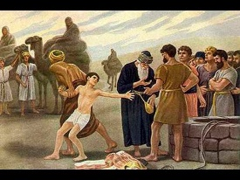
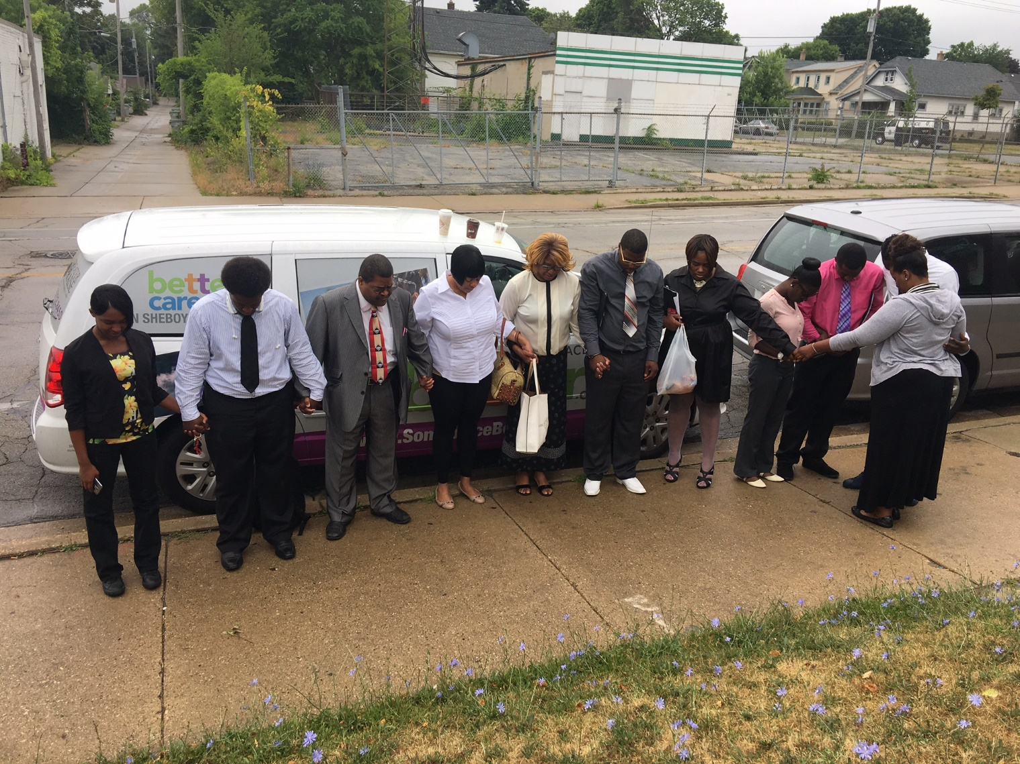
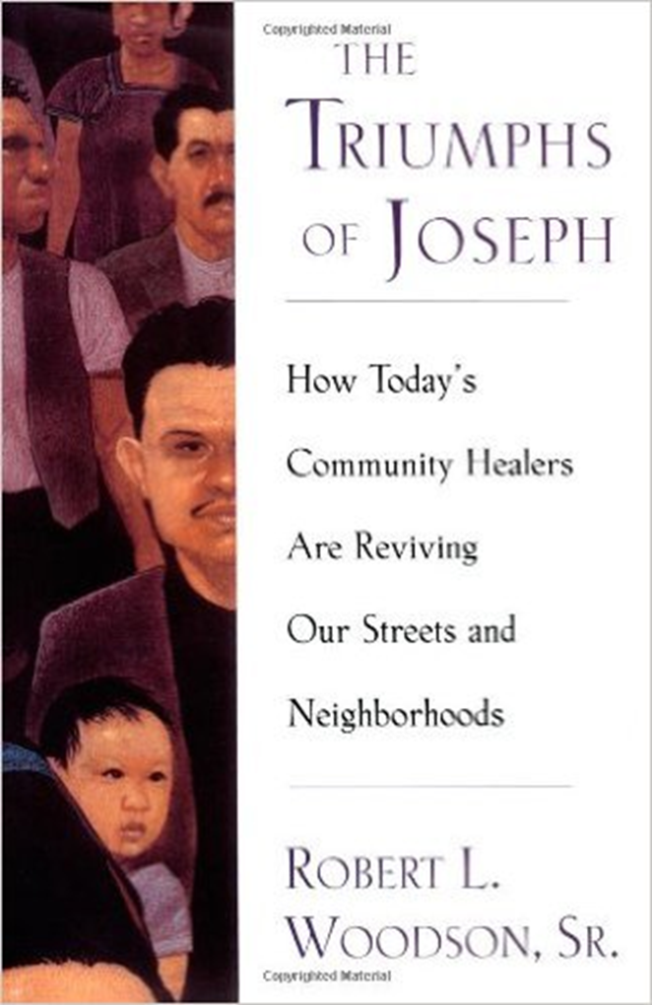
the JOSEPH PROJECT
- divine purpose -
http://www.josephprojectwi.org
Notes:
An initiative born out of the collaboration of Pastor Smith, Orlando Owens, and Scott Bolstad to partner manufacturing with available labor, supported by Senator Ron Johnson.
The Joseph in Milwaukee is Pastor Jerome Smith.

Slide 2
Task and Purpose
“In six years of traveling around Wisconsin, I have yet to visit a manufacturing company that can find enough people to meet their hiring needs, but you look at neighborhoods in Milwaukee and still see high rates of unemployment. That’s why we started The Joseph Project. We saw a need for making the connection between people who are genuinely seeking opportunity and the opportunities that exist around the state.
Senator Ron Johnson
MISSION STATEMENT:
To Help People
Notes:
This project is designed for those who want to turn their lives around and experience the dignity of being able to provide for themselves and their families. The Joseph Project helps them grasp the first rung on the ladder of success. My Senate staff, working collaboratively with Pastor Jerome Smith of Greater Praise Church of God in Christ and a growing number of Sheboygan area employers, are doing an incredible job motivating participants to complete the process. These aren’t just jobs; these are careers. Participants who have completed the program are earning good wages that allow them to buy cars, stay current paying household bills, and deposit savings in the bank. I appreciate Pastor Smith’s dedication and involvement as well as the employers and business leaders in Sheboygan who are helping make this possible. I could not be prouder of their efforts”

Slide 3
the JOSEPH PROJECT
A constituent services initiative launched in September 2015
Addressing two challenges simultaneously
Under and unemployment in inner cities
Labor shortfall in manufacturing
Success is based on relationships
No government funding
Exemplifies our mission

Slide 4
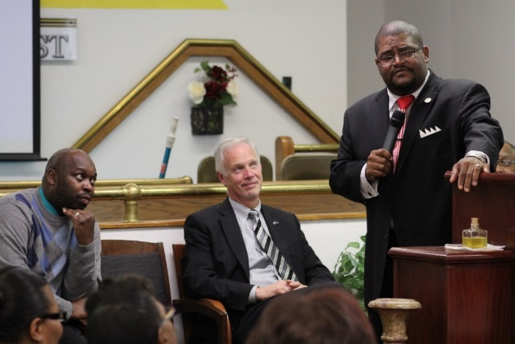
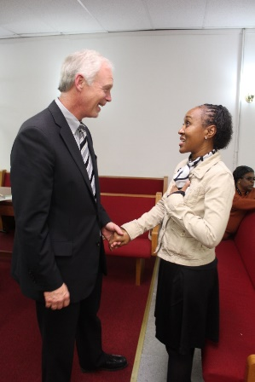
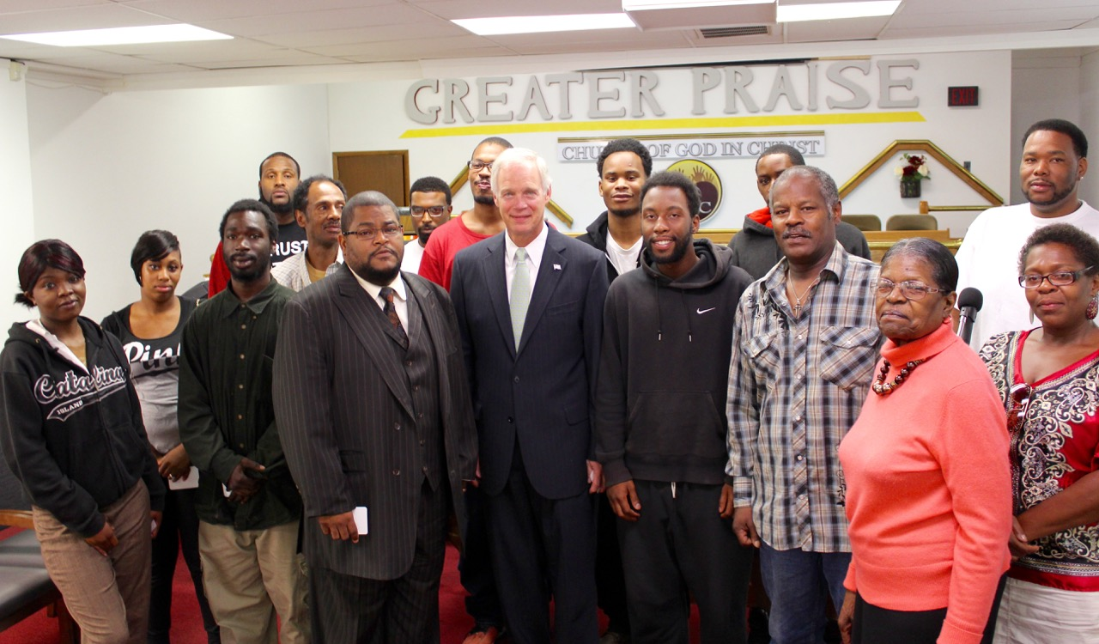
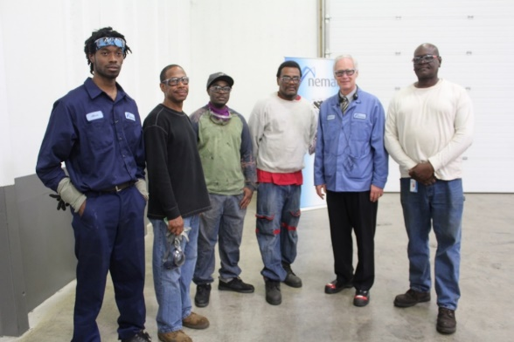
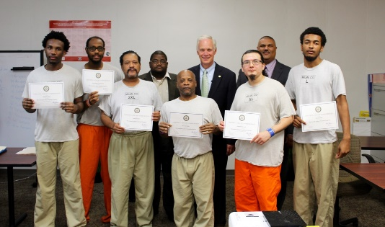
The Joseph Project Mission Statement
Connect those genuinely seeking opportunity with opportunities that already exist.

Slide 5
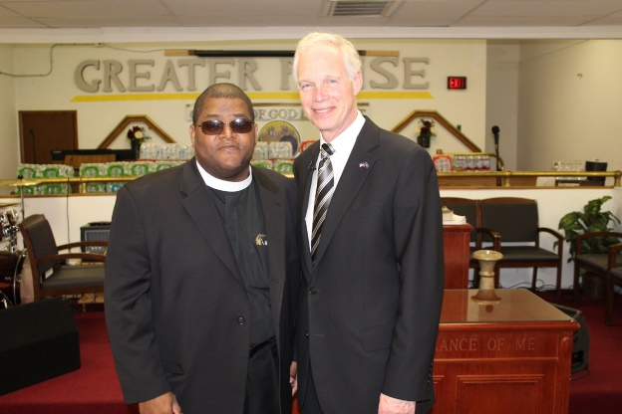
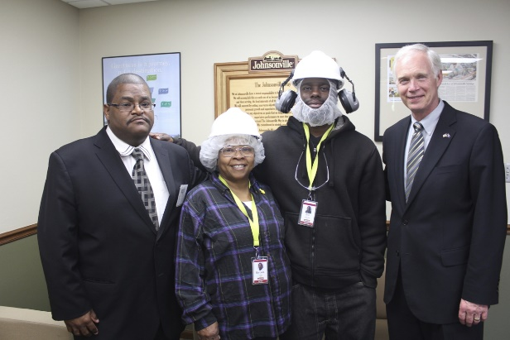
Who we are
A partnership between the faith and business communities
We remove the obstacles to good paying jobs
Volunteers
We accept no federal or state tax dollars

Slide 6
Business Partners

Slide 7
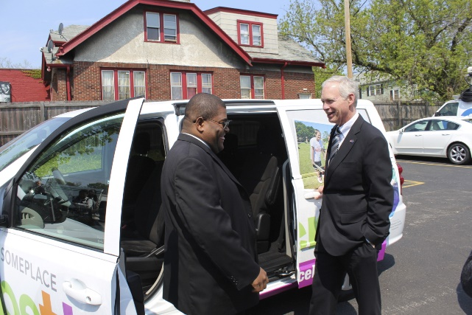
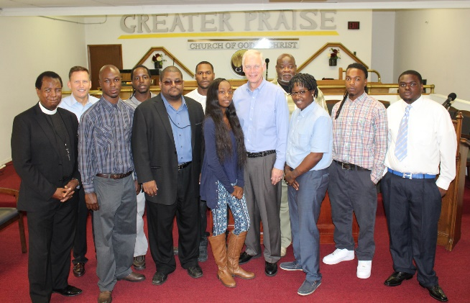
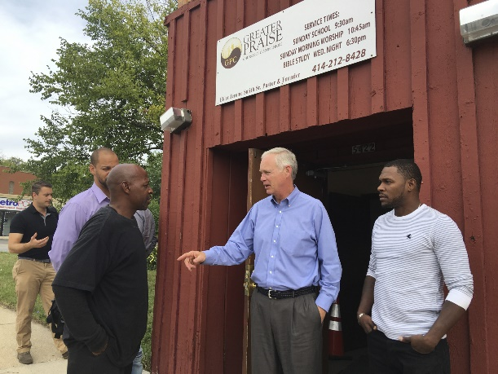
Grass Roots more than a partnership, it’s a cooperative
Candidates
Business Partners
Volunteers
Staff
Community
Faith Community
Notes:
The backbone, cornerstone, foundation is Pastor Jerome Smith. Community efforts outperform government programs.

Slide 8
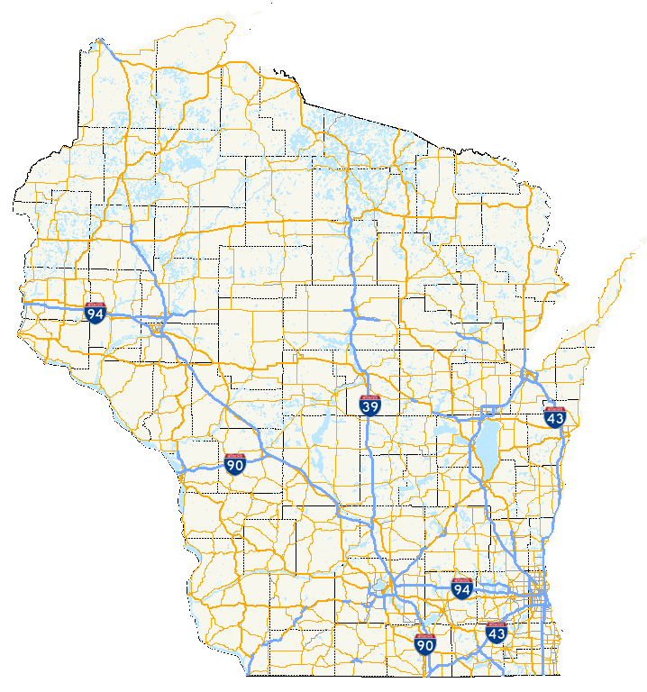
Where we are
Milwaukee
Greater Praise COGIC
House of Corrections
Madison
Capital City Sanctuary
Wausau
Greater Wausau Christian Services
Green Bay
The Micah Center
Chippewa Falls
Northern Wisconsin Center

Slide 9
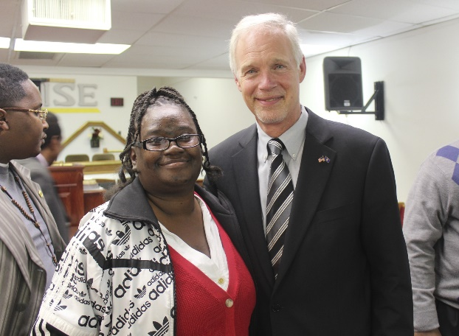
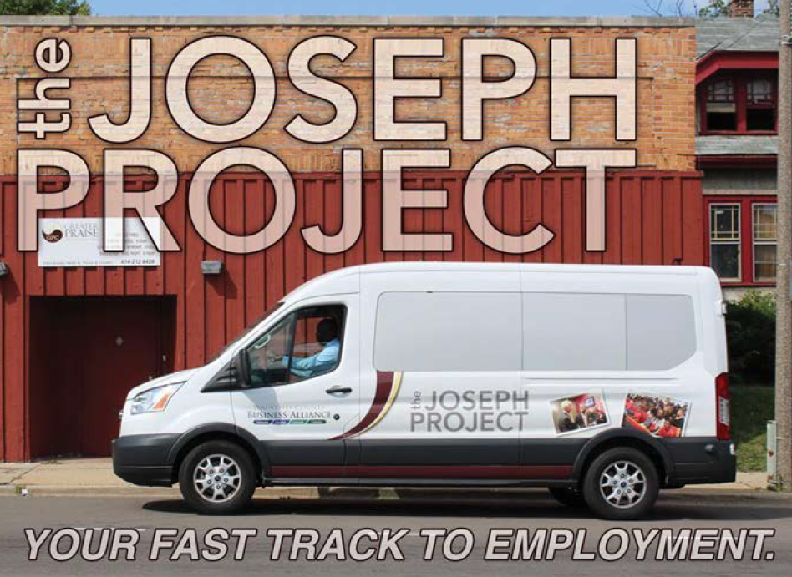
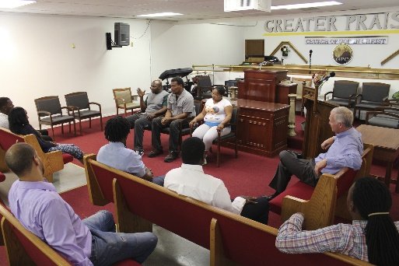
What we do
Find and vet potential
applicants
Essential skills workshop
Interviews
Transportation
Mentorship
Advocacy

Slide 10
How do we do it
Essential Skills Workshop focused on three areas:
Interview performance
Dealing with change/success
Joining a team
Employs the following schedule:

Slide 11
Schedule
Day 1
Day 2
Day 3
Day 4
Overview/ Business Presentations
Business Presentations
Spiritual Fitness
Interviewing Skills II
Communication
Personal Finances
Goal Setting/Time Management
Teamwork
Conflict Resolution
Resumes
Alumni Forum/Business Presentations
Business Presentations
Interviewing Skills I
Cautionary Tales
Notes:
Applications begin after Day 2.
Address three primary challenges… THE INTERVIEW; Change/success; Joining a team

Slide 12
Joseph Project Status Total
Historical and Statistical
Year | Completed Class | Interviewed | Pending | Began Work (Waiting to begin) | Still Working | No Go
2015 | 44 | 43 | 0 | 35 | 19 | 25
2016 | 139 | 131 | 1 | 93 | 55 | 83
2017 | 146 | 136 | 0 | 111 | 56 | 90
2018 | 113 | 106 | 22 | 60 | 38 | 53
Grand Total | 442 | 416 | 23 | 299 | 168 | 251
Notes:
Those still working….would they have secured FT employment without JP? That is the success of this program.

Slide 13
“I wish The Joseph Project was our little secret, because we’ve really benefitted from it. I would definitely recommend it, no reservations what so ever.
Tom Bair, HR Manager

Slide 14
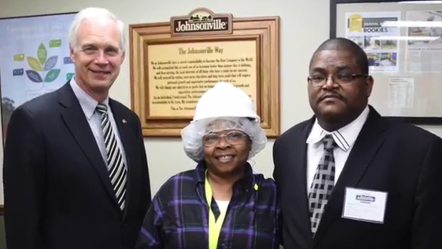
“We just jumped in and we’ve had members contributing at high levels for over a year. We are very pleased. All of our Joseph Project candidates have done quite well in the interview process.”
Heather Martin, HR

Slide 15
“I’ve been interviewing candidates all year, ranging from hourly to management positions. I can honestly say that the candidates from the Joseph Project have been some of the most prepared and well spoken in interviews. You have all done a great job with this program and it shows.”
Luis Granja, Plant Manager

Slide 16
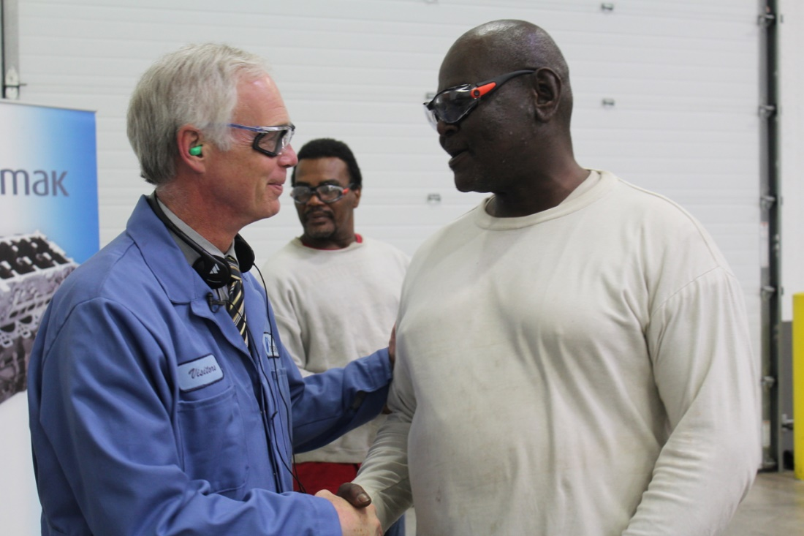
Ripple Effects
Making restitution
Escaping dependency
Combatting recidivism
Paying it forward
People are paying bills, buying things
Celebrating the dignity of work and living a purposeful life
Men and women setting positive examples for young people

Slide 17
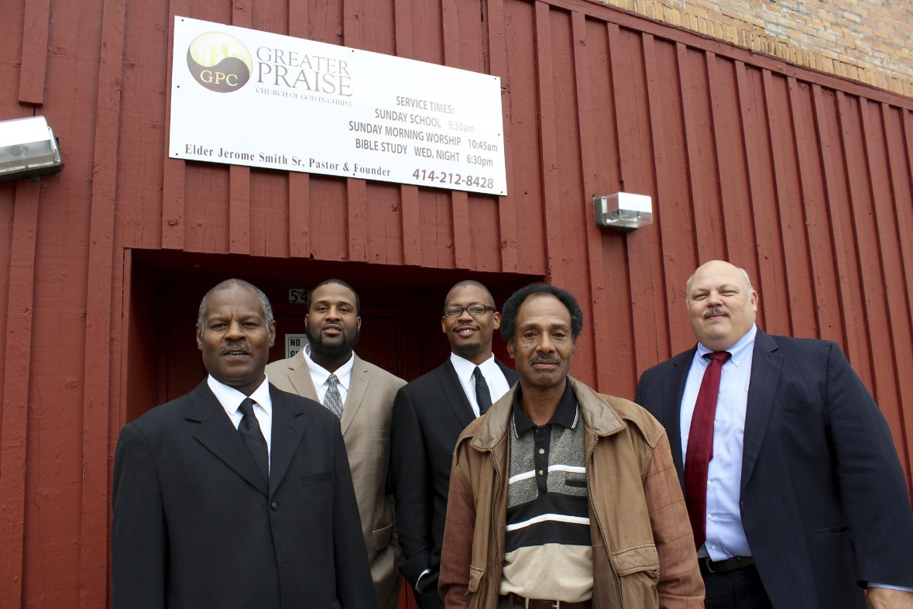
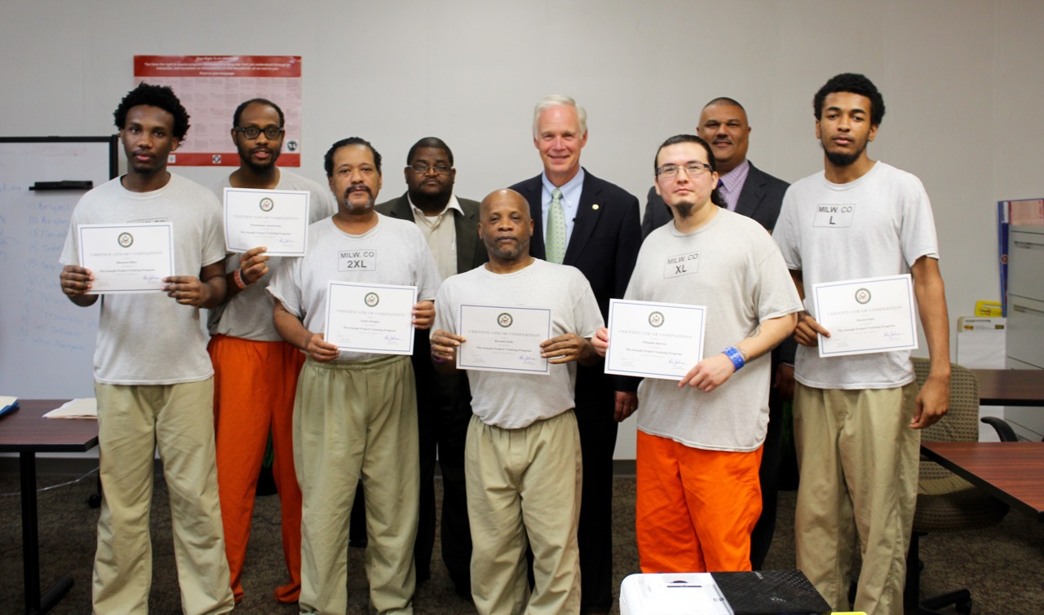
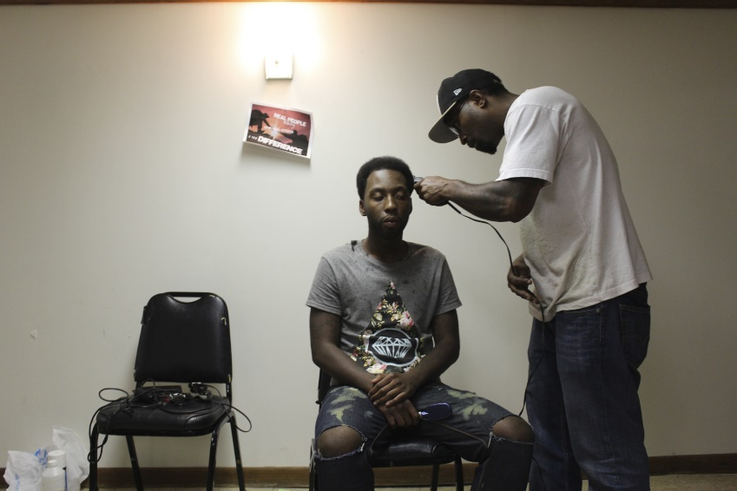
Moving Forward
A scalable model
Others seeking opportunity
Other businesses

Slide 18
Changing Lives One Person at a Time

