Slide 1
Imagine what we can do… Our Rotary Foundation 2022 2023

Slide 3
OUR Foundation and YOUR SUPPORT IN 2021-2023 has helped to fund in the world:
478 District Grants - $28.7 Million
1197 Global Grants - $76.9 Million
228 Disaster Response Grants- $7.09M- for Ukraine

Slide 5
Our district this Rotary year supporting 10 Global Grants– the most ever valued at $467970
Kenya – 2
Zambia -2
Burkina Faso
Tanzania
Turkey
Rwanda
India
Haiti

Slide 6
Our district this Rotary year supporting 19 District grants valued at $126,000
Foundation grant of $63 380 in our district
Types of projects:
Bike Repair Stations
Emergency Shelter
2 Homeless Shelters
4 Environmental projects
2 Food Programs
ADA Playground
5 Literacy Projects
2 Medical Equipment

Slide 7
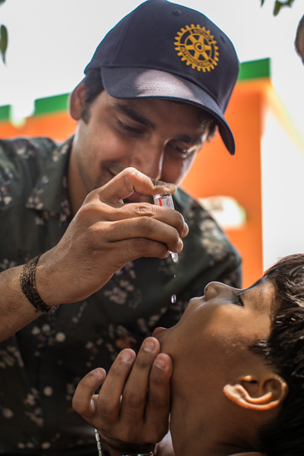
Polio Plus Our District Contributed $70,292 in 2021-2022
It’s not over “yet”– we still need to support and contribute
2022 cases
Pakistan: 19
Afghanistan: 2
Mozambique: 6
USA: 1—( non-vaccinated person- originated Pakistan)

Slide 8
More Club support for Our Foundation means…
More funds for more projects

Slide 9
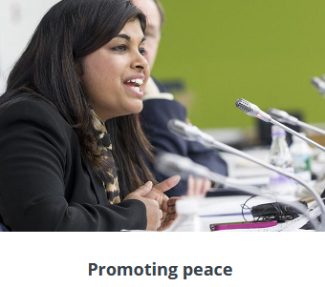
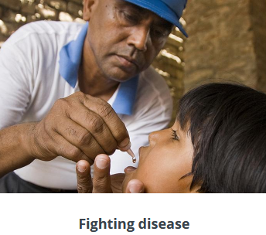
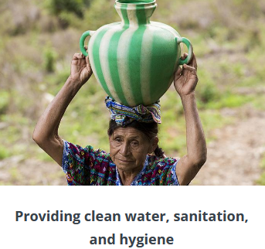
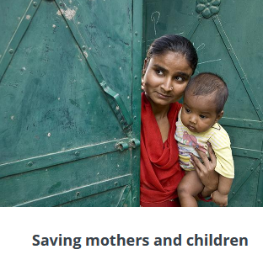
What do we fund: Our Causes

Slide 10
“Pieces” of our Foundation-- simple
Annual Fund– Also Called SHARE– our major focus for projects
Levels of Giving- Paul Harris Fellow, Paul Harris Society, Major Donor, Bequest
Rotary Direct– simple way to give
Endowment
Polio Plus
Other– Peace Centers, by Cause

Slide 11
Reminders– how does all this work?

Slide 12
More funding means more projects!
In 2021-2022 our District contributed $321276 to Annual fund

Slide 13
How can we achieve $1million donations to our Foundation by the end of Rotary Year 2024?
Ideas
Every club participate in Foundation Giving
Can every Rotarian contribute– maybe contribute a bit more? Increase our Rotary Direct Giving
Consider being a Major Donor
Consider Paul Harris Society
Consider joining the Bequest Society and Being a Benefactor
Can your club be a 100% membership giving Club
WE CAN DO IT!

Slide 14
What’s next?
Mark your Calendars:
November 22, 2022 Rotary District 7430 Foundation Giving Day
go to rotarydistrict7430.org- on the calendar- click and easy to donate

Slide 15
Bethlehem Morning Star Rotary Projects
New Bethany Ministries
Fountain Hill grocery equipment
Playground project
Victory house
Game of rent
Emergency shelter
Nicaragua Water Project
Kenya Global grant

Slide 16
Bethlehem Morning Star Matching Points
The Board has agreed to match Foundation gifts made during the 2022-23 Rotary year with up to 500 points. If a member contributes $500, the club will match 500 points and you will receive a Paul Harris Fellow. If you contribute a lesser amount, the club will still match your contribution with points to bring you closer to attaining your first or multiple Paul Harris recognition. This offer is retroactive for anyone who has contributed to Foundation since July 1, 2022. Match would be optional at discretion of donor.

Slide 17
Thank you! Let’s grow our Foundation in 2022 -2023

