Slide 1
LEHIGH UNIVERSITY UNITED NATIONS PARTNERSHIP

Slide 2
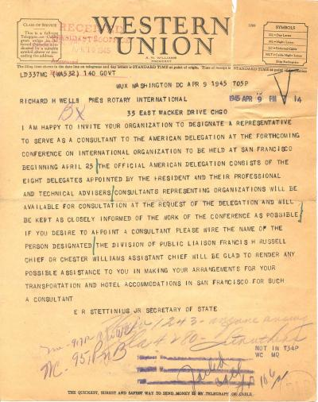

Slide 3
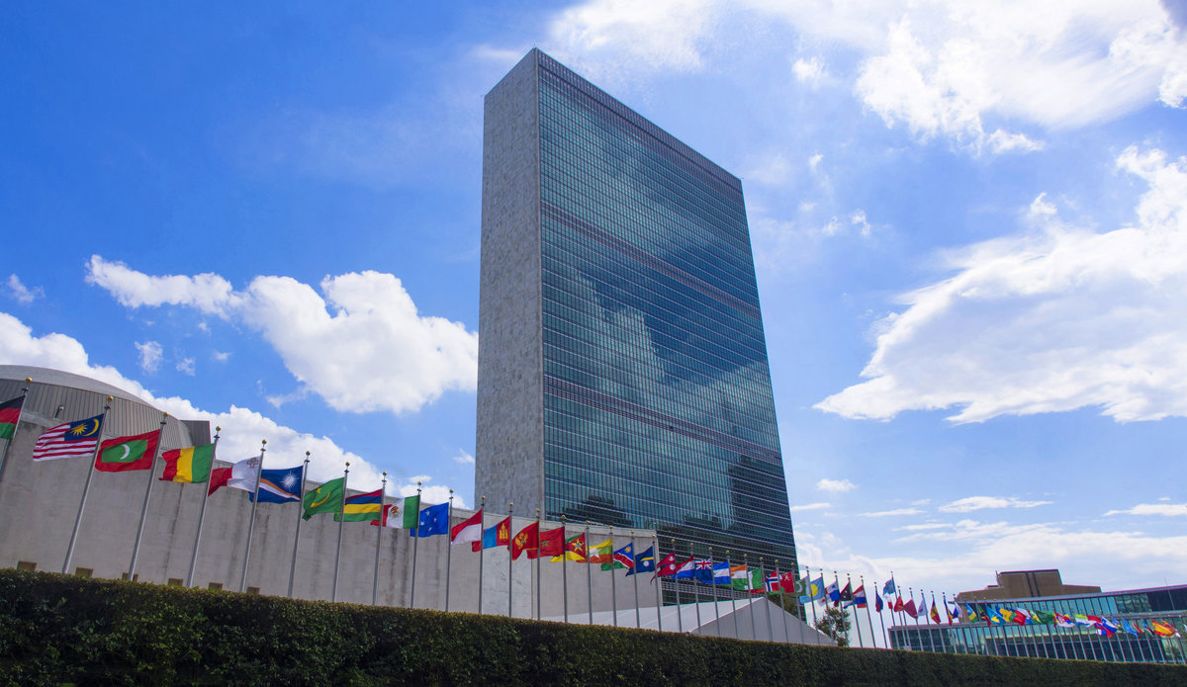
What is the UN?
The United Nations is an intergovernmental organization tasked with maintaining international peace and security, developing friendly relations among nations, achieving international cooperation, and being a center for harmonizing the actions of nations.
Notes:
Bill

Slide 4
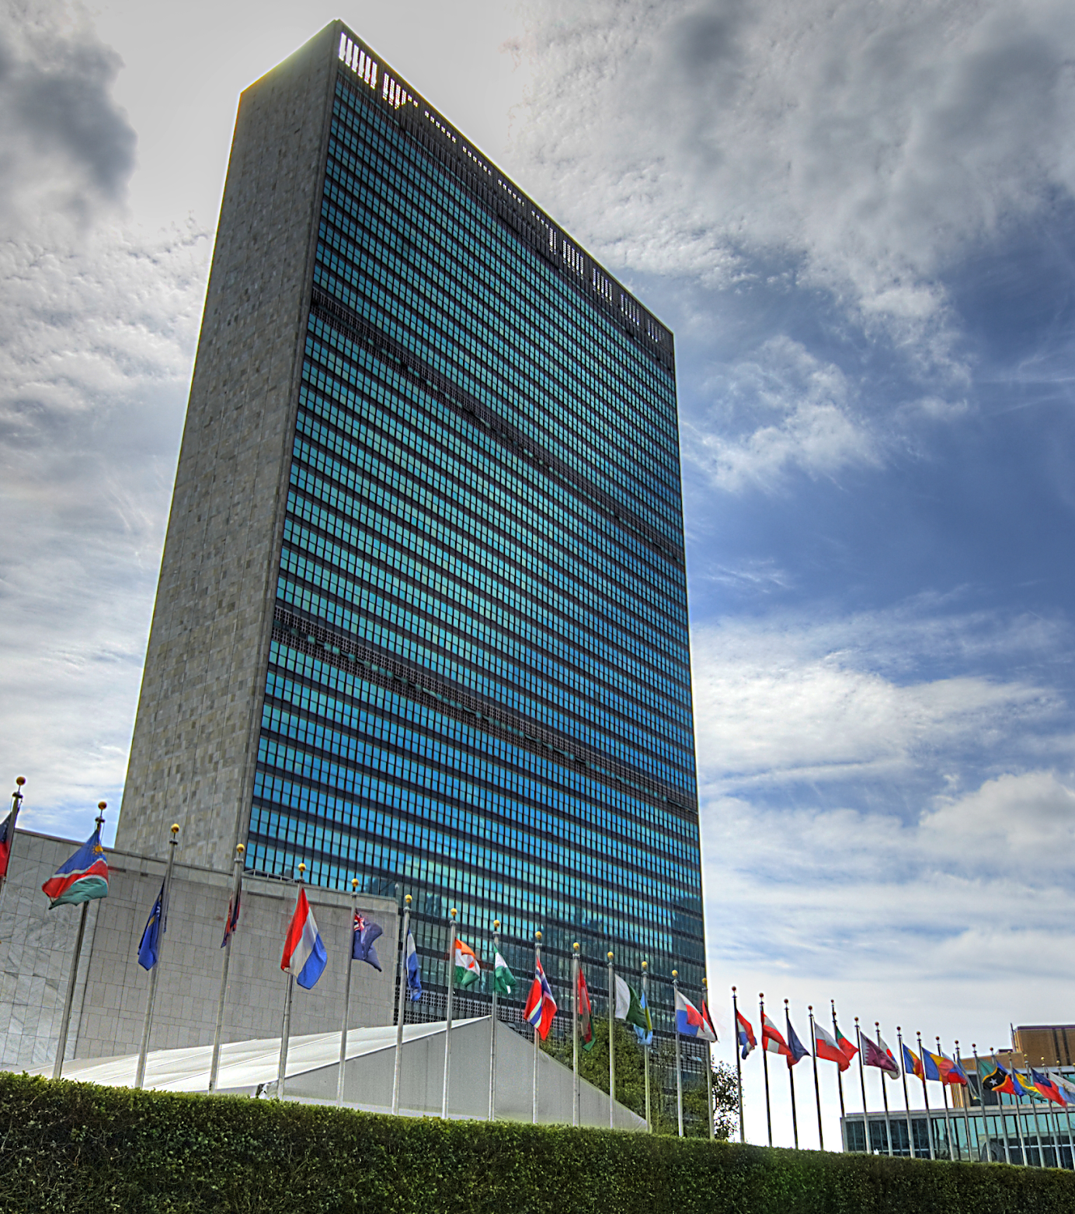
UN QUIZ
How many countries are there in the world? How many belong to the United Nations?
Are there any other organizations that belong to the UN?
Who? Why?
Who is the Current Secretary General? Where is (s)he from?
What are the official language(s) of the UN?
Notes:
Answers:
The United Nations recognizes 195 sovereign countries in the world. 193 are member states (Taiwan left the UN in 1971) and South Sudan has not applied yet (or been accepted) as a sovereign state. Vatican City has chosen not to join the UN and the Holy See and the State of Palestine are only observer states.
The current Secretary General is Antonio Guterres from Portugal.
Official languages of the UN: Russian, English, French, Spanish, Chinese, Arabic

Slide 5
Keys to the House
“I don’t know what you want (from the UN), but take it.”
Shashi Tharoor
Former Under-Secretary General, United Nations
This Photo by Unknown Author is licensed under CC BY-NC

Slide 6
SUSTAINABLE DEVELOPMENT GOALS
Notes:
Whitney

Slide 7
LU / UN Strategic Partnership Pillars
Lehigh University / United Nations Partnership is a comprehensive, university-wide curricular and co-curricular initiative that directly engages faculty, staff and students from all colleges, backgrounds, and majors.
Strategically guided by five pillars that align with the UN SDGs :
Youth Empowerment
Social Justice
Gender Equity
Sustainable Development
Health

Slide 8
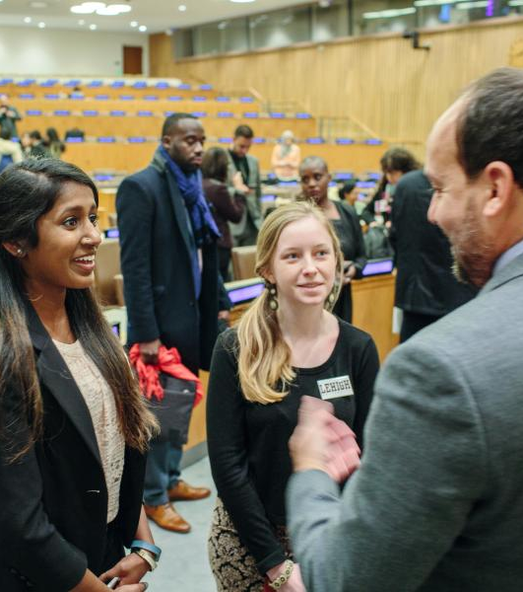
Lehigh United Nations Partnership
6th university in the world accredited as a UN NGO
+10,000 students, faculty, and staff have engaged in UN activities
More than 40 Lehigh students have interned at the UN
UN Ambassadors have spoken on campus or met our students at the UN
Research projects with UNESCO and UNEP
1st university to conduct direct research project with UN PGA
Notes:
Bill

Slide 9
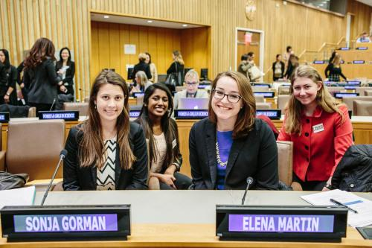
Lehigh Students Present at the UN
Notes:
Emma- talk about your experience and how it inspires/drives you to take advantage of opportunities here at Lehigh and in your future career?

Slide 10
Lehigh Class Visits UNEP in Nairobi
Notes:
Bill- example of international student experiences

Slide 12
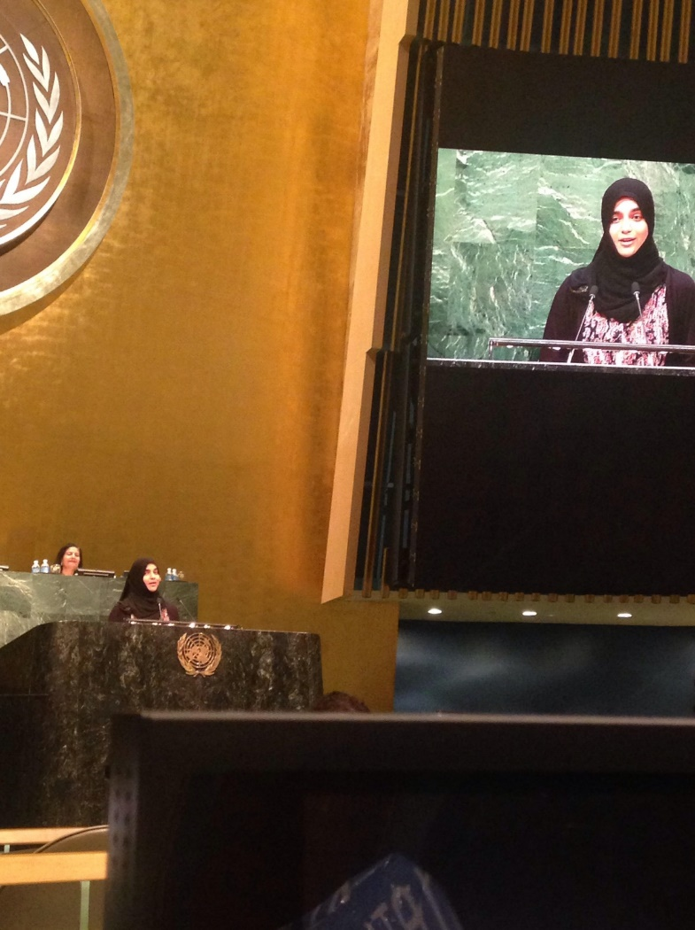
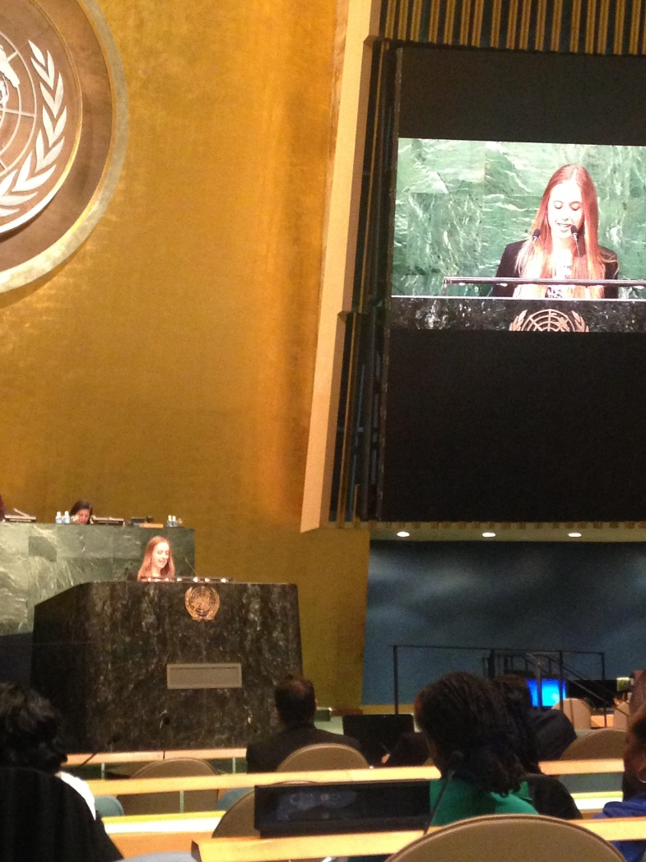
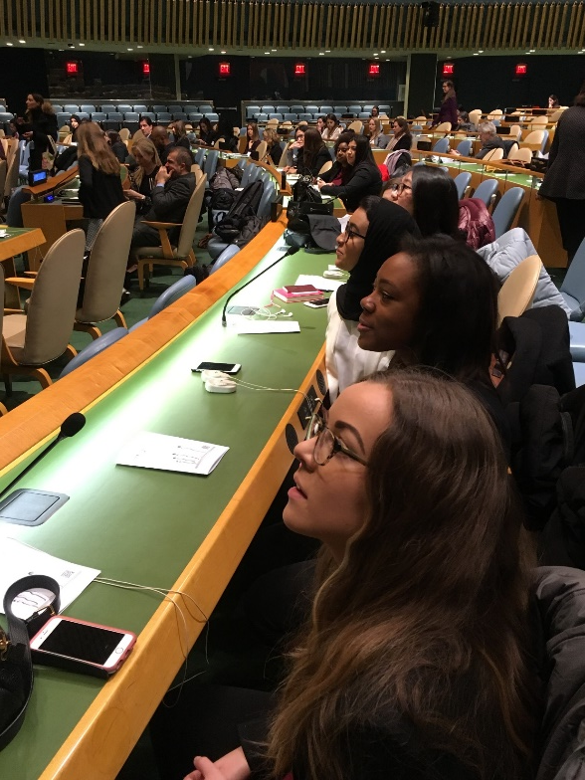
International Day of Women and Girls in Science, February 11
Hosted by Princess Dr. Nisreen El-Hashemite
Maryam Khan ’19
Kelsie Strobel ’18
Notes:
Bill- example of past students seeking solutions as well as upcoming Oct. 25th conference

Slide 13
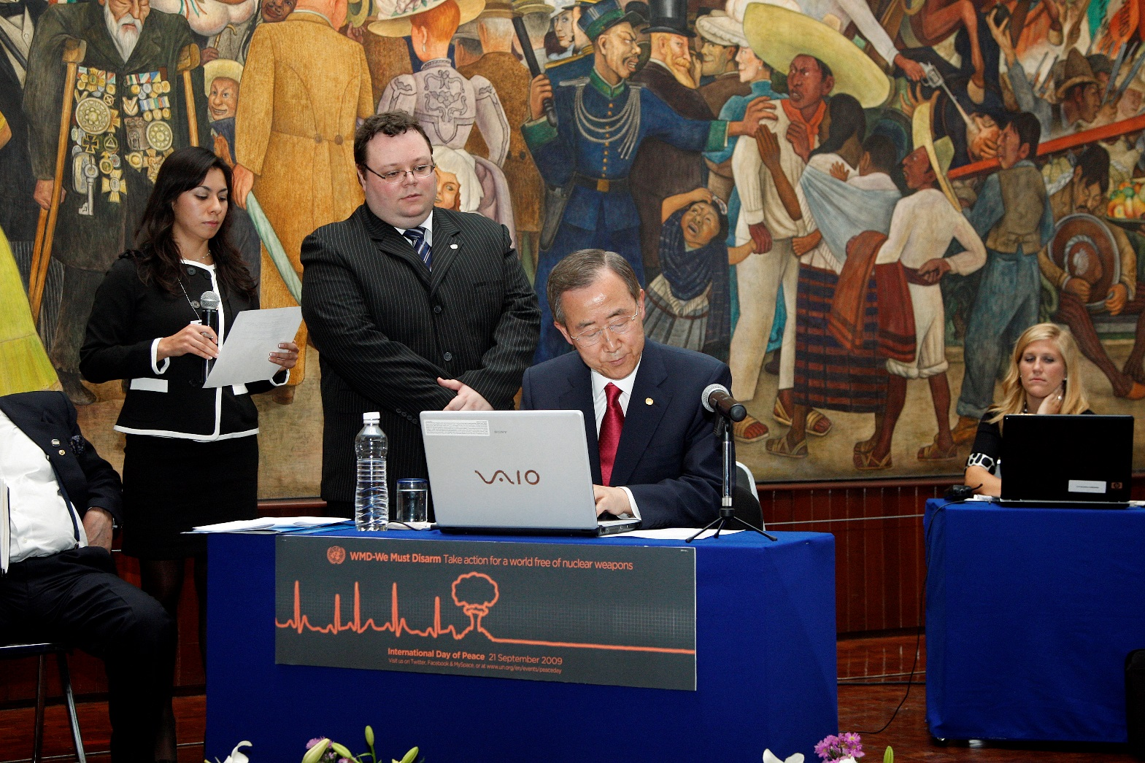
First UN Tweet
Notes:
Bill- will tell story

Slide 14
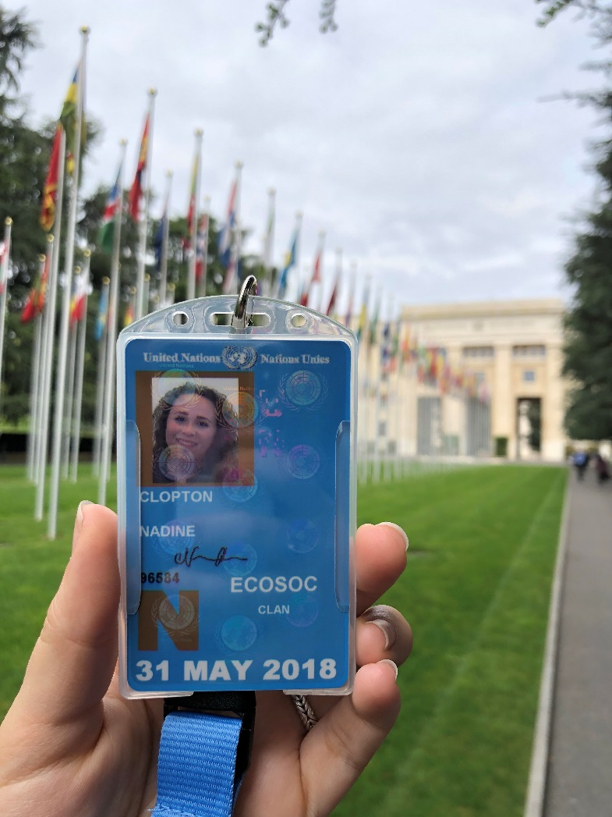
First UN Youth Representative in Geneva
Notes:
Bill

Slide 15
WHO Executive Director to Speak at Lehigh Monday
Population Health Colloquium | College of Health
Monday, February 22 at 1:00pm to 2:00pm
Virtual Event
The College of Health in collaboration with Lehigh's United Nations Partnership is pleased to continue our colloquium series. We invite you to join us as Dr. Nata Menabde, Executive Director, World Health Organization Office at the United Nations, New York presents "A Global Perspective: Advancing Health Outcomes Around the World."
This event is free and open to the greater Lehigh community. Registration is required.

Slide 16
LEHIGH UNIVERSITY UNITED NATIONS PARTNERSHIP

