Slide 1
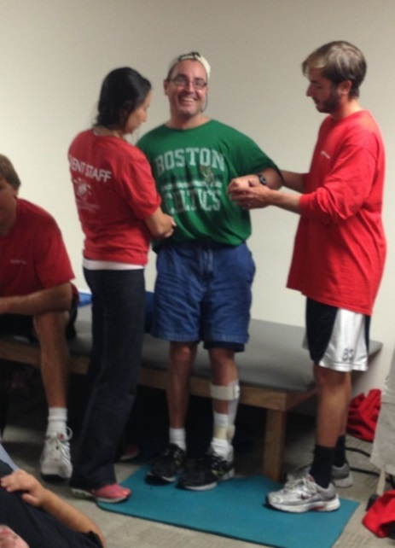
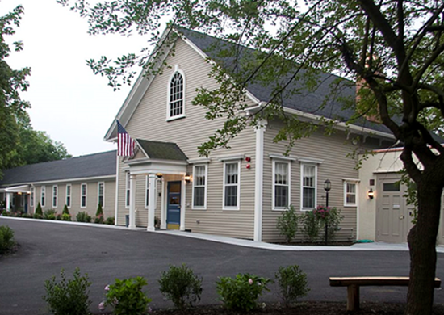
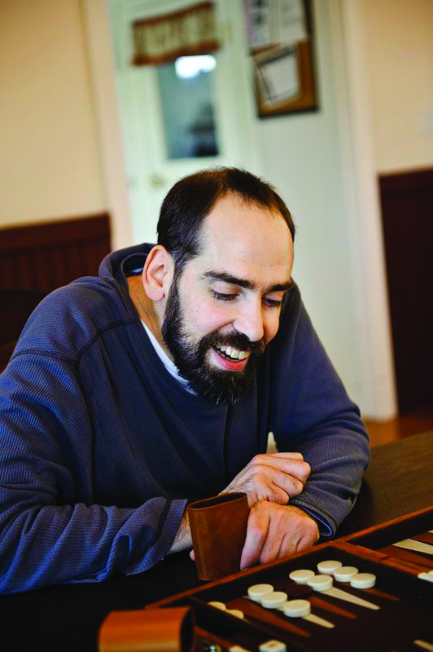
A New Approach to Life with Brain Injury
Rotary Club of Lexington
March 2, 2015

Slide 2
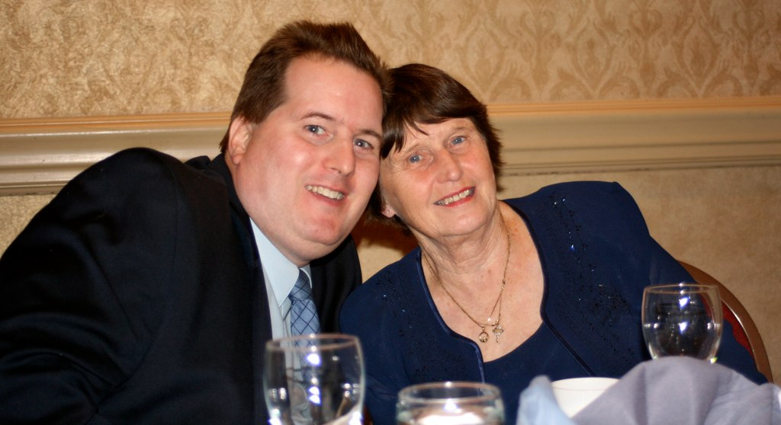
In an Instant
In an instant life will change after surviving a serious brain injury. The cause could be stroke, car accident, fall, heart attack, and more.
Many normal daily functions performed before the incident can be affected. They could be physical, memory, cognition, speech, behavior, emotion, and more. You are not the same person after the accident.
Brain injury does not discriminate. It can happen to anyone, anytime. SLI residents are former teachers, okers, veterans, engineers, students, mothers and fathers, sisters and brothers, and the list goes on……

Slide 3
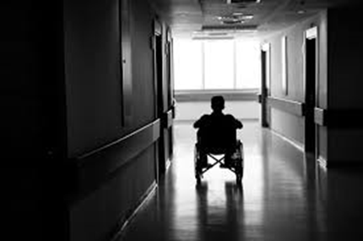
Sad Irony
It is a sad irony that advancements in medical technology keep many people alive after suffering a brain injury, yet for those disabled by the event, our health care system does not have an appropriate long-term care solution.
The cost of long-term care is very high, and more often than not a survivor will end up in a nursing home, state institution, at home without appropriate care, homeless.
It is estimated that up to 5,000 individuals in the Commonwealth with brain injury are in nursing homes, yet ABLE to live in the community with the appropriate support.

Slide 4
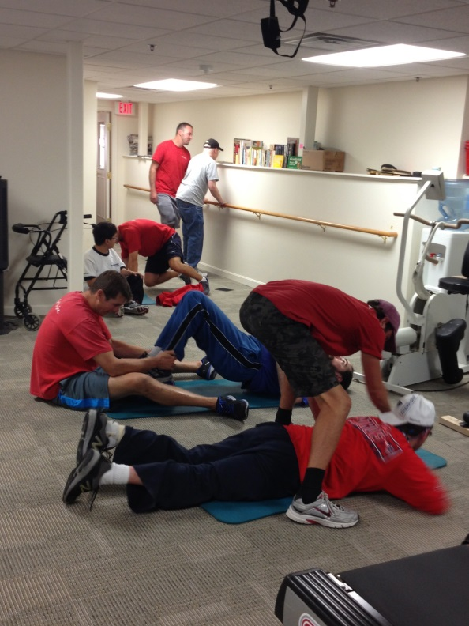
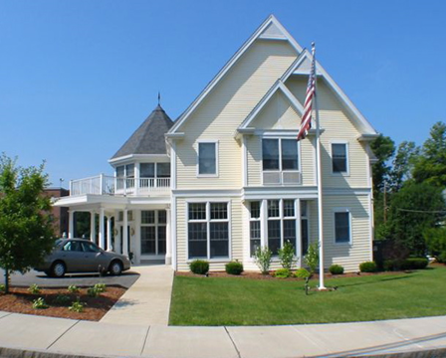
Mission
Supportive Living, Inc., (SLI), strives to raise the quality of life for survivors of brain injury.
To achieve this mission, SLI develops appropriate and affordable supportive housing; provides life-long physical, cognitive and social fitness through wellness programs; and fosters research aimed at improving the lives of those affected with brain injury.
SLI FOCUS
Residential Communities
Wellness Programs
Applied Research
`+

Slide 5
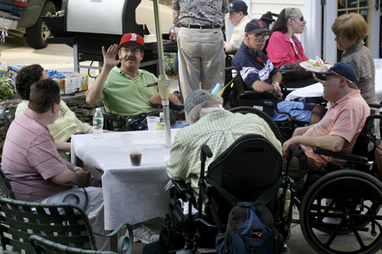
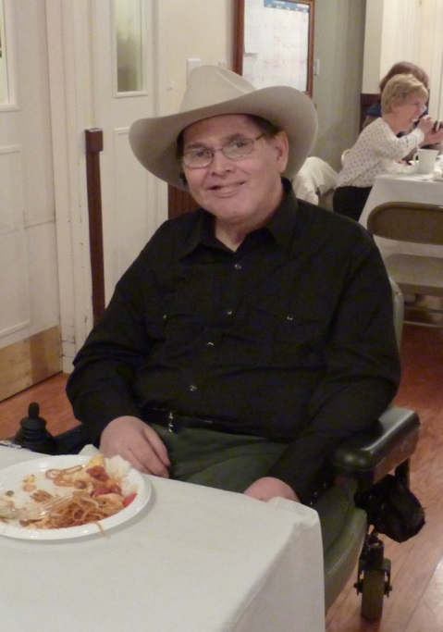
SLI History
1991 – Founded
1997 – Warren House, Woburn
2002 – McLaughlin House, No. Reading
2008 – Douglas House, Lexington
2011 – Brain Injury Research Programs, Lex
2012 – Brain Injury Wellness Center, Lex
2014 – Old Farm Rockport, Rockport
2015 – Old Farm Horticultural Center
2016 – 25th Year Anniversary

Slide 6
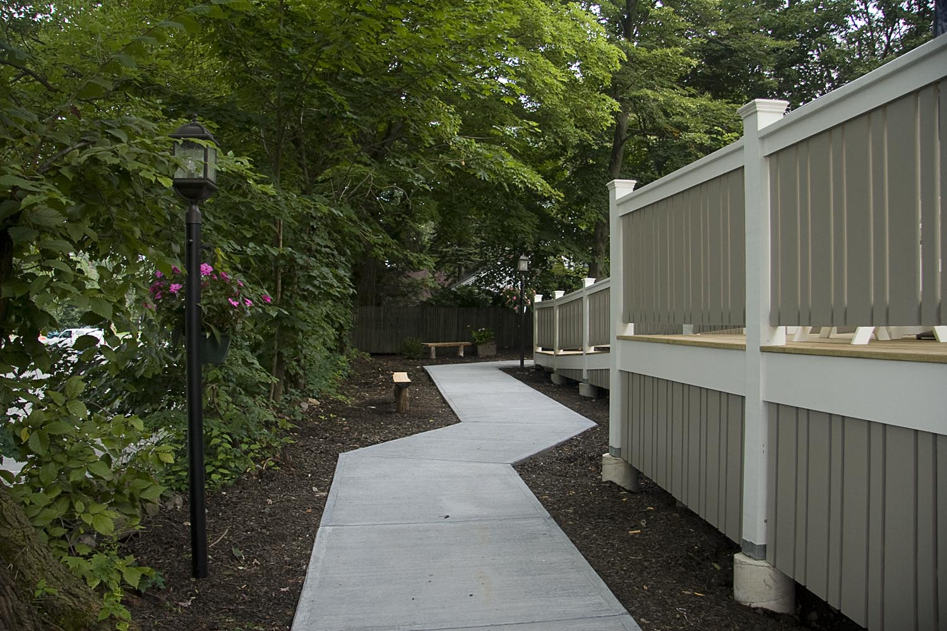
Douglas House Lexington Milestones
2004 – SLI purchases Lexington Press
2007 – All funding approved including $10,000 from the Rotary Club of Lexington
2008 – Construction completed
2009 – Lexington received The Robert Kuehn Award for Historic Renovations of Douglas House
2012 - SLI Brain Injury Wellness Center opens
2013 - Douglas House awarded The Richard Bechtel Design Award
2014 - Dana Home Foundation awards $10,000 to study issues facing Lexington residents with brain injury and other neurological conditions
2015 – The Rotary Club of Lexington provides $10,000 to support the Brain Injury Fitness Program at the Wellness Center

Slide 7
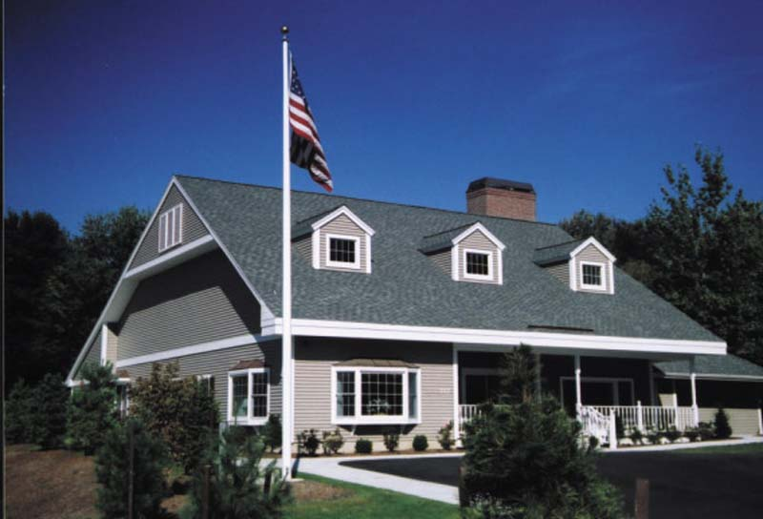
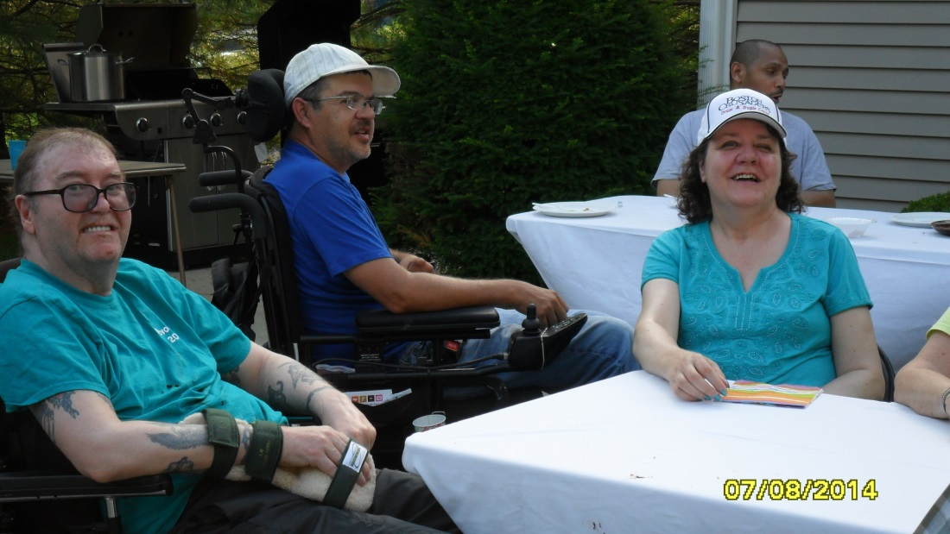
Residential Communities
A proper living environment that provides safety, support, and positive stimulation is a foundation for recovery.
Staff then work with residents to develop the specific supports and services needed to gain back some of the functions lost due to their injury, and re-enter life in the community.

Slide 8
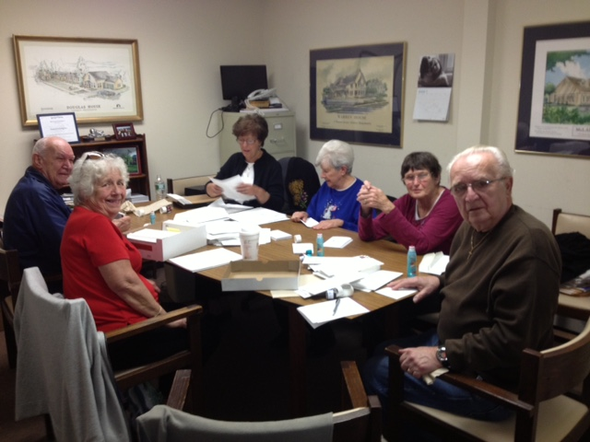
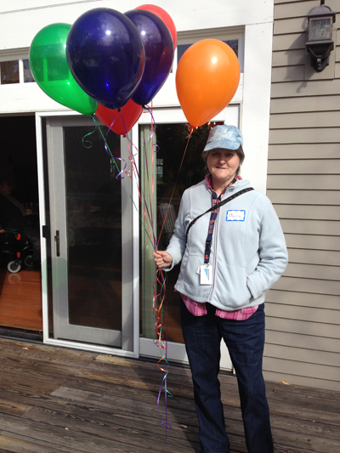
Local Communities
It is important for the SLI residential programs to have their own internal community. It is equally important for the residents to have a chance at participating in activities in the local community.
Community integration allows individuals to be more independent, to develop new relationships, and to do things that make them feel good about themselves, and to have FUN.
Lexington has been a model town in proactively reaching out and embracing the residents. Churches, schools, musical groups, neighbors, civic organizations, and businesses have all welcomed those at Douglas House.

Slide 9
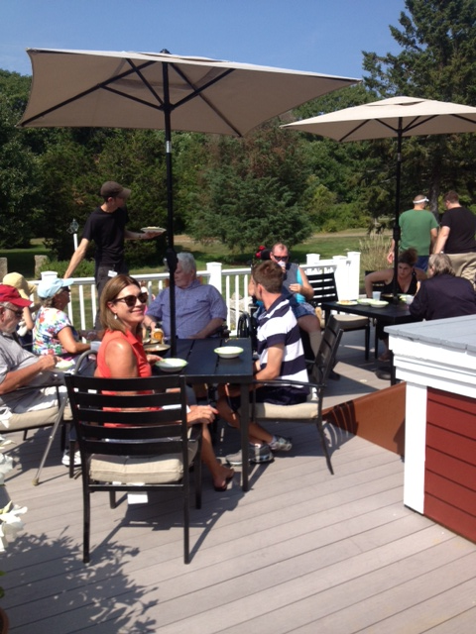
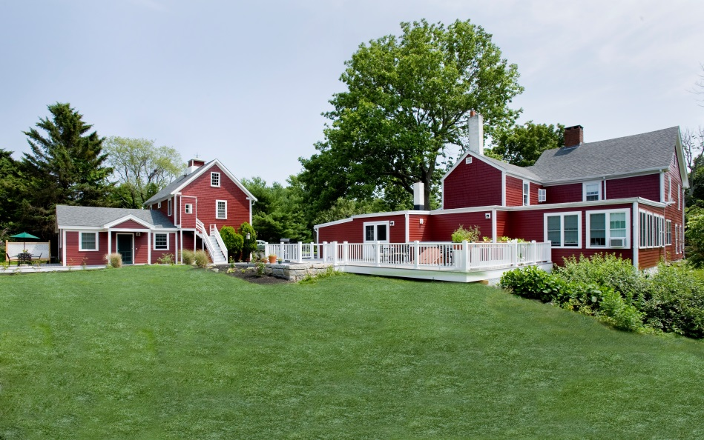
Old Farm Rockport – opened 2014 Therapeutic Horticultural Center - opening 2015

Slide 10
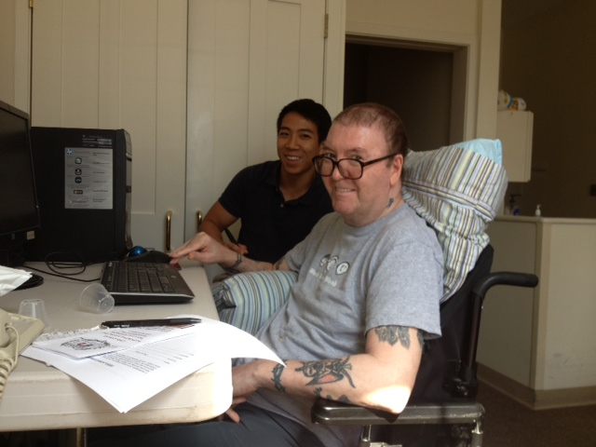
Conventional thinking related to brain injury has been that the neurological improvement to the brain will plateau after a certain period of time.
Research has proven this assumption to be incorrect and is showing how the brain can recover functions for many years after the injury. This recovery show the brain’s plasticity – the ability to improve.
The Brain Injury Wellness Center provides the fitness programs and conducts research to help foster and validate this new finding.

Slide 11
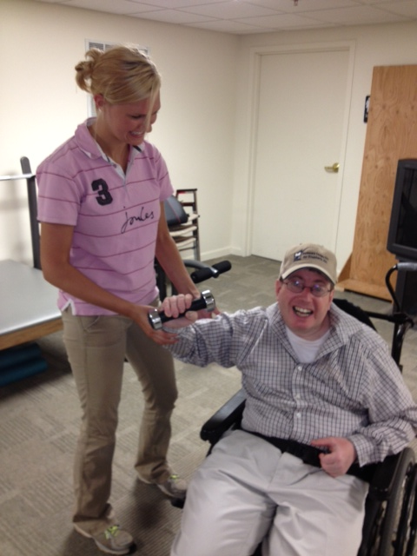
Brain Injury Wellness Programs
Physical Fitness - Supports overall well-being. The Wellness Center is currently running four group sessions – three days a week serving 24 individuals.
Cognitive Fitness - The brain is “plastic” – it has regenerative properties.
Social Fitness - Individuals with brain injury need the same social connections that we all do.
Partnerships with local universities and colleges along with medical and rehabilitation institutions provide SLI with many of the resources required to offer the programs and conduct the research.
FITNESS IS FUN

Slide 12
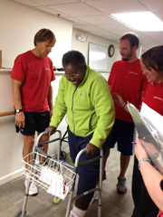
Research and Education Program
“If we knew what it was we were doing, it wouldn’t be called research, would it?” - Albert Einstein
SLI researchers have 10 concurrent projects related to brain injury rehabilitation and recovery to:
Develop new approaches to long term wellness
Provide a body of knowledge that will inform policy decisions and treatment modalities
Leverage what we know to help us understand what we don’t
Educate the public about brain injury

Slide 13
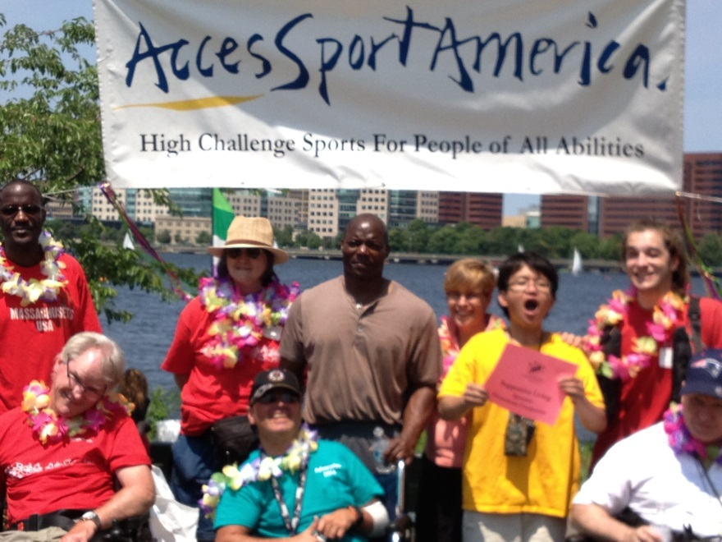
Challenges
HUD no longer funds similar affordable housing for people with disabilities.
MA Health funding does not cover long term therapies.
Research funding is limited on the benefits of long term therapies.
F
Douglas House residents helping raise money for Wellness Programs

Slide 14
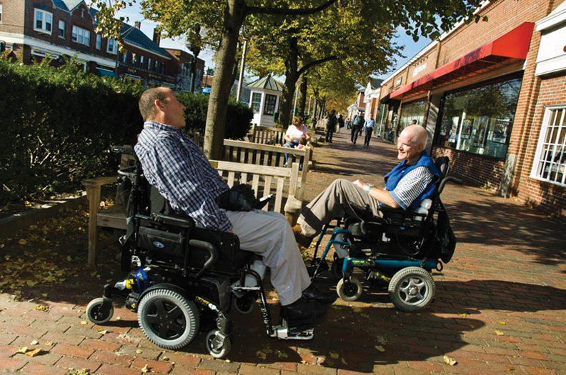
What We Need
Financial support – for all programs
Partnerships - leverage academic and medical involvement
Local Community involvement – churches, schools, organizations
Collective support for policy change

Slide 15
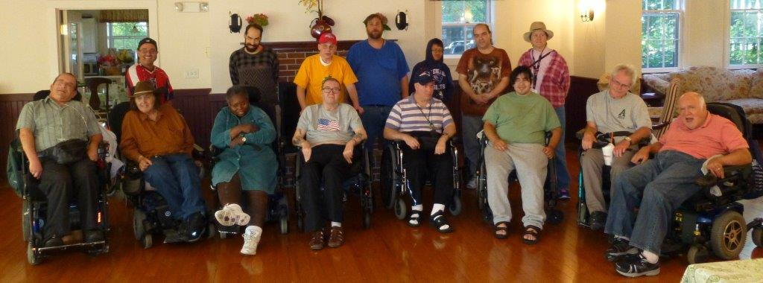
Many thanks to the Rotary Club of Lexington for making a difference!

