Slide 1
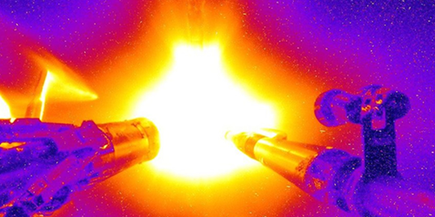
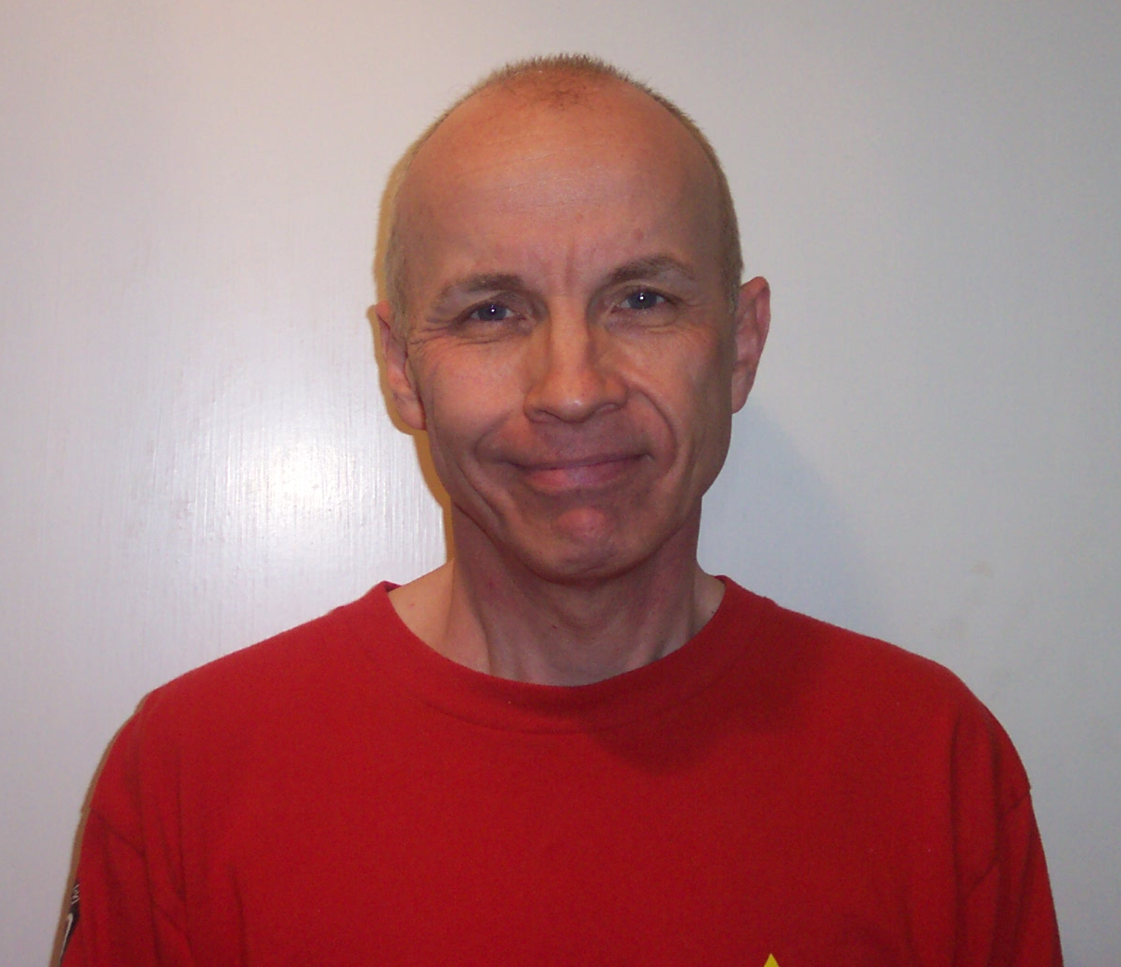
Rotary Club of Castro Valley
&
Castro Valley Educational Foundation
Nuclear Fusion & More
John Perkins
Fusion powers the sun and hydrogen bombs.
It offers a virtually limitless supply of energy.
How can we control such a destructive force?
Scientists at Lawrence Livermore National Lab (LLNL)
are trying to do just that and other fascinating projects.
February 16, 2021 at 6:00 p.m.
Register here or https://bit.ly/35FFfCn for the Zoom link.
John Perkins, PhD, is a physicist and expert on nuclear fusion at the Lawrence Livermore National Lab. His research focuses on the use of lasers to contain the fusion reaction at the National Ignition Facility. He earned his PhD in nuclear physics from the University of Birmingham, England.

