Slide 1

2022-2023- Kashinsky
Rotary Club of Saco Bay

Slide 2

Jennifer Jones- Makes History

Slide 3
Jennifer’s Goals
Increase our impact and Expand our reach by engaging the Family of Rotary at every age, gender and culture
Be ready to adapt. Continue to step up, when the world or community around you is stepping down.
Innovate, educate and communicate opportunities.
Open dialogue through social channels to heighten awareness
Support the Environment, Elevate Rotaract and Grow Rotary
DEI (Diversity, Equity and Inclusion) from the top down! More female members and members under 40!

Slide 4
subhead
“In order to live in the kind of society you want, you have to help build it.”

Slide 5
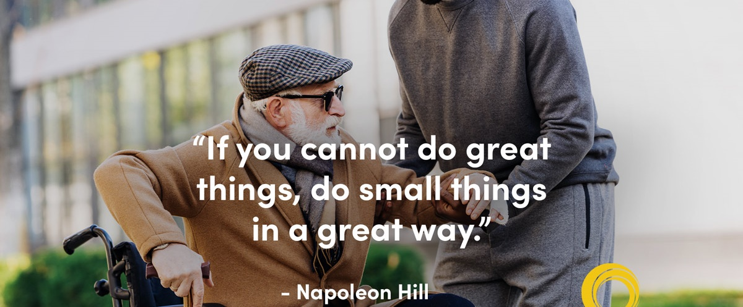
2022-2023 Goals
Rotary Club of Saco Bay

Slide 6
13 Required Goals- We not ME!
Club Membership at year end = 58
District Training Attendance = 5
Social Activities = 4 outside of regular meetings
Annual Fund = $2500
Polio Plus Fund = $1500
Service Projects = 12
Service Participation = 25
Rotaract Club Sponsorship = 1 (Actively)
Interact Clubs = 2 (OOB + Thornton- Actively)
Ryla participants = 8
Online Presence = Yes; how many updates = 2 per month
Media Stories on Club Projects = 6 per year

Slide 7
subhead
I am but a facilitator; YOU are the MAGIC!

Slide 8
RI Foundation: David LePauloue
Membership: Chris Jacques
Website/Communications:
Phil Smith
TBD– Media Mogul!!!
Finance: Bill Souter
Youth Outreach:
Rotaract: Dan Letellier
OOB Interact: Stephanie Moutsatsos
Jen Sirois: Student of the Month
TA Interact: (Teri Arenstam)
Meeting Speakers: Dan Colby
Committee Chairs
Leadership is about making others better as a result of your presence and making sure that impact lasts in your absence.

Slide 9
Committee Chairs - Continued
Community Service Projects: Sam Anagnostis
Fellowship Activities: Jeff Slaton
Charitable Giving: Jon Safford
District Recovery Initiative: John Bouchard
District 7780 Initiatives: Phil Hatch
Investment- Legacy: Chris Jacques & Jim Pate
Charlie Snow Scholarship Fund: Tony LeBlanc
Sargent-at-Arms: Phil Smith
Virtual Outreach/Technology: Jon Stafford

Slide 10
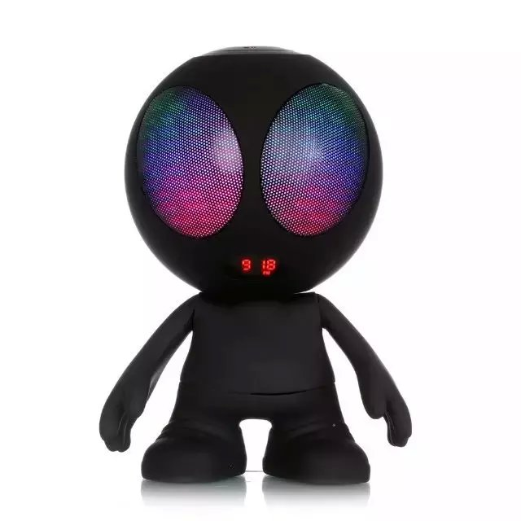
Speakers………. Not this kind!

Slide 11
Speaker ideas
Current non-profits we donate to regularly
Other non-profits in the Southern Maine area
New businesses in our community
Special Interest Groups
High School programs
Various educational programs in the area
New Mainers
Refugees
Public Employees (fire, policy, city manager, etc.)
Topics of interest
Service Projects during meeting

Slide 12
Service Initiatives (in play)
My Place Teen Center- June- Hatch Kick off!!!
Maine Works Ride Share- Ongoing
Dress a girl- Sock Collection- June/July
New England Parkinson’s Ride- September
Winter Gear (Scarf/Mitten) Collection- November
Angel Tree- November/December
Bell Ringing Salvation Army- December
Saco Light Parade - December
Lobster Dip- Special Olympics - January
Scarf Project- Special Olympics Winter – ongoing/January
Looking for large and small………… keep you eyes and ears open!!!!

Slide 13
Fundraising
Annual Duck Pluck – TBD future
Murder Mystery Dinner
Frank Santos Hypnotist
New England Parkinson Ride
Online Auction
Sea Dogs Ticket sales
Rotary Beer????
Donated ‘Sports Pool’ activities
Other ideas?????

Slide 14
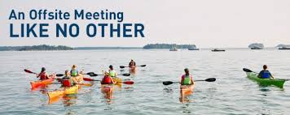

Slide 15
Socializing!!!! (Fellowship)
Team building – July
Sea Dogs Game- August
Biddeford/Saco Pub Crawl- September
Progressive Dinner Party- October
Lobster Bake- TBD….. (When lobster is affordable again LOL)
Murder Mystery Dinner -- TBD
Frank Santos Hypnotist -- TBD
Light Parade pre and post event gathering- December
Other ideas????? Kayaking, miniature golf, visiting local eateries/new businesses

Slide 16
BHAG
75%
Big, Hairy, Audacious Goal!
Attendance at SOM Meetings!

Slide 17
“Never doubt that a small group of thoughtful, committed, citizens can make a difference in the world. Indeed, it is the only thing that ever has.”
Margaret Mead

Slide 18
QUESTIONS

