Slide 1
Rotary International Global Grant Scholarships & Peace Fellowships
Presented by Kristin Post & Diane Rish
Rotary Club of Capitol Hill
February 26, 2019

Slide 2
Rotary Global Grant Scholarships

Slide 3
Rotary Global Grant Scholarships
Overview
$30,000 for one academic year of graduate level studies at an overseas university program
One recipient per District
Scholarships are funded by District Designated Funds and a matching Rotary Foundation Global Grant
District Deadlines:
Applications due to Club: October 31
Application due to District: January 1

Slide 4
Rotary Global Grant Scholarships
Supports graduate level studies at overseas university programs which support sustainable, high impact outcomes in one of Rotary’s six areas of focus

Slide 5
Rotary Global Grant Scholarships
Scholar Requirements
Completed application
Offer letter from college/university
Letter of support/sponsorship from a Rotary Club in District 7620
Resume/CV
Copy of college transcripts
Must live or work in District 7620
Nominating Rotary Club Requirements
Make a donation to the Annual Program Fund
Complete club Memorandum of Understanding & receive global grant training
Interview candidate and ensure all of the application requirements are met

Slide 6
Rotary Global Grant Scholarships
District 7620 Timeline
July - October
Clubs recruit applicants and encourage them to apply by October 31
October 31
Students submit completed applications and supporting documents to a qualified Rotary Club in our District
November - December
Clubs review application, interview applicants, and select their nominee.
January 1
Each club selects 1 candidate among pool of applicant and submits application/letter on behalf of candidate to the District Global Grants Scholarship Committee Chair
January - February
District reviews applications and contacts finalists for an interview
March - May
-- Interviews will be conducted and scholarship recipients notified of their scholarship award by the District Global Grants Scholarship Committee Chair
May - August
-- Rotary International Foundation and International Host Club evaluate and approve candidate 90 days prior to travel
August - September
-- Scholarship funding begins

Slide 7
Rotary World Peace Fellowship

Slide 8
Rotary World Peace Fellowship
Scholar Requirements
Resides anywhere in the world
Three years of work experience
Completed application (online)
Club letter of sponsorship
Resume/CV
Copy of college transcripts
Nominating club requirements
Interview candidate and ensure all of the application requirements are met
Maintain connection with the RWPF via email, provide assistance when possible

Slide 9
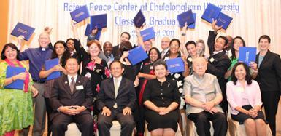
Rotary World Peace Fellowship Components (Master’s and Certificate)
Master’s Degree:
1-2 years of study
Applied Field Experience
Paul Harris Seminar (capstone presentation)
Choice of five peace centers (described below)
Certificate Program: Chulalongkorn University
Three month, professional development (twice annually)
Max. 25 students per session
Applicants- 5+ years work experience
2-3 weeks field study

Slide 10
Rotary World Peace Fellowships Master’s degree programs
Duke/UNC, North Carolina
Only dual campus program- 2 years (for either)
Apply to one program or the other, but they still have a limit of about 10 total
Duke= Master’s of International Development Policy (i.e. policy making/public service
UNC= Master’s in chosen field/department (i.e. Public Health, Journalism, etc.)
GRE required
TOEFL required
Public transportation- difficult

Slide 11
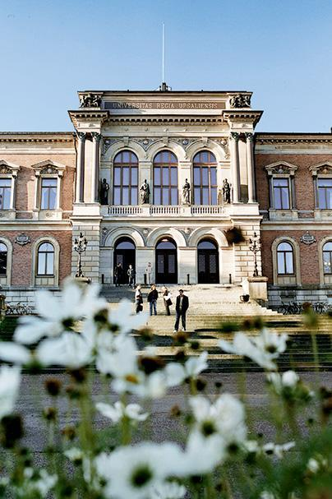
Rotary World Peace Fellowships Master’s degree programs
International Christian University, Japan
ICU:
2 year program
Founded after WWII (1949)
“Public Policy and Social Research” program
Includes foundation courses in Peace Studies
Includes Japanese Language Program (voluntary)
Courses taught in English
TOEFL required
Hiroshima field trip
Uppsala University, Sweden
Uppsala:
2 year program
Master of Peace and Conflict Studies
TOEFL required, courses taught in English

Slide 12
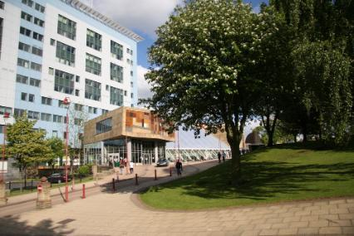
Rotary World Peace Fellowships Master’s degree programs
University of Bradford, England
1 year program
School of Social and International Studies, Peace Studies
“Leading university-based centers for studying
Development”
TOEFL required
University of Queensland, Australia
1.5 year program
School of Political Science and International Studies
Recently founded Asia Pacific Centre for Responsibility to Protect (R2P)
TOEFL required

Slide 13
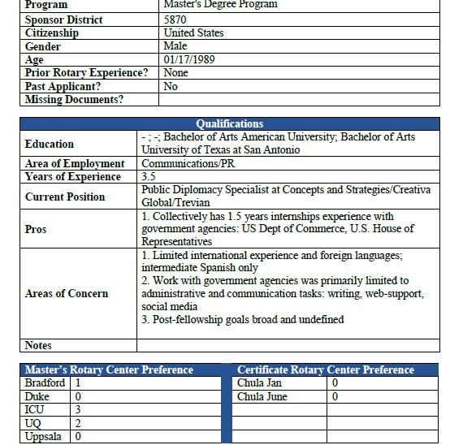
RWPF Requirements
Essay question prompts:
Highlight significant events in your life, including professional and volunteer experience, that have impacted your desire to work in peace and conflict resolution- CAREER GOALS
Highlight how you have taken on LEADERSHIP ROLES during academic/professional life
Highlight ACADEMIC SUCCESS, what has prepared you for this fellowship
Articulate interest in peace fellowship and WHY YOU CHOSE THE CENTER (#1 & #2 choices)
3, 2, 1 rule:
At least 3 years of professional experience, at least 2 references, at least 1 foreign language

Slide 14
RWPF Selection Process and Timeline
January – April :
Recruit and assist applicants
May 31:
Online applications due
June
Applicants interviewed by District 7620
July – October:
Foundation and University partners screen applicants
Late October/November:
Awardees notified and apply to Centers for final acceptance
Applications can be found at: https://www.rotary.org/en/peace-fellowships

Slide 15
So what can you do?
Recruit/promote these opportunities to deserving candidates in the community and encourage them to apply
Volunteer to serve as part of the club’s scholarships committee in fall 2019 to help review applications and interview candidates

Slide 16
Questions?

