Slide 1
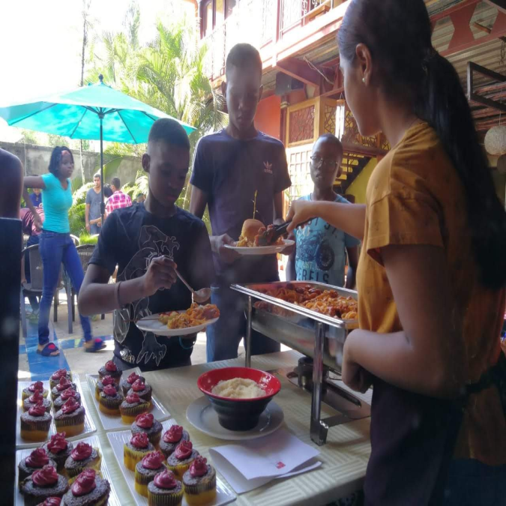
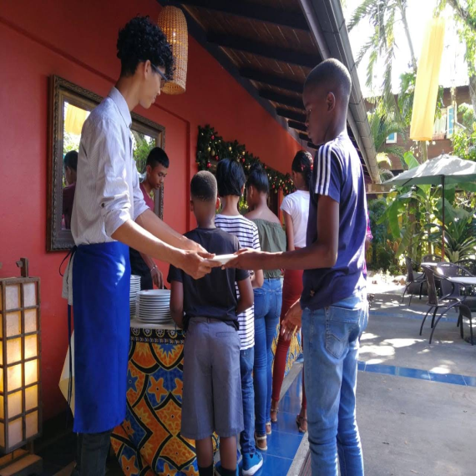
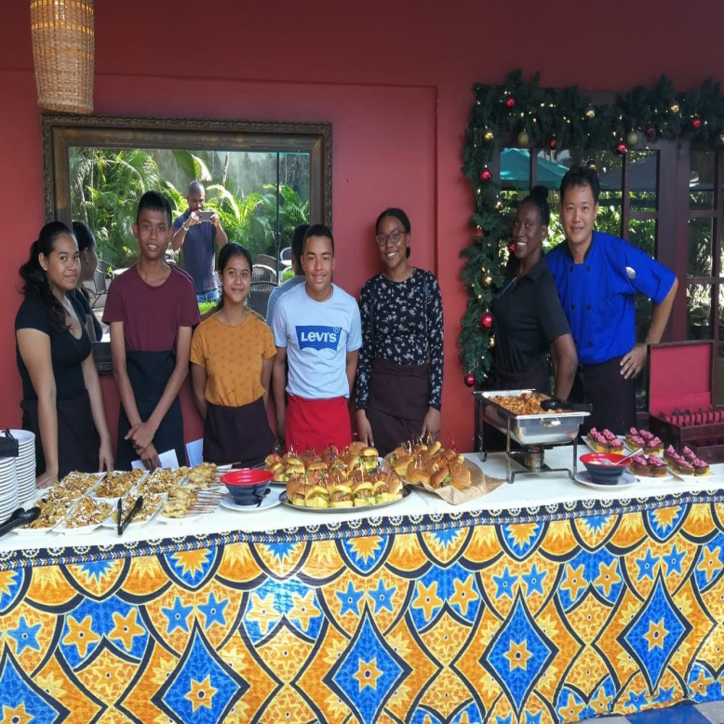
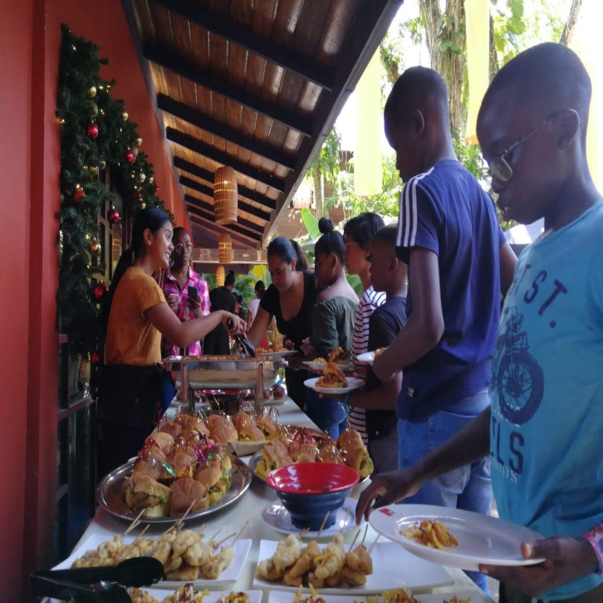
Spice Quest
December 1, 2019
Catering service assistance for employees of 123 kids helpline
Voluntary hours: 12

Slide 2
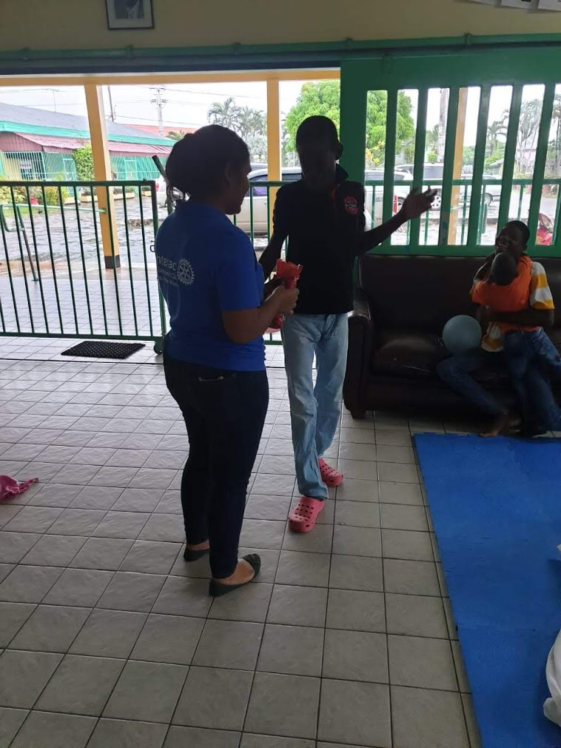
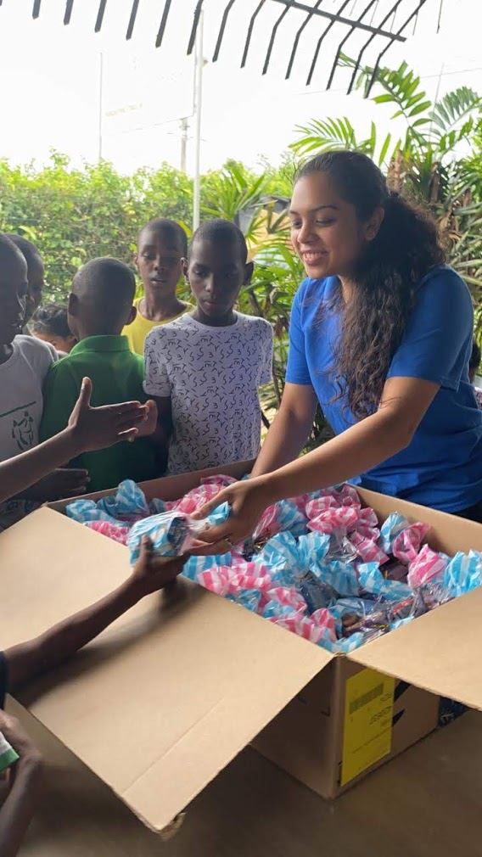
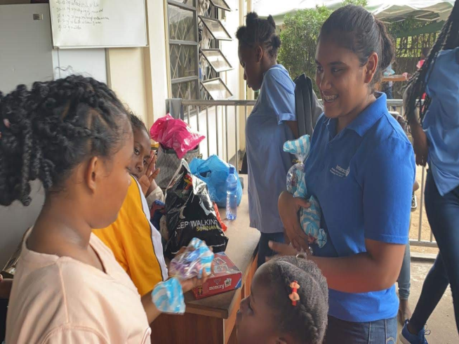
Children's day project
December 5, 2019
With the disabled children's home “Huberstichting”
And the children’s home “Hope for the Child Foundation”
Givings: toys, games, candy bags
Voluntary Hours: 9

Slide 3
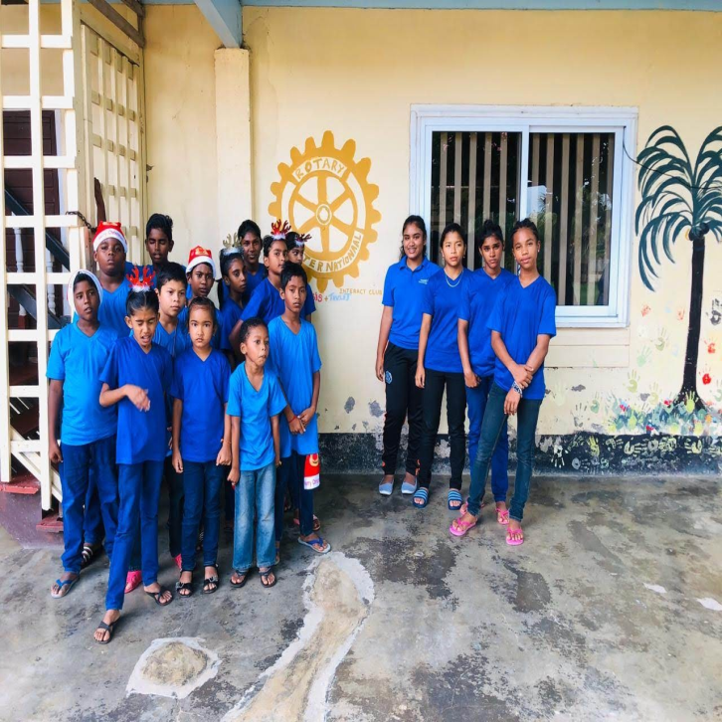
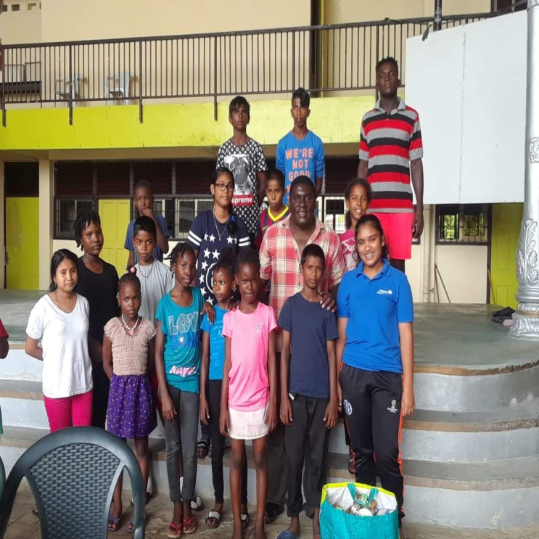
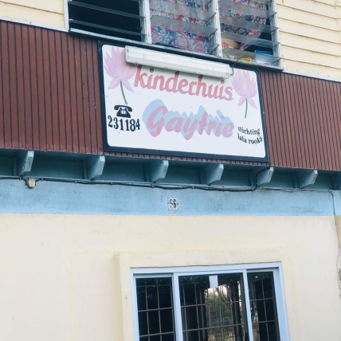
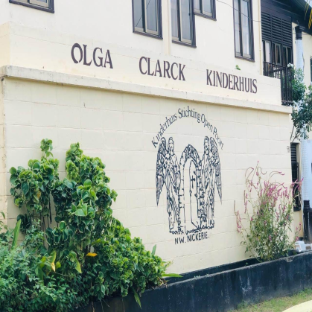
CaNW Christmas Givings
December 25, 2019
Food donations
In Nickerie at the Gaytrie children's home and the Olga Clarck children's home
Voluntary hours: 4

Slide 4
CaNW’s support:
- In June 2020 Interacted donated to the “Stichting Mythylschool Suriname” (school for children with a physical disability) in the form of a UV lamp for the swimming pool and 5 fans.
- October 5, 2019 “LGBT Month Opening Day” in Torarica (representatives of CaNW present)

Slide 5
Financial report 2019-2020:
Total cost: SRD 18.318,72 (USD 2,436.00)
Total sponsorship: SRD 11.484,81 (USD 1,527.20)

Slide 6
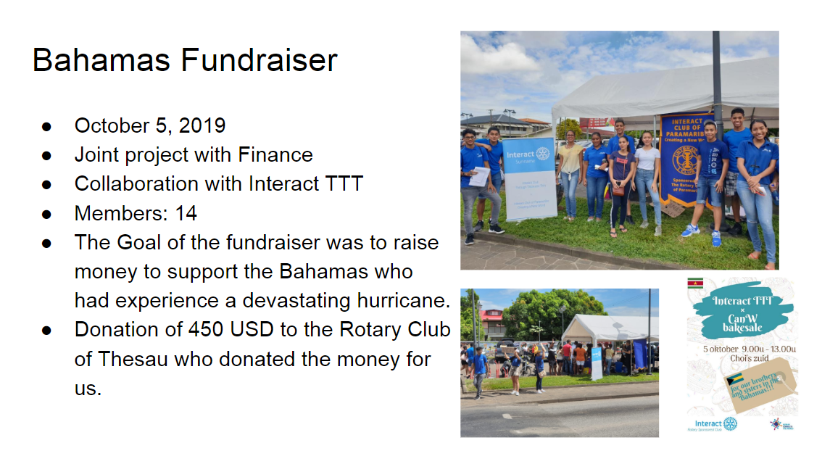
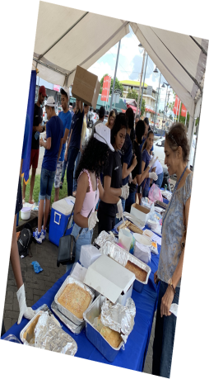
Voluntary hours: 100 hours
Revenue: SRD 2913,90
Donated to “Hurricane Dorian Relief Efforts fund from Rotary International”

Slide 7
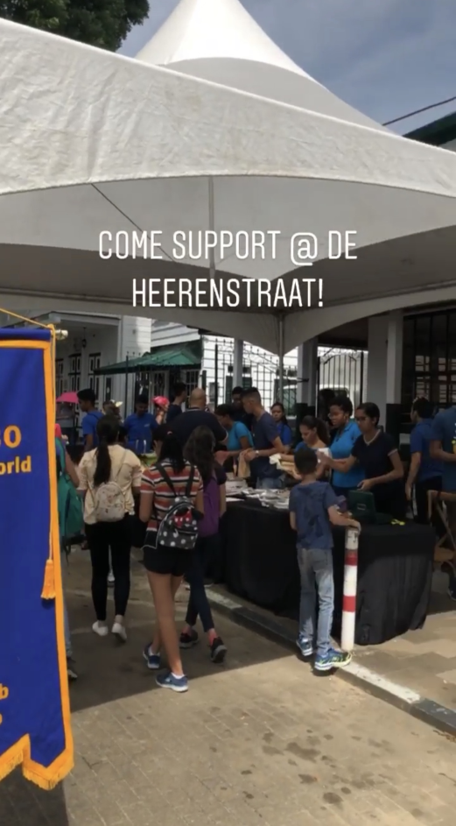
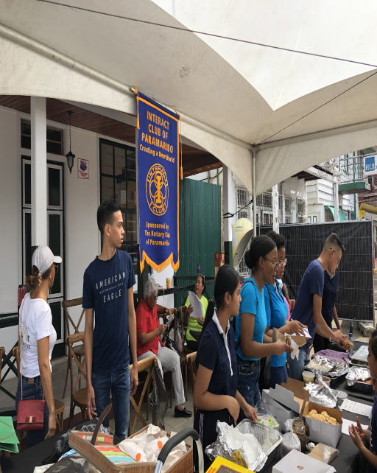
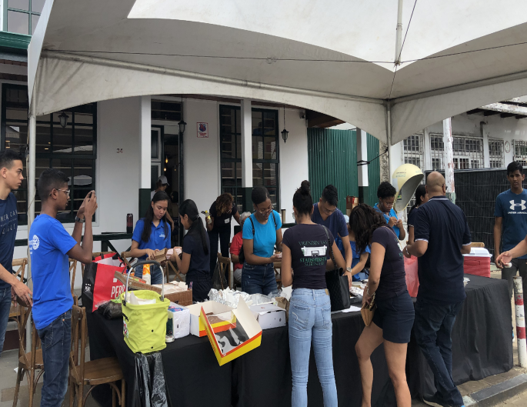
MONUMENTENDAG BAKESALE
Date: 17th of November 2019
Location: Heerenstraat, Paramaribo
Present members: 22
Voluntary hours: 120
Revenue: SRD 2700,-

