Slide 1
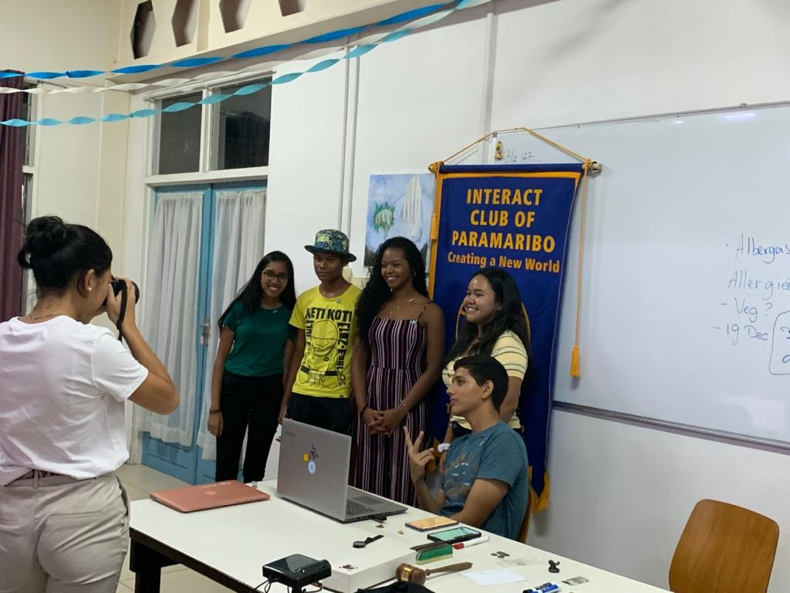
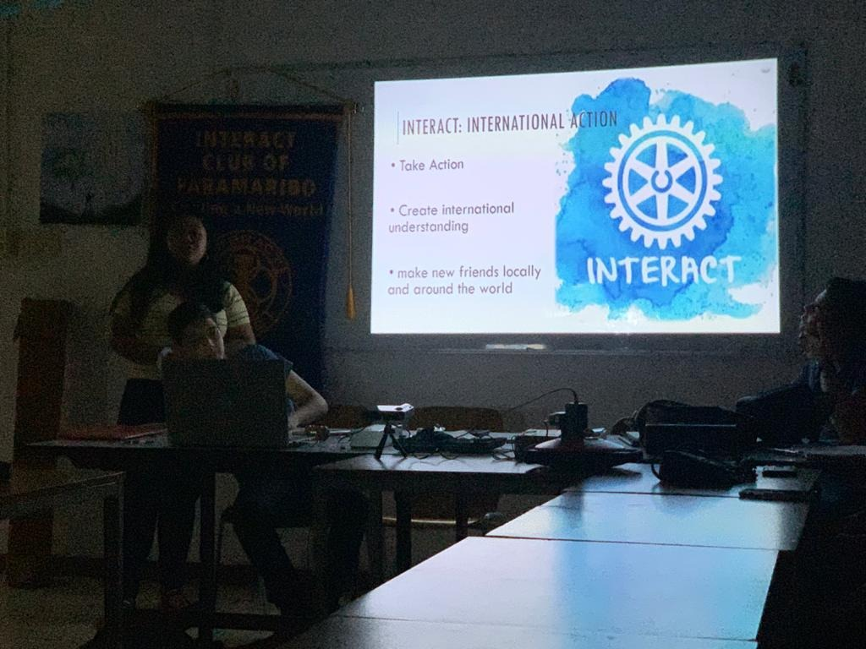
CLUB PROJECT:OPEN DAY
Date: November 9th,2019
Dedicated to potential members
Attendance:73%

Slide 2
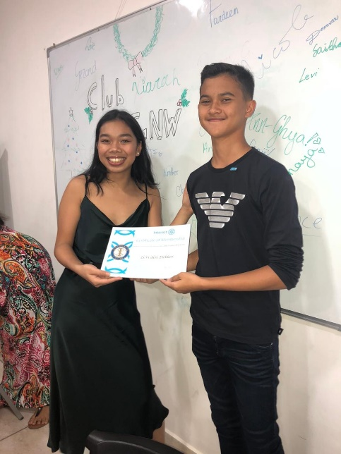
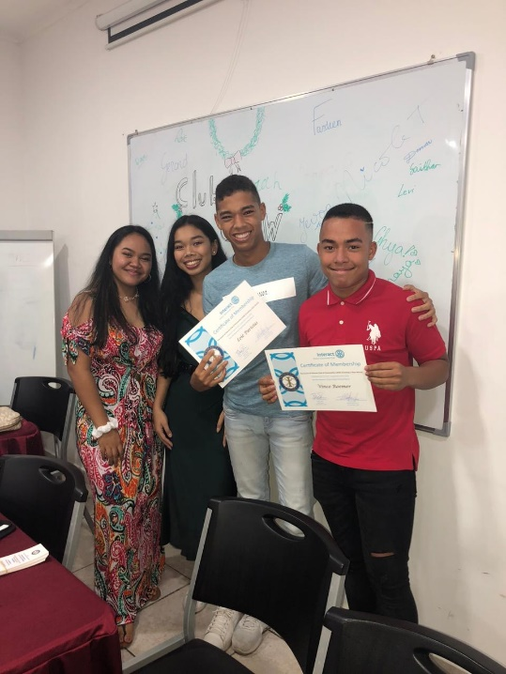
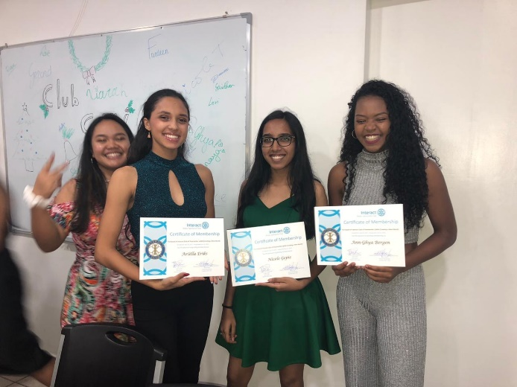
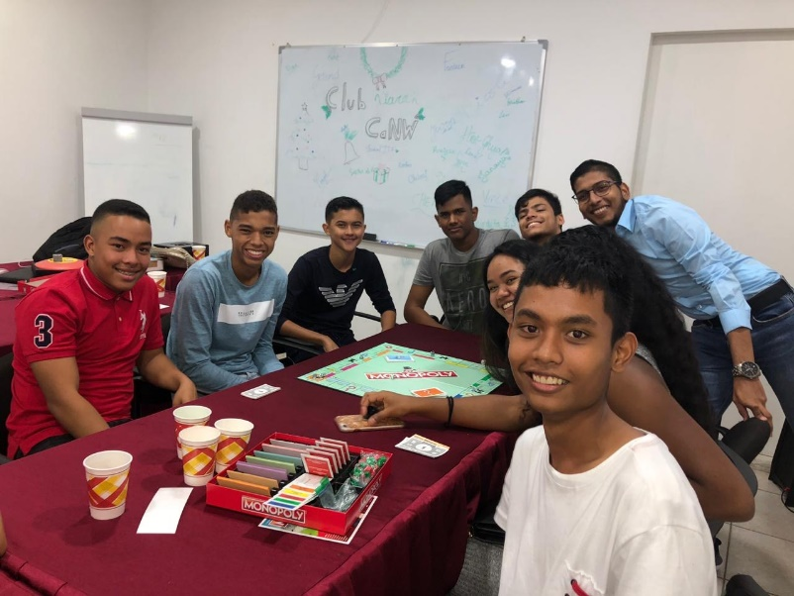
CLUB PROJECT:CHRISTMAS DINNER
Date: December 19th,2019
Dedicated to guests and members so we can celebrate Christmas together as a family
Attendance:60%

Slide 3
Best club projects
Workshop on Interact and RI by IP RCP Nicole Tjin A Djie 30 Nov 2019
Training / workshop Interact by advisor Mirdita Elstak 29 Feb 2020
Training Time Management / Procrastination of Rtn Gail Meyer February 15, 2020
Video Interact week 2019 6 November 2019
Information session on RYLA (Rotary Youth Leadership Awards) by Rtn Amanda Sheombar June 20, 2020
Leadership training by Rtn Amanda Sheombar June 20, 2020
Rotaract information for graduate students of President RaCP Derril Dankoor and IP RaCP Noviani Ketosari June 20, 2020
Post to Rotary.org of Interact Club of CaNW Projects 2019-2020

Slide 4
Number of completed projects:
15
Total voluntary hours:
1066

