Slide 1
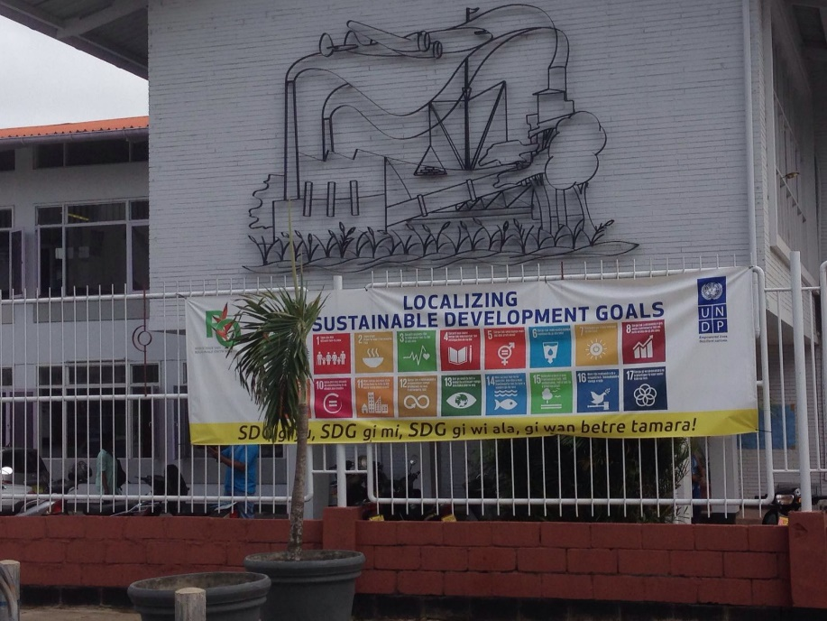
Sustainable Development Goals Ambassador Albert R. Ramdin
Rotary Paramaribo
2 March 2016

Slide 2
Situation in the world
World in flux and the end is not known: Creates uncertainty
Rapid technological changes
Decline of elements of a decent civilization
Economic deterioration
Changing global financial flows
Global politics with more players
Large parts of the world
Armed conflicts: State against Non-State violent actors
Misery of forced migration
New diseases
Environmental degradation

Slide 3
The origin
Millennium Development Goals
RIO+20: where it started
Process Post-2015 Development Agenda
From MDGs to SDGs
2030 Agenda for Sustainable Development

Slide 4
RIO+20 Outcomes
One of the main outcomes of Rio+20 UN Conference Sustainable Development (Rio de Janeiro, June 2012), was the agreement by Member States to launch a process to develop a set of Sustainable Development Goals (SDGs).
To address in a balanced way all dimensions of sustainable development and be coherent with and integrated into the UN development agenda beyond 2015.

Slide 5
Process Post-2015 Development Agenda: A Participatory Process
30 Member States led the process of preparing a proposal on the SDGs.
Participatory and multi-sectoral approach: involvement of relevant stakeholders and expertise from civil society, private sector, the scientific community and the United Nations system
Proposal: 17 goals and 169 targets
Synthesis report UN Secretary General:
“The Road to Dignity by 2030: Ending Poverty, Transforming All Lives and Protecting the Planet"

Slide 6
Process Post-2015 Development Agenda: A Participatory Process
Intergovernmental negotiations to prepare the outcome document, report of an intergovernmental committee of experts on sustainable development financing, SAMOA Pathway, FFD outcome, GA dialogues on technology facilitation, etc.
Member State-led with broad participation from Major Groups and other civil society stakeholders.
Outcome document:
‘Transforming our world: the 2030 Agenda for Sustainable Development’
A continuation of the 2000-2015 MDG’s …

Slide 7
2030 Agenda for Sustainable Development: 5 P’s
PEOPLE
PEACE
PROSPERITY
PLANET
PARTNERSHIP

Slide 8
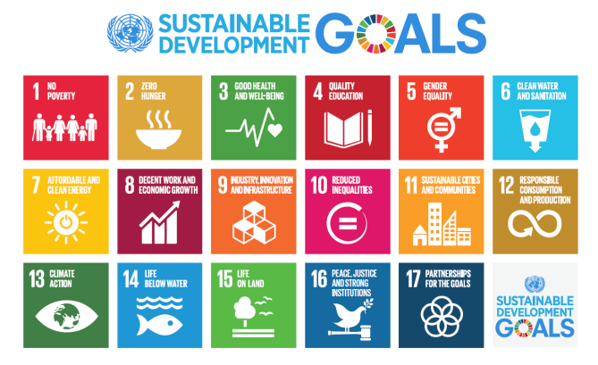
2030 Sustainable Development Agenda: 17 goals and 169 targets

Slide 9
The Sustainable Development Goals PEOPLE
SDG 1 End poverty in all its forms everywhere
SDG 2 End hunger, achieve food security and improved nutrition and promote sustainable agriculture
SDG 3 Ensure healthy lives and promote well-being for all at all ages
SDG 4 Ensure inclusive and equitable quality education and promote lifelong learning opportunities for all
SDG 5 Achieve gender equality and empower all women and girls
SDG 6 Ensure availability and sustainable management of water and sanitation for all
SDG 7 Ensure access to affordable, reliable, sustainable and modern energy for all
SDG 8 Promote sustained, inclusive and sustainable economic growth, full and productive employment and decent work for all

Slide 10
The Sustainable Development Goals PROSPERITY
SDG 8 Promote sustained, inclusive and sustainable economic growth, full and productive employment and decent work for all
SDG 9 Build resilient infrastructure, promote inclusive and sustainable industrialization and foster innovation

Slide 11
The Sustainable Development Goals PLANET
SDG 11 Make cities and human settlements inclusive, safe, resilient and sustainable
SDG 12 Ensure sustainable consumption and production patterns
SDG 13 Take urgent action to combat climate change and its impacts
SDG 14 Conserve and sustainably use the oceans, seas and marine resources for sustainable development
SDG 15 Protect, restore and promote sustainable use of terrestrial ecosystems, sustainably manage forests, combat desertification, and halt and reverse land degradation and halt biodiversity loss

Slide 12
The Sustainable Development Goals: PEACE
SDG 16 Promote peaceful and inclusive societies for sustainable development, provide access to justice for all and build effective, accountable and inclusive institutions at all levels

Slide 13
The Sustainable Development Goals PARTNERSHIP
SDG 10 Reduce inequality within and among countries
SDG 17 Strengthen the means of implementation and revitalize the global partnership for sustainable development

Slide 14
Implementation: three key global agendas
Sustainable Development Goals: holistic, inclusive and integrated
Financing for Development mandates
Climate Change: historic Paris Agreement
ALL TO BE IMPLEMENTED AT THE SAME TIME !!!
Capacity problem for small states …

Slide 15
Challenges
Coordination and monitoring
Managing inter-relationship
Mutual reinforcing nature of three processes
Financing: new money
Regional execution, including need for regional capacity building
Translation in strategic programming of international financial organizations
Translation at national level in Government plans and budget allocations
Define role of stakeholders: trust, coordination, etc.

Slide 16
Rotary International and UN
Promoting Peace
Fighting Disease
Providing Clean Water
Saving Mothers and Children
Supporting education
Growing local economies
Concrete deliverables, grass-root level, immediate results !
Small projects can have enormous impact … …

Slide 17
The SDGs in Suriname
Suriname has made good progress in achieving the MDGs
Implementation SDGs starts in January 2016
Good opportunities: align the new Development Plans to the SDGs based on Government priorities: Localizing SDG’s
Awareness raising on SDGs: Academia, Youth and DNA, booklet & posters, localizing the SDGs at community level

Slide 18
Challenges at national level
Lack of expertise at Government level
Strengthen planning and executive capacity
Timely release of Development Plan with SDG’s incorporated
Guard coordination internally (Council of Ministers should act as Coordination Council on SDG’s)
Facilitate coordination and communication externally by setting up a National SDG Execution Committee
Mobilize financial and technical resources for execution

Slide 19
Success Possible if …
Government is prepared to:
Demonstrate an inclusive approach through partnership
Develop sound policies
Insert SDG’s in development plan
Earmark financing also for other stakeholders
Stakeholders:
Take responsibility and initiative
Demonstrate willingness to bridge trust issues
Mobilize target groups
Share responsibilities
Remain vigilant advocates for change with progress
….. AND THE PEOPLE ARE CONSULTED AND INVOLVED !!!

Slide 20
Finally …..
SUSTAINABLE PROGRESS IS A SHARED AND COLLECTIVE RESPONSIBILITY !!!
I THANK YOU ….

