Slide 1
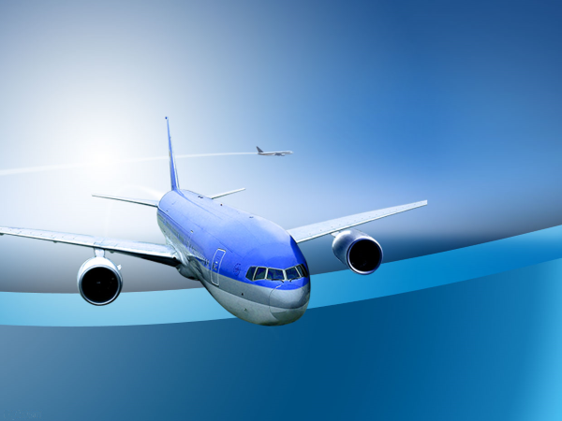
Flying for Less

Slide 2
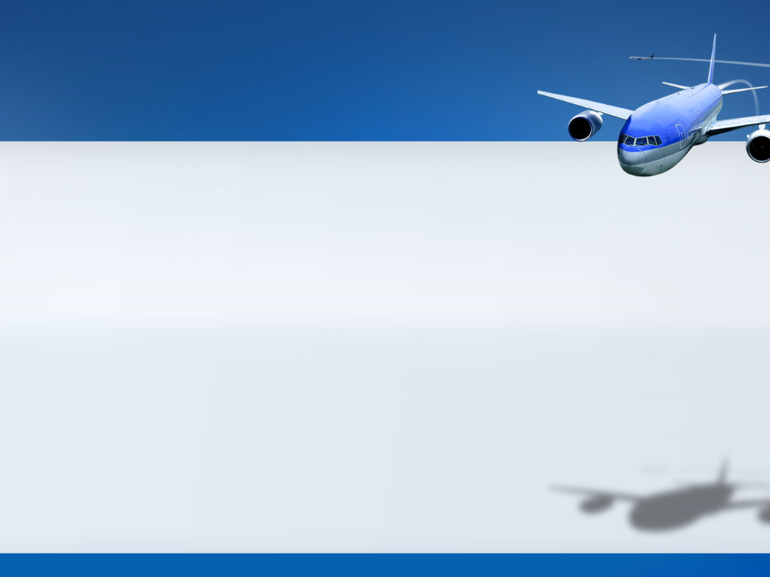
Tips from a
Frequent Flyer Junkie
or…

Slide 3
To fly at the pointy end of the plane for a fraction of the cost of a regular ticket
The Aim

Slide 4
Method
Use Frequent Flyer Points
earned from:
1. Flying
2. Credit card spend
3. Bonus points at supermarkets etc.

Slide 5

Problem
… but I still don’t have enough frequent flyer points!

Slide 6
Buy Frequent Flyer Points
Solution
Qantas & Virgin – Limited top-ups
Overseas airlines – Substantial options

Slide 7
Why would I do this?
Question

Slide 8
Why would I do this?
How about Sydney to London return in First Class for $5000 instead of $15000?
Question

Slide 9
Step 1: Identify which programs to join
Step 2: Join those programs
Costs nothing & many programs exclude newly signed up members from taking part in promotions
How do I do this

Slide 10
Step 3: Decide:-
• Destination
• Cabin class
• Timing
• Travellers
How do I do this

Slide 11
• Destination determines which program to use
How do I do this
• Cabin class, timing & no. of travellers
determine seat availability and how
far ahead booking will be needed

Slide 12
Combination of destination and timing can be used to choose the right program.
Note that a point bought in Program X may cost the same as a point in Program Y but a particular destination may cost half the points in Program Y.
Choosing the right program

Slide 13
Different programs have:
• Differing award routing rules and conditions. e.g. Program X may allow free stopovers on award bookings.
• Different fees and charges
Choosing the right program

Slide 14
Different programs have:
Differing limits on points that can be purchased at one time or within a year. e.g. a First Class flight to Europe might require 115,000 points, but the program may limit purchases to only 100,000 points per year.
Choosing the right program

Slide 15
Example: American Airlines
Sydney to Rome return
¹ Based on current promotion ² at USD 0.76 = AUD1.00
³ Includes fees and charges
Buying the points
Class | Miles | USD¹ | AUD^{2,3} | Qantas Cost
Economy | 120,000 | $2390 | $3224 | $1400 to $2200
Business | 170,000 | $3275 | $4389 | ~ $7600
First | 230,000 | $3870 | $5168 | ~ $14600

Slide 16
1. Getting the seat
2. Getting stung on foreign exchange
Problems

Slide 17
• Usually need to plan well ahead to get seats in Business or First on popular routes
• Different airlines release Award seats at different times ahead of the flight date (14 to 360 days)
Getting the seat(s)

Slide 18
Points purchases are usually in
US dollars - Don’t get stung.
Three reasonable options:
1. Purchase a prepaid Travel Money Card
2. Use a Visa/MasterCard Debit Card
3. Use a suitable credit card
Foreign Exchange

Slide 19
• Locks in rate, but 3 to 4% charge included
• Should not have to pay more than 1% on foreign exchange
Prepaid Travel Money Card

Slide 20
• No lock in rate
• Some offer competitive exchange rates
• Best is Citibank Plus Transaction card
- very competitive exchange rates
- no foreign exchange fees
- no fees on overseas ATM withdrawals
Visa/MasterCard Debit Card

Slide 21
• Bankwest Zero Platinum card
• 28 Degrees MasterCard
Both offer:
• Competitive foreign exchange rates
• No foreign exchange fees
• No annual fee
Best Credit Cards for Forex

Slide 22
The three largest alliances are:
• StarAlliance
• SkyTeam
• Oneworld
Airline Alliances

Slide 23
ANA Avianca Brazil Lufthansa South African Airways
Avianca Air New Zealand Singapore Airlines LOT Polish Airlines
Air Canada Aegean Airlines Croatia Airlines Shenzhen Airlines
EVA Airways Copa Airlines Brussels Airlines Ethiopian Airlines
SWISS Air India ADRIA Airways United Airlines Turkish Airlines
SAS THAI Asiana Austrian Air China EgyptAir TAP Portugal
Star Alliance
Available from Australian cities

Slide 24
China Southern Airlines Middle East Airlines
Air France Air Europa Aerolineas Argentinas
KLM Vietnam Airlines China Eastern Airlines
TAROM Aeromexico Saudia Xiamen Airlines
China Airlines Czech Airlines Delta Air Lines
Aeroflot Korean Air Alitalia Kenya Airways
Garuda
SkyTeam

Slide 25
Oneworld Airlines
Iberia Japan Airlines SriLankan Airlines
American Airlines Mexicana Qantas
Malaysia Airlines S7 Airlines airberlin
Royal Jordanian Qatar Airways Finnair
British Airways Cathay Pacific LATAM
Available from Australian cities

Slide 26
The best ones for points purchases are:
• American Airlines Advantage (Oneworld)
• United Airlines Mileage Plus (Star Alliance)
• Alaska Airlines Mileage Plan (Mix)
• Avianca LifeMiles (Star Alliance)
Airline Reward Programs

Slide 27
Program Comparison

Slide 28
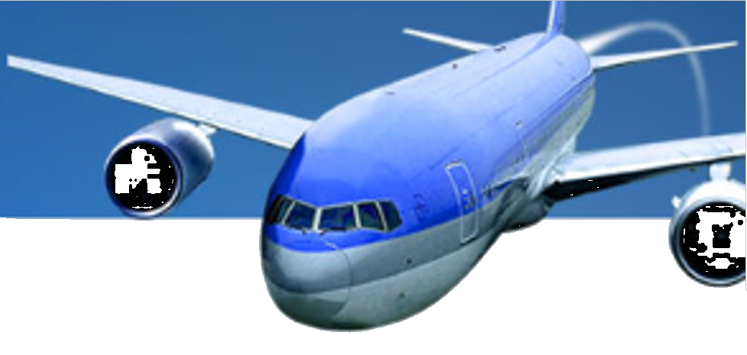
Sample AA Flights from Sydney
To | Class | Return Advantage Miles | Cost (AUD) (incl. current bonus) | Best Qantas Fare (AUD)
Perth | Economy | 20,000 | $442 | $451
Perth | Business | 35,000 | $774 | $4,484
Darwin | Business | 35,000 | $774 | $2,392
Auckland | Economy | 30,000 | $664 | $480
Auckland | Business | 50,000 | $1,106 | $1,609
Johannesburg | Business | 160,000 | $3,539 | $5,862
Los Angeles | Business | 160,000 | $3,539 | $7,196
Singapore | Business | 80,000 | $1,770 | $2,999
London | Business | 170,000 | $3,760 | $7,677
London | First | 230,000 | $5,087 | $14,877

Slide 29
Earning comparison
American Airlines vs Qantas on Qantas flights
American Airlines Advantage
From | To | Miles | Class | AA | QF
SYD | BNE | 465 | Y,B | 465 | 1200
SYD | BNE | 465 | H, K, L, M, V | 233 | 800
SYD | BNE | 465 | N, G, S, O, Q | 116 | 800
SYD | PER | 2037 | Y,B | 2037 | 2200
SYD | PER | 2037 | H, K, L, M, V | 1019 | 1450
SYD | PER | 2037 | N, G, S, O, Q | 509 | 1450

Slide 30
Redeeming comparison
American Airlines vs Qantas on Qantas flights
American Airlines Advantage
From | To | Class | AA Miles | AA Fees | QF Miles | QF Fees
SYD | BNE | Economy | 10,000 | $45 | 8,000 | $37.42
SYD | PER | Economy | 10,000 | $45 | 18,000 | $40.07
SYD | PER | Business | 17,500 | $45 | 36,000 | $40.07
SYD | BME | Economy | 10,000 | $45 | 22,500 | $88.06
SYD | BME | Business | 17,500 | $45 | 48,000 | $88.06

Slide 31
Conclusions – AA vs QF
Under 2000 miles
– Economy: Buy the ticket and credit points to
Qantas or use Qantas points
Over 2000 miles
– Economy: Depends on the booking class
– Business: Use AA points or buy AA points
– First: Use AA points or buy AA points
American Airlines Advantage

Slide 32
Comparison UA, AA & QF
Under 2000 miles
– Economy: Buy the ticket and credit points to
Qantas or use Qantas points
Over 2000 miles
– Economy: Depends on the booking class
– Business: Use AA points or buy AA points
– First: Use AA points or buy AA points
United Airlines MileagePlus

Slide 33
The “right” frequent flyer program depends on:
• Where you want to fly
• When you want to fly
• Your desire for comfort
• Your budget
• How far ahead you want to plan
Summary

Slide 34
Questions ?
Thank you

