Slide 1
IN THE COMMUNITY - NEWS
Member Spotlights
Featured Members:
Sid Snyder
Terry George

Slide 2
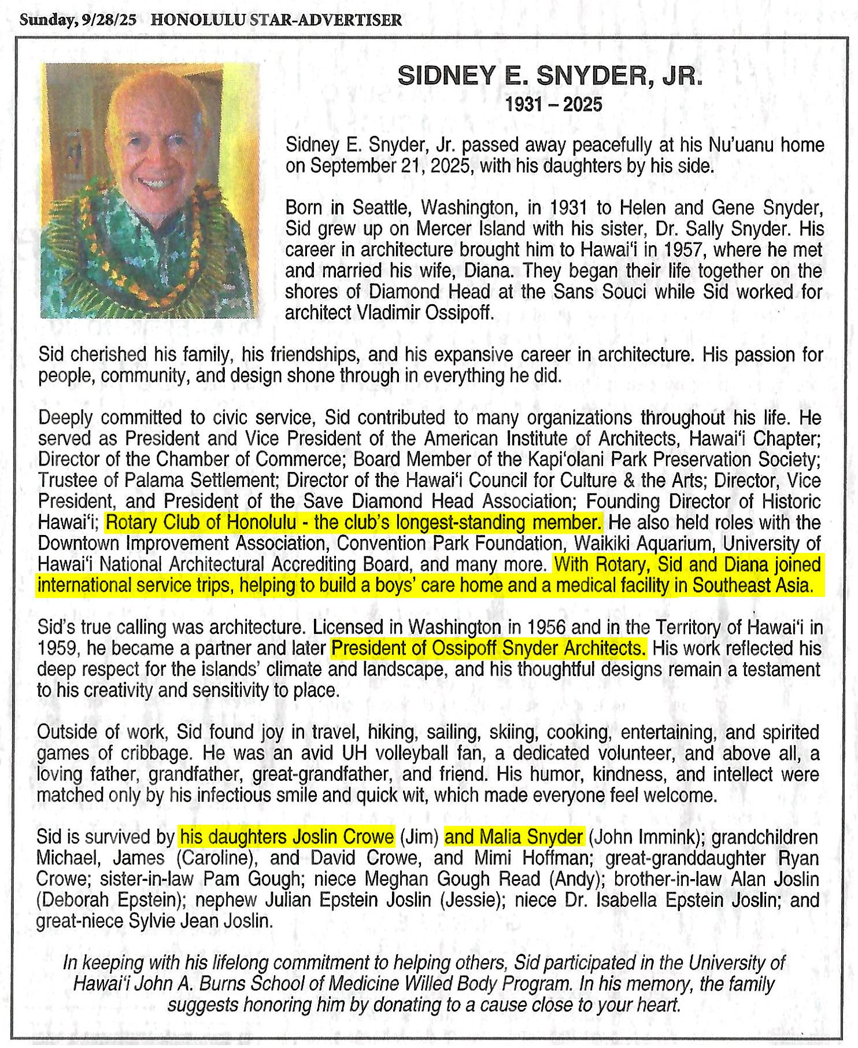

Slide 3
