Slide 1

PLAYGROUND FOR ELEMENTARY STUDENTS
Dakrong district, Quang tri province, Vietnam

Slide 2
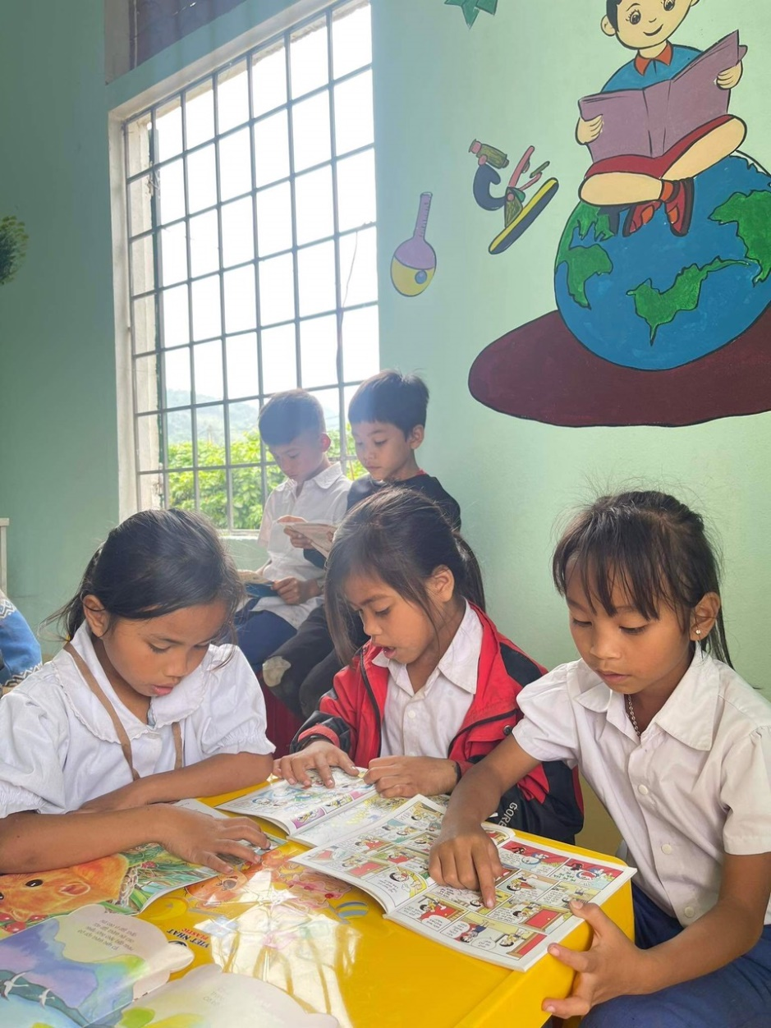
General information
Objectives
Playgrounds at Dakrong 2 elementary school
Approaches/methodology

Slide 3
General information
Title: Playground for elementary students in Dakrong district, Quang Tri province, Vietnam
Location: Dakrong district, Quang Tri province, Vietnam
Target groups: Elementary school-aged children and educators

Slide 4
Objectives:
To solve playground shortage in the Dakrong District;
To promote basic education and literacy need;
To supplement education facilities to ethnic minority children in remote mountainous areas;
To strengthen the capacity of governments; institutions, and communities by developing, managing, and maintaining additional education facilities.

Slide 5
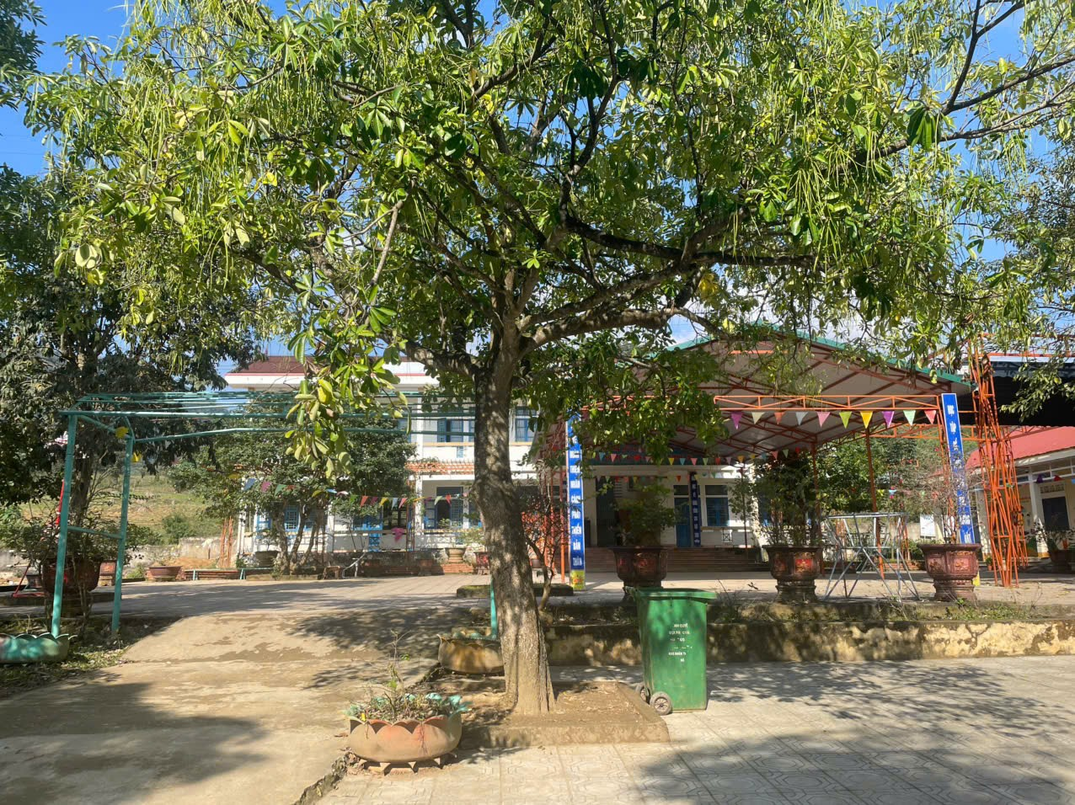
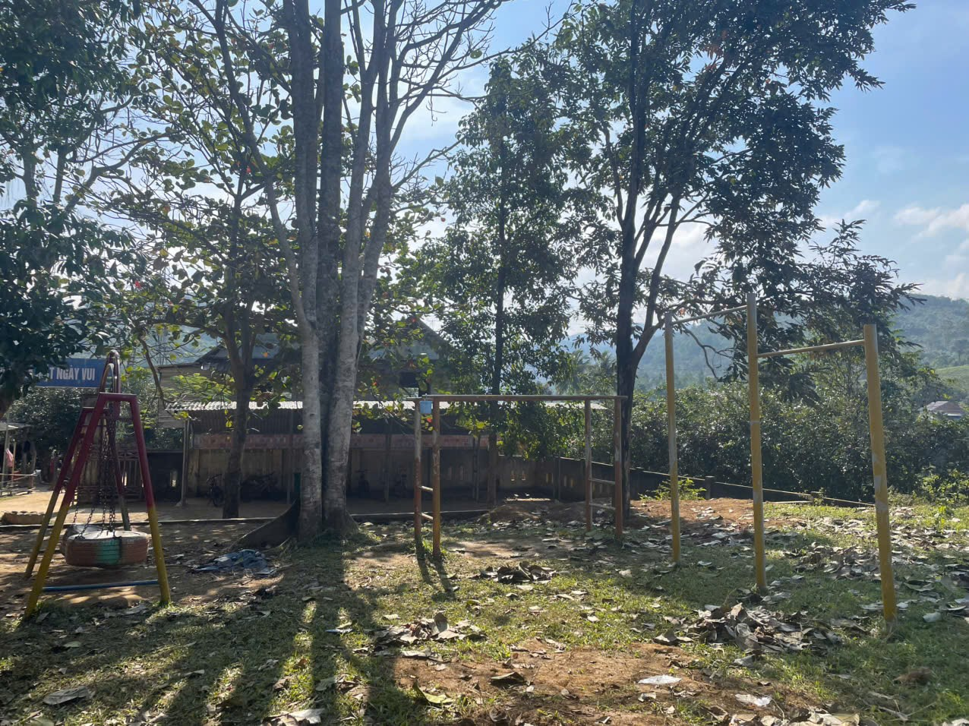
DAKRONG No.2 (Main campus)
Description: The campus has 148 students;
A small playground with 2 play equipment;
Goal:
Install extra playground equipment;

Slide 6
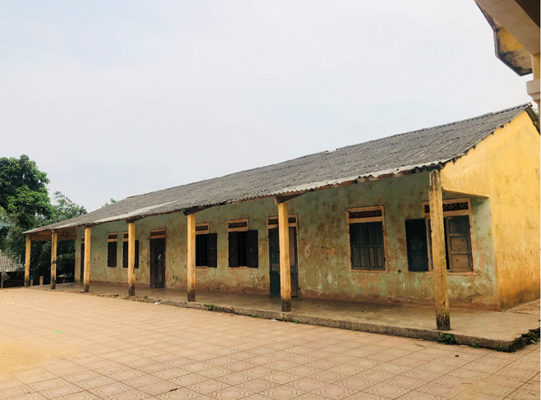
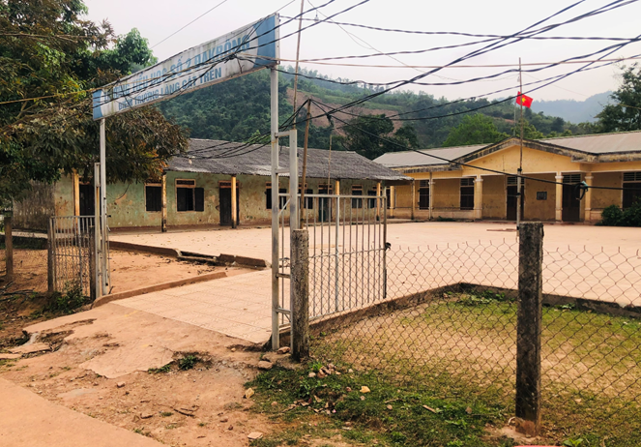
CAT TREN VILAGE CAMPUS
Description: The campus has 5 classrooms with 123 students
Goal:
Install playground equipment for 123 students
Plant some ornamental plants around the playground corner;

Slide 7
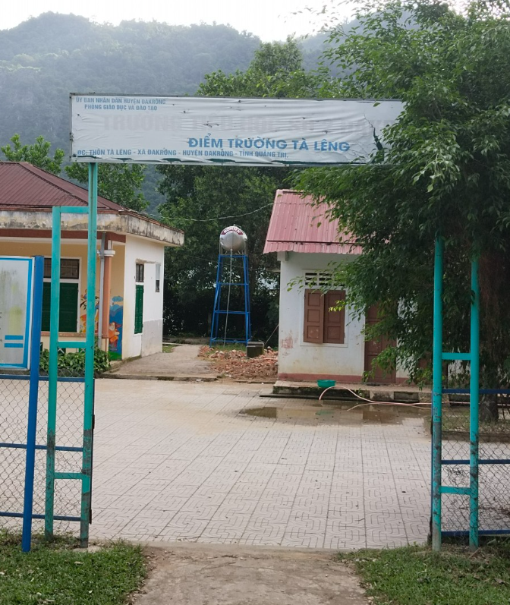
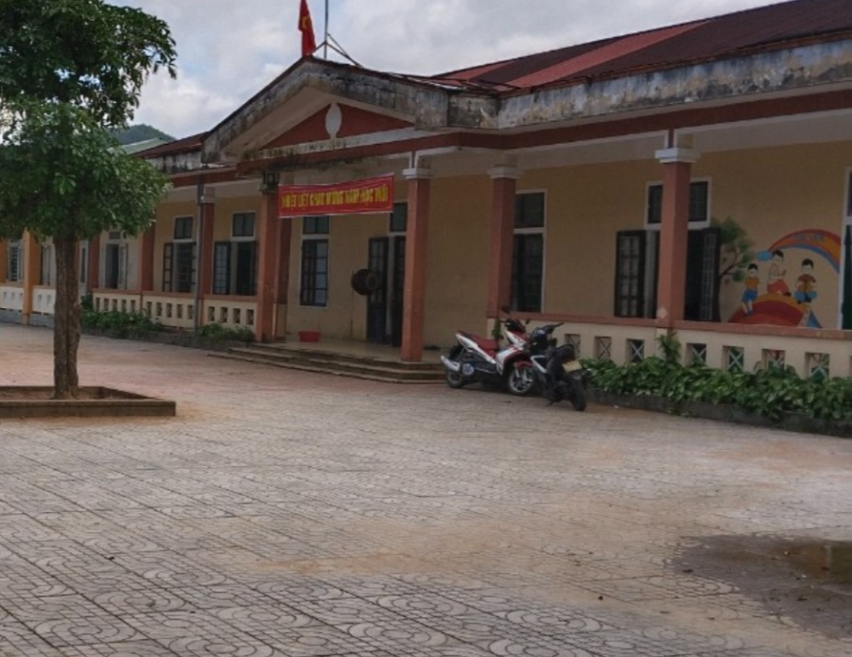
TALENG CAMPUS
Description: The campus has 5 classrooms with 101 students;
Goal:
Install playground equipment for 101 students;
Plant some ornamental plants around the playground corner;

Slide 8
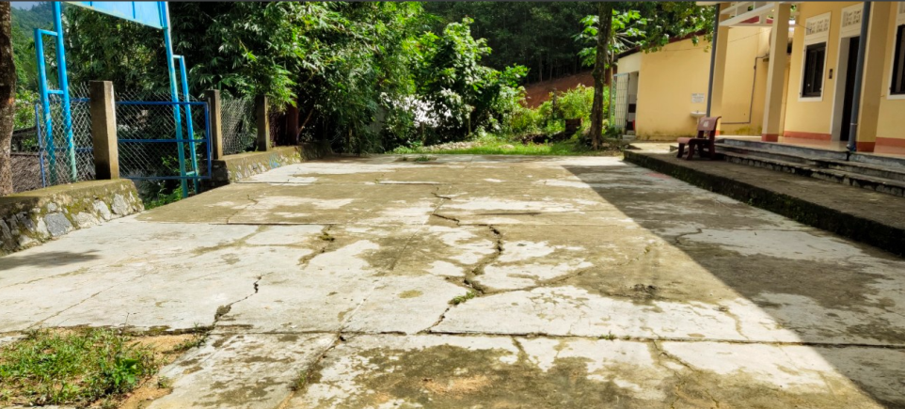
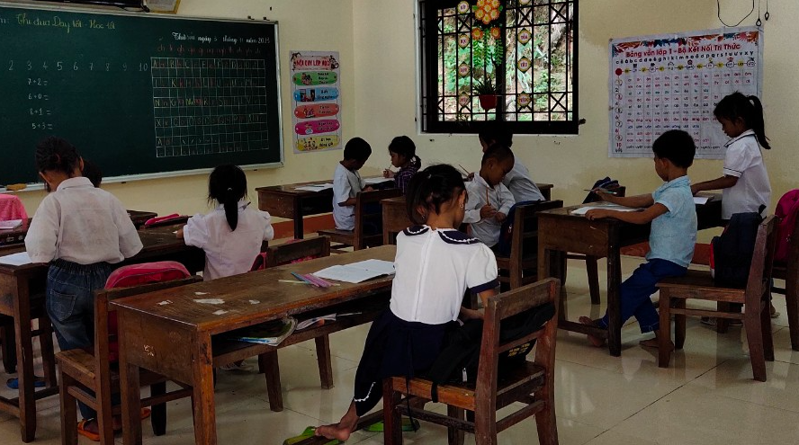
PATANG CAMPUS
Description: The campus has 2 classrooms with 34 students
Goal:
Install playground equipment for 24 students
Plant some ornamental plants around the playground corner;

Slide 9
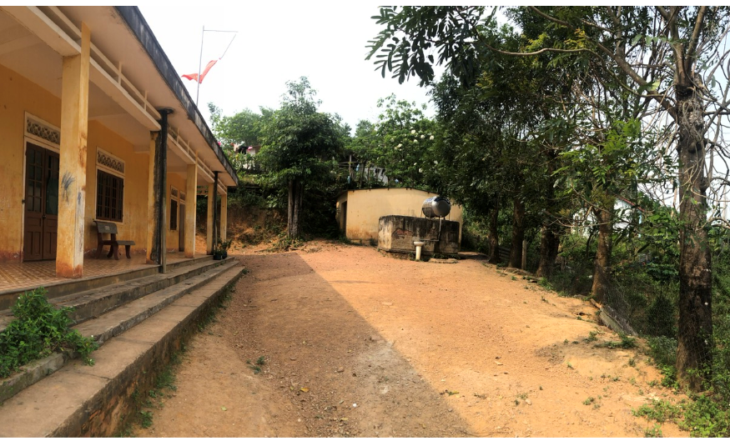
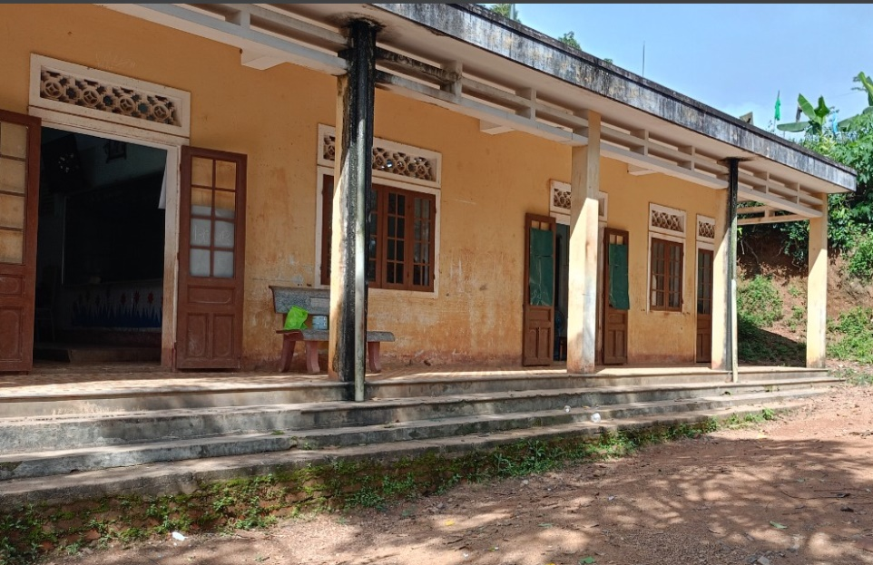
CUPUA CAMPUS
Description: The campus
has 2 classrooms with
25 students
Goal:
Reinforce the fence to ensure safety for students;
Install playground equipment for 24 students;
Plant some ornamental plants around the playground corner;

Slide 10
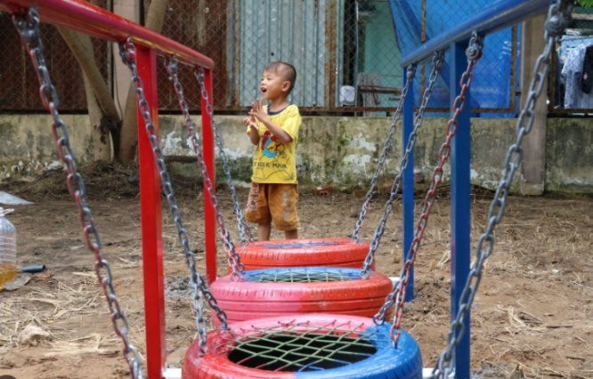
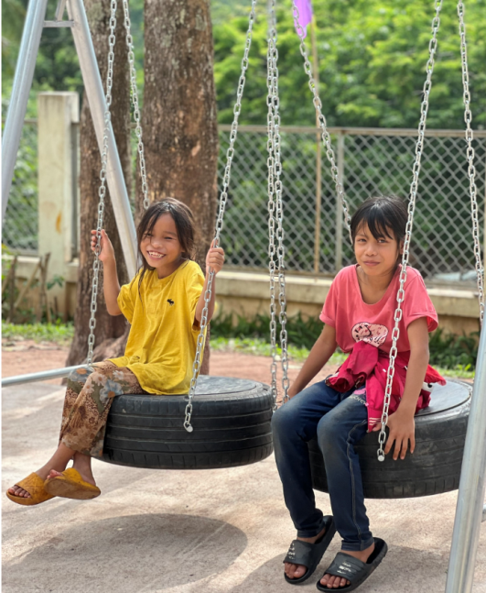
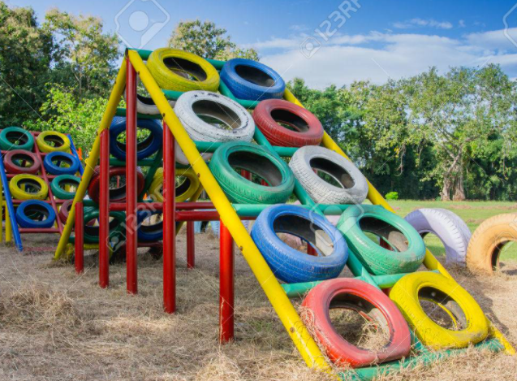
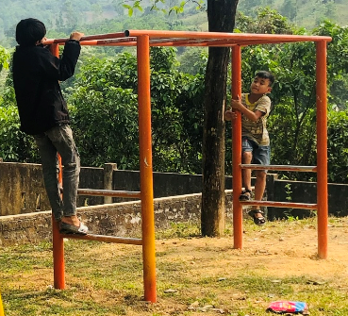
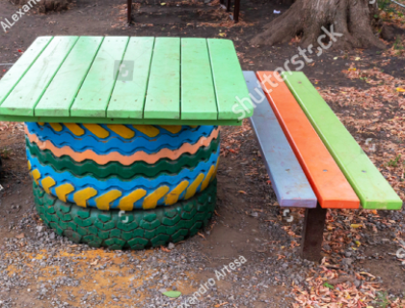
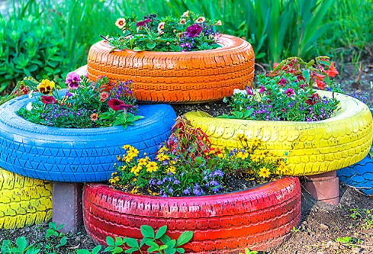
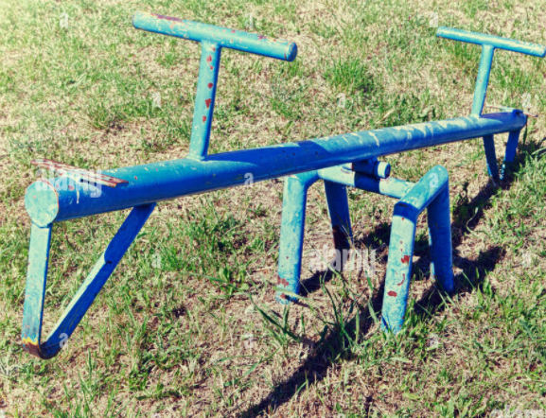
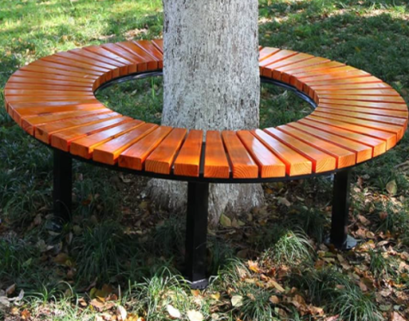
Samples

Slide 11
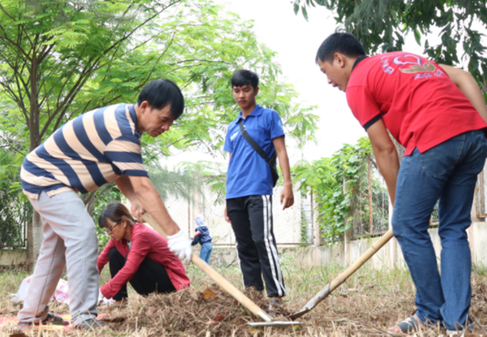
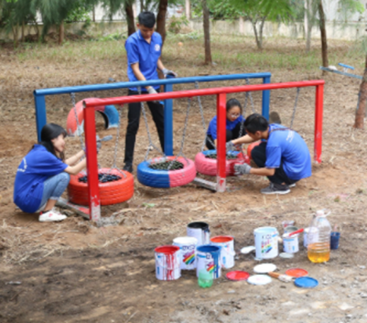
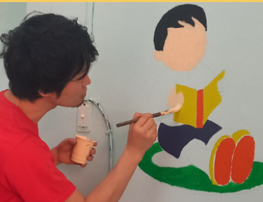
Methodology
-simple design;
-friendly-using;
-easy to be maintained;
-recycled materials;
-adapted to the existing landscape/classrooms;
-joint-hand by
Rotary club of Quang Tri members and local community with volunteer work;

Slide 12
ROTARY CLUB OF QUANG TRI
Uyên Le
Whatsapp/zalo: (84)395153535
Email: lethiuyen20@gmail.com

