Slide 2
Rotary’s 7 Areas of Focus
On June 25, 2020, Rotary International announced, with unanimous support from the Rotary Foundation Trustees and Rotary International Board of Directors, that it will be adding a seventh area of focus: supporting the environment.

Slide 3
Rotary & the Environment
18.4 million in Foundation global grant funding has been allocated to environment-related causes in the past five years through our support of community economic development and water, sanitation, and hygiene projects

Slide 4
Rotary: Helping Protect our Planet
We are committed to supporting activities that strengthen the conservation and protection of natural resources, advance ecological sustainability, and foster harmony between communities and the environment. We empower communities to access grants and other resources, embrace local solutions, and spur innovation in an effort to address the causes and reduce the effects of climate change and environmental degradation.

Slide 5
Taking Action
Protecting and restoring
Protecting and restoring land, coastal, marine, and freshwater resources
Enhancing
Enhancing the capacity of communities to support natural resource management and conservation
Supporting
Supporting sustainable agriculture, fishing, and aquaculture practices
Addressing
Addressing the cause of climate change by reducing the emission of greenhouse gases

Slide 6
Projects, Policy, Plans
Strengthening
Strengthening ecosystems and communities affected by climate change
Supporting
Supporting education initiatives that promote behavior that protects the environment
Advocating
Advocating for sustainable consumption to build an economy that uses resources more efficiently
Addressing
Addressing environmental justice issues and public health concerns

Slide 7
Rotary Club of Ottawa Environment Committee Approved by Board of Directors March 8, 2021

Slide 8
Rotary Club of Ottawa’s Environment Committee Terms of Reference
Our purpose is to empower members of our community to transform their lives in a just manner to live in harmony with the sustainability of the planet and its finite resources. In line with Rotary’s mandate to contribute meaningfully to the betterment of society around the world, we seek to encourage and promote good environmental practices that individuals can take to reduce negative environmental impacts and promote environmental justice.
Our objectives are to facilitate individuals and the community as a whole:
To become informed about the environmental challenges before us.
To obtain an understanding of the practical actions that can be undertaken to help meet those challenges.
To present science-based environmental solutions and to encourage people to take action.
To encourage and support individuals and groups as they take action which will positively impact the planet.
To assist and fund projects which may help vulnerable and marginalized communities improve their environment or reduce the impact of climate change

Slide 9
Protecting Land, Restoring Resources, Enhancing Ecosystems
Identifying and Funding Projects which improve the environment or reduce greenhouse gas emissions
Reforestation / Watersheds / Ecosystems
Clean Cook Stoves, Solar
Seeking Synergistic projects helping communities and families, especially women and children

Slide 10
Education, Advocating, Community
Speakers on Environmental Solutions and Actions
Newsletter Articles
Local Environmental / Sustainability Projects
Petitions, Marches, Letter Campaigns
Working with other Rotary Clubs on environmental projects
Collaborating with local organizations on environmental projects
Transforming ourselves and our communities: Food, Transportation, Home Energy Choices

Slide 11
City of Ottawa – Top 2 ways you can act on climate change to achieve zero greenhouse gas emissions by 2050
Make your home more energy efficient
Choose electric for your next car, or go car free
45 per cent of Ottawa’s greenhouse gas emissions come from homes and other buildings, mostly from burning natural gas for heat and hot water.
44 per cent of Ottawa’s greenhouse gas emissions come from transportation.

Slide 12
Speakers, Articles for Club Newsletter
What Topics would you like to learn more about?

Slide 13
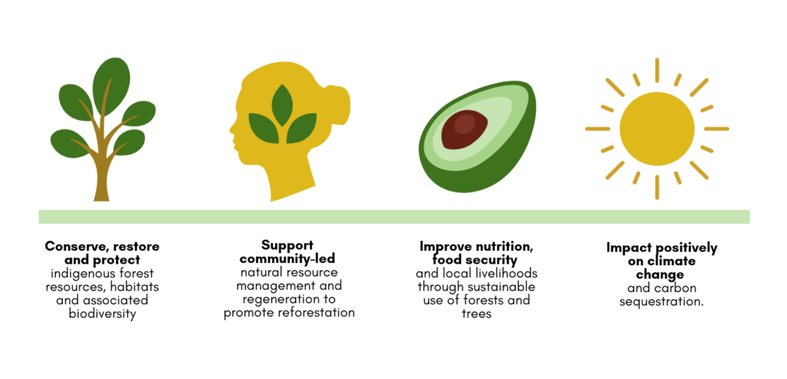
International Tree Foundation - Community-Centered approach to restore trees to our planet – Africa Projects

Slide 14
International Tree Foundation Africa Projects
Kenya– Forest Restoration, Agroforestry and nutrition, Education of children:
Cameroon – Sustainable farming and agroforestry, forest restoration, water improvement, better livelihoods, restore biodiverse ecosystem, stronger communities
Planting 20+ million trees and improving lives of 80,000 households
Projects Meet 9 UN Sustainable Development Goals:
- No poverty, Zero Hunger, Good Health, Gender Equality, Reduced Inequalities, Responsible Consumption and Production, Climate Action, Life on Land, Partnerships for the Goals

Slide 15
Mother’s Day May 9th – internationaltreefoundation.org/mothersday
Give a dozen trees this Mother's Day - International Tree Foundation
Purchase your bunch of trees for £12
We’ll send you a confirmation with a digital postcard about your trees which you can send on or print out.
Local ITF partners will plant your trees on the slopes of the Rwenzori Mountains, Uganda, where they will be nurtured and protected to ensure their survival for years and years to come.

Slide 16
How will you contribute to Protecting the Environment?
Establish an Environment Committee in your Rotary Club
Serve as a Rotary Environment Committee member
Donate / Raise Funds for Environment Related Projects – through Rotary Foundation or through your Club’s Service Committee
Provide Ideas, Suggestions, Support, Leadership regarding Environmental Projects
Consider impacts to the Environment of other projects, ensure sustainability
Learn, Act, Grow, Improve, Transform, Start Small & Make Good Things Happen

Slide 17
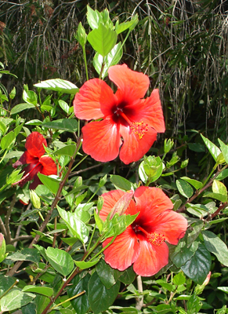
Discussion – What are your ideas to Protect and Support the Environment?

