Slide 1
Cyber Scams & Prevention
Pixel Guardian Team

Slide 2
About Us
Alex Kirwan
Founder & Cyber Security Advocate
Current student of Bachelors in Cyber Security
Bhargav Parthasarathy
Co Founder & Cyber Security Advisor
Recent Graduate from Masters in Cyber Security

Slide 3
Why Scams Matters to You
Scams are sneaky tricks that crooks use to steal your money or personal details—like your name, address, or bank info.
In WA, scammers stole $3.6 million from people in Jan 2025 alone, according to Scamwatch!
They contact you by phone, text, email, social media, or fake websites.
1 in 3 scams starts with a phone call, but don’t worry—we’ll show you how to spot them and keep safe.

Slide 4
TYPES OF SCAMS

Slide 5
Types of Scams
Text or SMS Scams
Phone Scams
Email Scams
Social Media Scams
Website Scams
In Person Scams

Slide 6
Text or SMS Scams
What They Are:
You get a text that looks like it’s from someone you trust—like Services Australia, your bank, or even a mate.
How They Trick You:
They sound urgent, like “Your account’s at risk—act now!”
They fake the sender’s number or name (called “spoofing”) to look real.
Common Examples:
Impersonation Scams: Pretending to be Centrelink or your bank.
Job Scams: Fake job offers promising quick cash.
Stay Safe Tip:
Don’t click links in odd texts. Call the real number you have for the person or company instead.
Australian Note:
Scamwatch says text scams are rising—watch out for fake delivery or tax refund messages!

Slide 7
Phone Scams
What They Are:
A scammer calls, pretending to be from a trusted place like Telstra or the ATO (Australian Taxation Office).
How They Trick You:
They might know your name or address already to sound legit.
They ask for bank details or try to get into your computer.
Common Examples:
Impersonation Scams: Acting like they’re from Medicare.
Threat Scams: Saying you owe money or face arrest.
Stay Safe Tip: Hang up if it feels off. Real groups don’t call out of the blue asking for secrets.
Australian Stat: Scamwatch reports phone scams cost Aussies $141 million last year!
This Photo by Unknown Author is licensed under CC BY-NC-ND

Slide 8
Email Scams
What They Are:
Fake emails that look official, often copying logos from places like Australia Post.
How They Trick You:
They ask you to click links or send money fast.
They might claim your account’s overdue or you’ve won a prize.
Stay Safe Tip: Check the email address—it should match the real website (like “@ato.gov.au” for the ATO). Don’t open emails from strangers.
Australian Note: Watch for “phishing” emails pretending to be from myGov—Scamwatch sees these a lot.
This Photo by Unknown Author is licensed under CC BY-SA

Slide 9
Social Media Scam
What They Are: Tricks on Facebook, Instagram, or WhatsApp, like fake ads or friend requests.
How They Trick You:
They offer cheap deals (like $10 sunnies) that never arrive.
They might hack a friend’s account to ask you for money.
Stay Safe Tip: Don’t send cash online, even to “friends.” Call them to check first.
Australian Trend: Scamwatch warns of scammers using social media for romance scams, targeting lonely hearts.
This Photo by Unknown Author is licensed under CC BY-SA-NC

Slide 10
Website Scam
What They Are: Fake websites pretending to be real stores or banks.
How They Trick You:
They steal your info when you log in or pay.
They pop up in Google searches with too-good-to-be-true prices.
Stay Safe Tip: Check the web address—it should start with “https://” and look normal (not “amaz0n.com”).
Australian Alert: Fake online shops spike around Christmas and Boxing Day sales, says Scamwatch.

Slide 11
What to Do If You Get Scammed
This Photo by Unknown Author is licensed under CC BY-ND

Slide 12
Don’t panic—here’s what to do:
Stop Contact: Hang up, don’t reply, and close any fake websites.
Tell Someone: Call a friend, family, or your local police (000 for emergencies).
Protect Your Money: Ring your bank ASAP if you shared details—they can lock your account.
Report It: Tell Scamwatch at www.scamwatch.gov.au or call the ACCC at 1300 795 995. Every report helps stop scammers!
Fix Your Computer: If they got in, take it to a shop to clean out anything nasty.
Get Help: Contact IDCARE (free Aussie support) at 1800 595 160 if your identity’s at risk.

Slide 13
Extra Tips to Stay Safe
Be Doubful: If it’s too good or too scary to be true, it’s probably a scam.
01
Keep It Private: Never give out passwords, bank details, or your Medicare number to someone who contacts you first.
02
Double-Check: If someone calls or texts, say, “I’ll ring you back,” and use a number from their official website.
03
Talk About It: Share what you learn with mates—Scamwatch says this helps stop scams spreading.
04

Slide 14
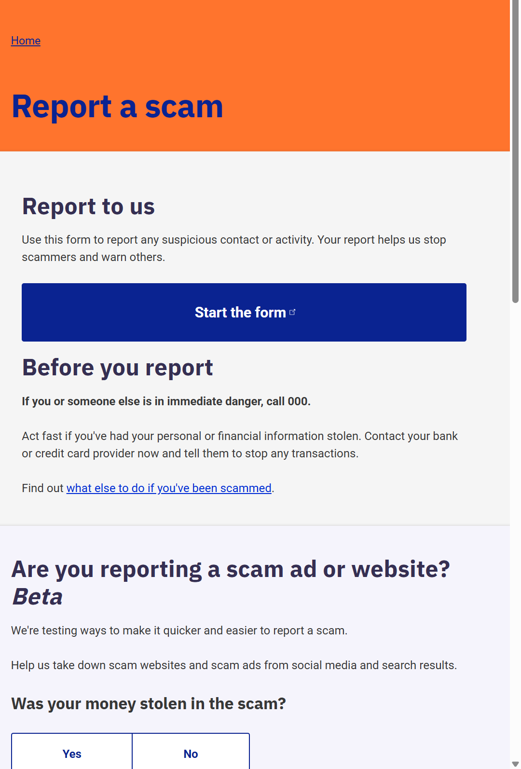
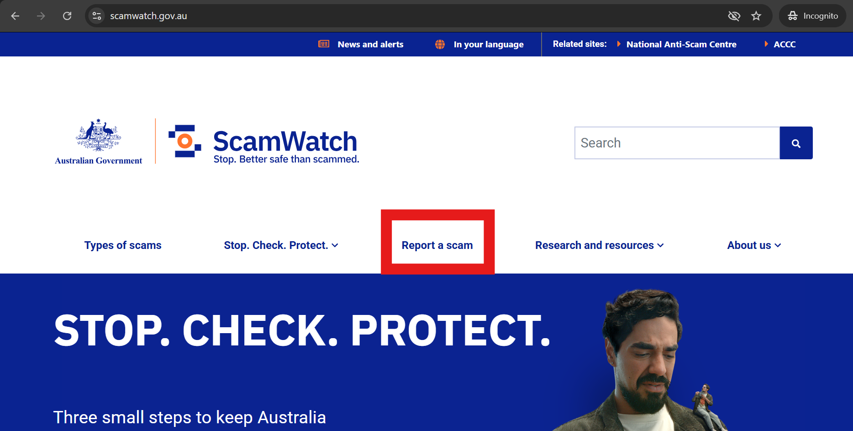
HOW to REPORT!!!
https://www.scamwatch.gov.au/

Slide 15
Questions?

Slide 16
Contact Us
Email: pixelguardian2025@gmail.com
LinkedIN:
https://au.linkedin.com/company/pixelguardiaN

Slide 17
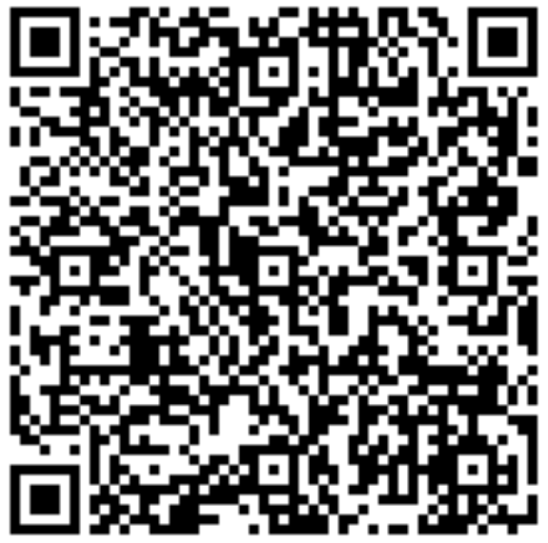
Thank you for listening to our presentation
Notes:
https://docs.google.com/forms/d/e/1FAIpQLScwSWS0lrAb_9U3H_n6pGamTuuICBeT56o6blC8aXGoGDiPWg/viewform?usp=dialog

