Slide 1
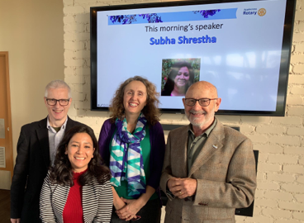
NEPAL AMR PROJECT
UPDATE
28 January 2020

Slide 2
AGENDA
1. Background
2. Nepal AMR Project Description
3. Nepal Feasibility Study
4. Project Beneficiaries
5. Next Steps

Slide 3
1. Background - One Health Initiative
Increase in people taking antibiotics for the wrong reasons, primarily
for viral infections
Bacteria are now producing multiple resistance to almost all antibiotics on the market
Estimated that by 2050, 10 million people a year will
die from infections that cannot be cured by antibiotics
RCA is preparing to launch a Rotary Action Group – One Health Initiative to enable Rotarians
around the world to become part of this life saving medical awareness programme
Concept of “One Health” promotes a way of considering health problems in a holistic manner,
appreciating the interconnectivity of human, animal and the environmental health

Slide 4
1. Background - Nepal AMR Project
Why?
Nepal infant mortality rate high compared to other South Asian countries
239 maternal deaths/100,000 live births (2016) in Nepal
6-8 maternal deaths/100,000 live births (2012-2014) in Australia
Sepsis is one of the leading causes of maternal and infant deaths in Nepal
Most of bacteria causing septicemia are reported to be multi drug resistant.
The burden of AMR is high in Nepal due to inappropriate use of antibiotics, poor health hygiene and sanitation, poor infection control programs
Most of the laboratories in Nepal are equipped to diagnose drug resistant infections by conventional methods (3-10 days)

Slide 5
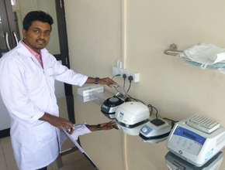
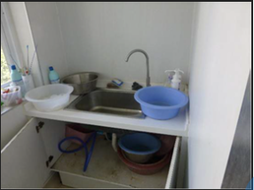
1. Background - Recent Club Global Grant Projects
2016 – Pathology Lab Equipment & Training Sri Lanka
Provision of equipment and training to hospitals and staff in Sri Lanka to
enable them to test for infectious diseases in a rapid and timely manner and
thus direct appropriate treatment
2017 – Cambodian Hospital Hygiene Project
Install hand basins and other equipment in a Cambodian Hospital to reduce
the risk of transmission of infectious diseases and death
Club has experience in these type of projects

Slide 6
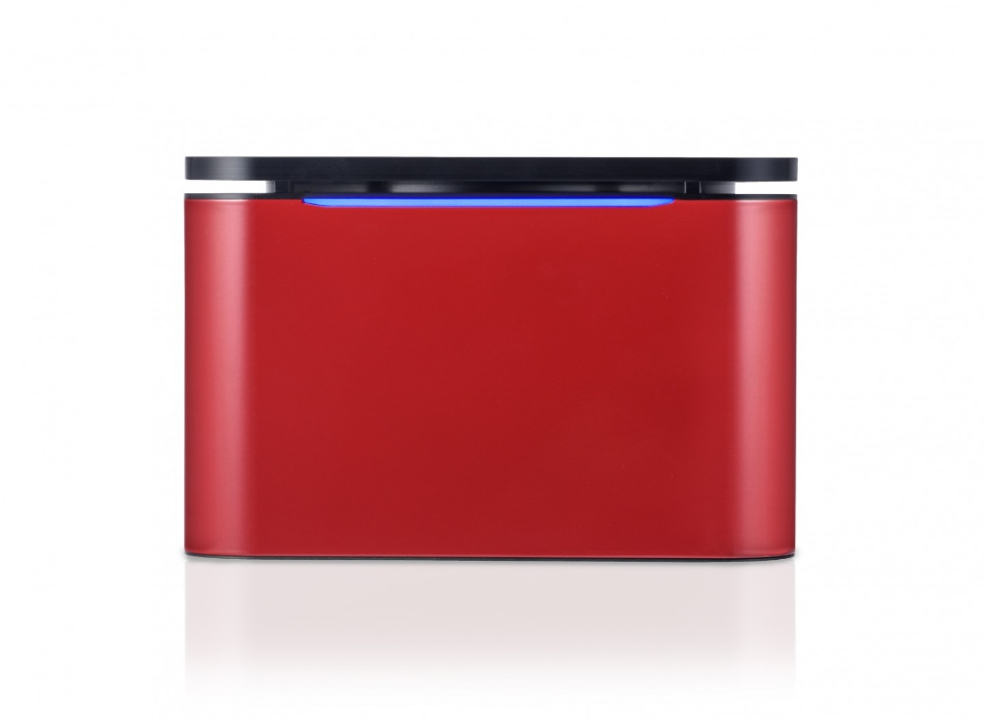
2. Project Description
Sepsis is one of the leading causes of maternal and infant deaths in Nepal. Prompt diagnosis and appropriate treatment are crucially important in reducing sepsis mortality.
Proposal
It is planned to establish molecular methods (PCR), provide equipment and professional in-house training for rapid detection of AMR drug resistant infections. Molecular methods will provide results in 10 hours as opposed to 3-10 days using conventional culture-dependent methods.

Slide 7
3. Nepal Feasibility Study
Feasibility Study was conducted 4-6 December 2019
in Kathmandu to:
Confirm the benefits of the project
Confirm the support of the Rotary Club of Kasthamandap (RCK) as Primary Host Sponsor
Confirm the support of Nepal Medical College & Teaching Hospital (NMCTH) as Cooperating Organisation

Slide 8
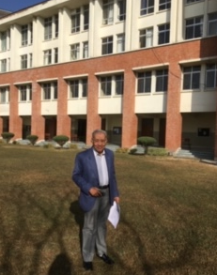
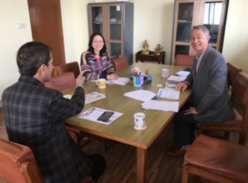
3. Nepal Feasibility Study
Meetings & Visits
Rtn Professor Dr Manohar, Head of Surgery, NMCTH
Nepal Medical College
Professor Dr Pramod, Principal Nepal Medical College
Nepal Teaching Hospital
RCK Planning Committee
RCK Weekly Meeting

Slide 9
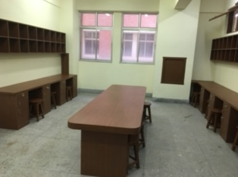
3. Nepal Feasibility Study
Outcomes
There was unequivocal support and commitment to the project.
Both RCK and NMCTH requested that the global grant application be broadened to cover all people in Nepal, with a focus on women and children.
NMCTH agreed to:
Provide a dedicated research laboratory (see photo)
Provide replacement reagents on an ongoing basis
Provide staff for training, testing and research at their cost

Slide 10
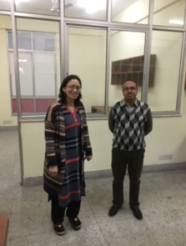
3. Nepal Feasibility Study
Outcomes
RCK agreed to:
To be the “Project’s” host sponsor
Assist in the MOU preparation
Receive, inspect and control the delivery of the equipment to NMCTH
Apply for the removal of 5% customs tax (13% VAT will apply)
See that all accounts have been received and paid
Monitor and follow up on agreed reporting deadlines
Assist in final report preparation

Slide 11
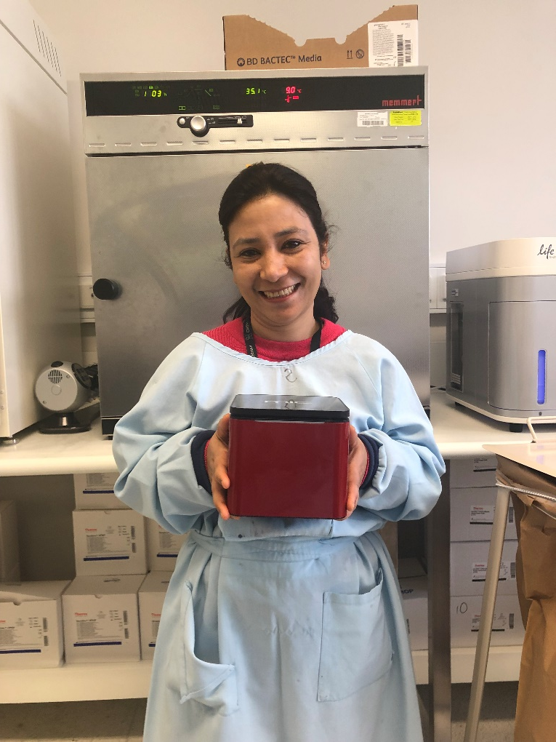
4. Project Beneficiaries
The provision of molecular methods (PCR), equipment and professional
in-house training by Professor Tim Inglis and PhD student
Subha Shrestha will ensure rapid detection of AMR drug resistant infections.
Beneficiaries:
Nepalese people – hundreds every year will receive faster and more accurate diagnosis and treatment of sepsis and antibiotic resistant infections
Technicians – initially 3 medical/microbiology professionals will be trained in the use of the PCR equipment at NMCTH. Staff will train others
Medical Researchers – data collected on a genetic level will provide doctors with guidance for proper antibiotic treatment

Slide 12
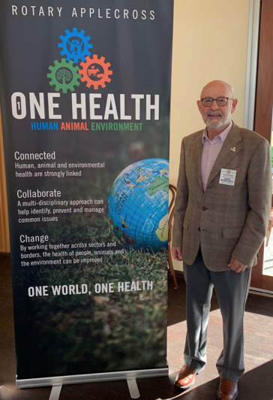
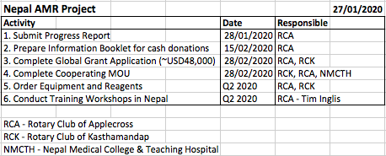
5. Next Steps

