Slide 1
How Busy Can a Rotarian Be!
Sharing the Rotary ideals of volunteering, enjoying community service, and helping those in need.

Slide 2

About Rotary
A little about:
Organisation and history
Ideals of membership
Operation of your Club
Educational & humanitarian programs
Opportunities to participate in projects
Fun and fellowship around the world

Slide 3
About Rotary
Topics covered in this presentation
What is Rotary
Object of Rotary & Four Way Test
How Rotary operates
Types of Membership
How Rotarians meet
How Rotarians communicate
Programs of Rotary International
Rotary International operations
District & Club Administration
Avenues of Service
Rotary Foundation
Club Operations
Club Administration – Board & Committees
Club Service
Club Funding & Sponsors
Club’s major Activities
Committees and Expectations
Question time!

Slide 4
About Rotary
What is Rotary?
Rotary is a global network of community volunteers who are business, professional and community leaders, providing humanitarian service, promoting ethical standards, and building goodwill and peace in the world.

Slide 5
About Rotary
Rotary International
Since 1905, Rotary has been making a positive impact in the world. Beginning in Chicago before spreading throughout the world, Rotary first touched our shores in Australia in 1921, with the charter of the Rotary Club of Melbourne, closely followed by the charter of a Sydney Club and other Clubs around the nation.
Since that time Rotary has grown all over Australia, and no matter where you are, you'll find a Club near you that has contributed to some amazing things..

Slide 6
About Rotary
Object of Rotary
The development of acquaintance as an opportunity for service
High ethical standards in business and your profession
The application of the ideal of service in each Rotarian’s personal, business and community life
The advancement of international understanding and peace

Slide 7
About Rotary
The Rotary Four Way Test
Developed in 1932, translated into over 100 languages and used by organisations world wide.
A test of everything we say and do:
Is it the Truth?
Is it Fair to all concerned?
Will it build Goodwill and Better Friendships?
Will it be Beneficial to all concerned?

Slide 8
About Rotary
How does Rotary operate
Bottom up!
Rotarians are members of Clubs
Clubs are the members of Rotary International
Districts provide administration for the Clubs, with district committees coordinating various programs carried out by Clubs.
Rotary International – the organisation with 1.2m members, 34000 clubs in over 200 countries

Slide 9
About Rotary
Types of Membership
Active Rotarians
Other Membership Categories (Associates etc.)
Friend of Rotary
Rotaractors (18 to 30 years of age)
Interactors (High school students)
Alumni (Youth Exchange, Vocational Training Teams, Scholars, Youth Training Programs)
Honorary Membership – the most valuable!

Slide 10
About Rotary
How do Rotarians meet?
Rotary Meetings, Club exchange visits
District Assembly
District Conference
Rotary Fellowships (about 80!)
Friendship Exchanges
Vocational project visits
International Convention (Hamburg)
Australian & NZ Conference (Christchurch)

Slide 11
About Rotary
How do Rotarians communicate?
Club Bulletin (News, photos, speakers)
Club webpage, Facebook, Chat Groups
President’s messages
Club committee meetings
District Newsletter and webpage
Rotary Down Under magazine
Other Rotary newsletters and WWW

Slide 12
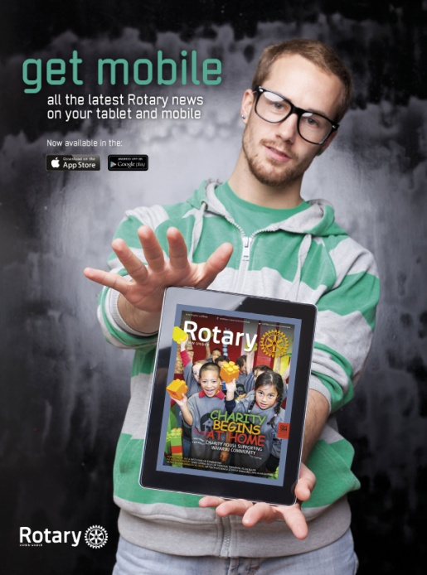
Rotary Training
Rotary Down Under
Australia & NZ’s official Magazine.
45,000 copies every month
Fully on line. Magazine on mobile, tablet, PC
You can submit articles for publication
Find out what other Clubs are doing
Use it to publicise Rotary – give your copy away to waiting rooms, libraries, etc

Slide 13
About Rotary
Programs of Rotary
Interact
Rotaract
Rotary Action Groups
Rotary Friendship Exchange
Rotary Youth Exchange
Rotary Youth Leadership Awards (RYLA)
And many more…………….

Slide 14
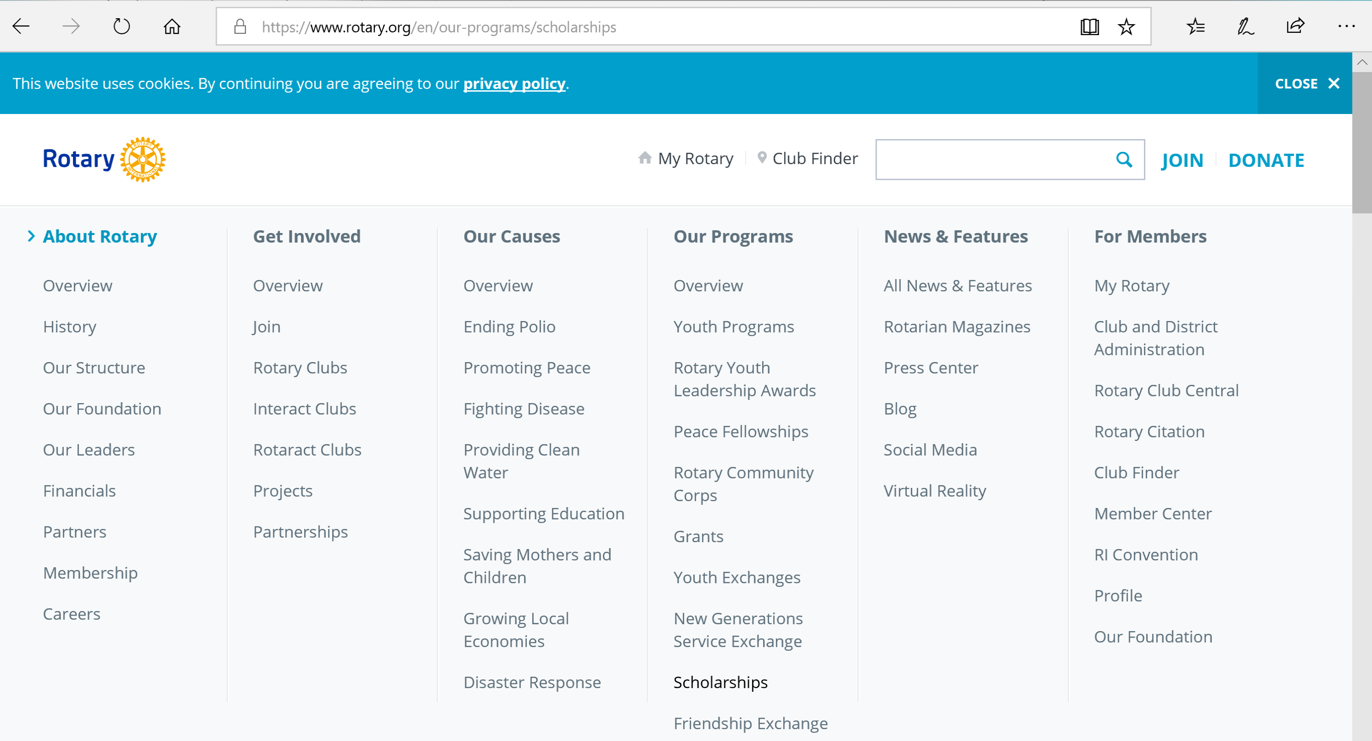
Detailed Information on all the above available on line. Front page of Rotary website. There are also a District 9465 and a Club website.

Slide 15
Rotary Training
How does Rotary International operate?
RI headquarters in Chicago (Evanston)
President and Board of Directors
Directors. One from each zone. 23 zones
530 Districts looking after 34,000 Clubs
Many committees (Volunteers)
Staff of 600+
Rotary Foundation - Board of Trustees.

Slide 17
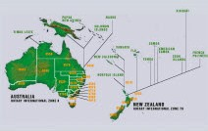
Rotary Training
District operations
District 9465 has 48 Clubs
District Governor and Board
Assistant Governors
District Committees
District web site, Facebook and weekly Digest
President Elect & District Officer Training
Multi District Seminars & Conferences
District Conference
District 9465

Slide 18
About Rotary
District and Club operations
District Administration – Board & Committees
Club Administration – Board & Committees
  Clubs have Projects and Programs !
  Clubs members & friends raise funds & donate funds
Notes:
Public Image Newsletter July 2019 -

Slide 19
About Rotary
Avenues of Service
Club Service
Membership
Club meeting & events
Community Service
Community & Business Awards
Community Mental Health Forum
Australian Rotary Health
Swap Meet Wishing Well
International Service
Cambodia Hospital additions,
Donations in Kind
Interplast / ROMAC
Shelterbox – Disaster relief
Vocational Service
Four Way Speech Contest
Vocational Training Teams
Schools mentoring programs
Student Awards
Rotary Fellowships
Visit Local Business
Youth Service
Rotary Youth Exchange
National Youth Science Forum
Rotary Youth Leadership Awards
Rotary Youth Program of Enrichment
Hadicamp

Slide 20

Rotary Training
The Rotary Foundation – what is it?
The RF exists to enable Rotarians to advance world understanding, goodwill and peace, the improvement of health, the support of education and the alleviation of poverty.
Rotary Foundation receives funds from Rotary Clubs and others to carry out educational and humanitarian programs, and to rid the world of polio.

Slide 21

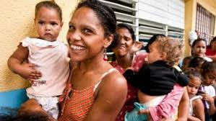
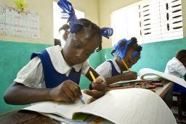

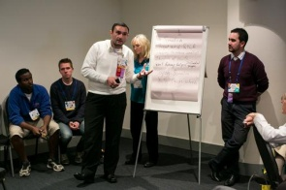

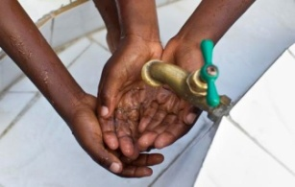

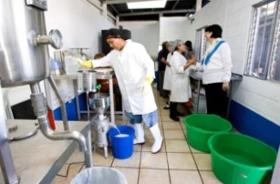

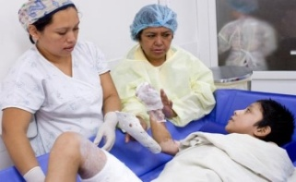



 |  |  | The Rotary Foundation funding world wide educational & humanitarian projects
 |  |  | MATERNAL & CHILD HEALTH Provide immunisation & antibiotics Promote good nutrition – encourage breast feeding Provide education & access to contraception
 |  |  | BASIC EDUCATION & LITERACY Provide teacher training & classroom supplies Promote increased attendance – provide water Develop adult literacy program
 |  |  | PEACE & CONFLICT PREVENTION Offer support to marginalised groups Help children who have been orphaned, injured Provide relief to refugees fleeing areas of conflict
 |  |  | WATER & SANITATION Improve sanitation facilities- install toilets & sewers Promote good hygiene – hand washing training Build wells with pumps & water harvesting systems
 |  |  | ECONOMIC & COMMUNITY DEVELOPMENT Partner with a local microfinance institution Send Training Teams to teach business plans Provide equipment or supplies for a business start up
 |  |  | DISEASE PREVENTION & TREATMENT Support health education programs Help immunise people against infectious diseases Sponsor health education & training
 |  |  | POLIO ERADICATION Maintain contributions for ongoing support We are so close to eradicating this virus

Slide 22
Rotary Training
The Rotary Foundation – source of funds?
Rotary Clubs donate to the Annual Programs Fund. Funds are invested for three years.
Endowments, special donations go to the Permanent Fund used to provide earnings for programs and to sustain the RF.
Funding from Rotary Clubs and other sources to the End Polio Now campaign.
Donations to the Australian Rotary Foundation Trust are tax deductible.

Slide 23
Rotary Training
The Rotary Foundation – Educational Programs
Ambassadorial Scholarships. About 500 students each year are sent to universities around the world.
Rotary Peace Fellowships. Post Grad students can go to one of 8 universities for peace studies and conflict resolution.
Vocational Training Teams. (VTT) Teams of 4-5 young professionals go on an exchange with another Rotary District for 4 weeks.

Slide 24
Rotary Training
The Rotary Foundation - Grant Programs
Global Grants. Clubs can use their funds to be matched with a grant from RF, working with a Club from another District. Used for installing water wells, medical and educational equipment, training, etc.
District Grants. Clubs apply for a grant thru the District RF Committee for local or overseas projects.

Slide 25
Rotary Training
The Rotary Foundation – Polio Plus Program
1985 – 350,000 cases of polio per year.
2018 – down to a 15 cases per year
Only 3 endemic countries – Nigeria, Afghanistan & Pakistan
Rotarians have donated over $US 1 billion
World wide over $US 5 billion
We are almost there!

Slide 26
About Rotary
Consider this Rotary Citation:
While the club remains the core of the Rotary experience, we are now far more creative and flexible in deciding what a club can be, how it can meet, and even what can be considered a Rotary meeting.
We need to be organized, strategic, and innovative in how we approach membership, forging wider and deeper connections to our communities and forming new club models to attract and engage more, and more diverse members.

Slide 27
Rotary Training
Club Operations – General
Clubs are formed by groups of active community people committed to service
Frequency of meetings? With or no meals
E-Clubs meet on line, across countries
President, Secretary & Treasurer & Board
Bank Accounts
  Club Admin Account for running the Club
  Club Charity Account for Charity income and grants
Guest speakers, Club Forums, R Information
Committee Structure used to manage projects.

Slide 28

Rotary Training
Applecross Rotary Operations
Board ~ Governed by a Constitution and By Laws.
  President
  Secretary
  Treasurer
  Club Service Director (President Elect)
  Community Service Director
  Jacaranda Festival Director
  Vocational/Youth Service Director
  International Director
  Rotary Foundation.
  Membership & Public Image
What a
great idea !!

Slide 29
Rotary Training
Club Operations – Club Service (President Elect)
Attendance Officer
Sergeant – the MC.
Bulletin Editor
Speaker program
Social Activities

Slide 30
Rotary Training
Club Operations – Funding
Subscriptions: $280 per annum
  Semi annual dues to RI $57 x 2= $114
  Annual fees to District = $130
  Annual Subs to Rotary Down Under = $ 40
Club’s Operating Costs covered by breakfast meeting attendees.
Project Costs covered in part by Club Sponsors, any surplus from Jacaranda Festival, PMM Car Parking donations and Art Show Commissions.
Any extra funding requirements have to be created by Club sponsored initiatives and/or grant applications.

Slide 31


Rotary Training
Club Sponsors – since 2016

Slide 32
Rotary Training
Major Club Activities
Jacaranda Festival
Perth Makers market Car parking
Art Exhibition

Slide 33
Rotary Training
Club Operations – Expectation of Members
A commitment to give back.
3 PMM car parking events per year (3-4 hours each)
JF participation on the day: ideally 10 hours.
Participation on at least 1 Club Committee
Attendance at breakfast meetings when practical.

Slide 34
Rotary Training - - - Applecross Rotary Club Projects
Community projects -
Jacaranda Festival
Community & Business Awards etc.
Community Mental Health Projects
Community car parking
Art Exhibition
True Blue Dreaming
Youth programs -
Student Exchange Program
National Youth Science Forum
Schools Rotary Speech Contest
Rotary Youth Leadership Awards
Rotary Youth Program of Enrichment
Local School Programs
Vocational programs -
Local Business visits
Vocational Training Teams overseas
Schools mentoring programs
National Youth Science Forum
Community Engagement
Waylen Bay SS
Capital radio
Melville Cares
Cockburn Cougars
Atwell Art Centre
And many more
Health & Disease Prevention
Australian Rotary Health
Polio Eradication Program
AMR Superbug Seminar
Wash Hands – Save Lives
International projects -
East Timor –Hospital additions,
Community Toilet facilities
Cambodia – Hand washing facilities
Shelterbox – Disaster relief
Sri Lanka – Medical equipment
South Africa – Market garden

Slide 35
Rotary Training
Summary (very briefly)
From 1905 to the present
35,000 Clubs with 1.2 m members
Clubs exist for fellowship, fun and promoting community service
Clubs provide leadership and opportunities for all members to experience the joy of service
International and local service projects provide ongoing humanitarian support, resulting in goodwill, promoting world peace.

Slide 36
Rotary Training
Questions & Suggestions?
Thank you for coming to learn about Rotary and how you, your family and friends can enjoy Rotary involvement

